Slide 1
JavaScript Syntax
By Strus Maksym

Slide 2

Case sensitivity
JavaScript is case sensitive. It is common to start the name of a constructor with a capitalised letter, and the name of a function or variable with a lower-case letter.

Slide 3
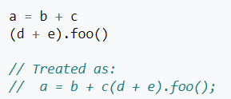
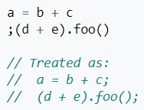
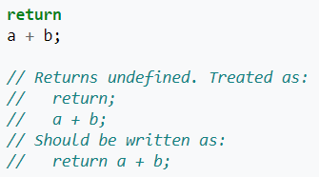
Whitespaces and semicolons
Spaces, tabs and newlines used outside of string constants are called whitespace. Unlike in C, whitespace in JavaScript source can directly impact semantics. The five restricted productions are: return, throw, continue, etc…

Slide 4
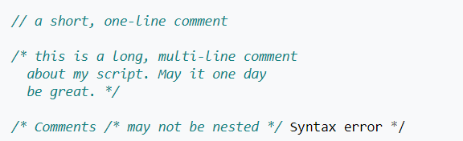
Comments
Comment syntax is the same as in C++ and many other languages.

Slide 5
Variables
Variables in standard JavaScript have no type attached, and any value can be stored in any variable. Starting with ES6, the version of the language finalised in 2015, variables can be declared with let (for a block level variable), var (for a function level variable) or const (for an immutable one). An identifier must start with a letter, underscore (_), or dollar sign ($); subsequent characters can also be digits (0-9). Because JavaScript is case sensitive, letters include the characters "A" through "Z" (uppercase) and the characters "a" through "z" (lowercase).

Slide 6

Scope and hoisting
Variables are lexically scoped at function level (not block level as in C), and this does not depend on order (forward declaration is not necessary): if a variable is declared inside a function (at any point, in any block), then inside the function, the name will resolve to that variable. This is equivalent in block scoping to variables being forward declared at the top of the function, and is referred to as hoisting.

Slide 7
Primitive data types
The JavaScript language provides six primitive data types:
Undefined
Null
Number
String
Boolean
Symbol

Slide 8
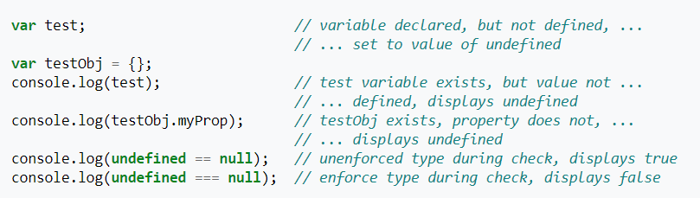
Undefined
The value of "undefined" is assigned to all uninitialized variables, and is also returned when checking for object properties that do not exist. In a Boolean context, the undefined value is considered a false value.
Note: undefined is considered a genuine primitive type. Unless explicitly converted, the undefined value may behave unexpectedly in comparison to other types that evaluate to false in a logical context.

Slide 9

NULL
Unlike undefined, null is often set to indicate that something has been declared, but has been defined to be empty. In a Boolean context, the value of null is considered a false value in JavaScript.

Slide 10
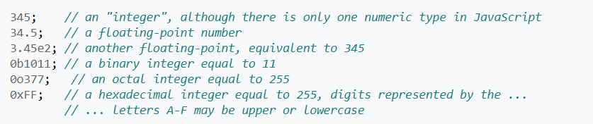



Number
Numbers are represented in binary as IEEE-754 doubles, which provides an accuracy of nearly 16 significant digits. Because they are floating point numbers, they do not always exactly represent real numbers, including fractions.

Slide 11



String
A string in JavaScript is a sequence of characters. In JavaScript, strings can be created directly (as literals) by placing the series of characters between double (") or single (') quotes. Such strings must be written on a single line, but may include escaped newline characters (such as \n). The JavaScript standard allows the backquote character (`, a.k.a. grave accent or backtick) to quote multiline literal strings, but this is supported only on certain browsers as of 2016: Firefox and Chrome, but not Internet Explorer 11

Slide 12
Boolean
JavaScript provides a Boolean data type with true and false literals. The typeof operator returns the string "boolean" for these primitive types. When used in a logical context, 0, -0, null, NaN, undefined, and the empty string ("") evaluate as false due to automatic type coercion. All other values (the complement of the previous list) evaluate as true, including the strings "0", "false" and any object. Automatic type coercion by the equality comparison operators (== and !=) can be avoided by using the type checked comparison operators (=== and !==).
When type conversion is required, JavaScript converts Boolean, Number, String, or Object operands as follows:

Slide 13
Boolean (2 part)
Number and String
The string is converted to a number value. JavaScript attempts to convert the string numeric literal to a Number type value. First, a mathematical value is derived from the string numeric literal. Next, this value is rounded to nearest Number type value.
Boolean
If one of the operands is a Boolean, the Boolean operand is converted to 1 if it is true, or to 0 if it is false.
Object
If an object is compared with a number or string, JavaScript attempts to return the default value for the object. An object is converted to a primitive String or Number value, using the .valueOf() or .toString() methods of the object. If this fails, a runtime error is generated.

Slide 14
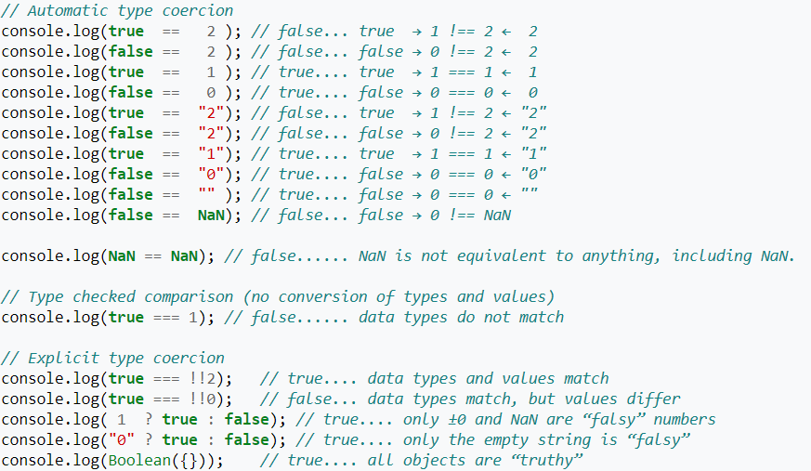
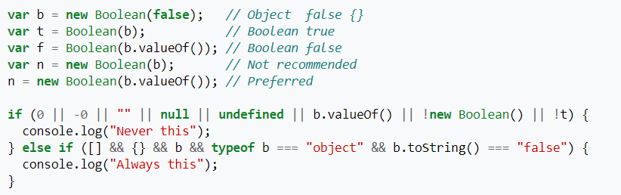
Boolean (3 part)

Slide 15
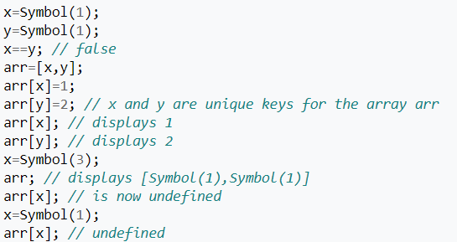
Symbols
New in ECMAScript6. A Symbol is a unique and immutable identifier.

Slide 16


