Slide 1
JavaScript Unit testing:Cypress part I
By Strus Maksym

Slide 2
“Test Pyramid”

Slide 3
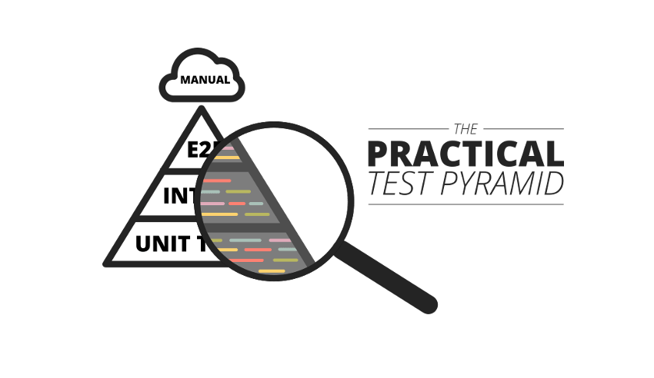
The "Test Pyramid" is a metaphor that tells us to group software tests into buckets of different granularity. It also gives an idea of how many tests we should have in each of these groups. Although the concept of the Test Pyramid has been around for a while, teams still struggle to put it into practice properly. This article revisits the original concept of the Test Pyramid and shows how you can put this into practice. It shows which kinds of tests you should be looking for in the different levels of the pyramid and gives practical examples on how these can be implemented.

Slide 4
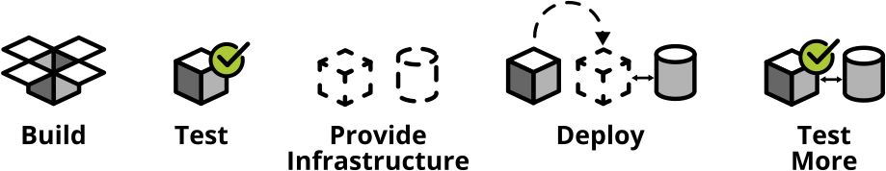
Test automation
Building, testing and deploying an ever-increasing amount of software manually soon becomes impossible — unless you want to spend all your time with manual, repetitive work instead of delivering working software. Automating everything — from build to tests, deployment and infrastructure — is your only way forward.

Slide 5
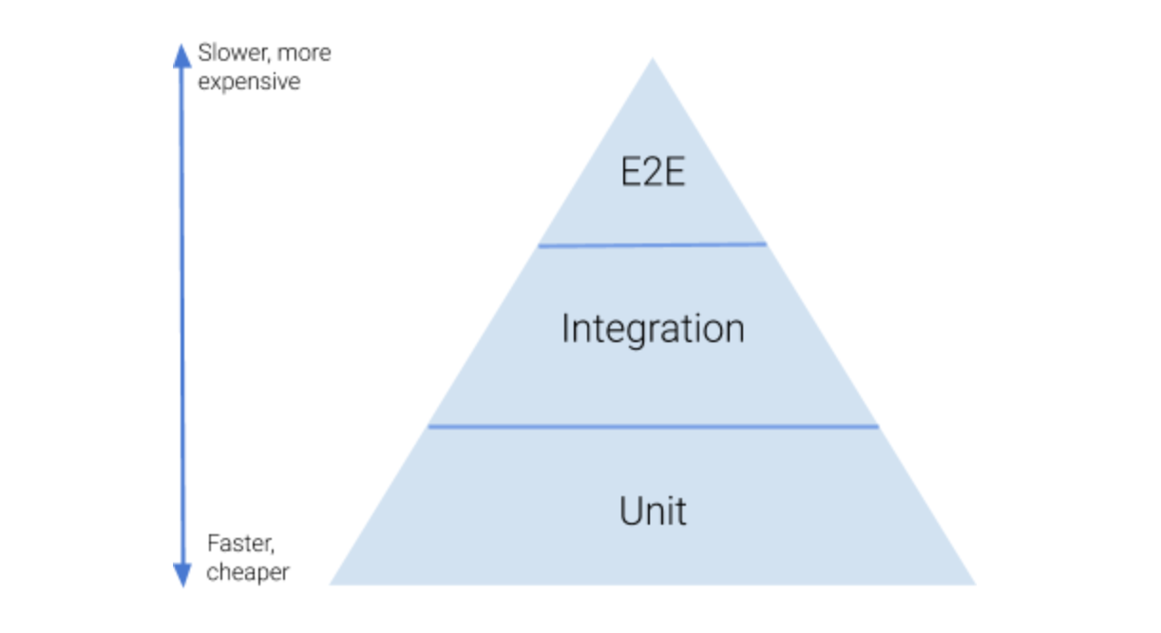
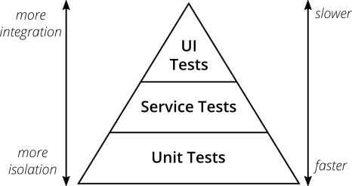
Pyramid
Test pyramid consists of three layers that your test suite should consist of (bottom to top):
Unit Tests
Service Tests
User Interface Tests

Slide 6
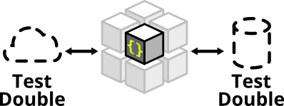
Unit tests
The foundation of your test suite will be made up of unit tests. Your unit tests make sure that a certain unit (your subject under test) of your codebase works as intended. Unit tests have the narrowest scope of all the tests in your test suite. The number of unit tests in your test suite will largely outnumber any other type of test.

Slide 7
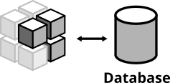
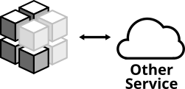
Integration tests
All non-trivial applications will integrate with some other parts (databases, filesystems, network calls to other applications). When writing unit tests these are usually the parts you leave out in order to come up with better isolation and faster tests. Still, your application will interact with other parts and this needs to be tested. Integration Tests are there to help. They test the integration of your application with all the parts that live outside of your application.

Slide 8
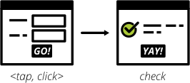
UI tests
UI tests test that the user interface of your application works correctly. User input should trigger the right actions, data should be presented to the user, the UI state should change as expected.
Yes, testing your application end-to-end often means driving your tests through the user interface. The inverse, however, is not true.
Testing your user interface doesn't have to be done in an end-to-end fashion. Depending on the technology you use, testing your user interface can be as simple as writing some unit tests for your frontend javascript code with your backend stubbed out.

Slide 9
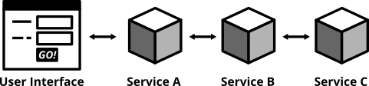
E-2-E tests
Testing your deployed application via its user interface is the most end-to-end way you could test your application. The previously described, webdriver driven UI tests are a good example of end-to-end tests.

Slide 10
About Cypress
The Cypress.io platform is perfect for testing the interfaces of web applications. The main task is to check how the client side interacts with the server side (end-to-end tests) and the individual components of the page with each other (integration tests).

Slide 11
Who uses Cypress?
Usually,users are typically developers or QA engineers building web applications using modern JavaScript frameworks.
Cypress enables you to write all types of tests:
End-to-end tests
Integration tests
Unit tests
Cypress can test anything that runs in a browser.

Slide 12
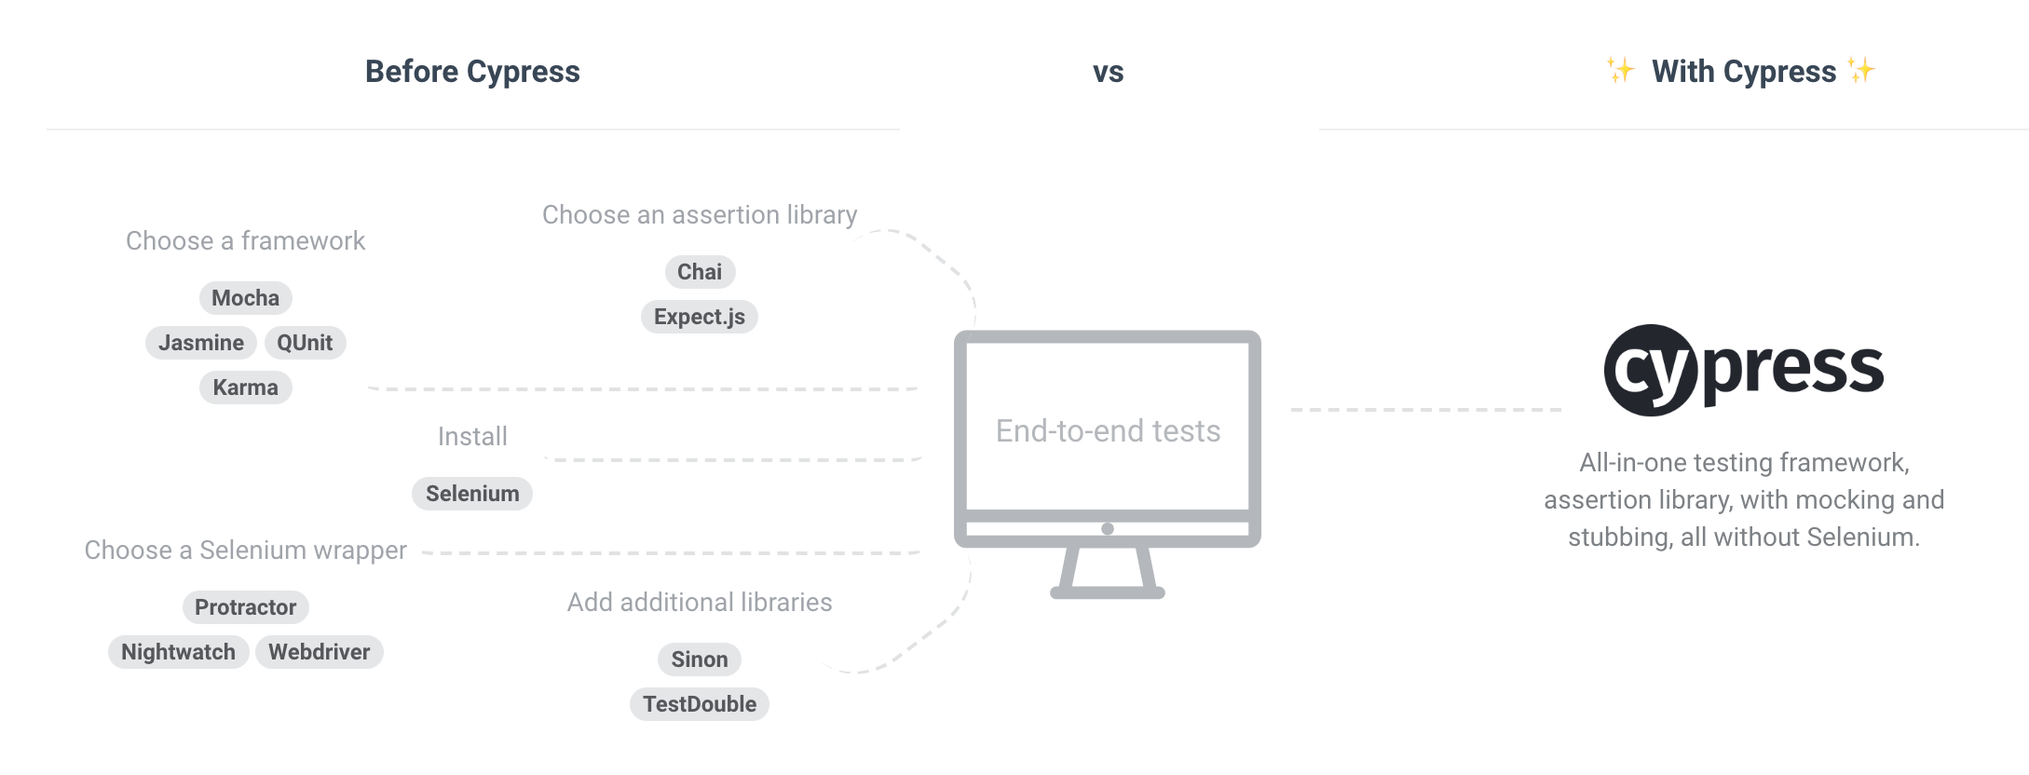

Slide 13
Benefits of Cypress
Cypress operates at the network level and is capable of managing application traffic;
Easy to integrate into the project;
Has a separate browser Google Chrome;
Combines other types of testing in one platform;
Able to refer to every web page object in the DOM.

Slide 14
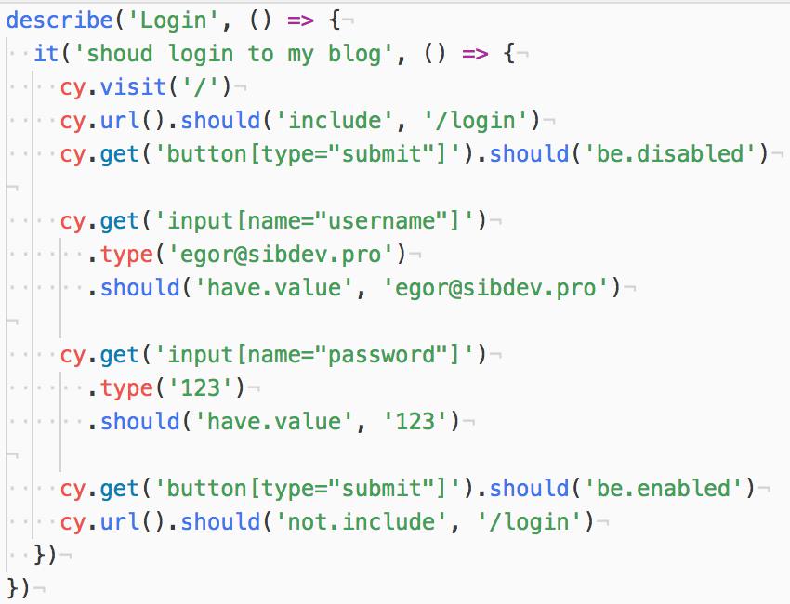
Example of code

Slide 15
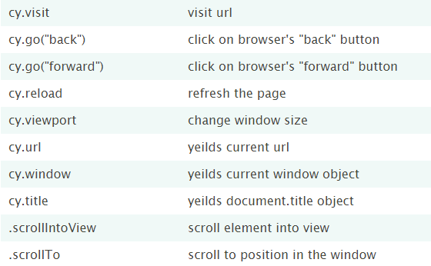
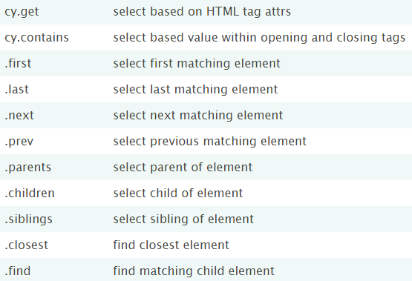
Usual commands

Slide 16

THE END

Slide 17


