Slide 1
JQuery
By Strus Maksym

Slide 2

In general
jQuery is a fast, small, and feature-rich JavaScript library. It makes things like HTML document traversal and manipulation, event handling, animation, and Ajax much simpler with an easy-to-use API that works across a multitude of browsers. With a combination of versatility and extensibility, jQuery has changed the way that millions of people write JavaScript.

Slide 3
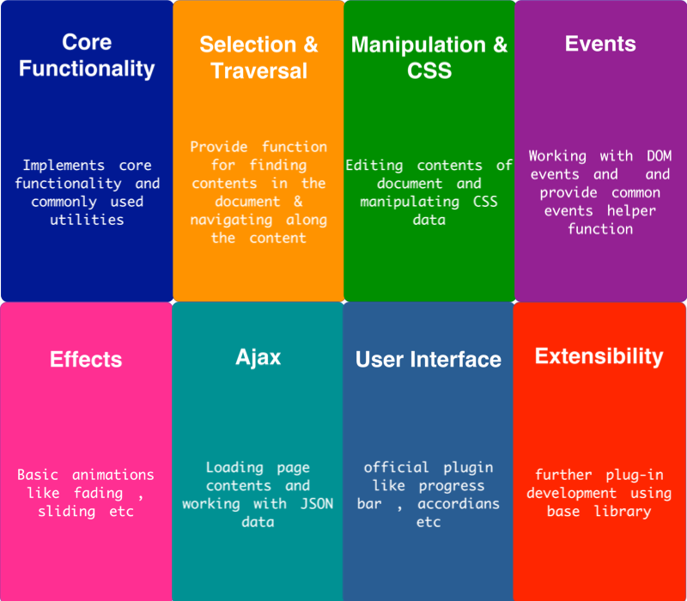
Features

Slide 4
Syntax
The jQuery syntax is tailor-made for selecting HTML elements and performing some action on the element(s).
Basic syntax is: $(selector).action()
A $ sign to define/access jQuery
A (selector) to "query (or find)" HTML elements
A jQuery action() to be performed on the element(s)

Slide 5
Example
$(this).hide() - hides the current element.
$("p").hide() - hides all <p> elements.
$(".test").hide() - hides all elements with class="test".
$("#test").hide() - hides the element with id="test".

Slide 6
Selectors
jQuery selectors allow you to select and manipulate HTML element(s).
jQuery selectors are used to "find" (or select) HTML elements based on their name, id, classes, types, attributes, values of attributes and much more. It's based on the existing CSS Selectors, and in addition, it has some own custom selectors.
All selectors in jQuery start with the dollar sign and parentheses: $().

Slide 7
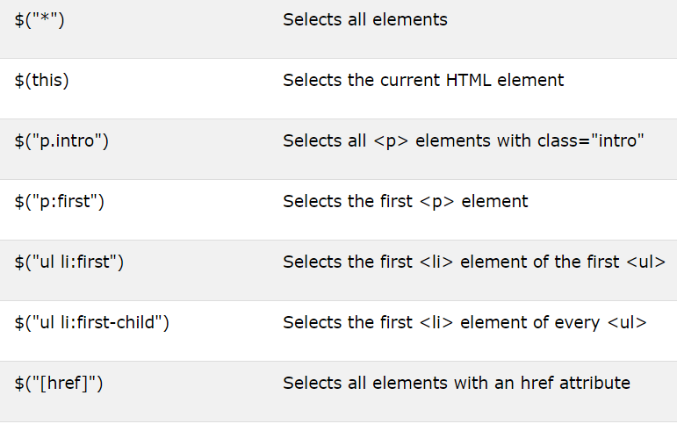
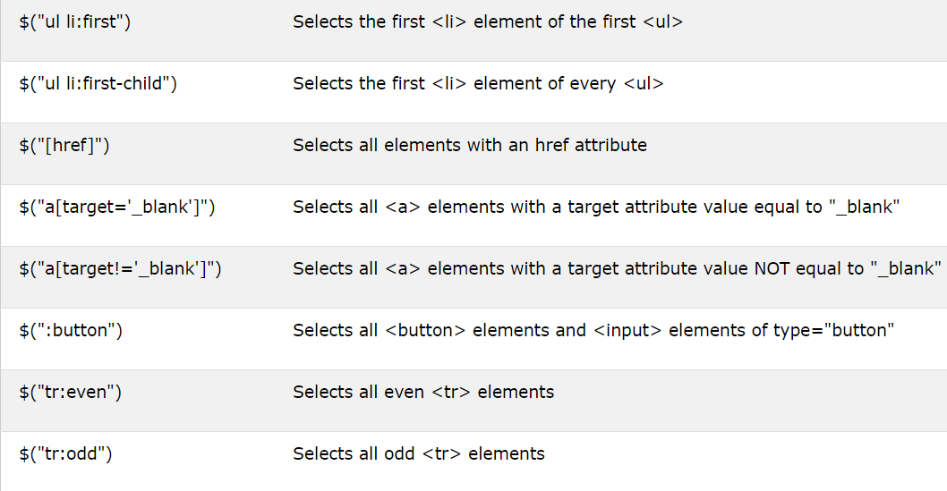
Example

Slide 8
Events
All the different visitors' actions that a web page can respond to are called events.
An event represents the precise moment when something happens.
Examples:
moving a mouse over an element
selecting a radio button
clicking on an element
The term "fires/fired" is often used with events. Example: "The keypress event is fired, the moment you press a key".
For stopping bubbling and prevention of default actions can be use return false; instead of native e.preventDefault() and e.stopPropagation() from JavaScript.

Slide 9
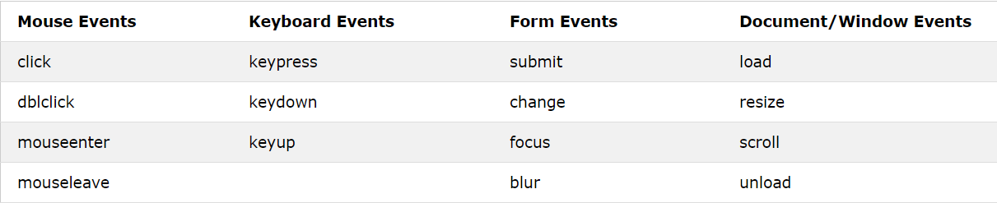
Example

Slide 10
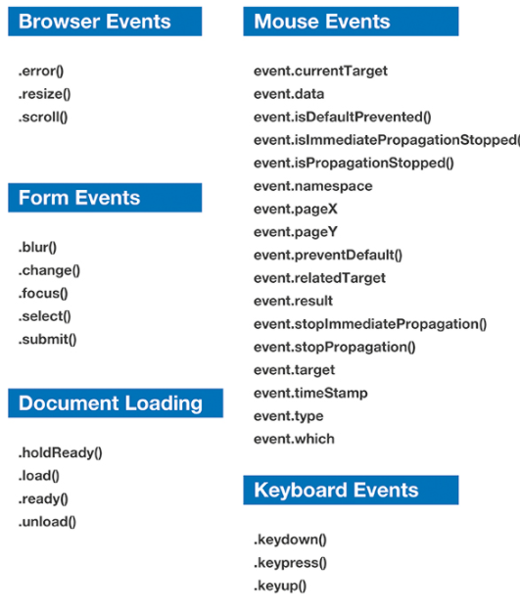
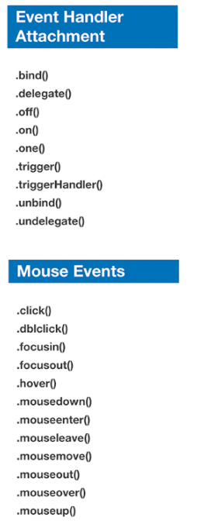
Example (2 part)

Slide 11
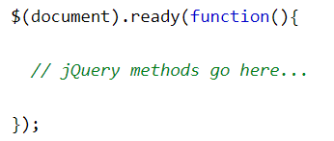
The Document Ready Event
It is good practice to wait for the document to be fully loaded and ready before working with it. This also allows you to have your JavaScript code before the body of your document, in the head section.

Slide 12
Manipulating with CSS or DOM
jQuery contains powerful methods for changing and manipulating HTML elements and attributes and DOM elements (nodes).

Slide 13
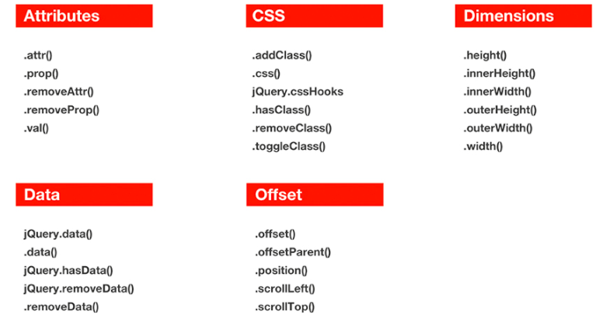
Example (HTML,CSS)

Slide 14
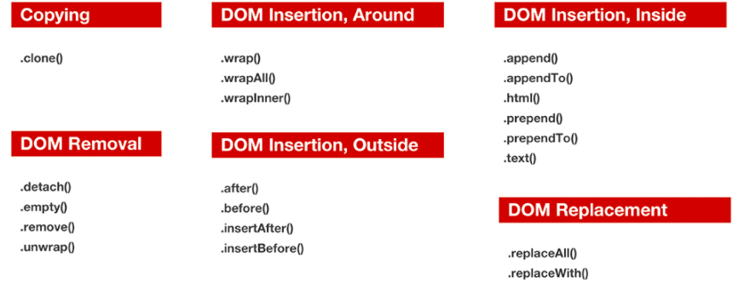
Example (DOM)

Slide 15
Traversing
jQuery traversing, which means "move through", are used to "find" (or select) HTML elements based on their relation to other elements. Start with one selection and move through that selection until you reach the elements you desire.

Slide 16
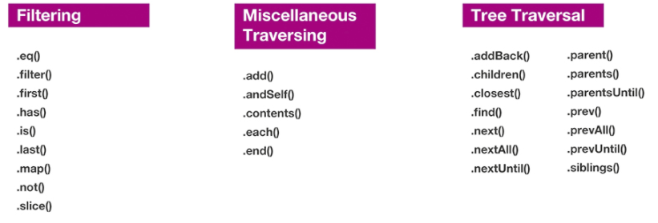
Example

Slide 17
Effects
The jQuery library provides several techniques for adding animation to a web page. These include simple, standard animations that are frequently used, and the ability to craft sophisticated custom effects.

Slide 18
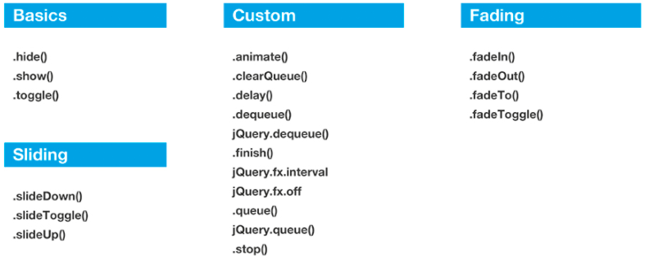
Example

Slide 19
AJAX
jQuery provides several methods for AJAX functionality.
With the jQuery AJAX methods, you can request text, HTML, XML, or JSON from a remote server using both HTTP Get and HTTP Post - And you can load the external data directly into the selected HTML elements of your web page!

Slide 20
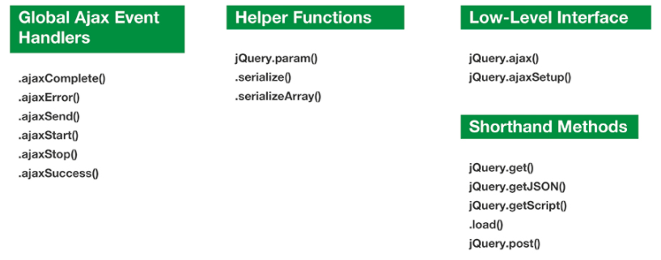
Example

Slide 21
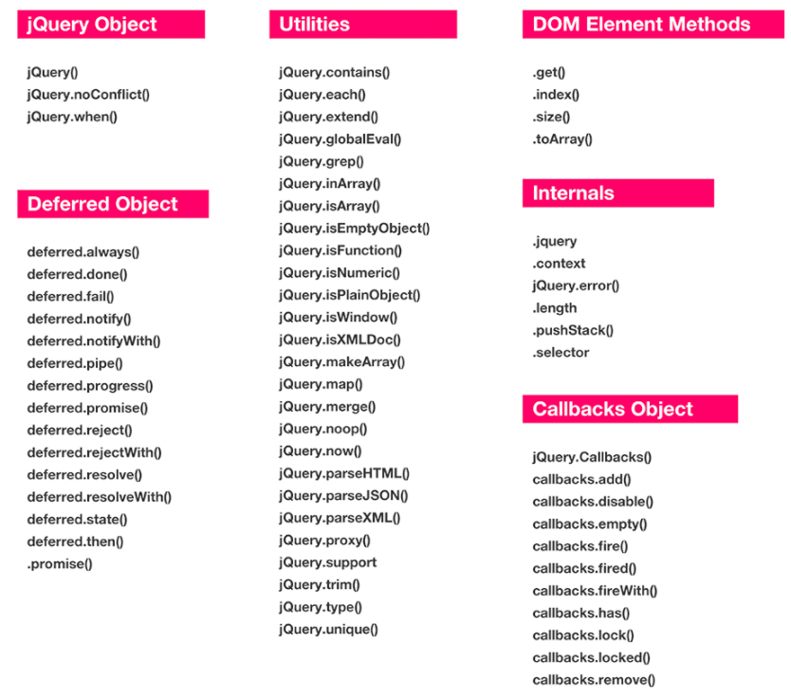
Core

Slide 22


