Slide 1
RegExp
By Strus Maksym

Slide 2
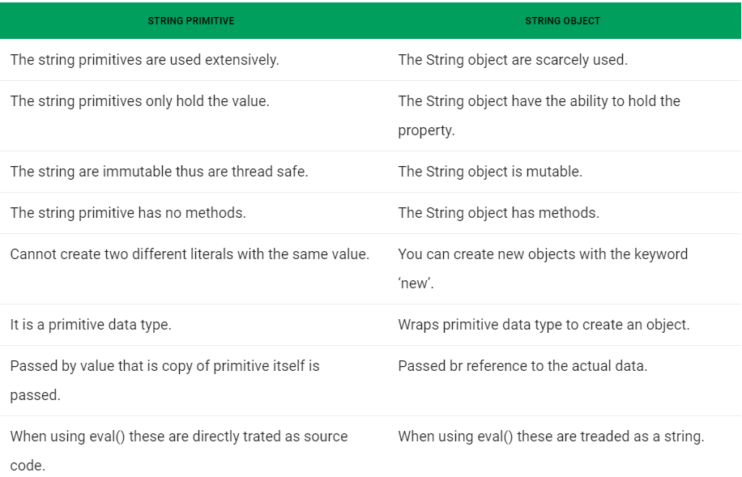
Primitive String vs Object String

Slide 3
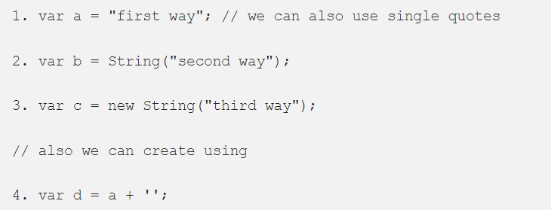
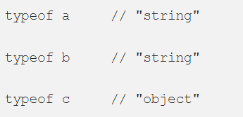
Creating string structures
The 1 and 2 will create primitive string , where as 3 will create a String object. But we can call all the string methods on the primitive string created from 1 and 2 , when we call one of the String object method on primitive String the browser will automatically convert the primitive string into string object .

Slide 4
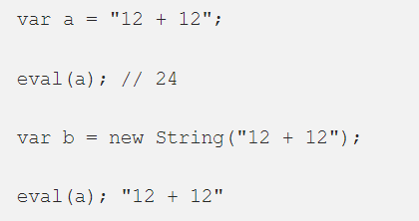
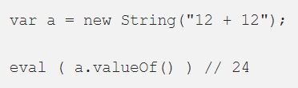
Eval and string types
The string primitive is always parsed, i.e(string literal are treated as source code) , where as the string object is evaluated into a single string .
String primitives and String objects also give different results when using eval().
Primitives passed to eval are treated as source code.
String objects are treated like other objects , and it returns the object.

Slide 5
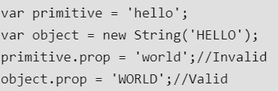
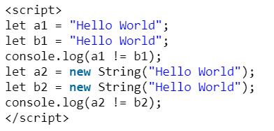
String types behavior
Example 1: As we have learned above the string object can hold properties. We can use String objects to hold an additional value in the properties. Even though this not commonly used, it is still a feature of JS.
Example 2: The below example will shows how a1 and b1 are shown to be equal since they are literals having the same value, whereas a2 and b2 are shown to be different because we used the keyword new which creates two different objects.

Slide 6
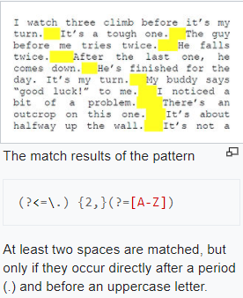
RegExp in general
A regular expression (shortened as regex or regexp; also referred to as rational expression) is a sequence of characters that define a search pattern. Usually such patterns are used by string-searching algorithms for "find" or "find and replace" operations on strings, or for input validation. It is a technique developed in theoretical computer science and formal language theory.

Slide 7
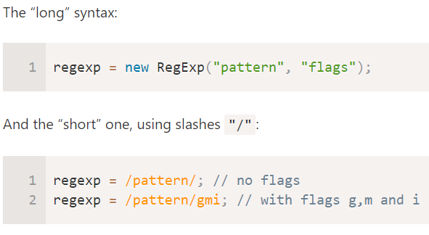
Initialization

Slide 8
Flags
Regular expressions may have flags that affect the search.
There are only 6 of them in JavaScript:
i
With this flag the search is case-insensitive: no difference between A and a
g
With this flag the search looks for all matches, without it – only the first match is returned.
m
Multiline mode
s
Enables “dotall” mode, that allows a dot . to match newline character \n
u
Enables full unicode support. The flag enables correct processing of surrogate pairs. More about that in the chapter Unicode: flag "u" and class \p{...}.
y
“Sticky” mode: searching at the exact position in the

Slide 9
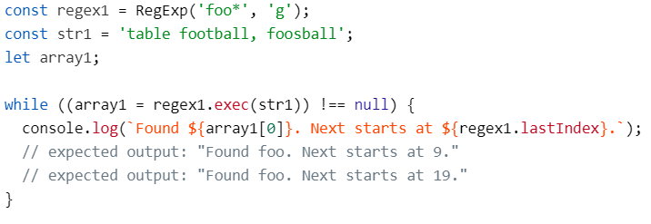
RegExp.exec()
The exec() method executes a search for a match in a specified string. Returns a result array, or null.
JavaScript RegExp objects are stateful when they have the global or sticky flags set (e.g. /foo/g or /foo/y). They store a lastIndex from the previous match. Using this internally, exec() can be used to iterate over multiple matches in a string of text (with capture groups), as opposed to getting just the matching strings with String.prototype.match().

Slide 10

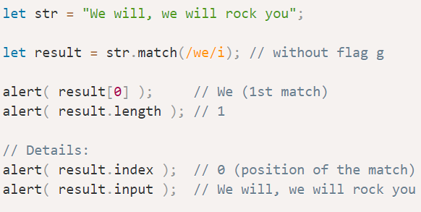
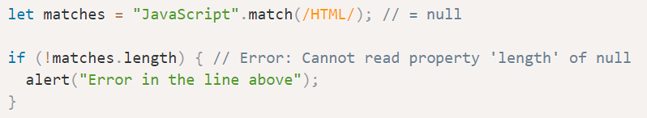
Str.match(regexp)
The method str.match(regexp) finds all matches of regexp in the string str.
It has 3 working modes:
If the regular expression has flag g, it returns an array of all matches:
If there’s no such flag it returns only the first match in the form of an array, with the full match at index 0 and some additional details in properties:
And, finally, if there are no matches, null is returned (doesn’t matter if there’s flag g or not).

Slide 11
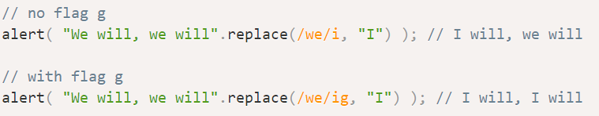
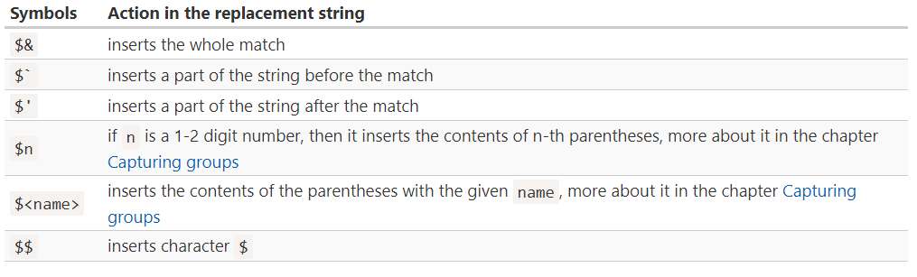
Str.replace(regex,replacement)
The method str.replace(regexp, replacement) replaces matches found using regexp in string str with replacement (all matches if there’s flag g, otherwise, only the first one).
For instance:

Slide 12
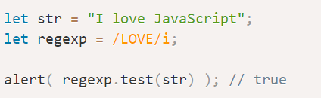
Regexp.test(str)
The method regexp.test(str) looks for at least one match, if found, returns true, otherwise false.

Slide 13
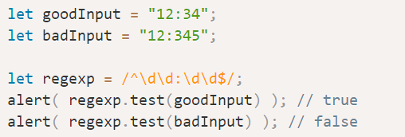


Anchors
The caret ^ and dollar $ characters have special meaning in a regexp. They are called “anchors”.
The caret ^ matches at the beginning of the text, and the dollar $ – at the end.
A word boundary \b is a test, just like ^ and $.

Slide 14

Sets and ranges
Several characters or character classes inside square brackets […] mean to “search for any character among given”.
Square brackets may also contain character ranges.
For instance, [a-z] is a character in range from a to z, and [0-5] is a digit from 0 to 5.
In the example below we’re searching for "x" followed by two digits or letters from A to F:

Slide 15
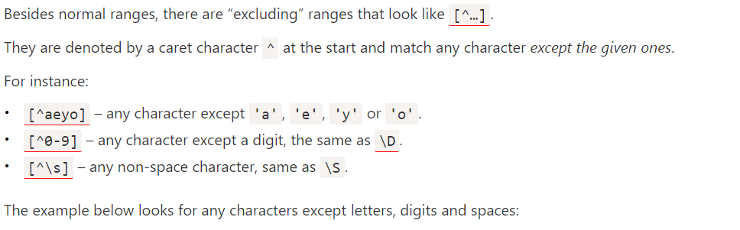
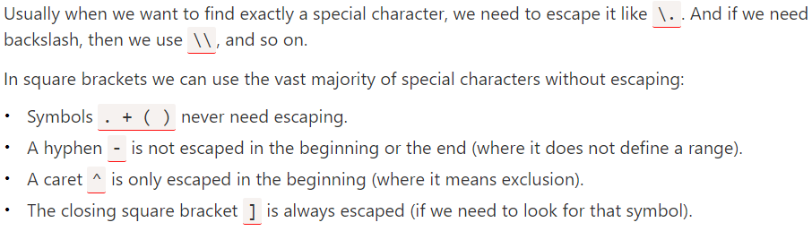
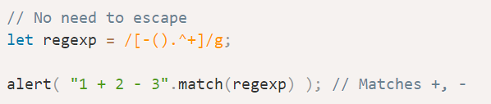
Ranges (part 2)

Slide 16
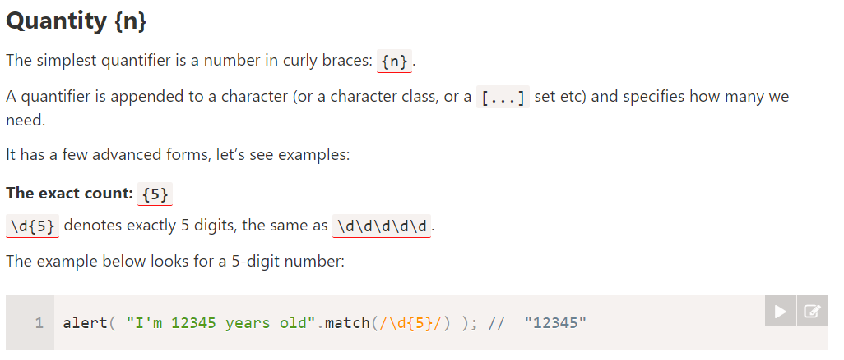
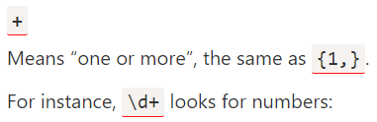


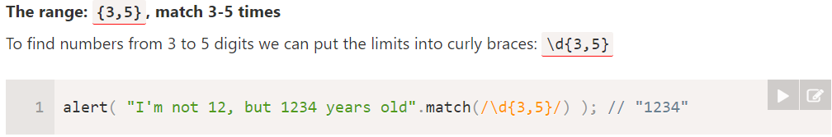
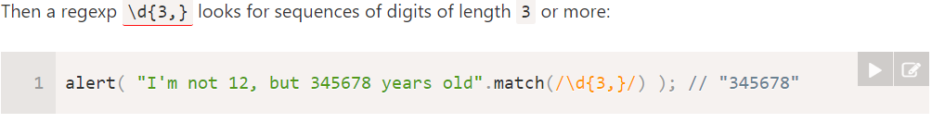
Quantifiers

Slide 17
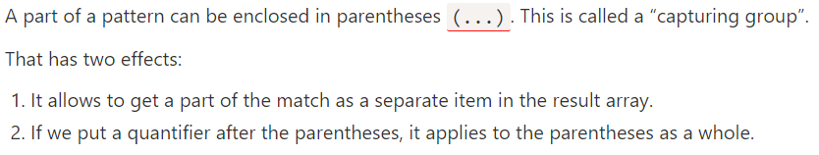
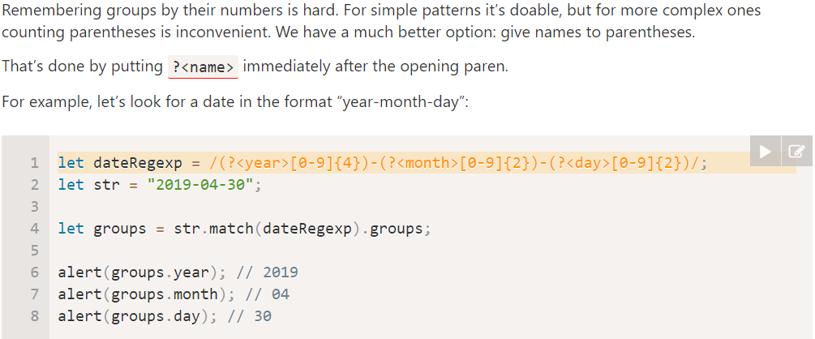
Groups

Slide 18
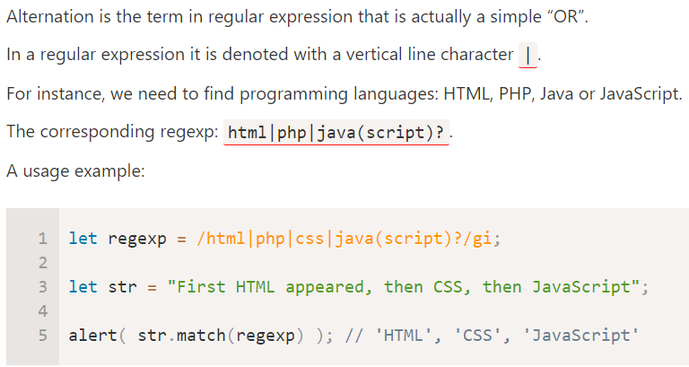
Alternations (OR)

Slide 19
Character classes
\w matches any alphanumeric character (plus underscore), equivalent to [A-Za-z_0-9]
\W matches any non-alphanumeric character, anything except [^A-Za-z_0-9]
\d matches any digit, equivalent to [0-9]
\D matches any character that’s not a digit, equivalent to [^0-9]
\s matches any whitespace character: spaces, tabs, newlines
\S matches any character that’s not a whitespace
\n matches a newline character
. matches any character that is not a newline char (e.g. \n)

Slide 20


