Slide 1
JavaScript Syntax
By Strus Maksym

Slide 2

Case sensitivity
JavaScript is case sensitive. It is common to start the name of a constructor with a capitalised letter, and the name of a function or variable with a lower-case letter.

Slide 3
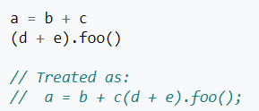
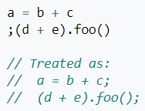
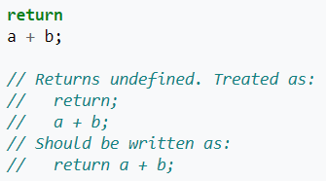
Whitespaces and semicolons
Spaces, tabs and newlines used outside of string constants are called whitespace. Unlike in C, whitespace in JavaScript source can directly impact semantics. The five restricted productions are: return, throw, continue, etc…

Slide 4
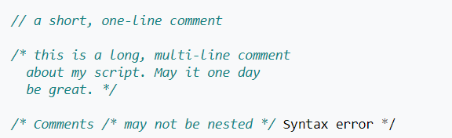
Comments
Comment syntax is the same as in C++ and many other languages.

Slide 5
Variables
Variables in standard JavaScript have no type attached, and any value can be stored in any variable. Starting with ES6, the version of the language finalised in 2015, variables can be declared with let (for a block level variable), var (for a function level variable) or const (for an immutable one). An identifier must start with a letter, underscore (_), or dollar sign ($); subsequent characters can also be digits (0-9). Because JavaScript is case sensitive, letters include the characters "A" through "Z" (uppercase) and the characters "a" through "z" (lowercase).

Slide 6

Scope and hoisting
Variables are lexically scoped at function level (not block level as in C), and this does not depend on order (forward declaration is not necessary): if a variable is declared inside a function (at any point, in any block), then inside the function, the name will resolve to that variable. This is equivalent in block scoping to variables being forward declared at the top of the function, and is referred to as hoisting.

Slide 7
Primitive data types
The JavaScript language provides six primitive data types:
Undefined
Null
Number
String
Boolean
Symbol

Slide 8
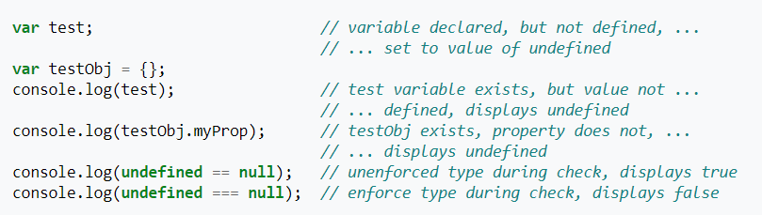
Undefined
The value of "undefined" is assigned to all uninitialized variables, and is also returned when checking for object properties that do not exist. In a Boolean context, the undefined value is considered a false value.
Note: undefined is considered a genuine primitive type. Unless explicitly converted, the undefined value may behave unexpectedly in comparison to other types that evaluate to false in a logical context.

Slide 9

NULL
Unlike undefined, null is often set to indicate that something has been declared, but has been defined to be empty. In a Boolean context, the value of null is considered a false value in JavaScript.

Slide 10
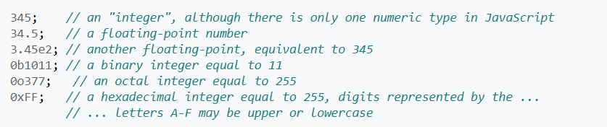



Number
Numbers are represented in binary as IEEE-754 doubles, which provides an accuracy of nearly 16 significant digits. Because they are floating point numbers, they do not always exactly represent real numbers, including fractions.

Slide 11



String
A string in JavaScript is a sequence of characters. In JavaScript, strings can be created directly (as literals) by placing the series of characters between double (") or single (') quotes. Such strings must be written on a single line, but may include escaped newline characters (such as \n). The JavaScript standard allows the backquote character (`, a.k.a. grave accent or backtick) to quote multiline literal strings, but this is supported only on certain browsers as of 2016: Firefox and Chrome, but not Internet Explorer 11

Slide 12
Boolean
JavaScript provides a Boolean data type with true and false literals. The typeof operator returns the string "boolean" for these primitive types. When used in a logical context, 0, -0, null, NaN, undefined, and the empty string ("") evaluate as false due to automatic type coercion. All other values (the complement of the previous list) evaluate as true, including the strings "0", "false" and any object. Automatic type coercion by the equality comparison operators (== and !=) can be avoided by using the type checked comparison operators (=== and !==).
When type conversion is required, JavaScript converts Boolean, Number, String, or Object operands as follows:

Slide 13
Boolean (2 part)
Number and String
The string is converted to a number value. JavaScript attempts to convert the string numeric literal to a Number type value. First, a mathematical value is derived from the string numeric literal. Next, this value is rounded to nearest Number type value.
Boolean
If one of the operands is a Boolean, the Boolean operand is converted to 1 if it is true, or to 0 if it is false.
Object
If an object is compared with a number or string, JavaScript attempts to return the default value for the object. An object is converted to a primitive String or Number value, using the .valueOf() or .toString() methods of the object. If this fails, a runtime error is generated.

Slide 14
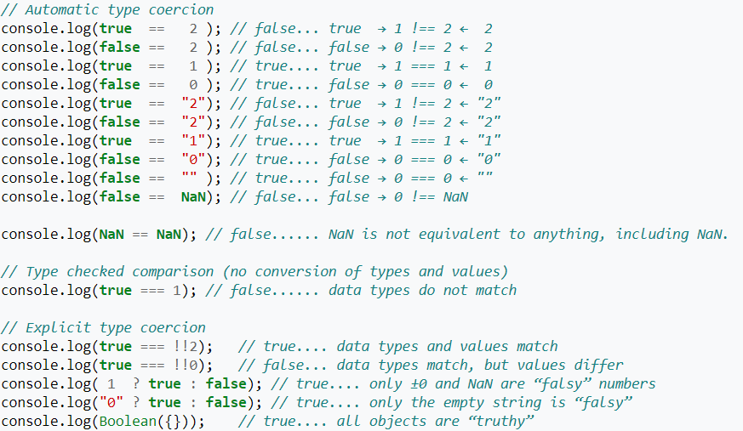
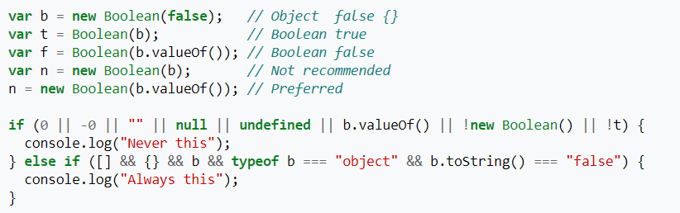
Boolean (3 part)

Slide 15
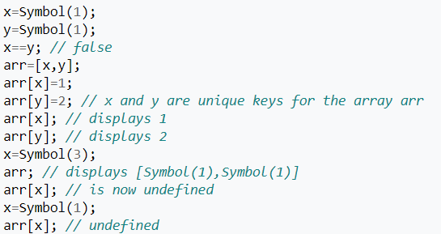
Symbols
New in ECMAScript6. A Symbol is a unique and immutable identifier.

Slide 16
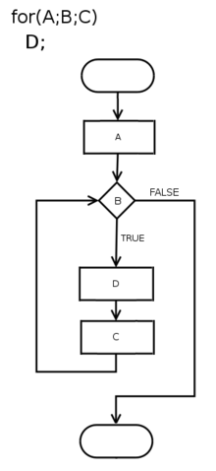
Control Flow
The kinds of control flow statements supported by different languages vary, but can be categorized by their effect:
Continuation at a different statement (unconditional branch or jump)
Executing a set of statements only if some condition is met (choice - i.e., conditional branch)
Executing a set of statements zero or more times, until some condition is met (i.e., loop - the same as conditional branch)
Executing a set of distant statements, after which the flow of control usually returns (subroutines, coroutines, and continuations)
Stopping the program, preventing any further execution (unconditional halt)
In JavaScript we use a pair of curly brackets { } and an enclosed sequence of statements constitute a compound statement, which can be used wherever a statement can be used.

Slide 17
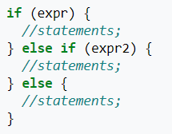
If/else
In JavaScript we are used writing if/else if/else key words

Slide 18
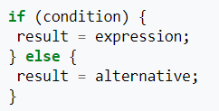
Ternary operator
The conditional operator creates an expression that evaluates as one of two expressions depending on a condition. This is similar to the if statement that selects one of two statements to execute depending on a condition. I.e., the conditional operator is to expressions what if is to statements.

Slide 19
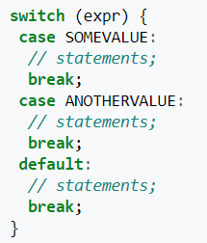
Switch
The syntax of the JavaScript switch statement is as follows:
break; is optional; however, it is usually needed, since otherwise code execution will continue to the body of the next case block.
Add a break statement to the end of the last case as a precautionary measure, in case additional cases are added later.
String literal values can also be used for the case values.
Expressions can be used instead of values.
The default case (optional) is executed when the expression does not match any other specified cases.
Braces are required.

Slide 20
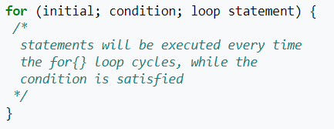
Loops (For)
The syntax of the JavaScript for loop is as follows:

Slide 21

Loops (For … in … )
The syntax of the JavaScript for ... in loop is as follows:
Iterates through all enumerable properties of an object.
Iterates through all used indices of array including all user-defined properties of array object, if any. Thus it may be better to use a traditional for loop with a numeric index when iterating over arrays.
There are differences between the various Web browsers with regard to which properties will be reflected with the for...in loop statement.

Slide 22
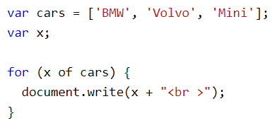
Loops (For … of … )
Loop through the values of an array:

Slide 23
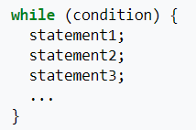
Loops (While)
The syntax of the JavaScript while loop is as follows:

Slide 24
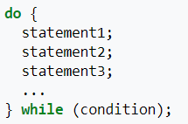
Loops (do … while)
The syntax of the JavaScript do ... while loop is as follows:

Slide 25
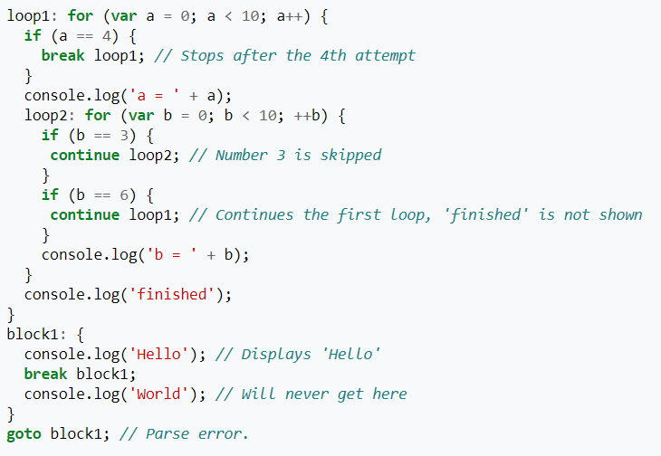
Labels
JavaScript supports nested labels in most implementations. Loops or blocks can be labelled for the break statement, and loops for continue. Although goto is a reserved word,[14] goto is not implemented in JavaScript.

Slide 26
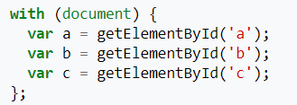
With
The with statement adds all of the given object's properties and methods into the following block's scope, letting them be referenced as if they were local variables.

Slide 27
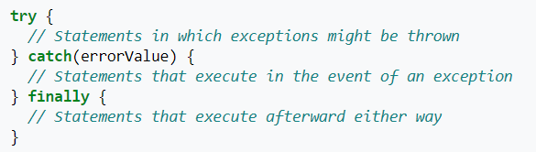
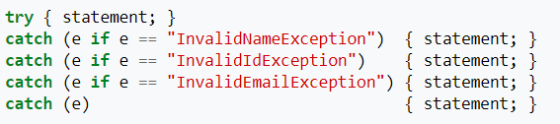
Error handling
JavaScript includes a try ... catch ... finally exception handling statement to handle run-time errors.
The try ... catch ... finally statement catches exceptions resulting from an error or a throw statement. Its syntax is as follows:
mozilla

Slide 28
onerror
In a browser, the onerror event is more commonly used to trap exceptions.

Slide 29

Promises error handling

Slide 30
“Use strict”
Strict mode makes it easier to write "secure" JavaScript.
Strict mode changes previously accepted "bad syntax" into real errors.
As an example, in normal JavaScript, mistyping a variable name creates a new global variable. In strict mode, this will throw an error, making it impossible to accidentally create a global variable.
In normal JavaScript, a developer will not receive any error feedback assigning values to non-writable properties.
In strict mode, any assignment to a non-writable property, a getter-only property, a non-existing property, a non-existing variable, or a non-existing object, will throw an error.

Slide 31



“Use strict” (part 1)
Using a variable, without declaring it, is not allowed:
Deleting a variable (or object) is not allowed.
Duplicating a parameter name is not allowed:

Slide 32
“Use strict” (part 2)
Octal numeric literals are not allowed:
Octal escape characters are not allowed:
Writing to a read-only property is not allowed:
Writing to a get-only property is not allowed:
Deleting an undeletable property is not allowed:
The word eval cannot be used as a variable:
The word arguments cannot be used as a variable:
The with statement is not allowed:
For security reasons, eval() is not allowed to create variables in the scope from which it was called:

Slide 33
“Use strict” (part 3)
The this keyword in functions behaves differently in strict mode.
The this keyword refers to the object that called the function.
If the object is not specified, functions in strict mode will return undefined and functions in normal mode will return the global object (window):

Slide 34

“Use strict” (part 4)
Keywords reserved for future JavaScript versions can NOT be used as variable names in strict mode.
These are:
implements
interface
let
package
private
protected
public
static
yield

Slide 35


