Slide 1
BEM,Pug
By Strus Maksym

Slide 2
BEM
The BEM methodology is a set of universal rules that can be applied regardless of the technology used, be it CSS, Sass, HTML, JavaScript or React.BEM helps to solve the following tasks:
reuse layout;
painlessly change the layout in places in one project;
transfer the finished layout from project to project;
create stable, predictable and understandable code;
reduce the time to debug the project.

Slide 3
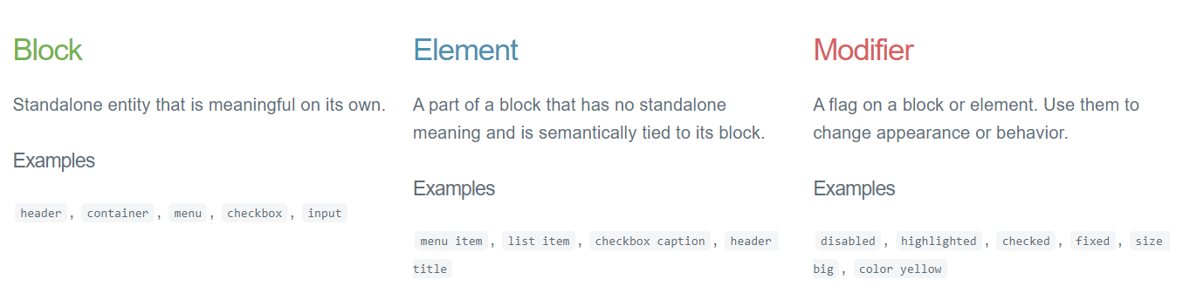
What is BEM?

Slide 4
Benefits
Modularity
Block styles are never dependent on other elements on a page, so you will never experience problems from cascading.
You also get the ability to transfer blocks from your finished projects to new ones
Reusability
Composing independent blocks in different ways, and reusing them intelligently, reduces the amount of CSS code that you will have to maintain.
With a set of style guidelines in place, you can build a library of blocks, making your CSS super effective.
Structure
BEM methodology gives CSS code a solid structure that remains simple and easy to understand.

Slide 5
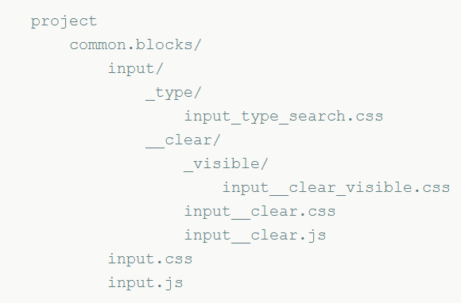
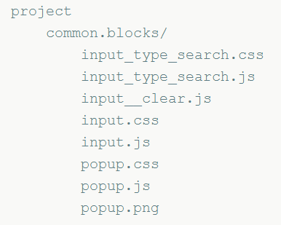
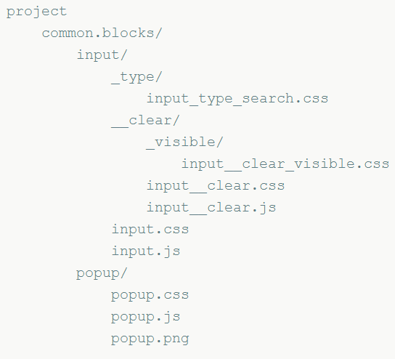
File structure organization
Nested
Flat
Flex

Slide 6
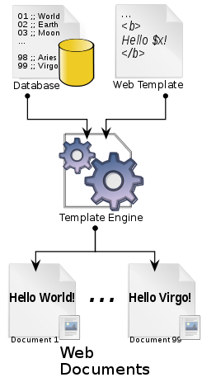
What’s a Template Engine and Why Do I Need One?
A template engine is a program which is responsible for compiling a template (that can be written using any one of a number of languages) into HTML. The template engine will normally receive data from an external source, which it will inject into the template it’s compiling. This is illustrated by the following diagram.

Slide 7

Pug
Pug is a high-performance template engine heavily influenced by Haml and implemented with JavaScript for Node.js and browsers.
This project was formerly known as "Jade". However, it was revealed to us that "Jade" is a registered trademark; as a result, a rename was needed. After some discussion among the maintainers, "Pug" was chosen as the new name for this project. As of version 2, "pug" is the official package name.
Before the renaming, work had already begun on “Jade 2.0.0”. Therefore, the rename to Pug coincided with the major version bump. As a result, upgrading from Jade to Pug will be the same process as upgrading any other package with a major version bump.

Slide 8
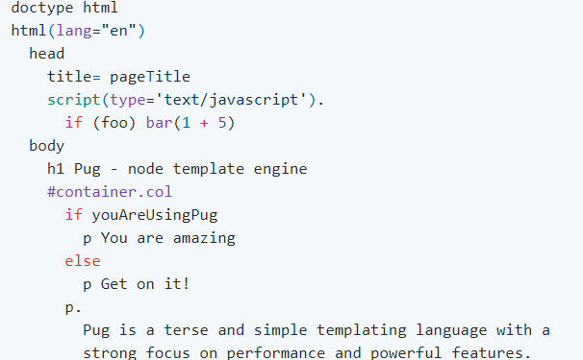
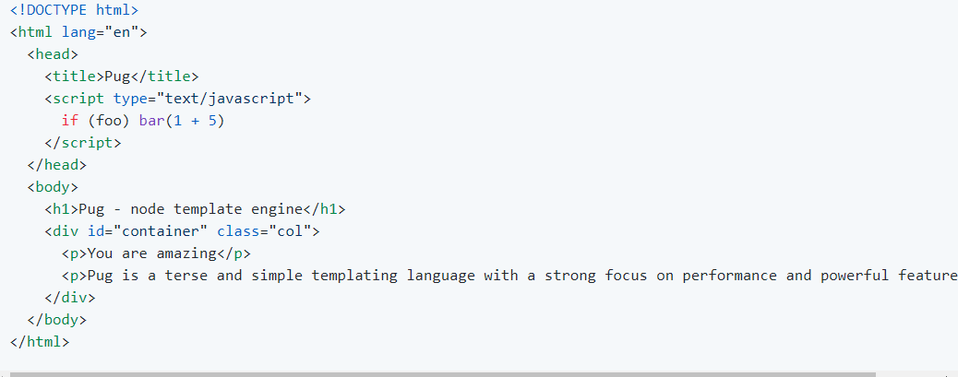
Syntax

Slide 9
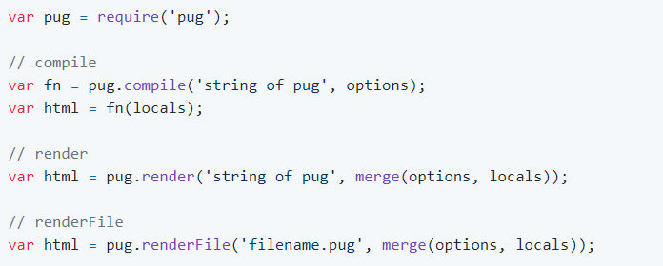
API

Slide 10
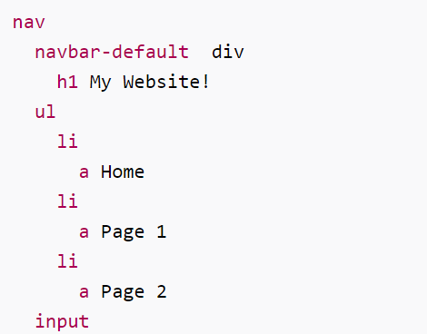
Tags

Slide 11
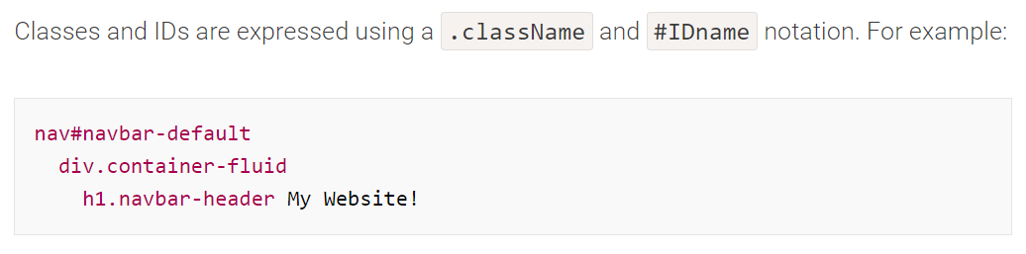
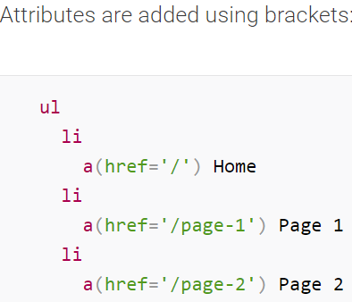
ID,classnames and attributes

Slide 12
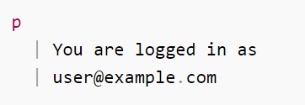
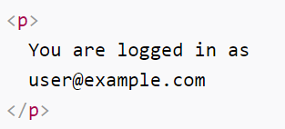
Text Blocks

Slide 13


Comments

Slide 14

Unbuffered code

Slide 15
Buffered code

Slide 16

Interpolation

Slide 17
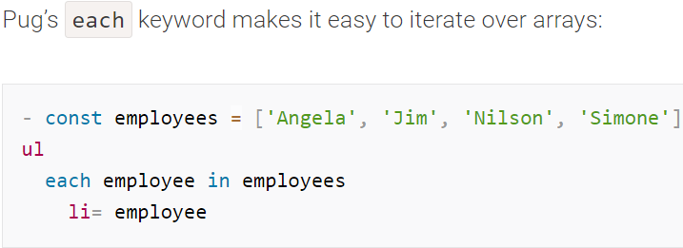
Iterations

Slide 18
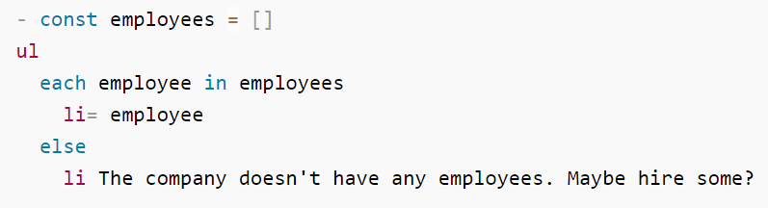
Else statement for iterators

Slide 19
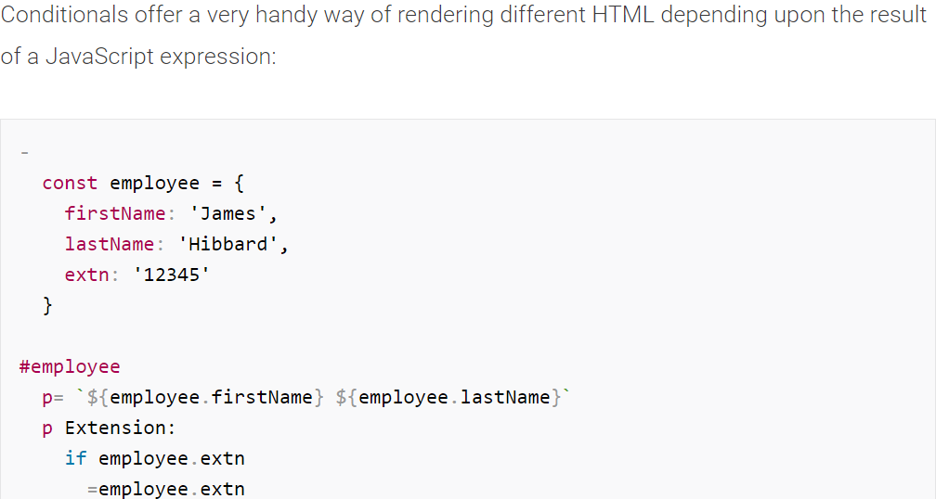
If/else statements

Slide 20


