Slide 1
Context.Keys
By Strus Maksym

Slide 2
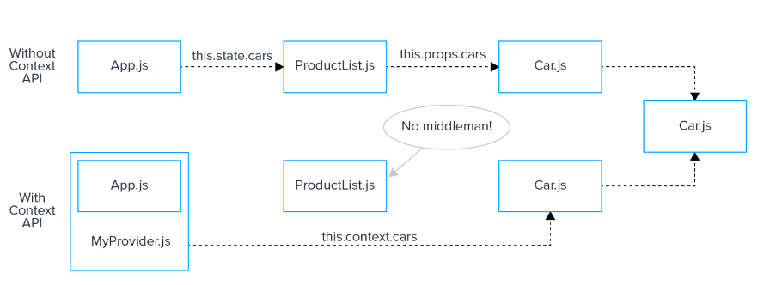
When we use Context
We use Context to deliver necessary data to current components. This one solves one major problem–prop drilling

Slide 3
Initializing Context API
Its just a one line of code! (Context is equal to Redux.CreateStore)

Slide 4
Key words
MyContext.Provider – wrap value
MyContext.Consumer – receive value

Slide 5
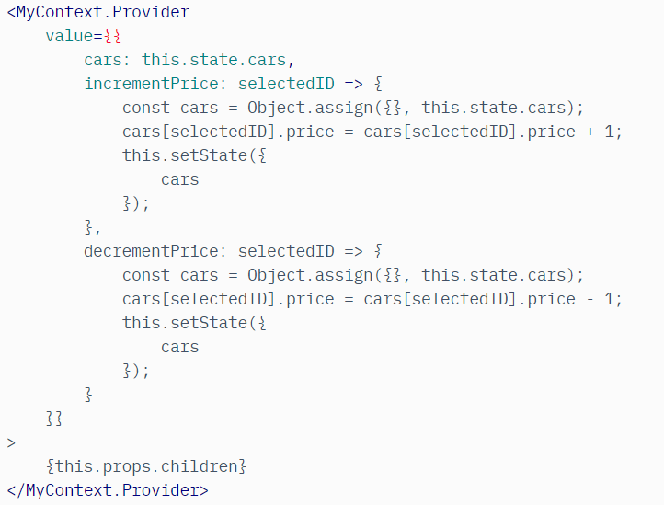
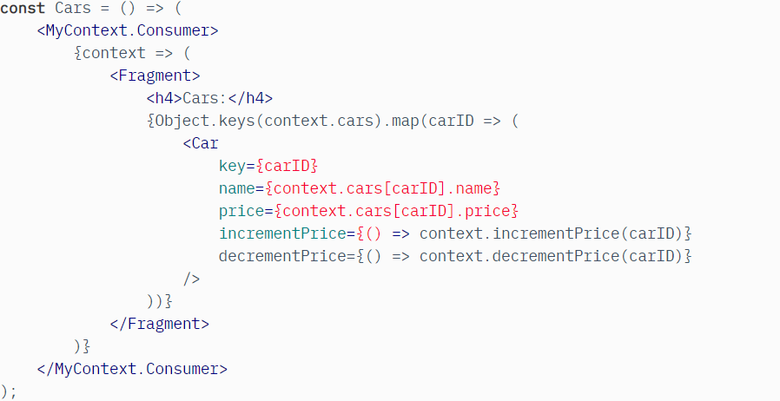
Example of using Context API

Slide 6
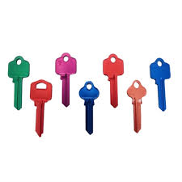
Keys
Helps you to obtain an information about the certain element of the component list

Slide 7
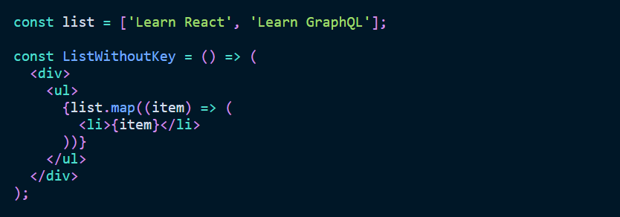
Keys usage
Incorrect

Slide 8
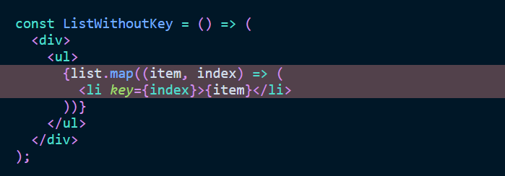
Keys usage
Correct

Slide 9


