Slide 1


UNIWERSYTET VIZJA · SCHOOL OF COMPUTER SCIENCE
STUDENT
Heorhii Butenko
Index: 46584
SUPERVISOR
dr Petro Guchek
FIELD OF STUDY
Computer Science
Design and Implementation of a Web-based Service Booking System for Small Businesses in an Urban Environment
bloomtime.page
www.vizja.pl

Slide 2
Presentation Agenda
01
02
03
Problem Statement & Purpose
Competitor Analysis
Technology Stack
82% of bookings still made by phone
Treatwell, Fresha, Booksy: gaps BloomTime fills
Node.js 22, React 18, PostgreSQL 16
04
05
06
System Architecture
Database Design
Key Features
Client > Nginx > Express > PostgreSQL + APIs
31 migrations, 12 core tables, relational schema
Booking engine, CMS, Google OAuth, i18n
07
08
09
Implementation Highlights
Live Application
Conclusions & Future Work
Slot calculation, JWT flow, email pipeline
bloomtime.page: 25 salons, 70+ users
Shipped. What comes next.
2 / 11
www.vizja.pl

Slide 3
Problem Statement & Purpose
THE PROBLEM
THE PURPOSE
82%
82% of beauty appointments booked by phone in 2024
Under 30 seconds: pick salon, service, slot, confirm
4–6 hours/week spent managing bookings manually
One dashboard for all bookings, staff, revenue
of salon bookings still
made by phone
3-step friction: Google > call > wait before booking
Automated email cuts no-shows instantly
27% no-show rate without automated reminders
Visual CMS for non-technical owners
8% monthly revenue lost to scheduling conflicts
25 real salons onboarded at launch
3× faster
digital booking vs phone call
BloomTime eliminates all 5 friction points — digital booking in under 30 seconds, 26 salons onboarded at launch
3 / 11
www.vizja.pl

Slide 4
Competitor Analysis
FEATURE
TREATWELL
FRESHA
BOOKSY
BLOOMTIME
Target Market
Large chains
Global SMB
Individual stylists
Urban SMB (academic)
Business Model
Commission
Freemium SaaS
Subscription
Open-source / custom
Admin CMS
Basic
Standard
Limited
Full custom CMS
Multi-language
Yes
Partial
Yes
EN + PL (i18next)
OAuth Login
Google
Google
Google
Google OAuth 2.0
Email Notifications
Yes
Yes
Limited
HTML templates
Custom Deployment
Yes
Yes
Yes
Yes — own VPS
4 / 11
www.vizja.pl

Slide 5
Technology Stack
BACKEND
FRONTEND
INFRASTRUCTURE
Runtime · data · auth
UI · routing · i18n
Hosting · ops · ssl
Node.js 22 (LTS)
React 18
DigitalOcean Droplet
Express.js 4.18
Vite 5 (bundler)
Ubuntu 24.04 LTS
PostgreSQL 16
React Router 6
Nginx reverse proxy
JWT Authentication
i18next (EN/PL)
PM2 process manager
Google OAuth 2.0
Leaflet.js maps
Let's Encrypt SSL
Nodemailer 6
Google OAuth libs
GitHub version control
Stripe API v17
CSS custom properties
Mailtrap SMTP
bcrypt + helmet
ESLint + Prettier
HTTPS port 443
5 / 11
www.vizja.pl

Slide 6
System Architecture
›
›
›
CLIENT
NGINX
NODE.JS
POSTGRESQL
Browser
443 / HTTPS
Express
Database
React + Vite
Reverse proxy
EXTERNAL SERVICES
Google
Stripe
Nodemailer
Mailtrap
OAuth 2.0
Payments
SMTP
Sandbox
6 / 11
www.vizja.pl

Slide 7
Database Design
users
companies
bookings
services
id, email, full_name
id, name, slug
id, user_id (FK)
id, name, description
password_hash, phone
owner_user_id (FK)
service_id (FK)
company_id (FK)
role_id (FK)
city, district
staff_id (FK)
price_cents
google_sub
address, phone
starts_at, ends_at
duration_minutes
loyalty_points
description
status (enum)
category_slug
is_active
working_hours (rel)
promo_code, notes
image_url
7 / 11
www.vizja.pl

Slide 8
Key Features
Booking Engine
Admin CMS Panel
Google OAuth 2.0
Calculates available slots in real time against staff schedules. Detects conflicts before insert. Applies promo codes & loyalty discounts at checkout.
Non-technical owners edit homepage, theme, FAQ and banners via visual interface. No code required. Changes go live in under 5 seconds.
Users sign in with Google in one click. Backend verifies id_token, creates/links account, issues signed JWT.
EN / PL i18next
Email Pipeline
Loyalty & Payments
All UI strings switch between English and Polish instantly. Language stored in localStorage. Browser preference auto-detected on first visit.
Branded HTML emails sent via Nodemailer on registration, booking creation and status change. Template renders inline CSS for Gmail/Outlook compatibility.
5 loyalty points per completed visit. 1 point = 1% discount, capped at 20%. Stripe gift cards via webhook: paid > pending > confirmed by salon owner.
8 / 11
www.vizja.pl

Slide 9
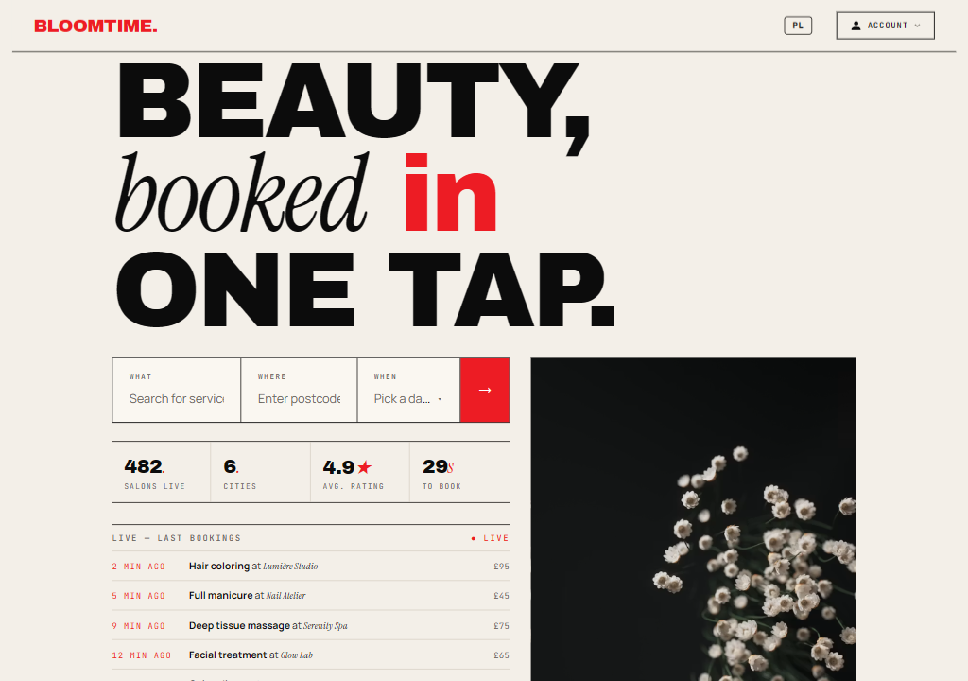
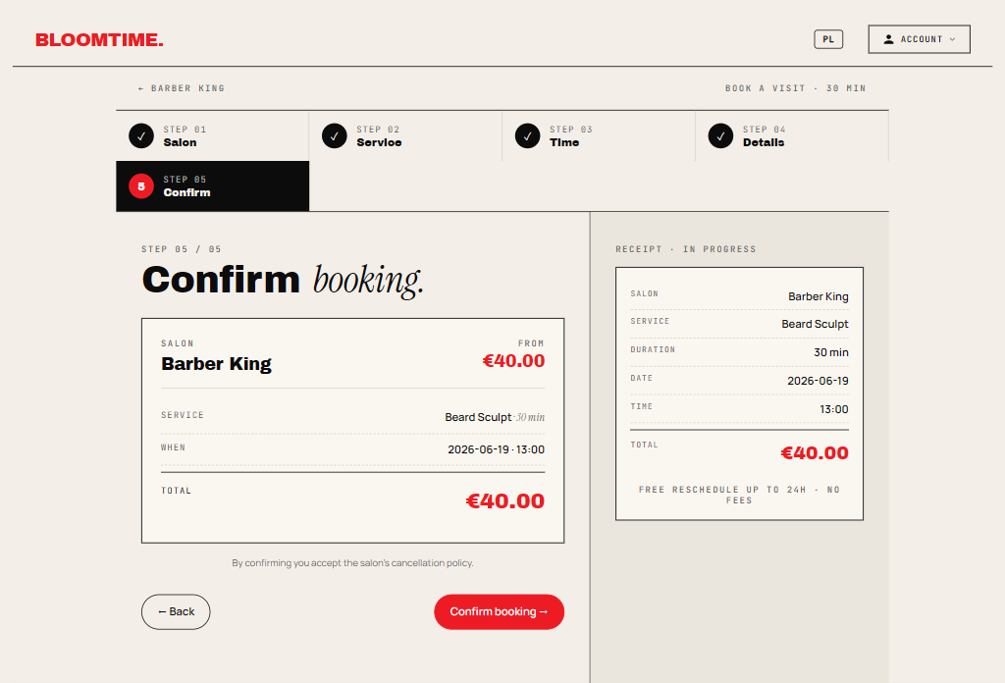
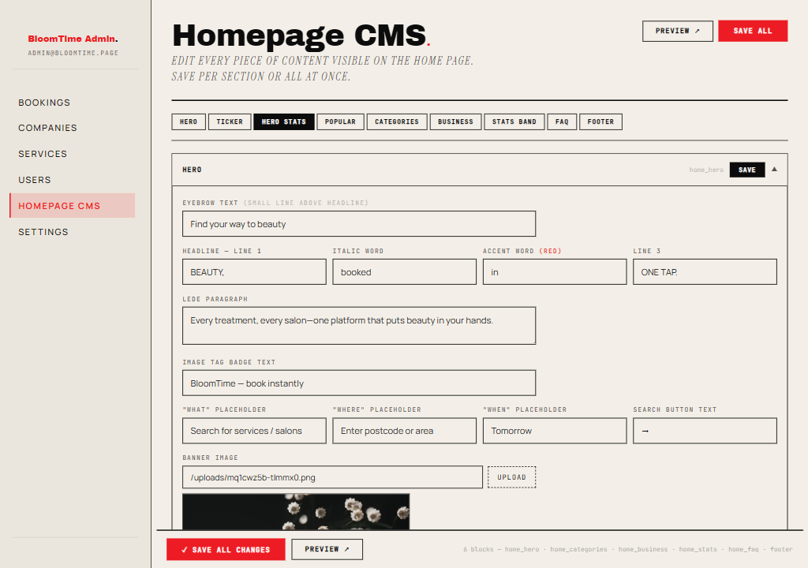
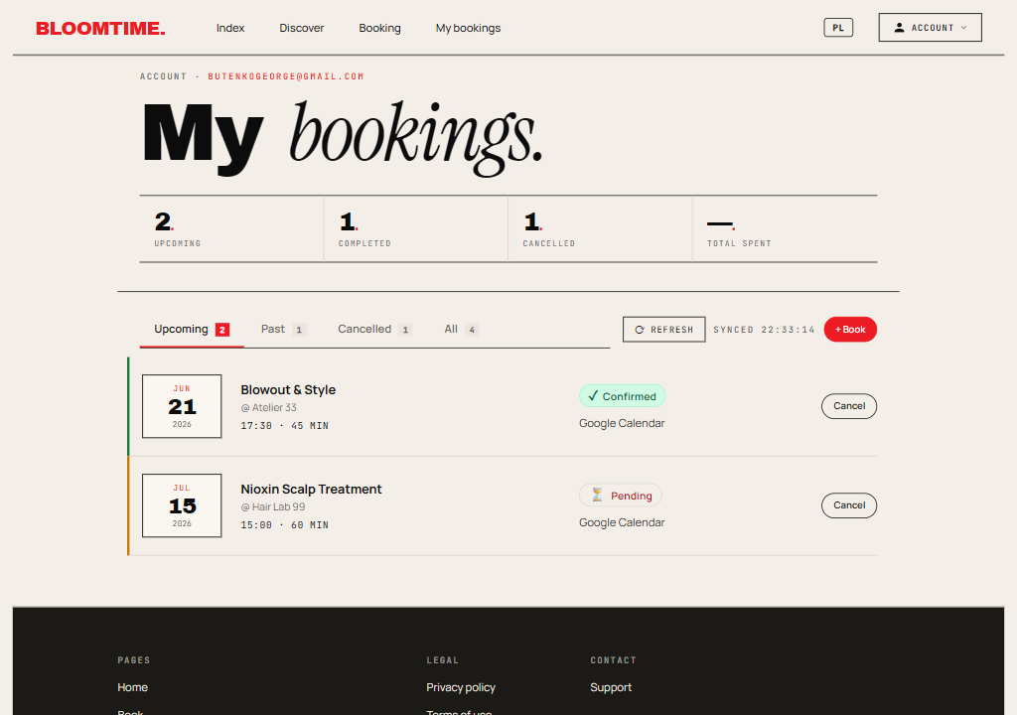
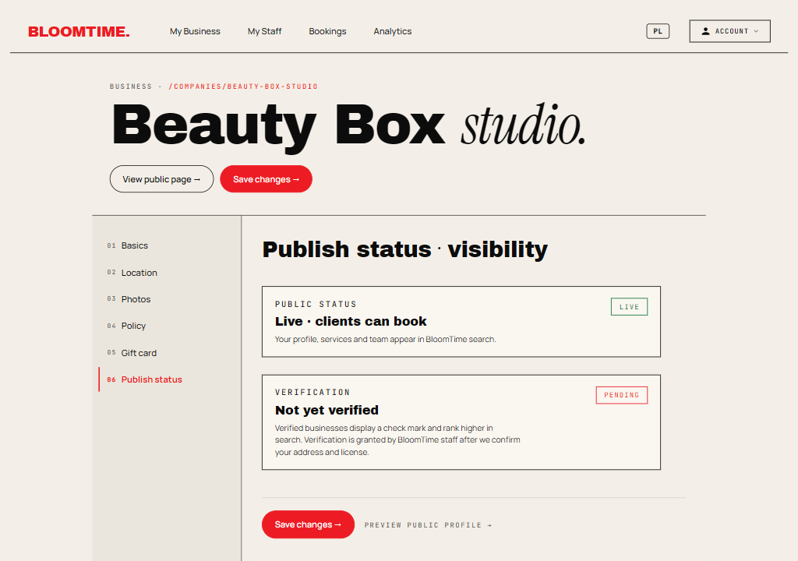
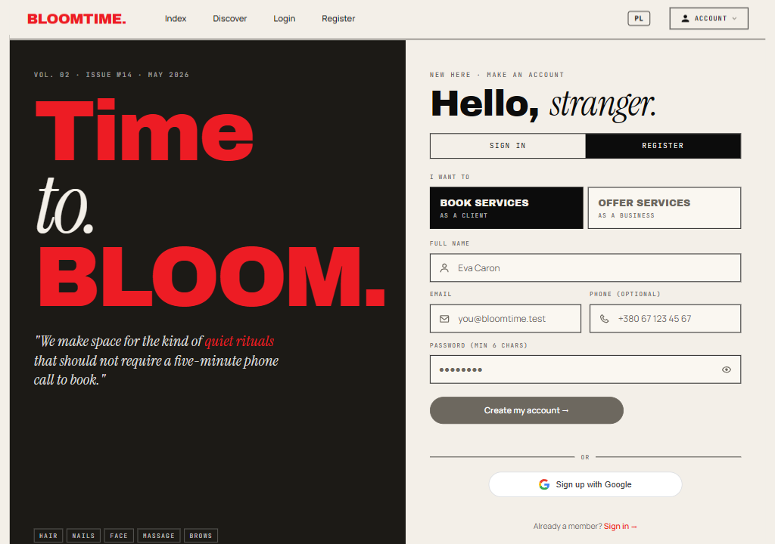
Application Screenshots
www.vizja.pl

Slide 10
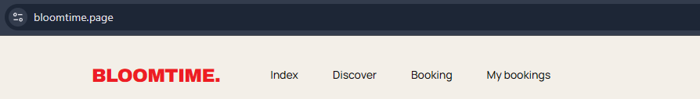
Live Application
LIVE
https://bloomtime.page
25
70+
31
15+
Beauty salons onboarded
Registered users
Database migrations
REST API modules
10 / 11
www.vizja.pl

Slide 11
What Was Achieved
bloomtime.page: live, HTTPS, zero downtime
FUTURE DEVELOPMENT
Next Steps
26 salons + 70 users onboarded at launch
React Native mobile app (iOS + Android)
Booking engine: real-time conflict detection
Direct payment processing per booking
Google OAuth: passwordless login in 1 click
ML-based recommendation engine
CMS: non-technical owners edit content live
Push notifications via FCM
i18n: EN/PL switch with browser detection
Multi-city rollout with geo-search
Email pipeline: HTML templates, 2s delivery
Google Calendar / Apple Calendar sync
Stripe integration: gift cards + loyalty points
BloomTime: from academic project to live product with 26 onboarded salons, real users, and zero infrastructure costs beyond $6/month VPS.
11 / 11
www.vizja.pl

Slide 12
Thank you for attention ☺
www.vizja.pl

