Slide 1

UNIWERSYTET VIZJA · SCHOOL OF COMPUTER SCIENCE & TECHNOLOGIES
Design and Implementation of a
Web-Based Student Management System
for Educational Institutions
LIVE https://thesms.me
STUDENT
Maksym Shpak
Index: 45567
SUPERVISOR
Marcin Kacprowicz
Diploma seminar
FIELD OF STUDY
Computer Science
Engineering degree · 2026
www.vizja.pl

Slide 2
WHY THIS SYSTEM
2 / 10
Problem Statement & Purpose
3 places
spreadsheet, paper register and email thread
0
audit trail of who entered or edited a grade
by hand
every average and every attendance total
THE PROBLEM
THE PURPOSE
— Fragmented records — spreadsheets, paper registers, email threads
— No single view — grades and attendance never meet in one place
— Manual arithmetic — averages recalculated by hand, errors slip through
— No accountability — nobody can prove who recorded a mark
— No confidentiality — every teacher can see every student
— No Polish interface — staff work in English-only tools
— One source of truth — a relational schema with enforced constraints
— Instant analytics — KPI tiles and three charts from ORM aggregation
— Automatic authorship — every grade stores who assigned it
— Scoped visibility — teachers see their own courses, admins see all
— Bilingual by design — the whole interface switches EN ⇄ PL
— Deployable — one build script, HTTPS, managed PostgreSQL
Result: 25 students, 8 courses, 51 active enrolments and a 3.70 mean mark — the same four KPI tiles as the live dashboard.
www.vizja.pl

Slide 3
EXISTING PLATFORMS
3 / 10
Comparative Analysis
CRITERION | MOODLE | USOS | GOOGLE CLASSROOM | SMS — THIS PROJECT
Target user | Large universities | Polish public HEIs | Schools and courses | Departments and small institutions
Deployment | Self-hosted, heavy | Vendor-managed | Google cloud only | Self-hosted, one Django app
Setup effort | Days of plugin work | Institutional contract | Minutes, no control | Minutes — a single build script
Gradebook | Yes, complex | Yes | Basic | Weighted components + author audit
Attendance register | Plugin required | Yes | Not available | Built in, three statuses
Role isolation | Configurable, intricate | Yes | Limited | Enforced at queryset level
Bilingual EN / PL | Language packs | Polish-first | Yes | Native, 312 strings
Analytics | Reports plugin | Institutional reports | Minimal | Chart.js dashboard + CSV
Cost of ownership | GPL + hosting | Licensed | Free, data in Google | Open source, €0 hosting
Positioning: the established platforms are either too heavy or too closed for a single department; SMS trades breadth for a focused, auditable and fully self-hosted core.
www.vizja.pl

Slide 4
CHOSEN FOR A MAINTAINABLE MONOLITH
4 / 10
Technology Stack
BACKEND
Runtime · data · authentication
FRONTEND
Templates · charts · theming
INFRASTRUCTURE
Hosting · operations · CI
· Python 3.12
· Django 6.0.6
· PostgreSQL 18 (Neon)
· SQLite 3 for development
· Django session authentication
· Custom user model with roles
· Django ORM · 6 migrations
· dj-database-url 2.1
· Django Templates · 30 files
· Semantic HTML5
· CSS custom properties · 1 945 lines
· Vanilla JavaScript ES6 · 425 lines
· Chart.js 4 — doughnut and bars
· Turbo 8 page transitions
· Bootstrap Icons
· Light and dark themes
· Render web service
· Neon managed PostgreSQL
· Gunicorn 22 (WSGI)
· WhiteNoise 6.6 static files
· HTTPS with HSTS preload
· GitHub Actions CI
· Git version control
· Zero CDN dependencies
No build step, no separate API server. Every asset is vendored locally, so the application runs and demonstrates fully offline.
www.vizja.pl

Slide 5
SERVER-RENDERED MTV MONOLITH
5 / 10
System Architecture
CLIENT
Browser
HTML · CSS · ES6 Turbo navigation
EDGE
Render · TLS 443
HTTPS, HSTS static via WhiteNoise
APPLICATION
Gunicorn + Django 6
URL › View › Template ORM aggregation
DATA
PostgreSQL 18
Neon managed DATABASE_URL, one codebase
›
›
›
REQUEST PIPELINE — MIDDLEWARE
Security
Session
CSRF
Locale
WhiteNoise
Authentication
Role decorators
Queryset scoping
SUPPORTING SERVICES
i18n EN / PL
Interface language switch
GitHub Actions
Tests and deploy gates
Teachers screen
Admin issues lecturer accounts
CSV export
Role-scoped reporting
/api/dashboard/
JSON metrics endpoint
www.vizja.pl

Slide 6
6 MODELS · 6 MIGRATIONS
6 / 10
Database Design
User extends AbstractUser
Student academic identity
Course taught unit
id
username · email
first_name · last_name
role → admin | teacher
password (PBKDF2)
is_active
id
student_number (unique)
first_name · last_name
email
study_program
date_enrolled · is_active
id
course_code (unique)
course_name · description
semester · credits
max_students
teacher_id → User
Enrollment student ⇄ course
Grade weighted component
Attendance daily register
id
student_id → Student
course_id → Course
enrollment_date
status → active | completed | dropped
unique (student, course)
id
enrollment_id → Enrollment
kind → coursework | midterm | final | retake
weight 1–100 %
grade_value 2.0 – 5.0
assigned_by → User
id
enrollment_id → Enrollment
date
status → present | absent | late
notes
unique (enrollment, date)
Integrity where it belongs: unique constraints, foreign keys and cascade rules live in the schema, so no interface path can create a duplicate enrollment or an orphaned grade.
www.vizja.pl

Slide 7
WHAT THE SYSTEM ACTUALLY DOES
7 / 10
Key Features
Academic Records
CRUD for students, courses and enrollments. Administrators issue lecturer accounts on Teachers. Enrollment is refused once max_students is reached.
Weighted Gradebook
Coursework, midterm, exam and retake — each with a weight. The course mark is their weighted mean. assigned_by records who last saved the component.
Attendance Register
Present, absent and late — one row per enrollment per day, enforced in the schema. Mark Class saves a whole roster in a single request.
Analytics & Export
Four KPI tiles, three Chart.js views and JSON at /api/dashboard/. CSV export of students and grades is scoped to the caller's role.
Role-Based Access
Administrators see the institution; teachers see only their courses. Decorators guard the route, querysets filter again — a guessed URL returns nothing.
i18n & Quality
312 strings, English ⇄ Polish, locale-aware dates. 111 automated tests; GitHub Actions runs a live smoke job against thesms.me.
www.vizja.pl

Slide 8
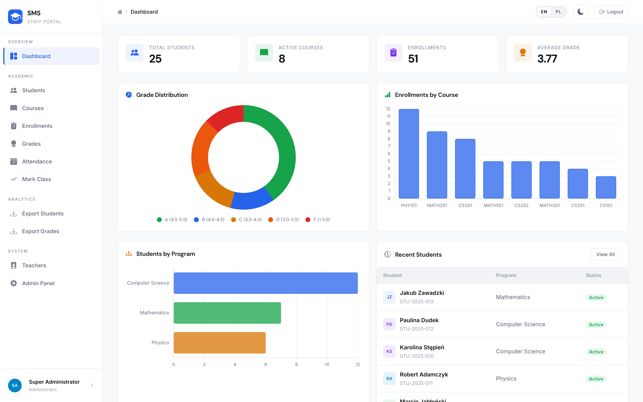
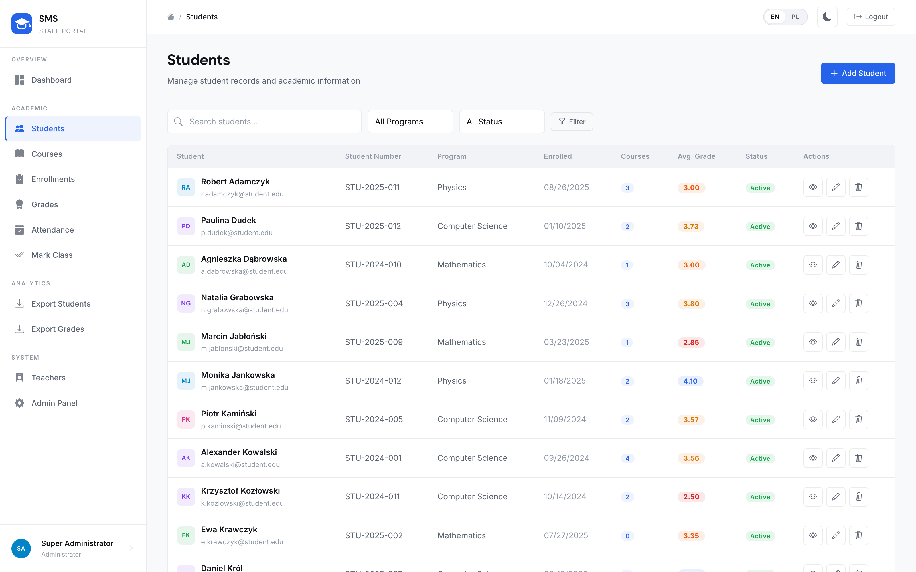
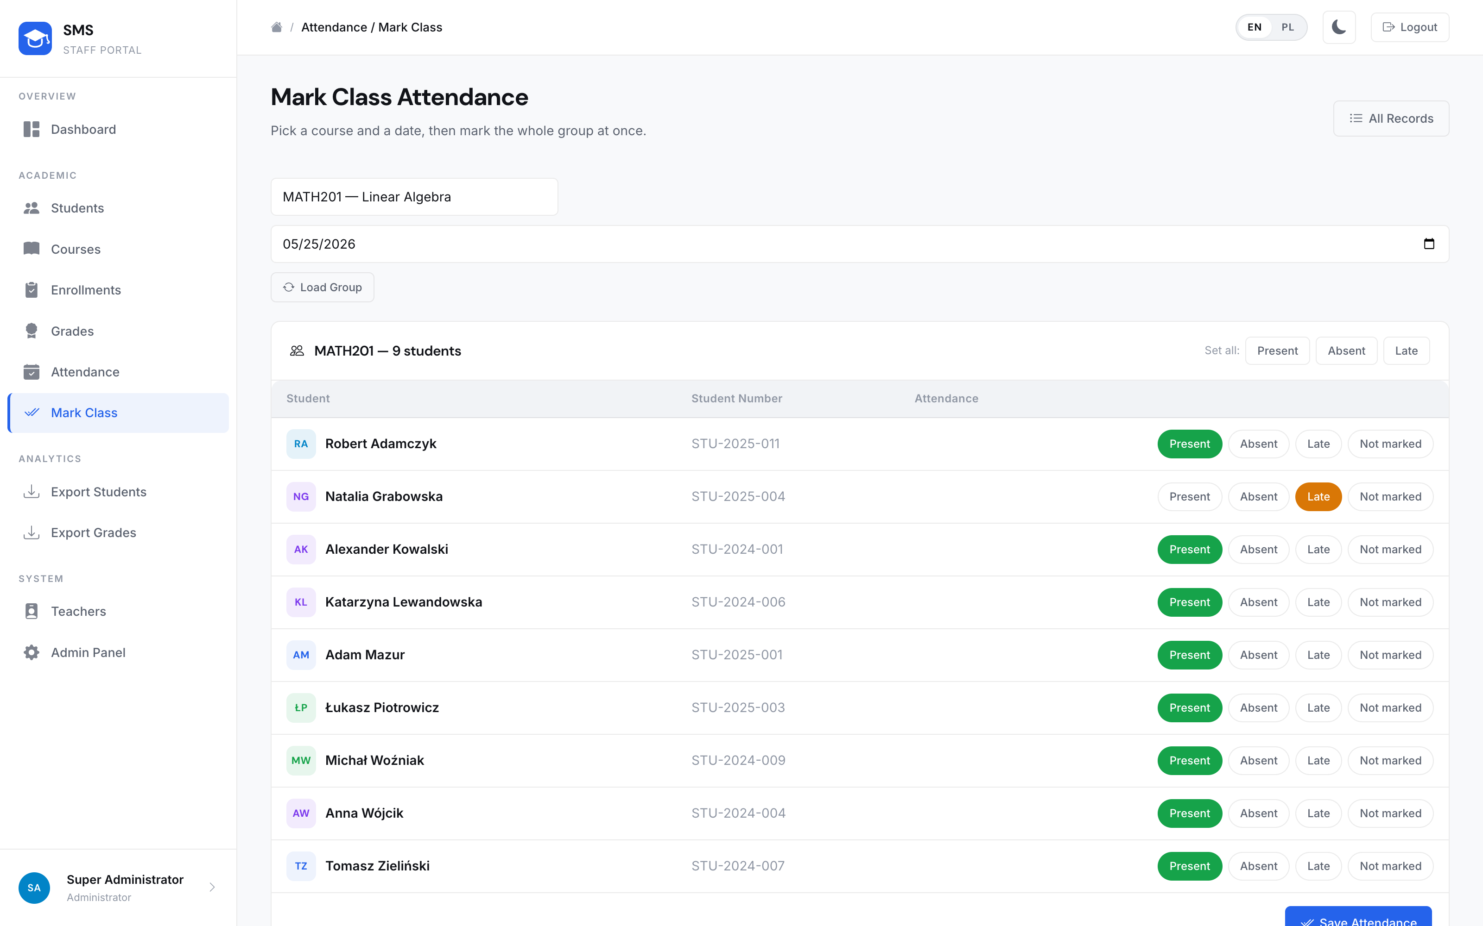
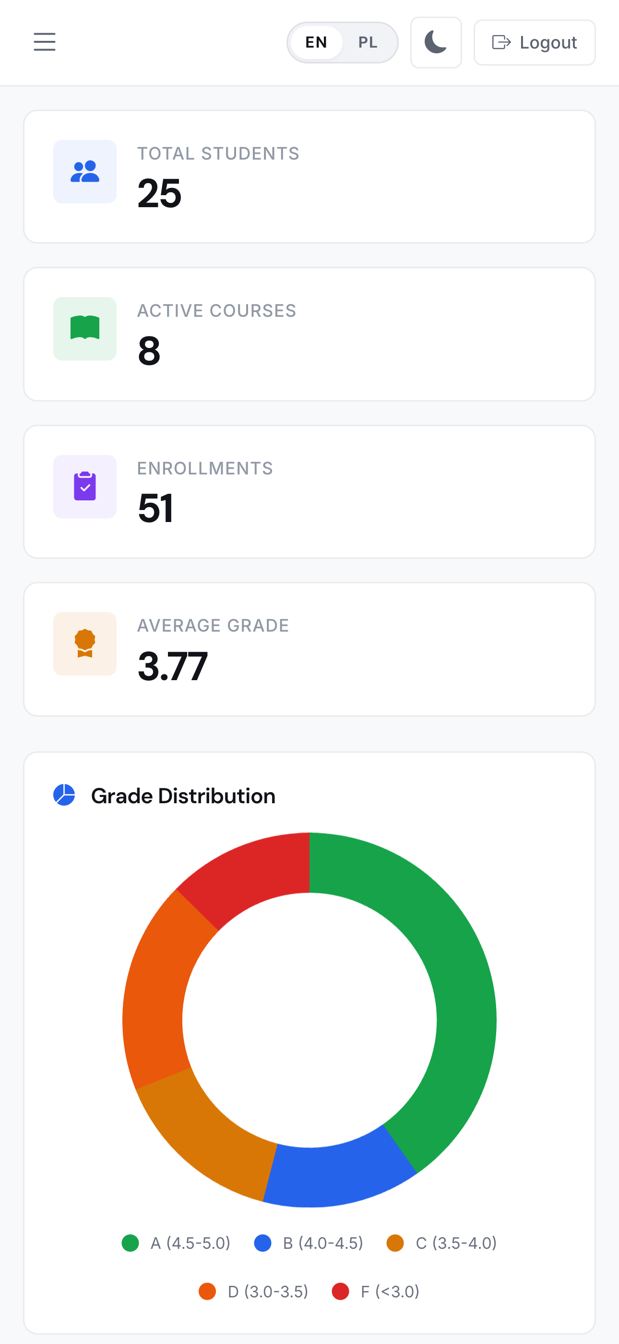
THE RUNNING INTERFACE
8 / 10
Application Screenshots
Dashboard — KPI tiles and three Chart.js views
Student register — search, filters, pagination
Mark Class — a whole roster saved in one request
Responsive
down to 375 px
Every table is role-aware: a teacher opening the same page sees only students in their own courses, and the action buttons disappear.
www.vizja.pl

Slide 9
IN PRODUCTION, NOT ON A LAPTOP
9 / 10
Deployment & Results
LIVE https://thesms.me
DEFENCE LOGIN (teacher)
prof.martinez / demo1234
25
students
8
courses
51
enrollments
3.70
avg. grade
€0
monthly cost
DELIVERED
FUTURE WORK
— Live on Render + Neon — HTTPS, HSTS, managed PostgreSQL
— Six-model schema — constraints and an audit trail in the database
— Role isolation — teachers see their courses; admins see the institution
— Bilingual interface — 312 strings, locale-aware dates and numbers
— 111 tests + live smoke — suite locally; Actions hits the deployed site
— Student portal — a third role with read-only access to own results
— Semester transcripts — generated PDF reports per student
— Email notifications — alerts on new grades and absences
— Documented REST API — token-authenticated public interface
— Two-factor login — TOTP for administrator accounts
www.vizja.pl

Slide 10
Thank you for your attention
Questions are welcome.
Maksym Shpak
Computer Science · Index: 45567
https://thesms.me
www.vizja.pl

