Slide 1
Section 2: 3D Secure and Overview
What is 3DS and Overview
-
Three Domains in the 3DS

Slide 2
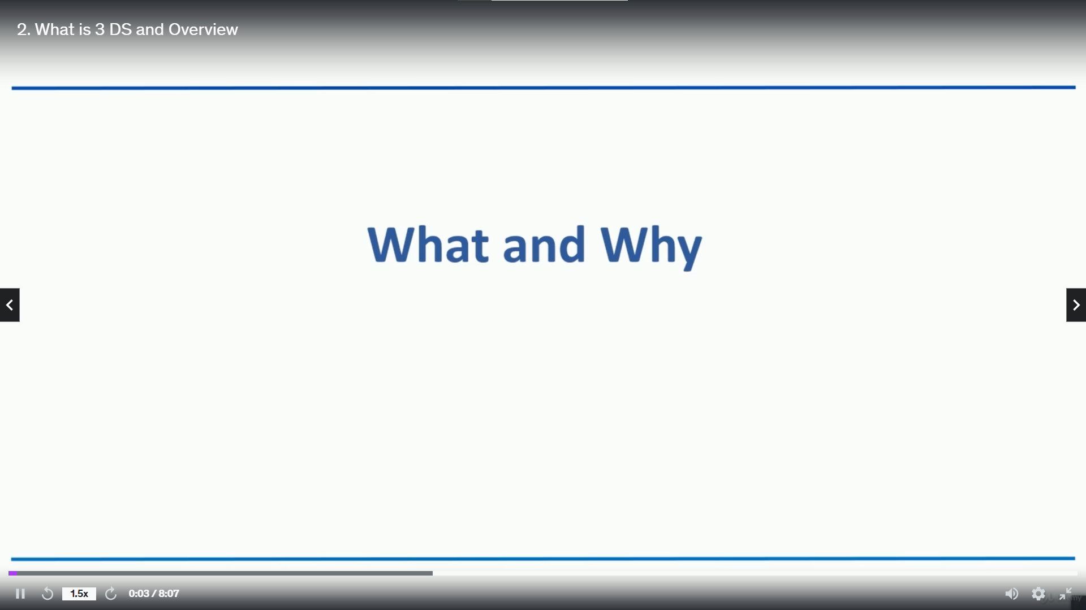

Slide 3
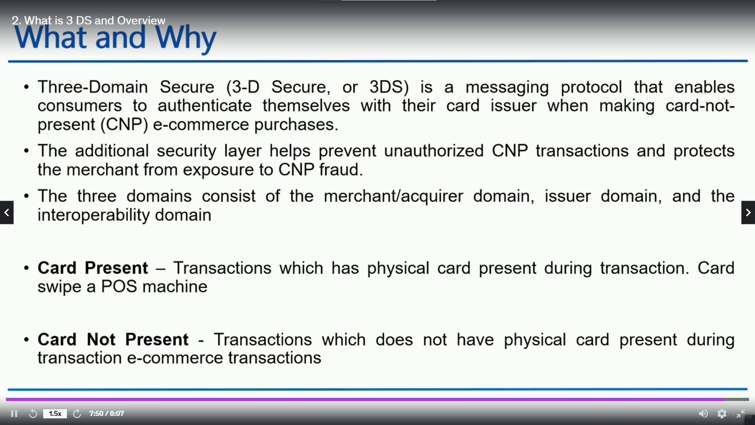

Slide 4
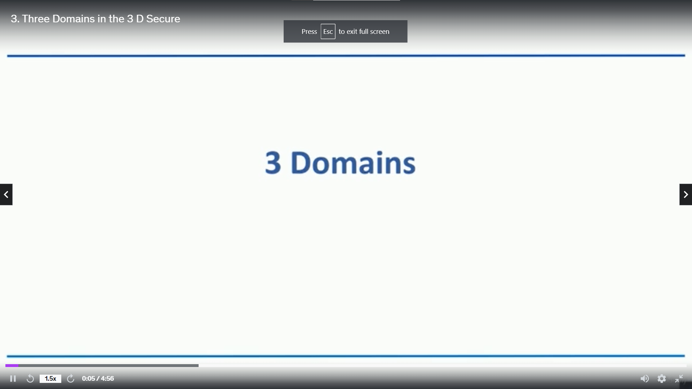

Slide 5
