Slide 1
Section 3: 3D Secure Transaction Flow and logics
3DS Domain wise Transaction Flow
-
Important Terminologies in the transaction flow
-
Step wise transaction details
-
3DS Transaction flow by VISA

Slide 2
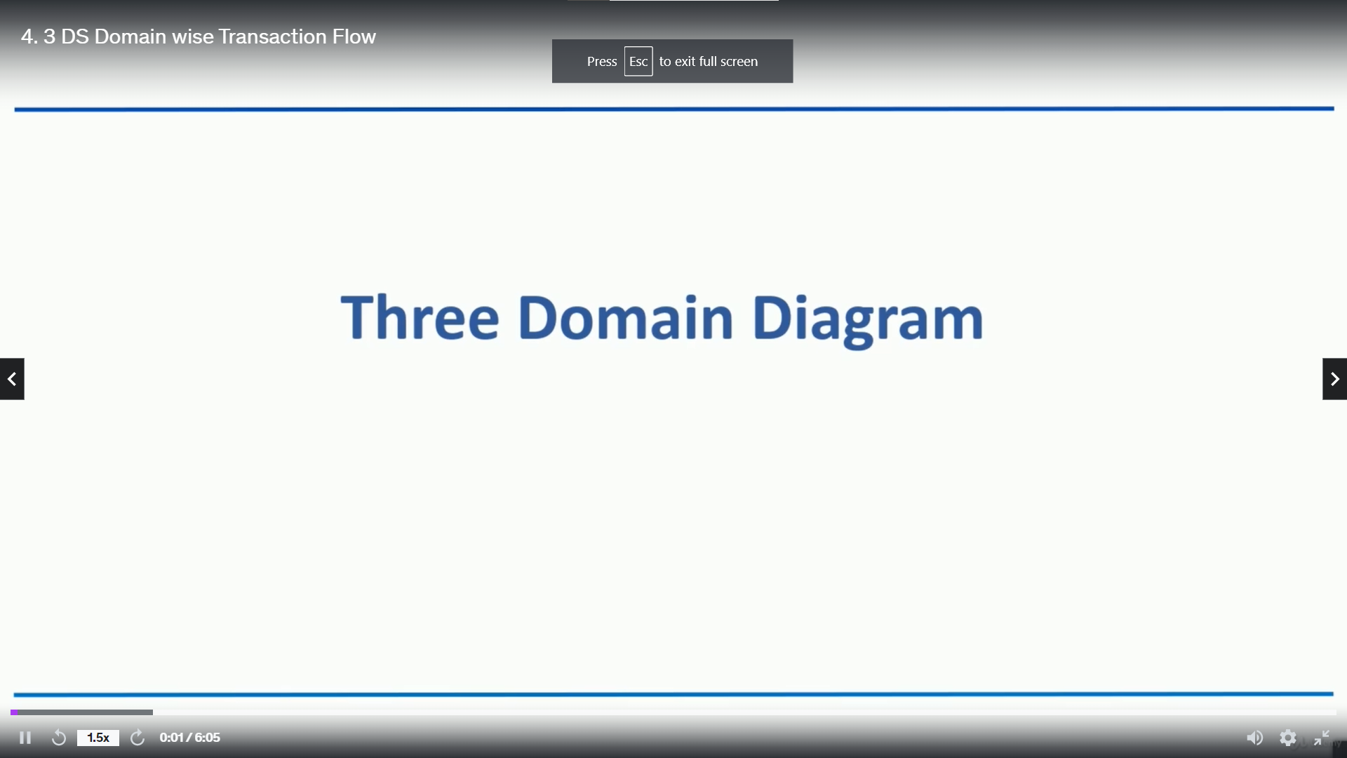

Slide 3
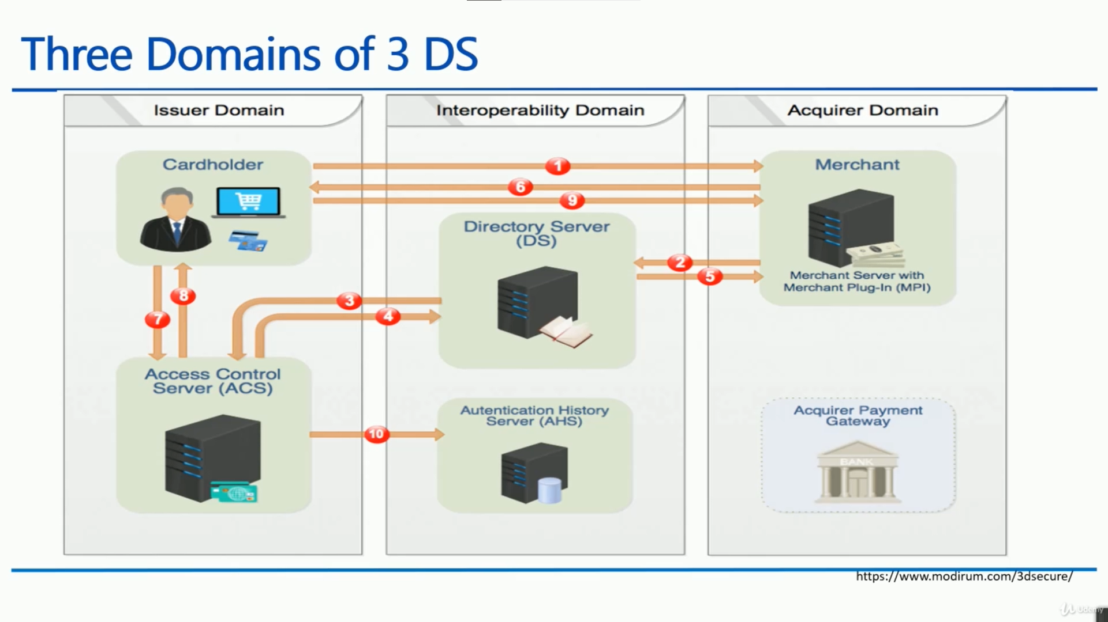

Slide 4
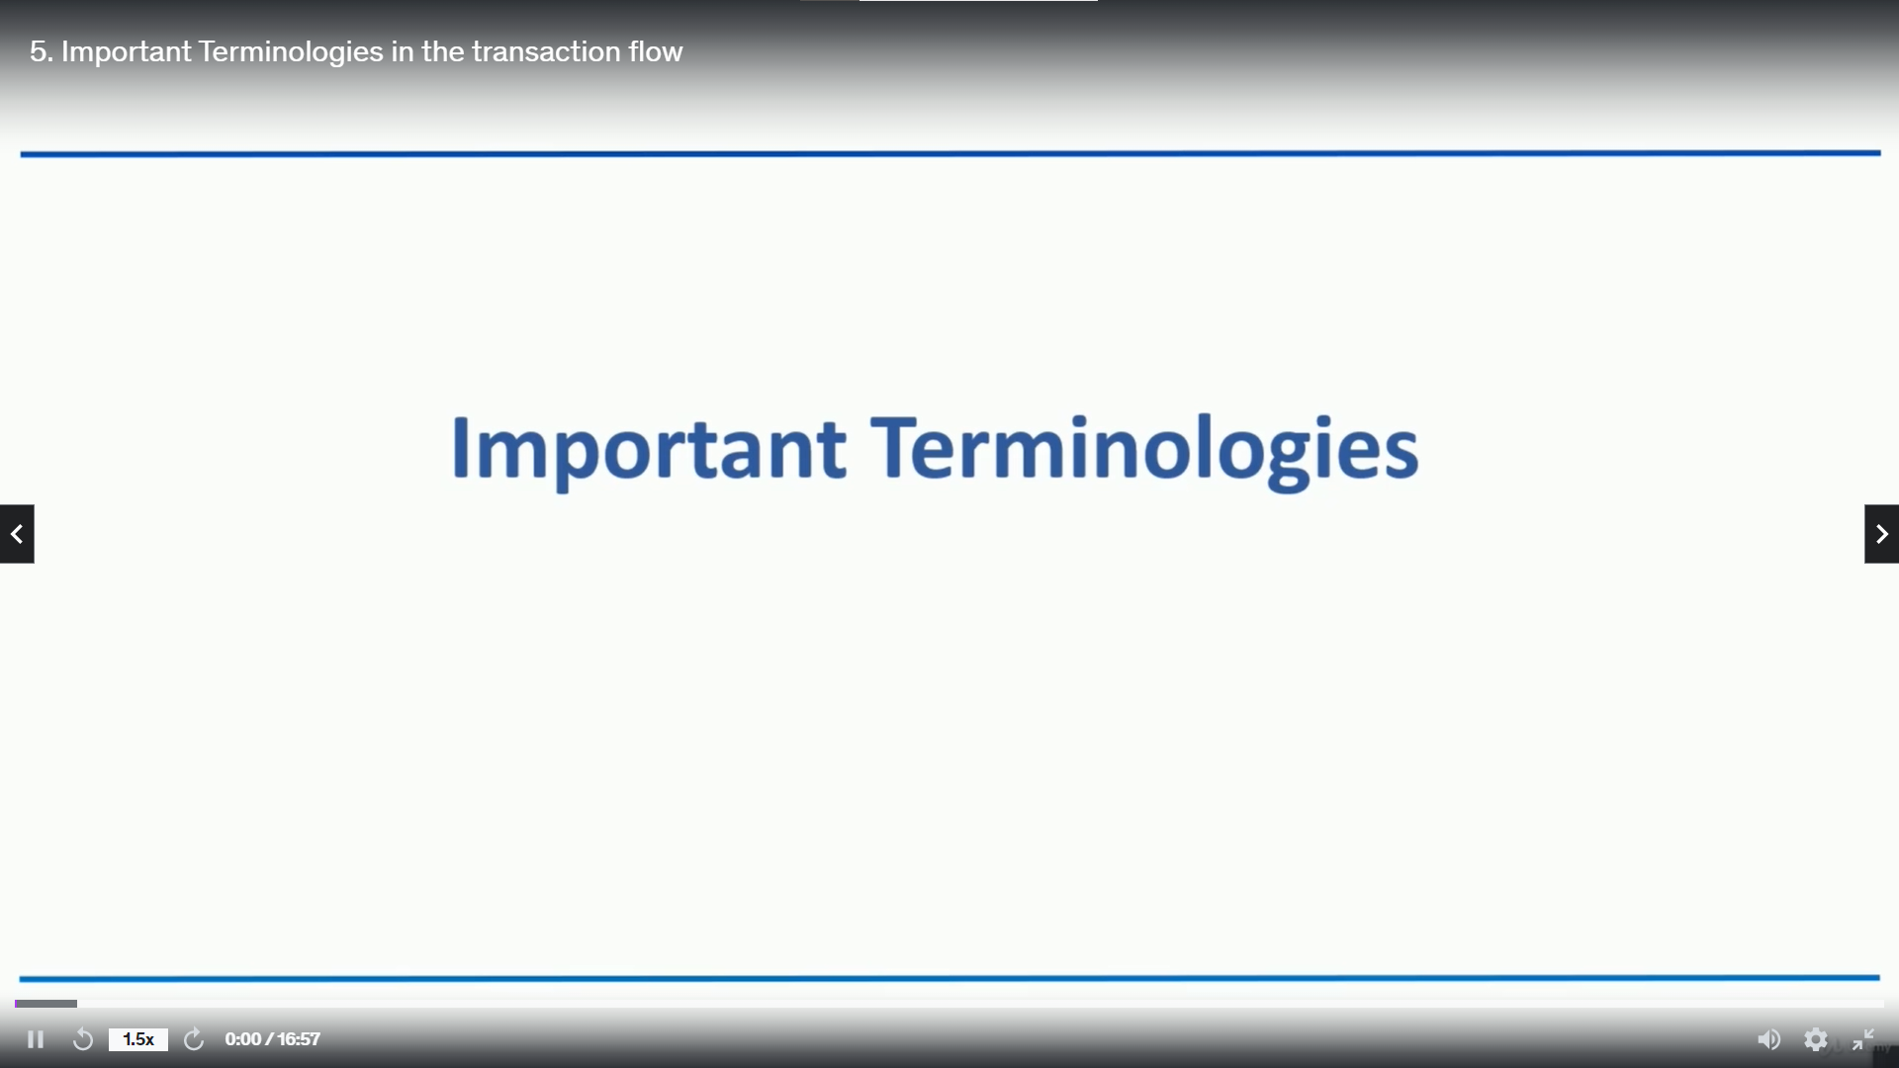

Slide 5
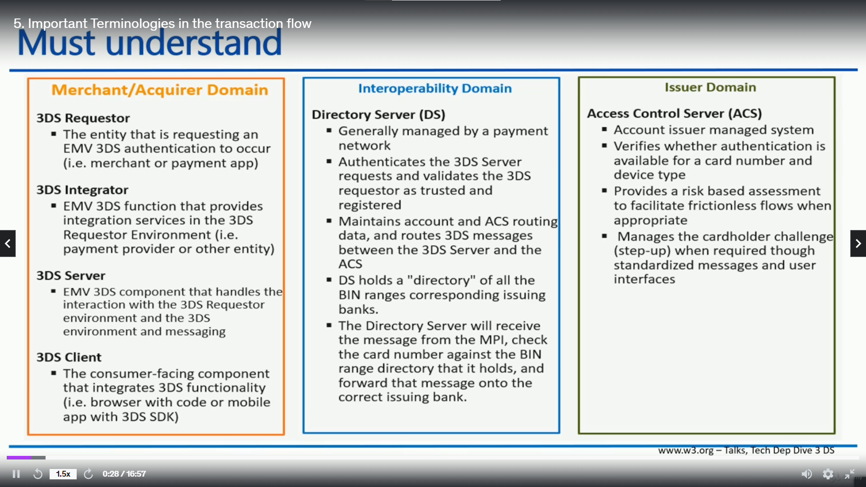

Slide 6
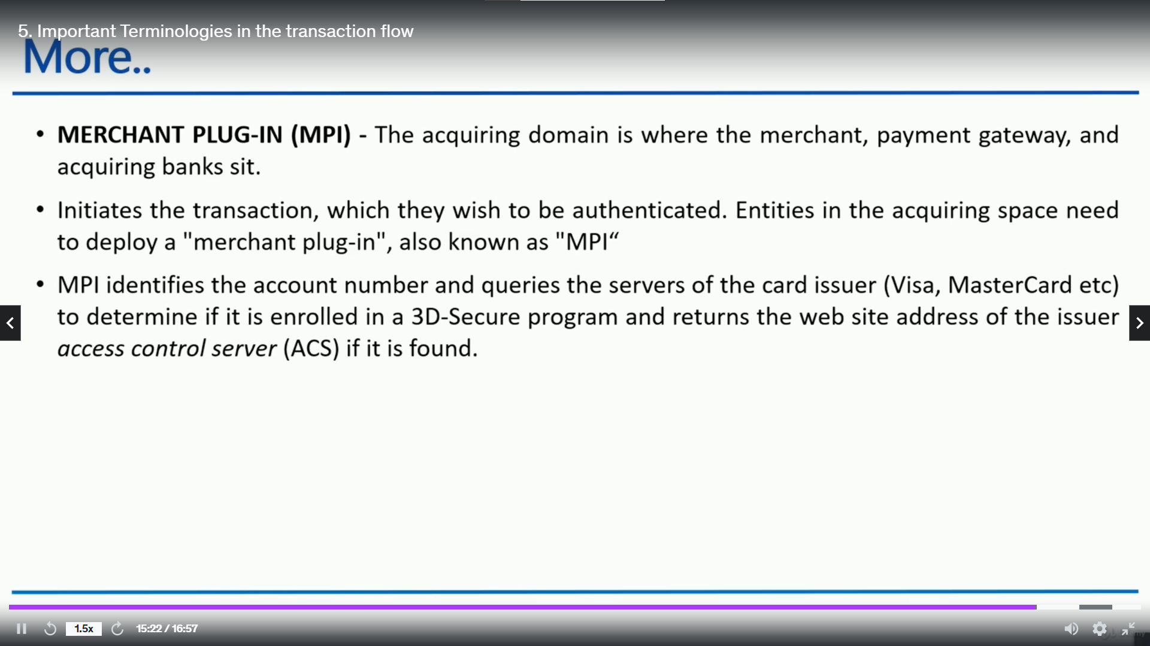

Slide 7
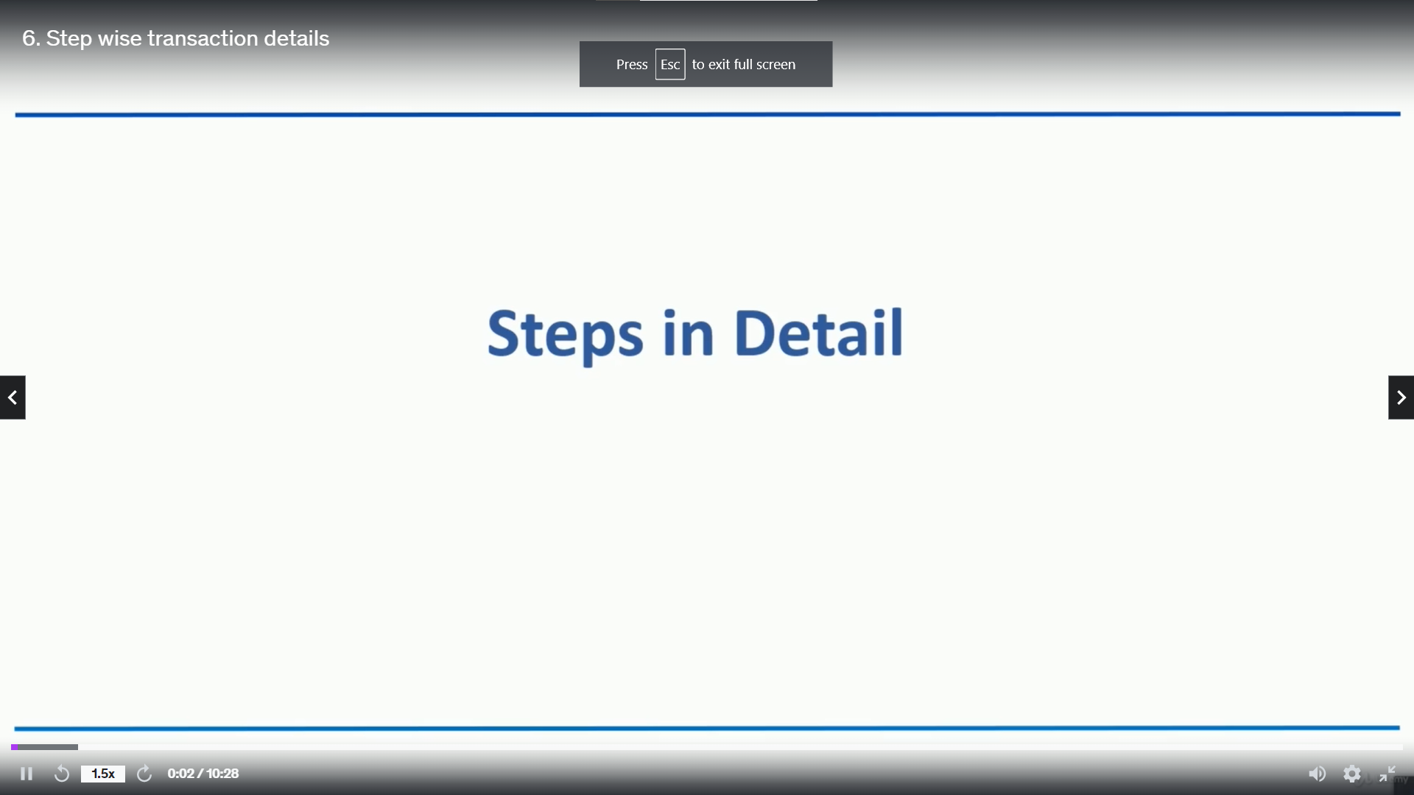

Slide 8
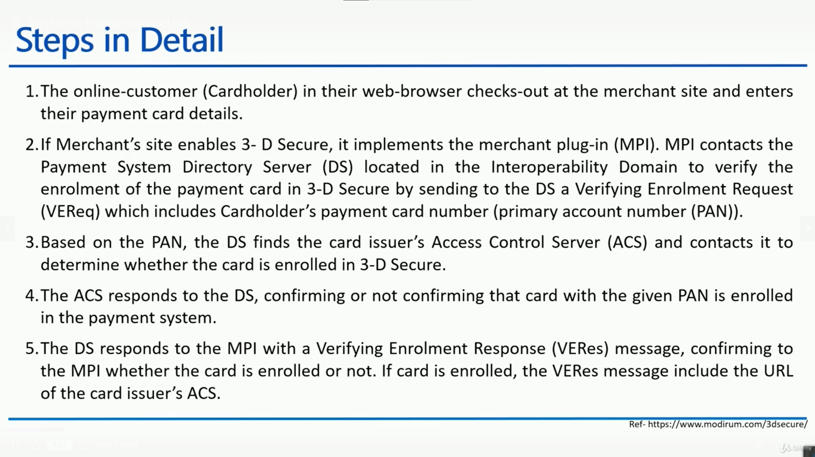

Slide 9
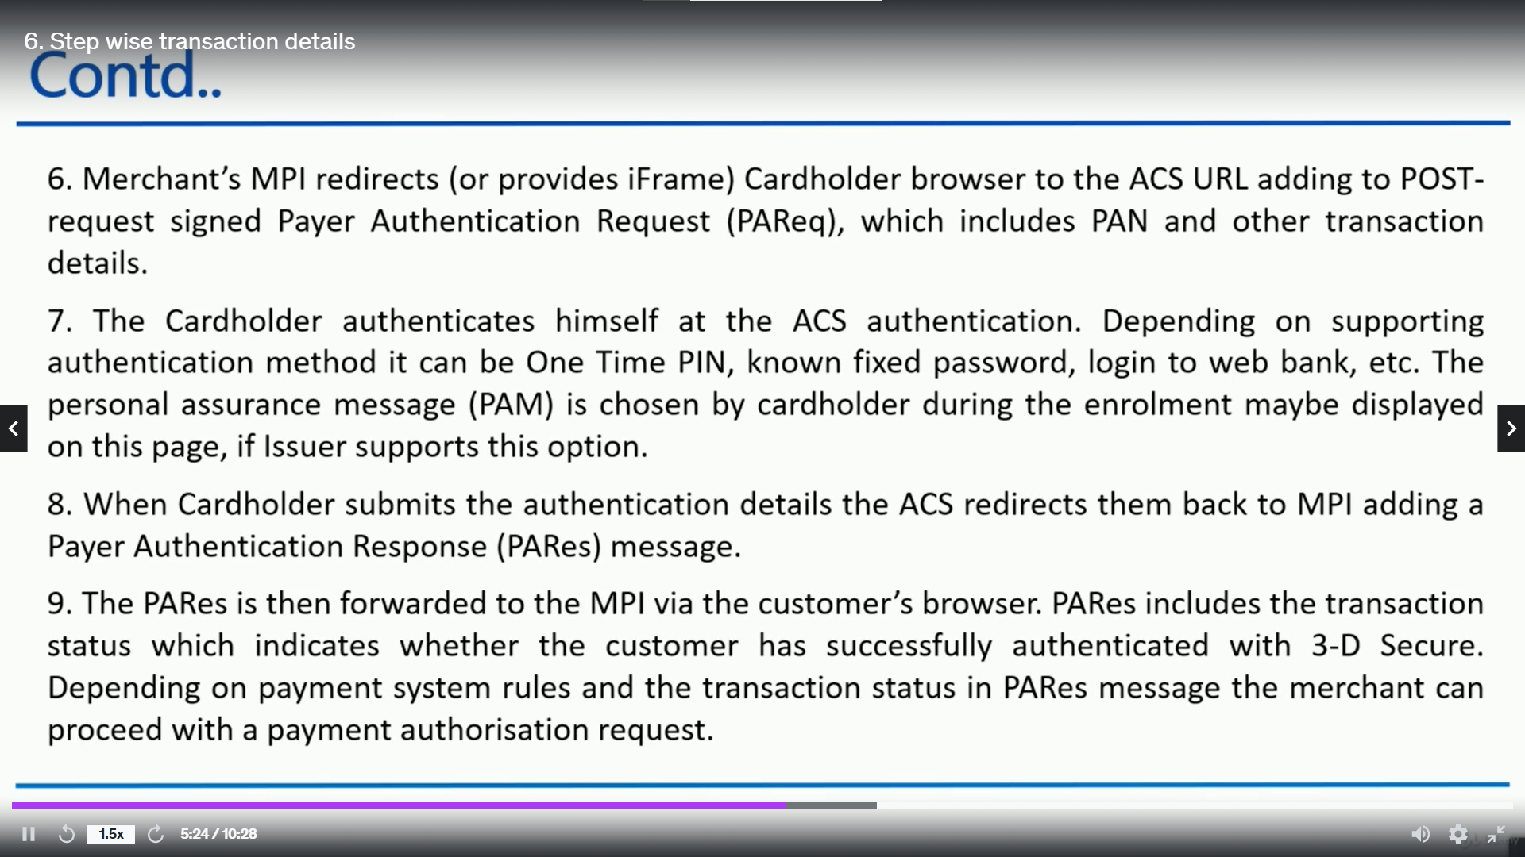

Slide 10
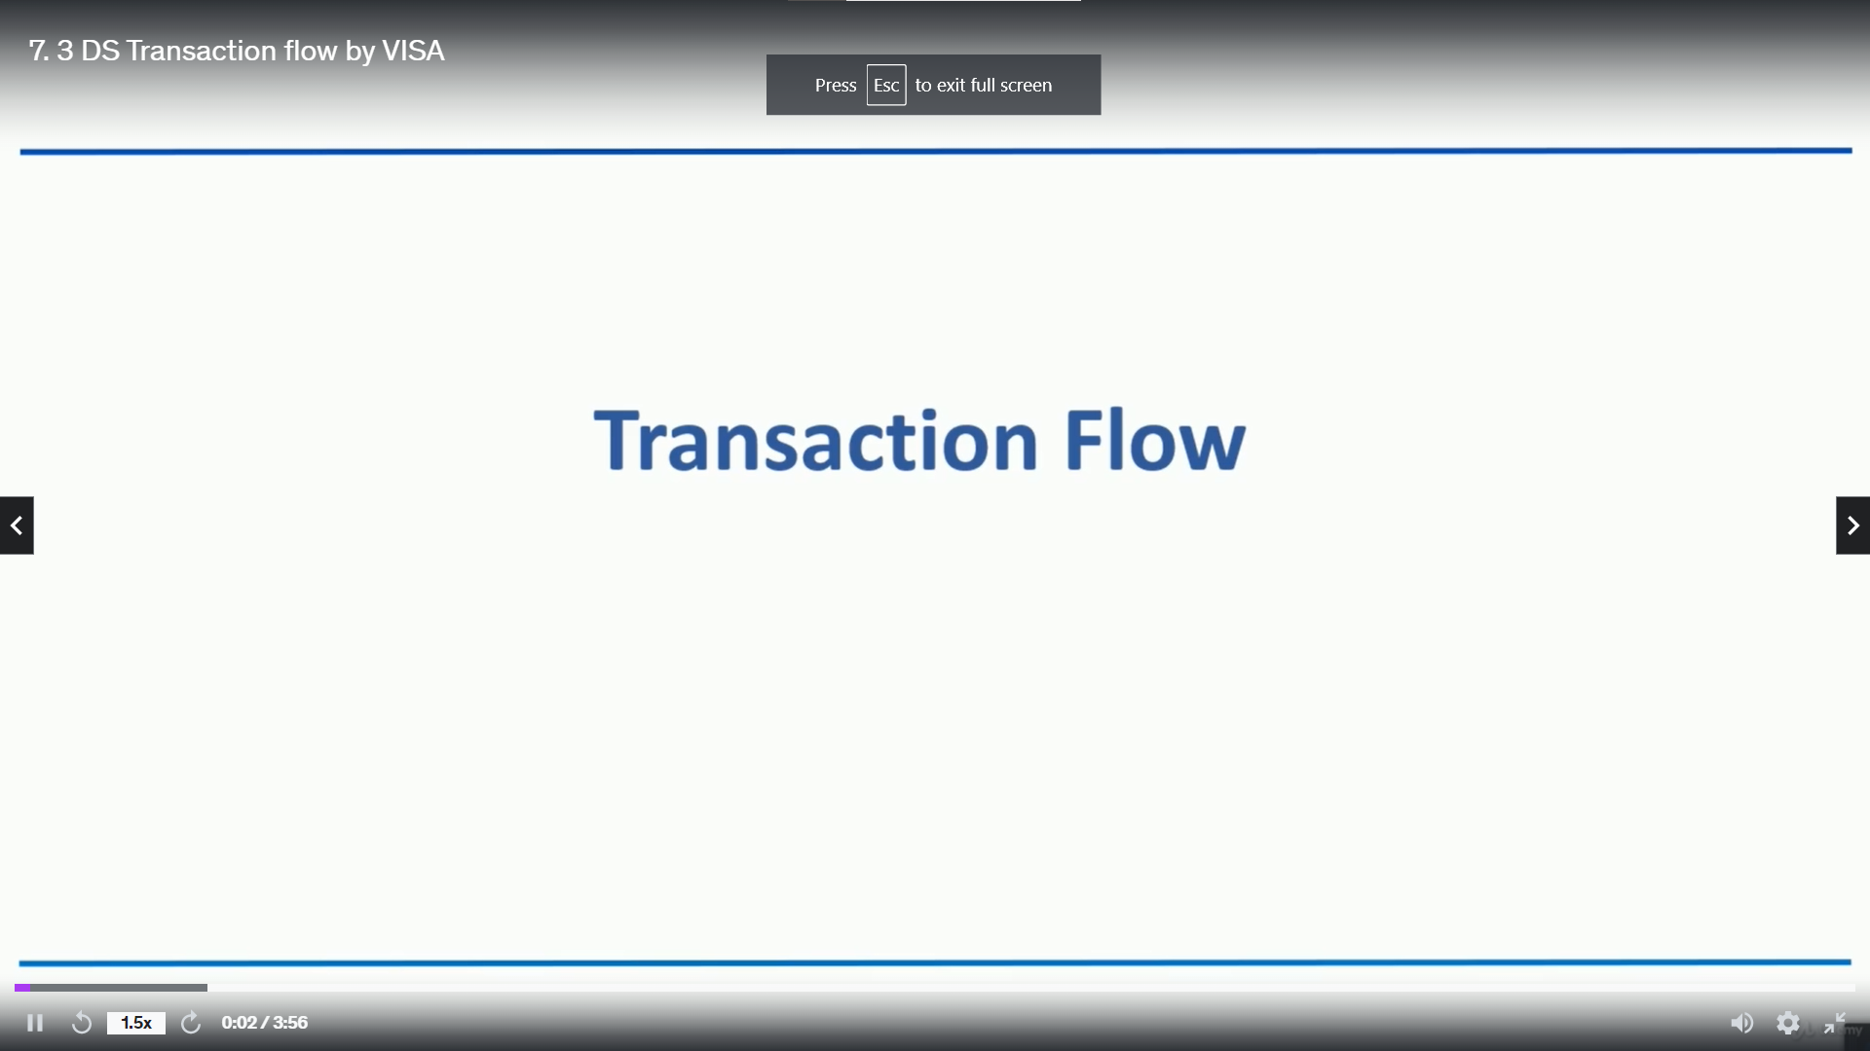

Slide 11


