Slide 1
Section 4: Transaction Logics and Liability Shift in 3D Secure
Transaction Logic 3DS 1.0
-
Transaction Logic Flow 2.0
-
Liability Shift in 3D Secure

Slide 2
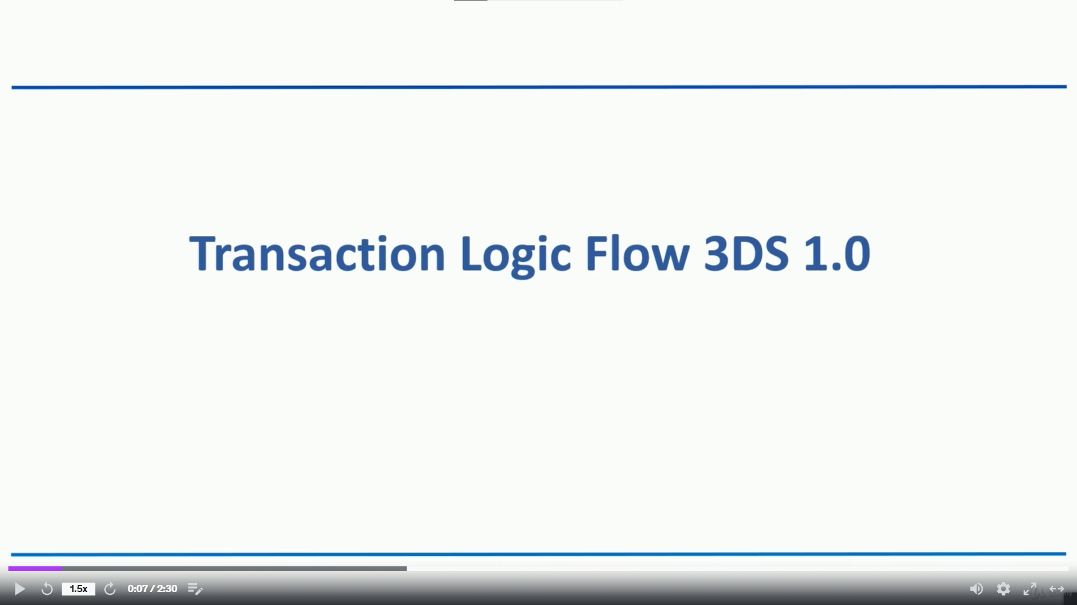

Slide 3
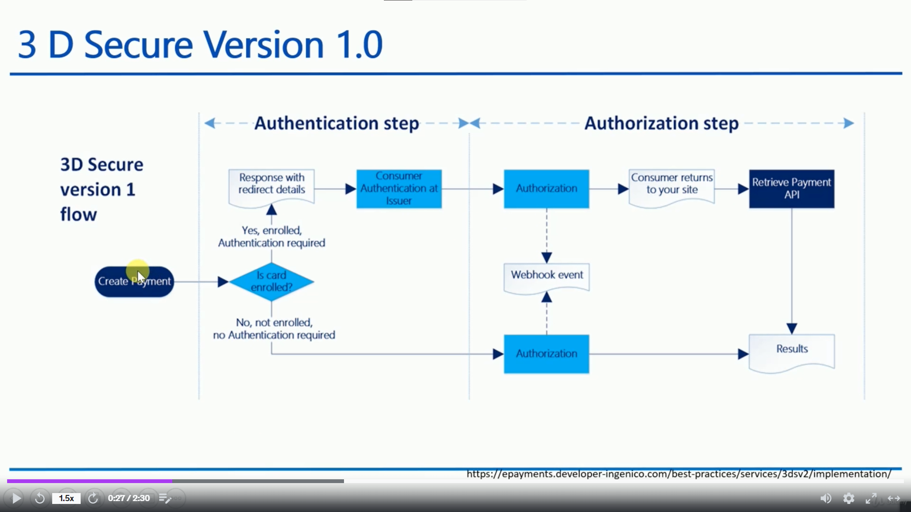

Slide 4
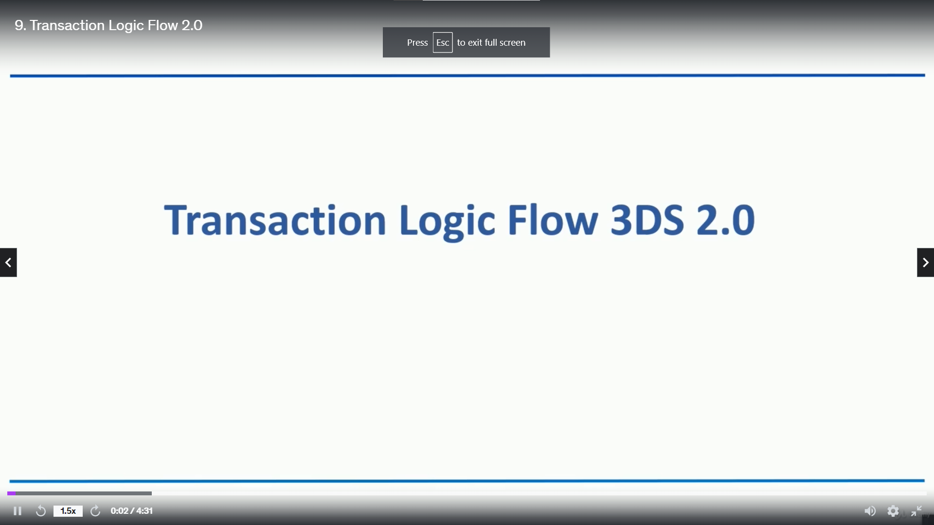

Slide 5
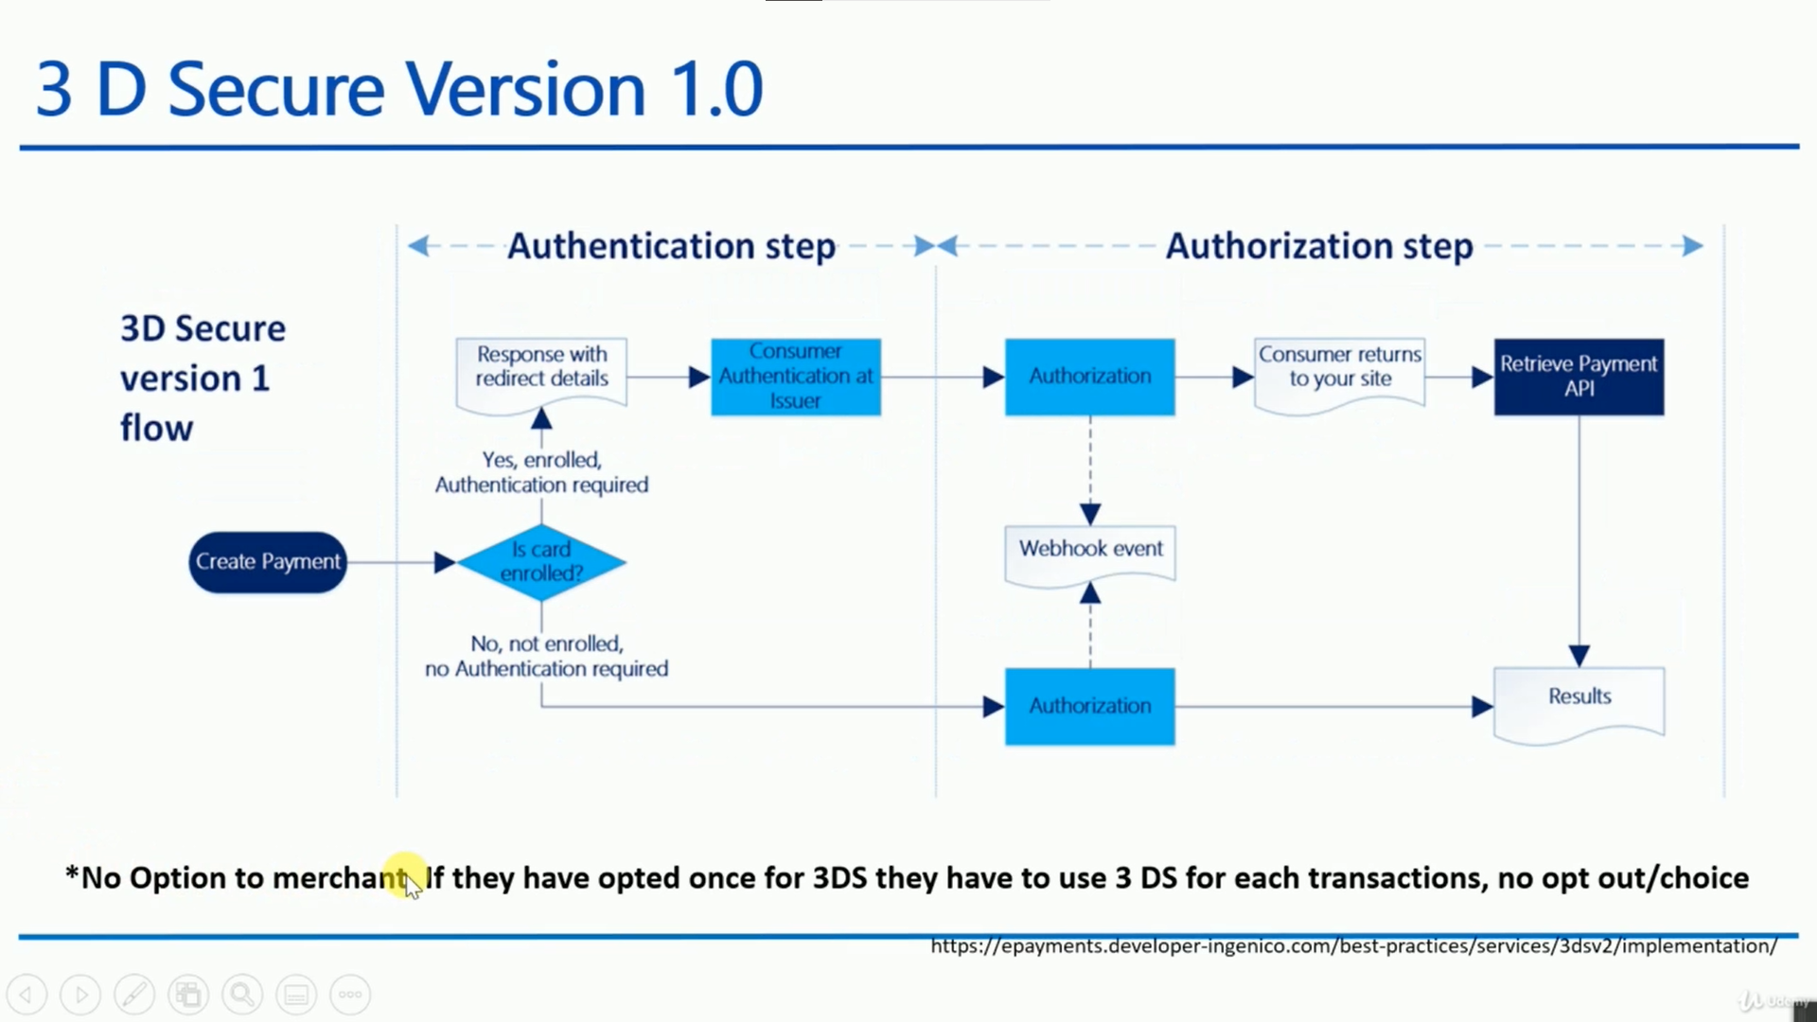

Slide 6
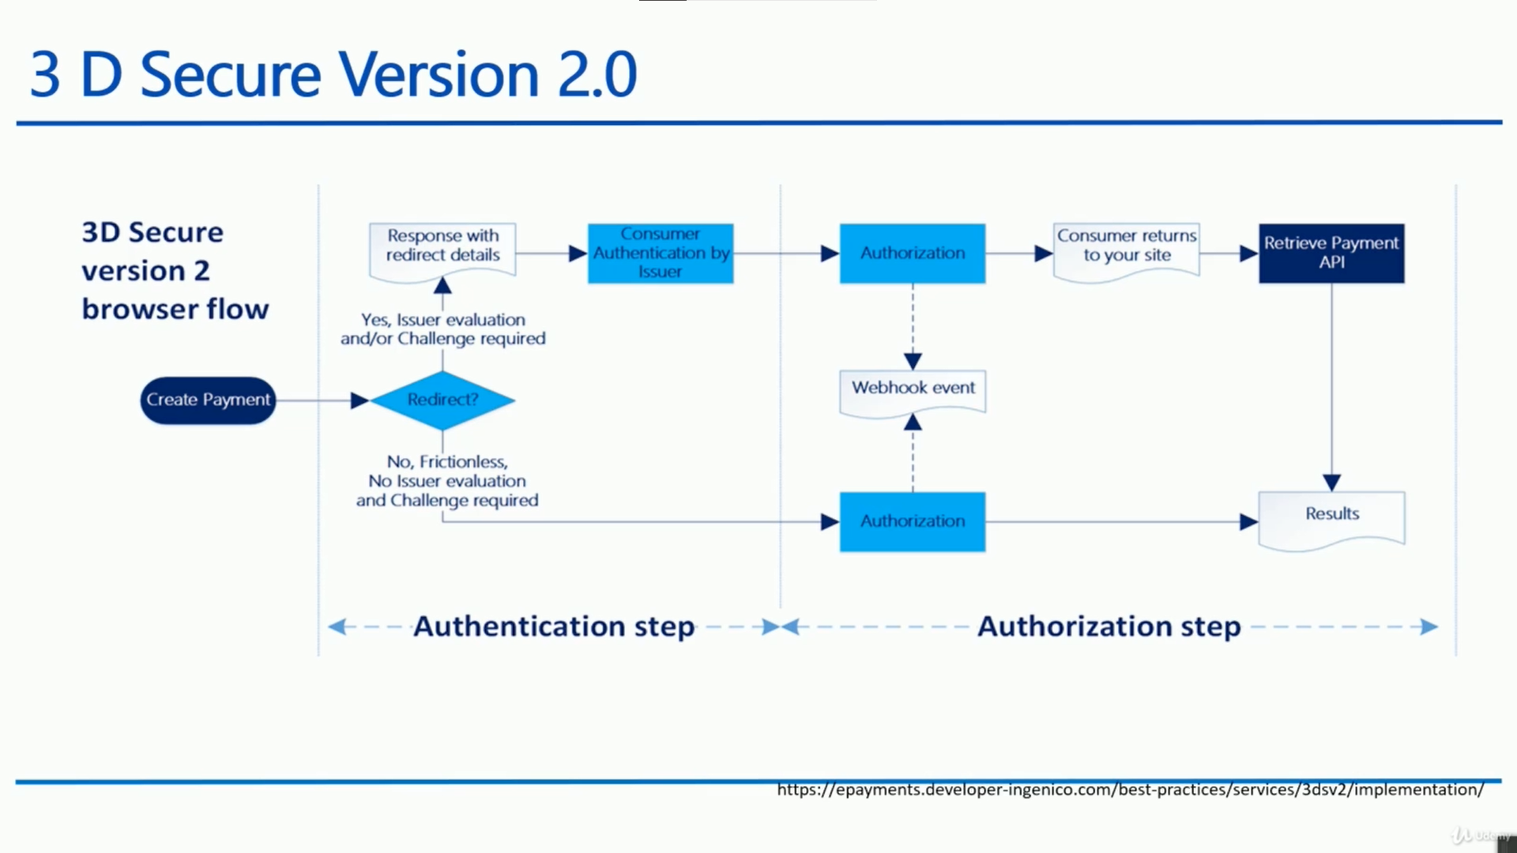

Slide 7
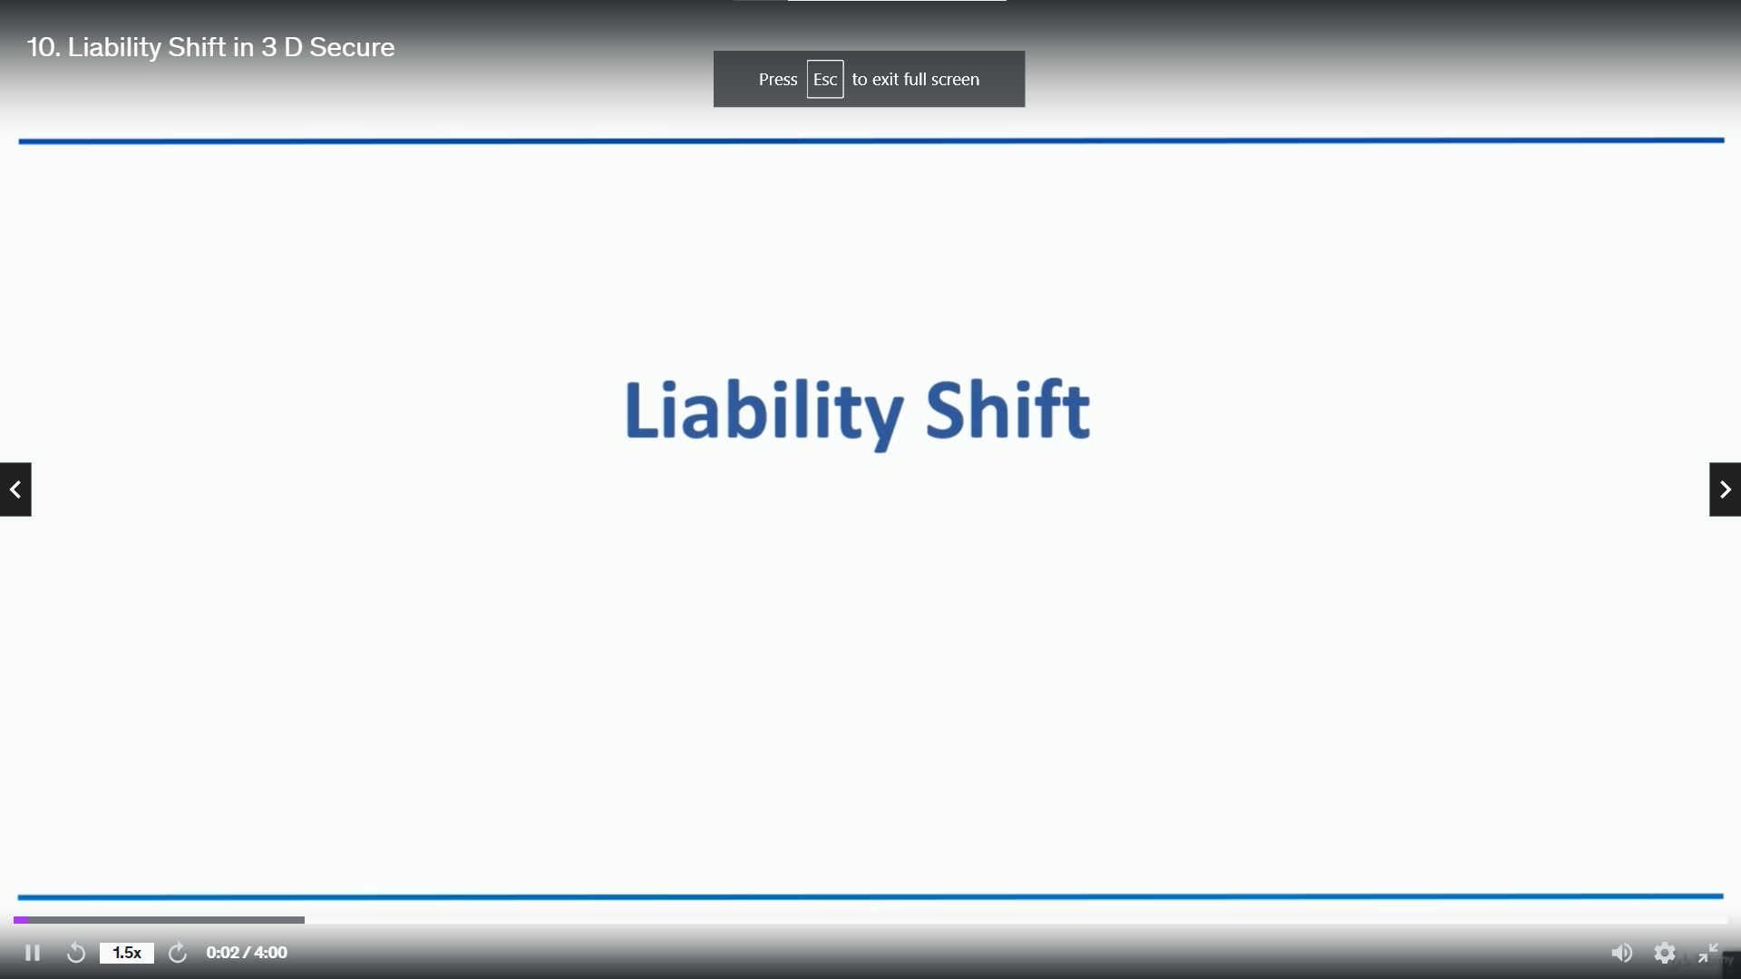

Slide 8
