Slide 1
Section 5: EMV 3DS or 3DS 2.0
EMV 3DS or 3DS 2.0
-
Different Names but same function

Slide 2
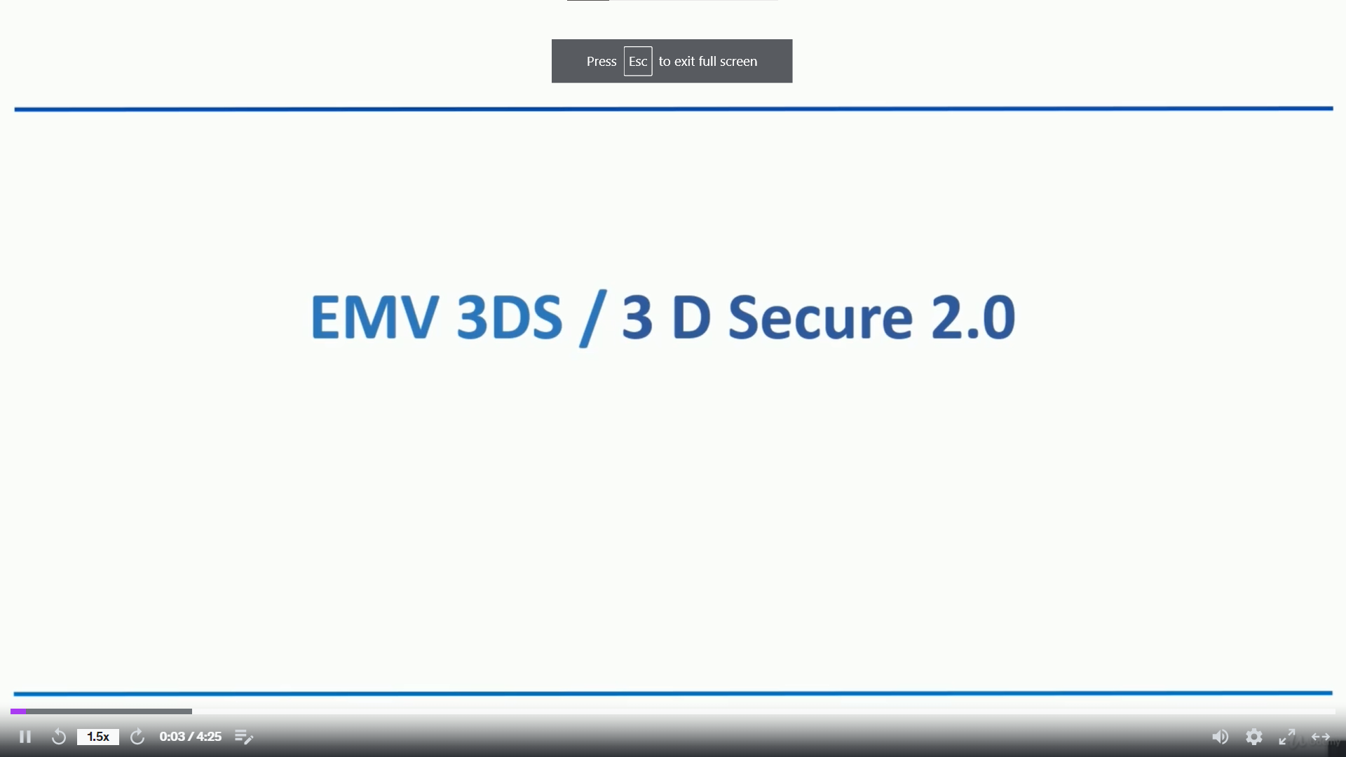

Slide 3
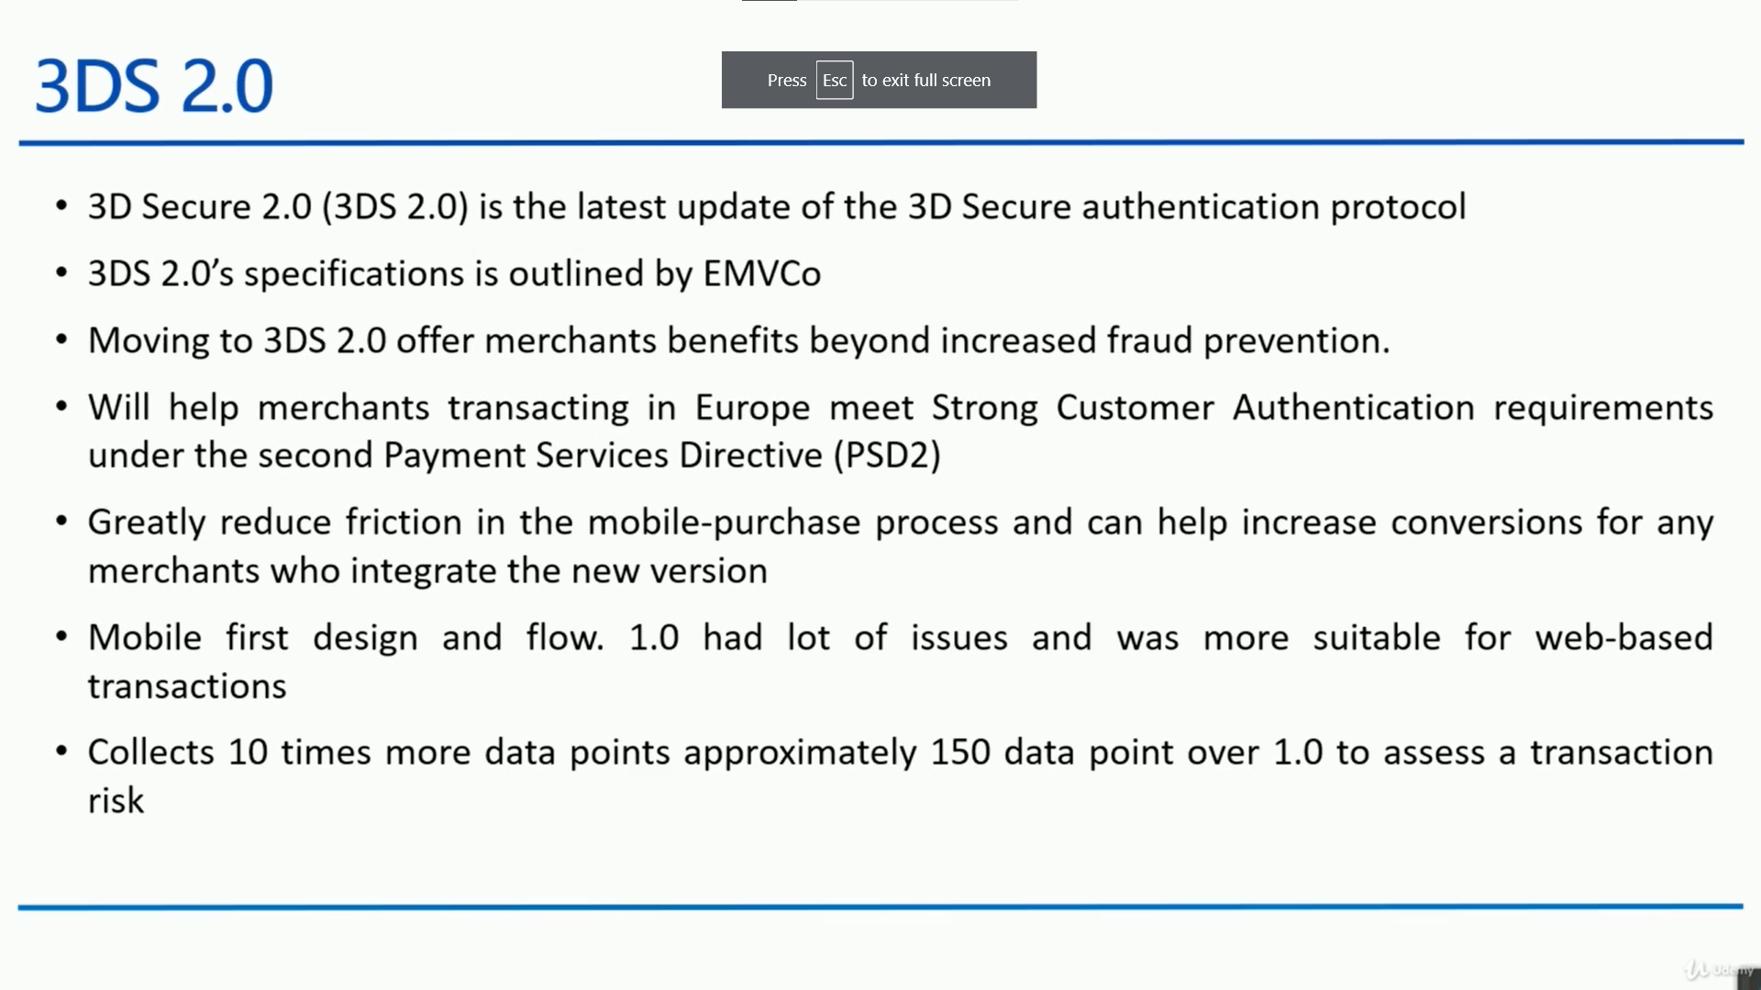

Slide 4
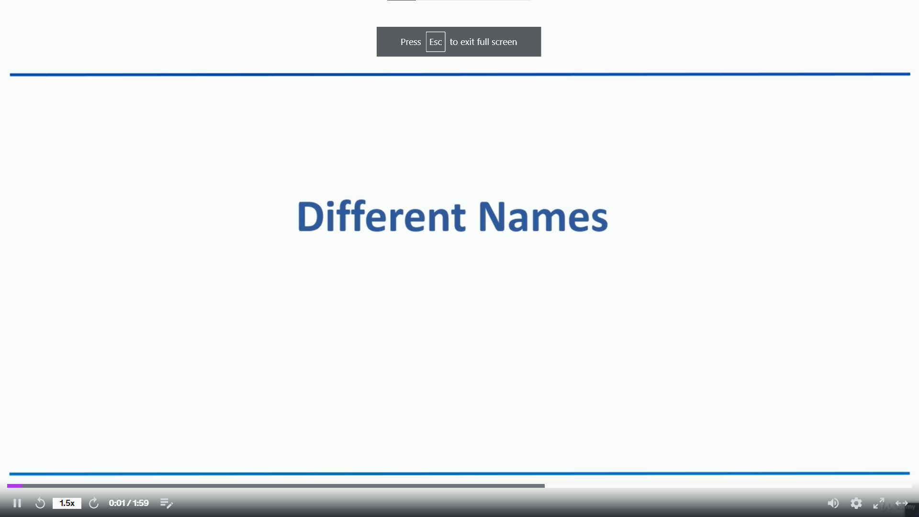

Slide 5
