Slide 1
Section 7: 3D Secure 1.0 VS 2.0 a Table of features and comparison
3D Secure 1.0 VS 2.0 a Table of features and comparison

Slide 2
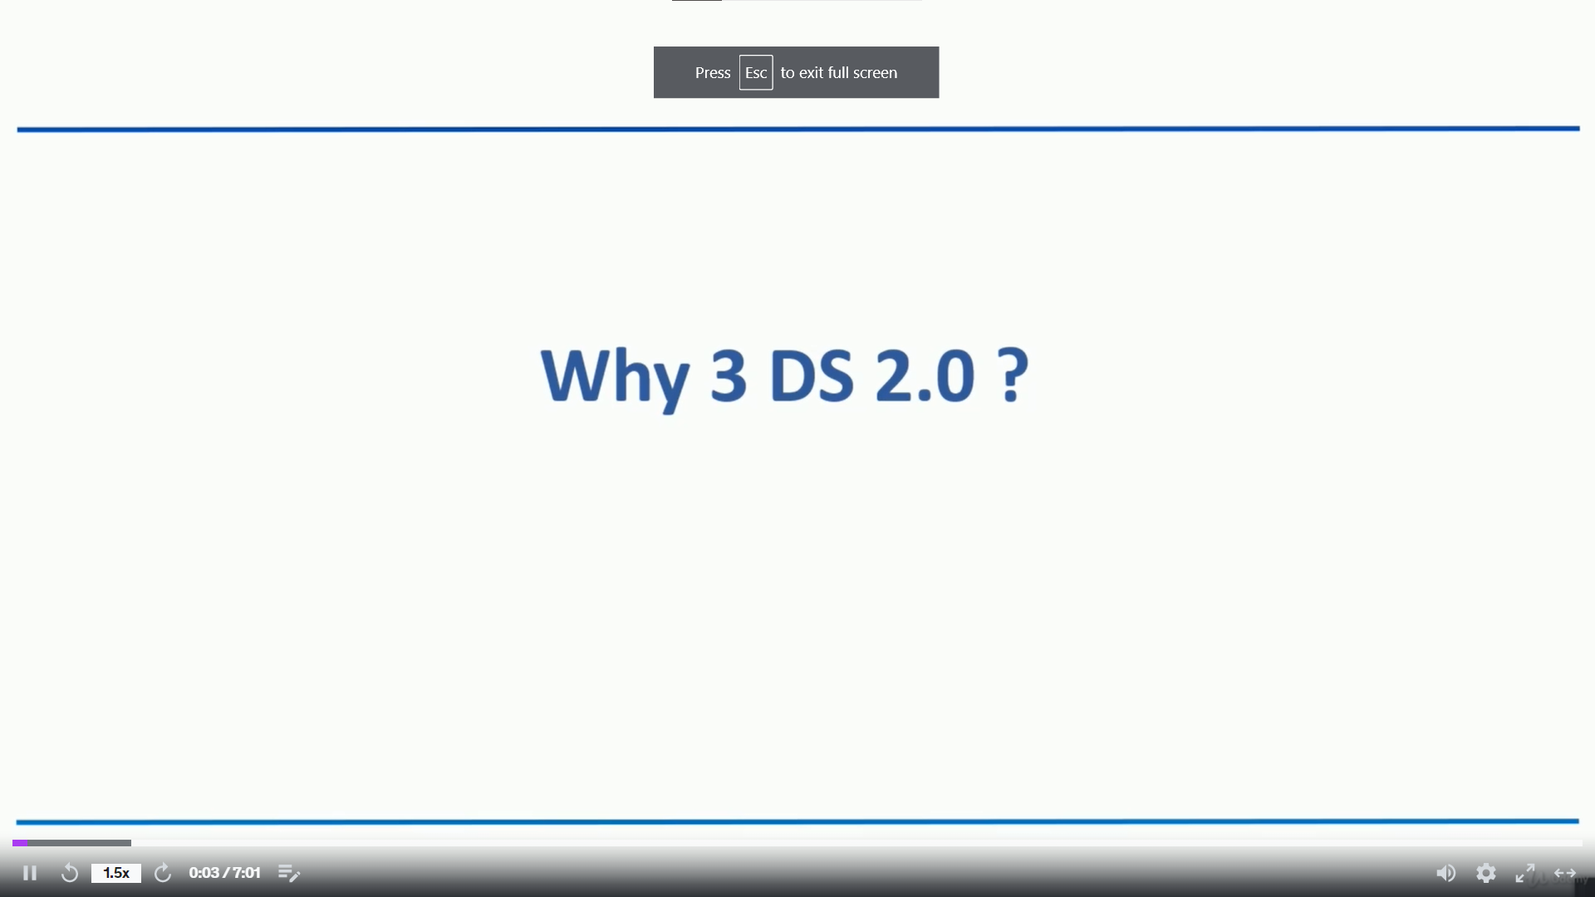

Slide 3
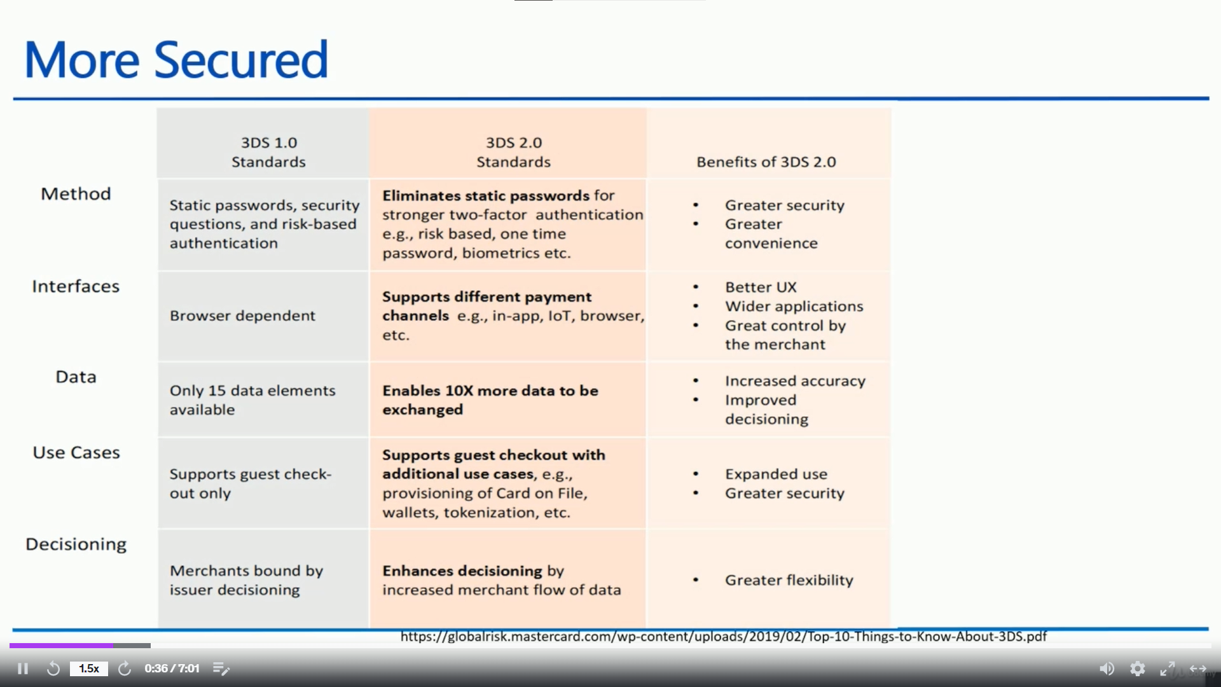

Slide 4
