Slide 1
Section 8: Data points captured in 3D Secure and Stakeholder Benefits
Data points captured in 3D Secure 1.0 and 2.0
-
Benefits of 3D Secure 2.0 for Fls, Merchants and Customers

Slide 2
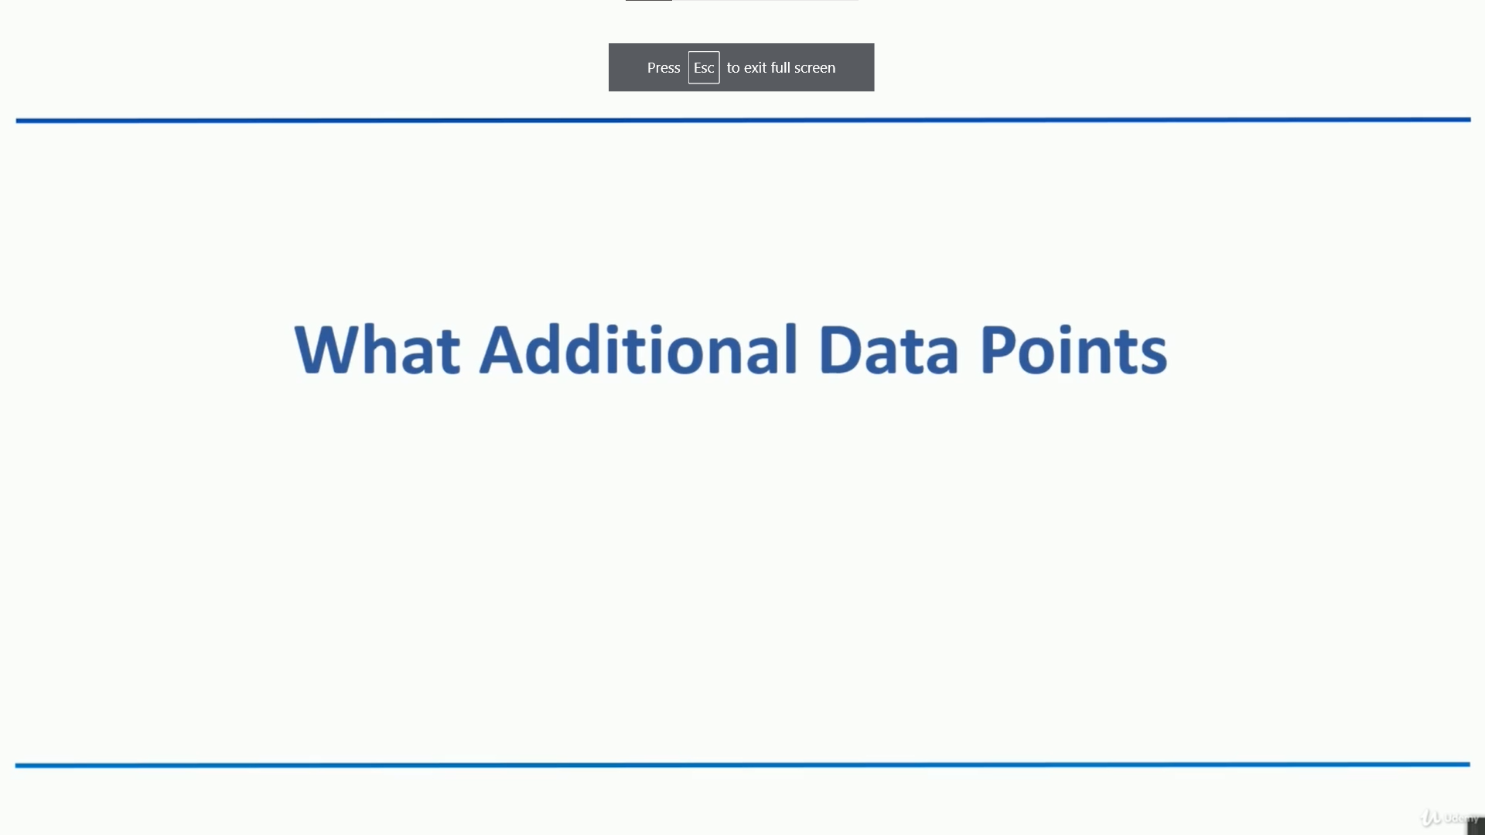

Slide 3
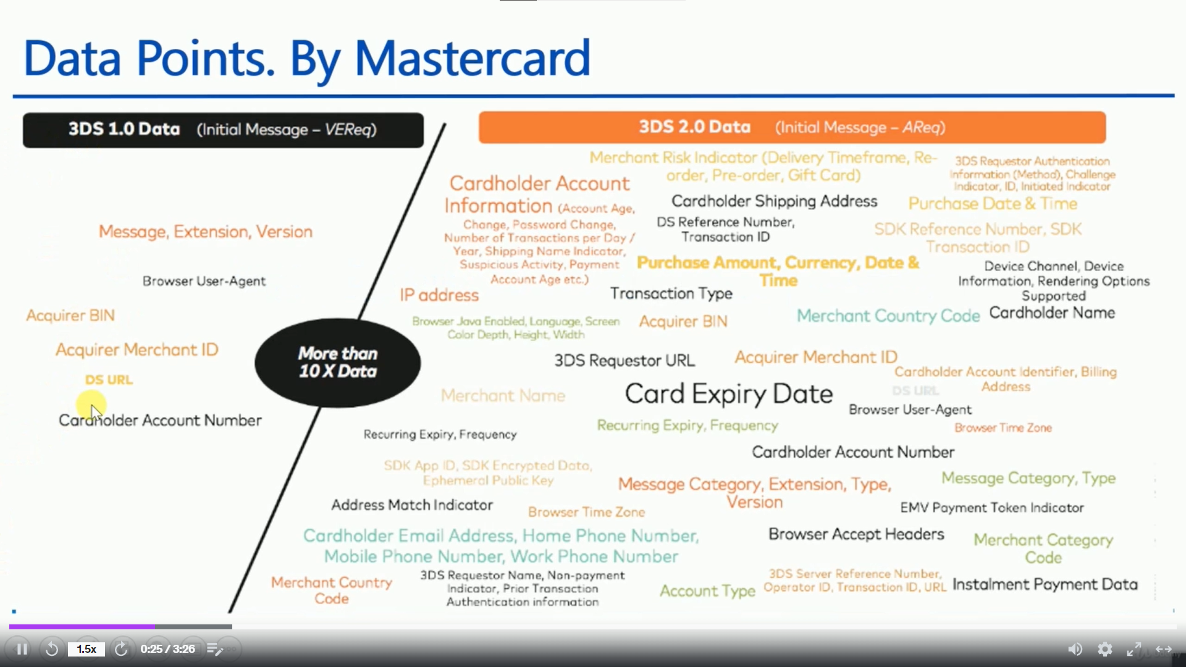

Slide 4
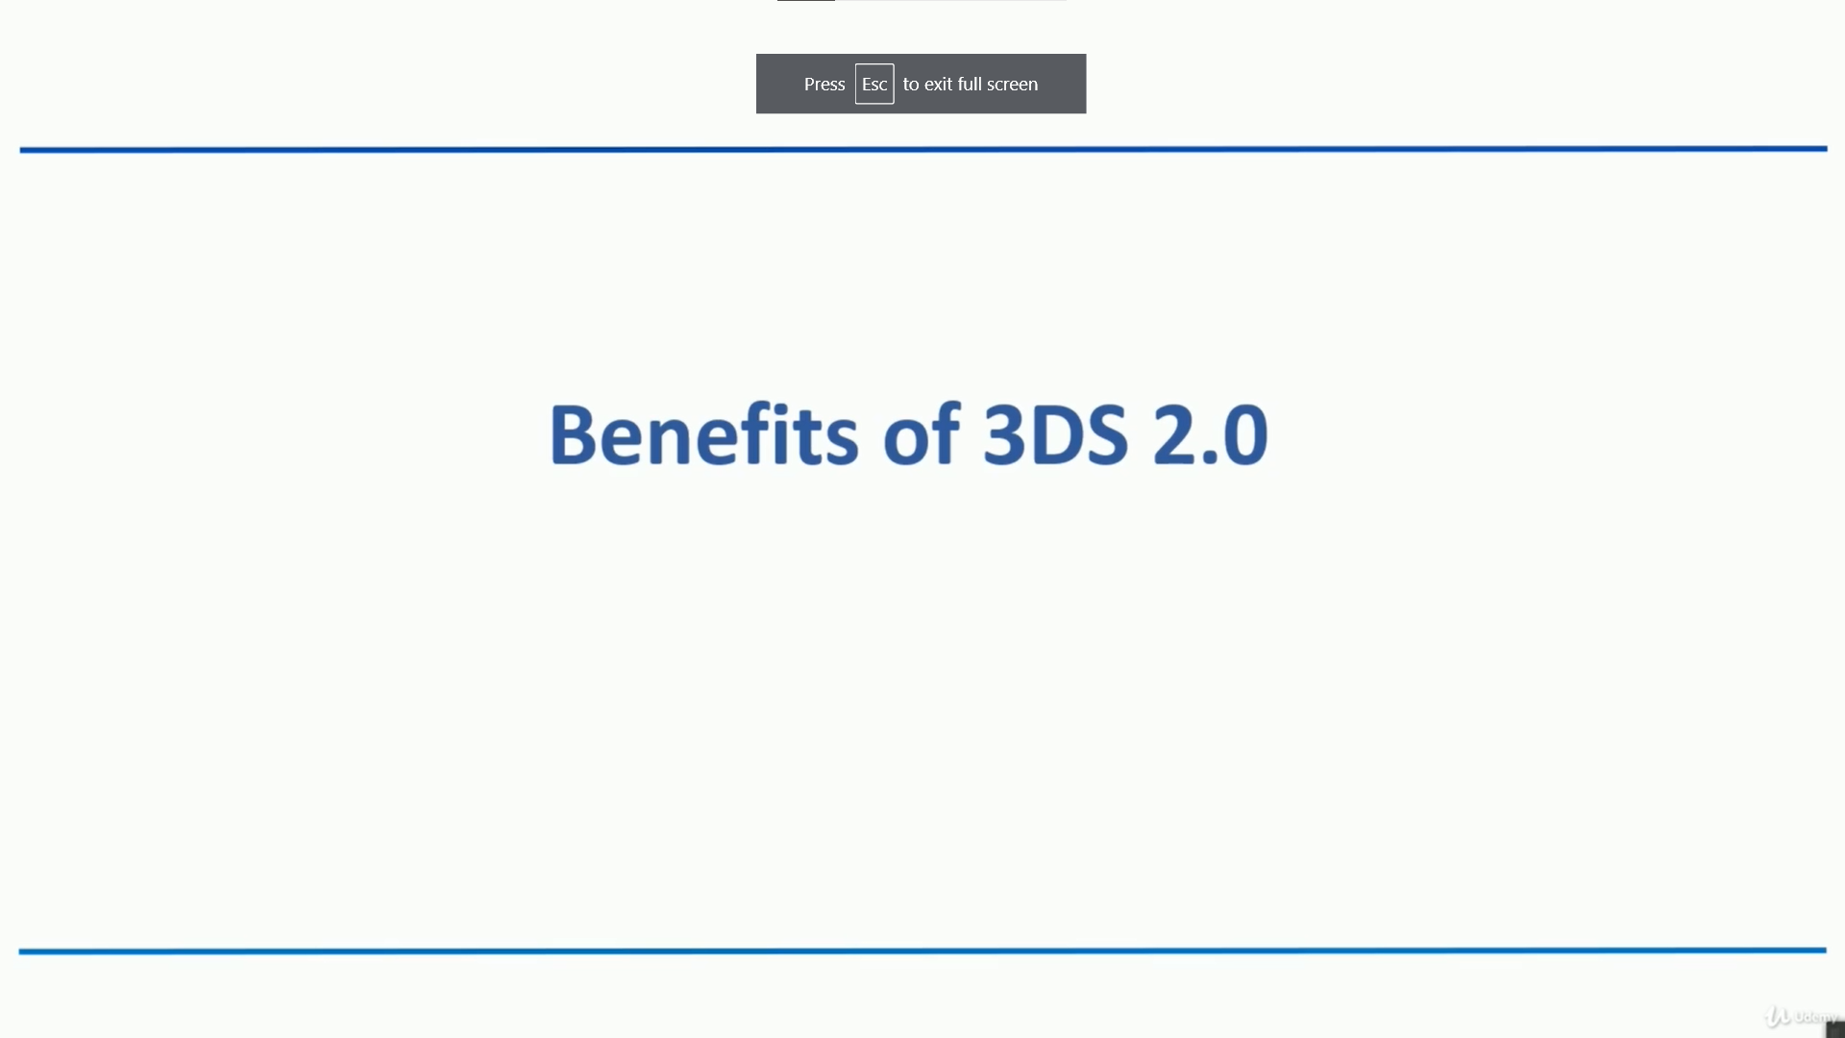

Slide 5
