Slide 1
Section 9:
3D Secure 2.0 and PSD 2
3D Secure 2.0 and PSD 2

Slide 2
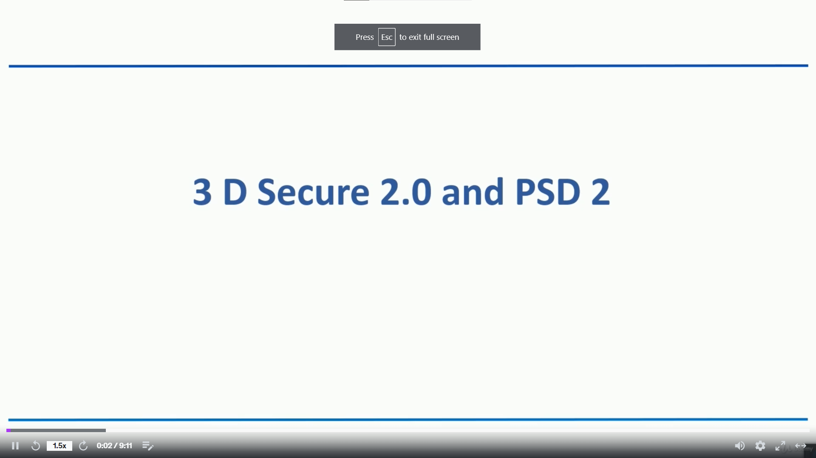

Slide 3
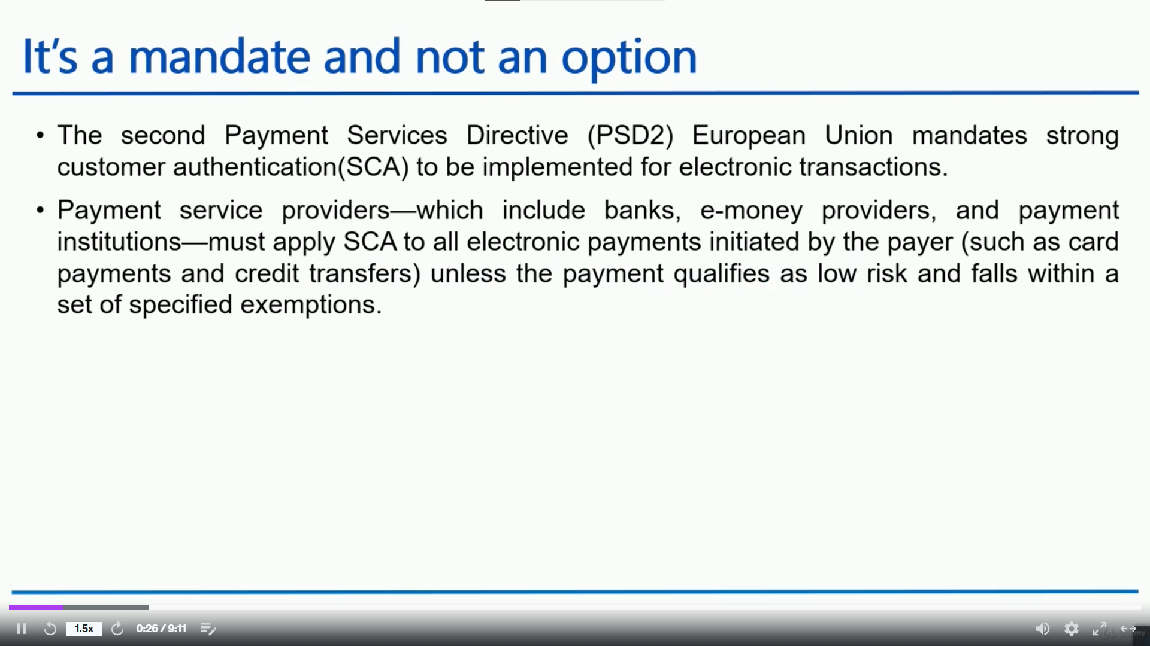

Slide 4
