Slide 1

Databricks

Slide 2
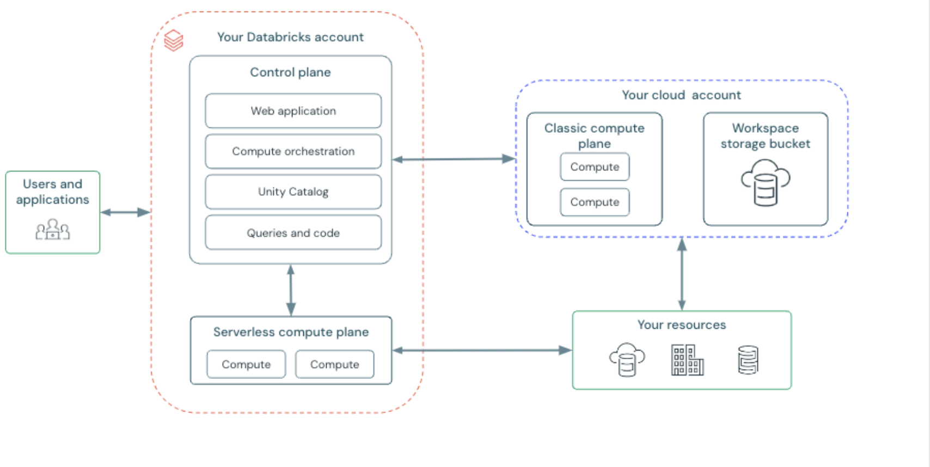
Architecture

Slide 3

Architecture
Addititonal points:
Build on Data Lake (DBFS)
Delta Lake is built on top of Data Lake

Slide 4
Deployment
Delta Live Table (Pipelines)
MLflow Model Registry (Deploy models)
Databricks SQL (Dashboards)
Jobs

Slide 5
Security
One account model
Unity Catalog (ACL)
Network protection methods (users, compute plane, serverless compute plane)
Data encryption (only in enterprise version)
Security Analysis Tool (experimental)

Slide 6
Network protection
Users: PriveteLink, IP access lists, Firewall rules
Compute plane: secure cluster connectivity, PrivateLink,
Serverless compute plane: NCC (network connectivity configurations)

Slide 7
Pricing model
DBU (databricks units): not a fixed price
Tear level (+ free version available)
Pricing in cloud provider not included

Slide 8
Monitoring
- From the system table
- Databricks Lakehouse Monitoring

Slide 9
ML features and use cases
Mosaic (AI gateway (manage and orchestrate access), AI model serving (deploy), AI model training, vector search, agent evaluation, agent framework)
AI playground
AutoML
Runtime for ML (+ Photon + Graviton)
MLflow (lifecycle management) <- natively integrated
Databricks feature management

Slide 10
Additional AI features
AI functions in SQL
Pre-trained models in Unity Catalog or in Databricks Marketplace + Foundation model API

Slide 11
Data Sharing
Delta Share (native integration)
Unity Catalog (native integration)

Slide 12
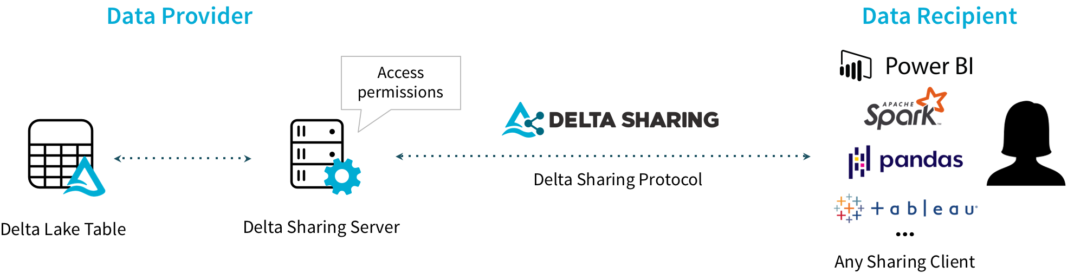
Data Sharing

Slide 13
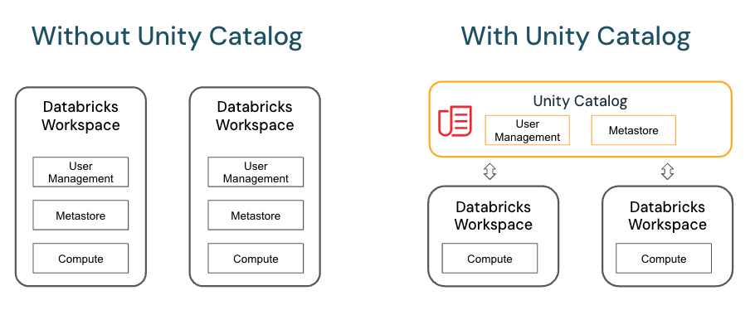
Data Sharing

Slide 14
Support for OTF
Delta (Native support)
Hudi (Needs to be settuped manually)
Iceberg (Needs to be settuped manually)

Slide 15
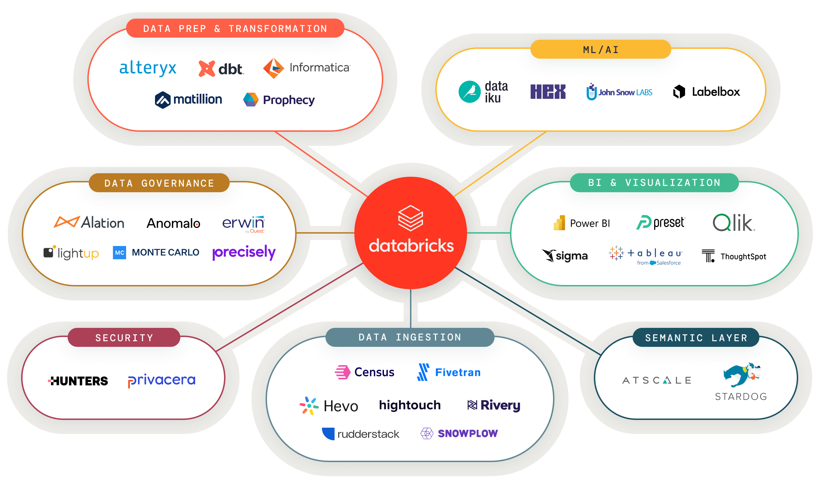
Integrations

Slide 16
Community
Free version (Community Edition)
Collaboration on open-source projects (Spark, Delta, Mlflow, Unity Catalog)
Events and meetups (Spark+AI Summit)
Forum

Slide 17
Showcase
Delta Live Table
AI assistant
Unity Catalog
Magic commands + AI commands
Delta Table

