Slide 1
peephole
1.Peek is a first step toward adding support for assembly-level program analyses, transformations, and optimizations in CompCert: https://compcert.org/
2. Peek provides an x86-level liveness analysis over registers
把寄存器分成live_in ，live_out， pres(没有影响的寄存器列表)
3. Currently our symbolic evaluator supports only non-jump instructions, and does not support any instructions which access memory
[1]
[1] Peek: A Formally Verified Peephole Optimization Framework for x86

Slide 2
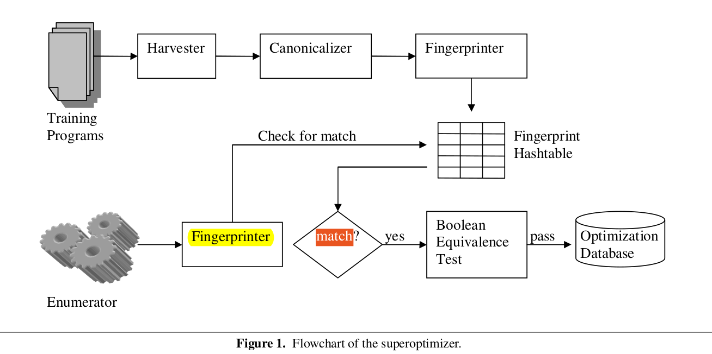
peephole
1.This paper explore a different approach to automaticly build peephole optimizer by using superoptimization techniques in off-line.
2. The optimization are organized into a lookup table, mapping guest sequenses to host sequeneces.
3.自动生成guest 到host的映射指令序列，并作为一条规则放到查找表中，需要优化的时候，进行查表，根据源指令序列查找优化后的指令序列进行替换
[2] Automatic Generation of Peephole Superoptimizers, Stanford, 2006

Slide 3
peephole
1.Peek is a first step toward adding support for assembly-level program analyses, transformations, and optimizations in CompCert: https://compcert.org/
2. Peek provides an x86-level liveness analysis over registers
把寄存器分成live_in ，live_out， pres(没有影响的寄存器列表)
3. Currently our symbolic evaluator supports only non-jump instructions, and does not support any instructions which access memory
[1]
[1] Peek: A Formally Verified Peephole Optimization Framework for x86

