Slide 1
(IN THE NAME OF GOD)

Slide 2
(Lexer)
Define and passing keywords, operators and etc (tokens in general) to the parser.
In simple language, lexer passes true defined tokens to the parser for Semantic evaluation processes on them.

Slide 3
(Parser)
Gets the tokens from Lexer one by one for semantic evaluation processes.
Creates the symbol table and pars tree for semantic validation of language.

Slide 4
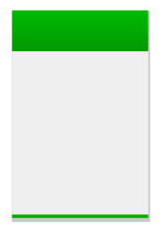

(Lexer File)

Slide 5
(Parser File)

Slide 6
(Convert Flex.l File)

Slide 7
(Convert Conf.y file)

Slide 8
(Compile the code)

Slide 9
LET’S GET IN THE ACTUAL CODE

