Slide 1
W209 Project Proposal: Geo-Tracking Visualization App with D3.js
Arthur Mak
9/11/2015
Notes:
http://youtui.be/5rolDK2V7s8

Slide 2
Objectives
Create a web-based geo-location tool to show people’s behavior
Integrate onto a map with rich and visual animations
Make the data look alive and interesting with time-component and rich colors
Include interesting parameters and selection criteria so that users can keep exploring and learning more about the data
Use D3.js and a source of mapping data (eg. Google Map API)
Example doing something awesome like this: http://youtui.be/5rolDK2V7s8

Slide 3
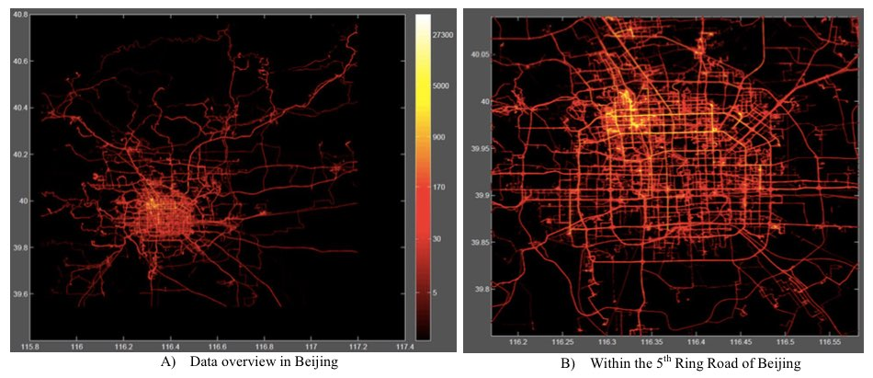
Dataset
Dataset by Microsoft Research Center: http://research.microsoft.com/en-us/downloads/b16d359d-d164-469e-9fd4-daa38f2b2e13/
Tracks 176 individuals for a period of 4 years, covering distances of 1,251,654 km
Includes interesting labeled data by those individuals that include shopping, sightseeing, dining, hiking, cycling, as well as their transportation method

Slide 4
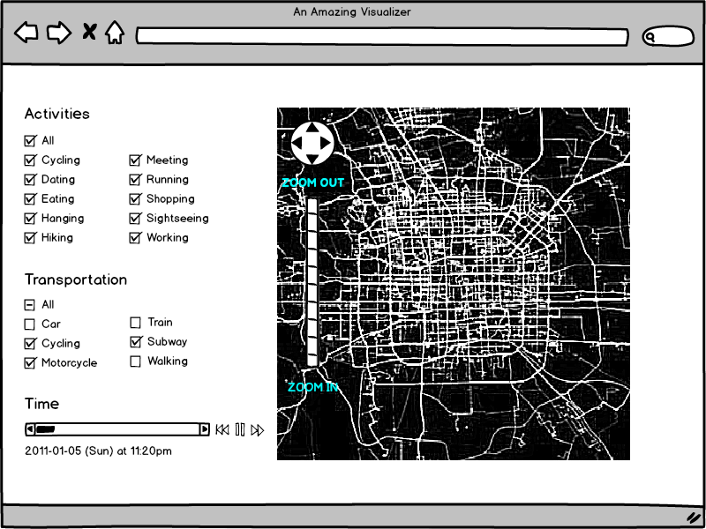
Wireframe

