Slide 1

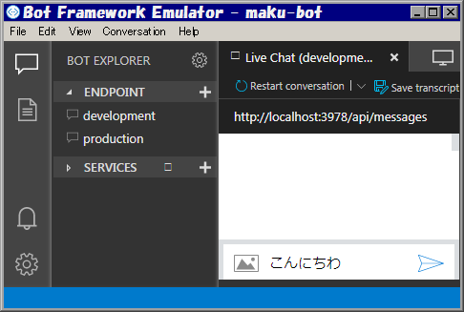
Local host
Azure
Bot
Bot
.bot file
"type": "endpoint",
"name": "development",
"endpoint": "http://...",
Bot Framework Emulator
read
"type": "endpoint",
"name": "production",
"endpoint": "http://...",

Slide 2





QnA
Maker
LUIS
.bot file
"type": "luis"
"type": "qna"
Bot
read
adapter
"type": "endpoint"
Skype etc.
Bot Connector
Emulator

