Slide 1
Makumba: the Role of Technology for the Sustainability of Amateur Programming Practice and Community
Cristian Bogdan (Royal Institute of Technology, Stockholm)
Rudolf Mayer (Vienna University of Technology)

Slide 2
The Sustainable Intranet
600 scripts (2002) -> 2000 scripts (2008)
  Member database, group management, document database, event database, event participation management, job fair, wiki, surveys, mailing list archives, single sign-on…
2000 internal users
  79 locations in 30 European countries
4000-5000 customers accessing the public part
Multinational company?
  No, student organization, www.best.eu.org
  Organizes e.g. 2-week courses for all students
Professional Intranet development/maintenance?
  No, amateur, voluntary, distributed development team (Tech Committee)
  At least 10 active members at all times
  Despite members leaving and others coming in
  Despite some members only knowing some HTML when joining

Slide 3
The Intranet Dark Ages
1992-2002
Isolated people programming small systems
  Event participation management (since 1992), document database (since 1996), virtual job fair (since 1998)
Some of the systems were pioneering uses of the WWW
  1995: ~1500 students applied to events via a Web interface
Systems were often lost from year to year, re-done by somebody else
  Re-inventing the wheel
  Or event participation management was done manually
Several technologies were tried out
  C/C++ with plain text files, Java/serialization, Lotus Notes/Domino, Java servlets, plain HTML pages generated locally
Need for one common technology that would be
  Easy to learn by potential members
  Usable by highly distributed Tech Committee

Slide 4
Makumba
Designed initially as a “plain text Lotus Notes” 1999-2001
  Notes visual programming had not worked
Meant as a common technology for a new, integrated Intranet
At the time, Java Server Pages (JSP) technology was launched by Sun
  Makumba became one of its first “tag libraries”
Mostly based on HTML and SQL
  SQL is based on “natural language” so people who don’t know it can simply rely on their English
Initial, generic name (“metadata”) was changed in 2000 to something more specific to the student organization
  The Makumba party, lights out, then the Makumba joke is told
  Joke is only known by those who attended a Makumba party
  Main designers hadn’t attended any, but the reputation was enough to decide on the name
Macumba: a tribal religion
  “The technological religion of a student tribe”

Slide 5
Themes
Sustainability of practice
Amateur Community
Amateur Programming
  e.g. Open Source
Amateur: pre-professsional, professional, post-professional
  Tech Committee (Makumba users) as Pre-professional programmers
Community of Practice, Legitimate Peripheral Participation (Lave and Wenger)
  Member “configuration”
“Learning path” of community member

Slide 6
Amateur Community
On the margin between work and leisure (Stebbins)
The professionals and the public (audience)
Bogdan and Bowers, C&T 2007: ham radio
Challenge motivates the work, originates in contingencies
Inexhaustible (for sustainability) but addressable
Pioneering new contingency spaces
Examples of amateur communities
  Degree Confluence project
  Operation Migration
Open Source software
  Professional amateur community
  Programming leads to a rich set of contingencies
  Easy to start new contingency spaces

Slide 7
A little theory
A sustainable amateur community will have enough members at all the milestones of the member learning paths
  At all important learning thresholds on the paths
This can help technology design by prescribing successive “learning departments” in the technology
  “Skill modularity”
Bogdan (2003) PhD thesis
Can we verify this for the case of Tech Committee and Makumba?

Slide 8
Methods
Makumba design
Action research, Cooperative design
Verifying the theory
Sustainability as a long-term matter
Non-elicited data:
  Code repository, membership lists, e-mail traffic
  The two authors were members of the Tech Committee at different times (1997-2003 and 2004-2008)
Elicited data
  Questionnaire on self-assessed skill levels (30 respondents, current and former Tech Committee members)
  Skill levels were assessed for annual time points
  Complemented with committee leader assessment of the member skill
  Open questions: learning experience, comparison with other technologies

Slide 9
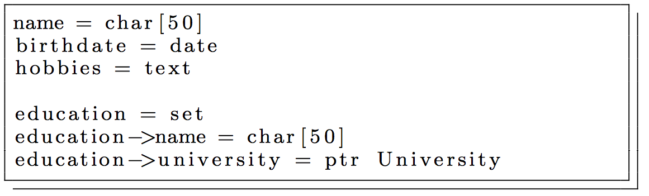
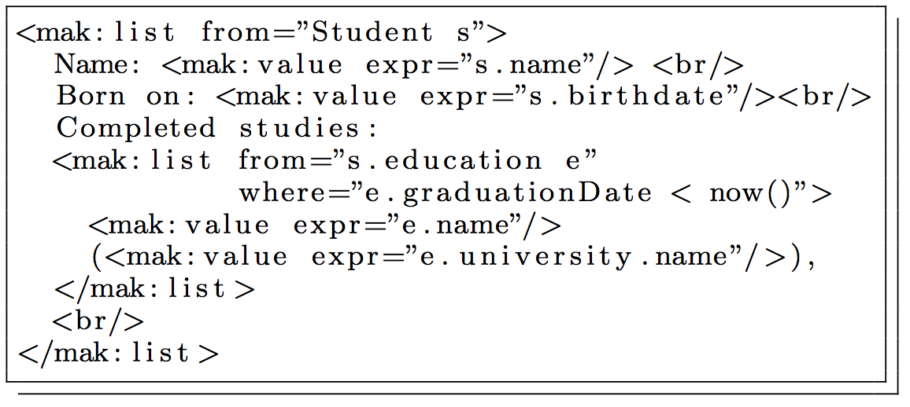
Makumba “skill modules”
Makumba Data Definition
  MDD
  Simple data description format
  Easy to read, rarely change
  From 42 (2002) to 114 files
JSP for viewing data
  Entry level
  HTML + SQL (from, where)
  It is said to be learned in 3h
JSP for changing data
Total JSPs:
  from 676 to 1860 files
BL=Business Logic
  Java API, most complex
  From 80 to 289 files

Slide 10
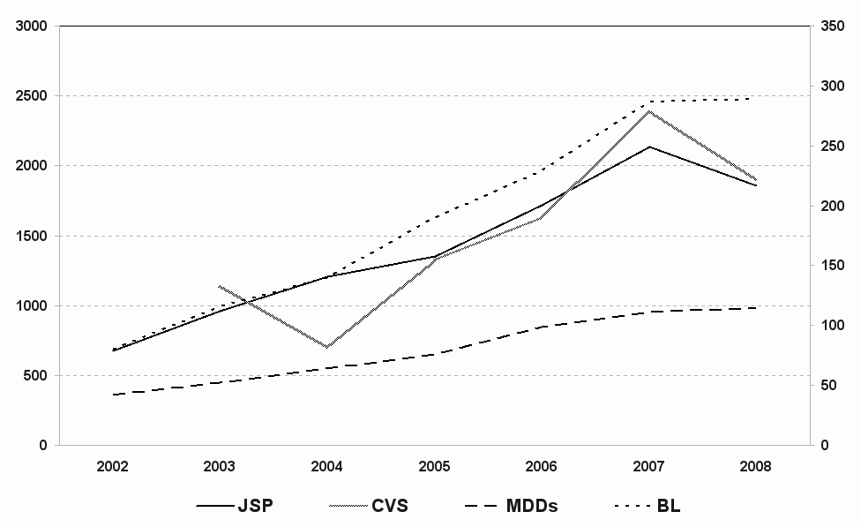
Size of the Intranet

Slide 11
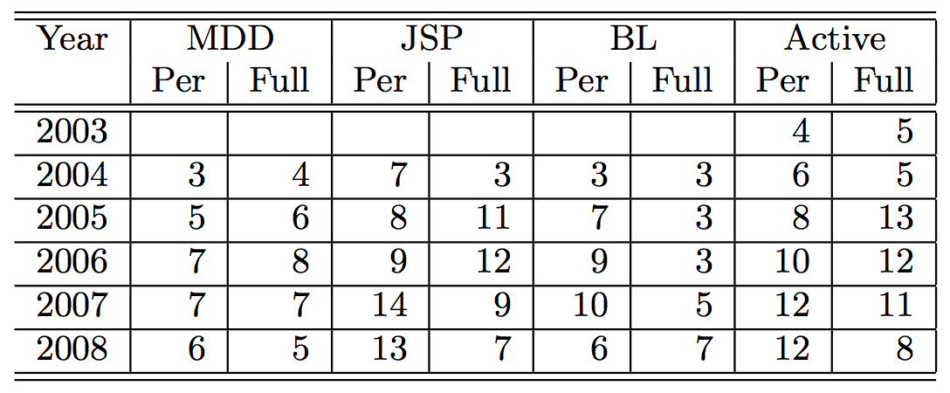
Tech Committee Membership counts
Most “learning departments” are well populated at all times with both “peripheral” and “full” members who work on the respective type of code
People move in and out of the Tech Committee
Not all of the members active with JSP (HTML +SQL) ever “make it” to BL (Java)
MDD is changed by few members, but understood by all
We refined JSP in the questionnaire to detect an evolution from viewing data to changing data

Slide 12
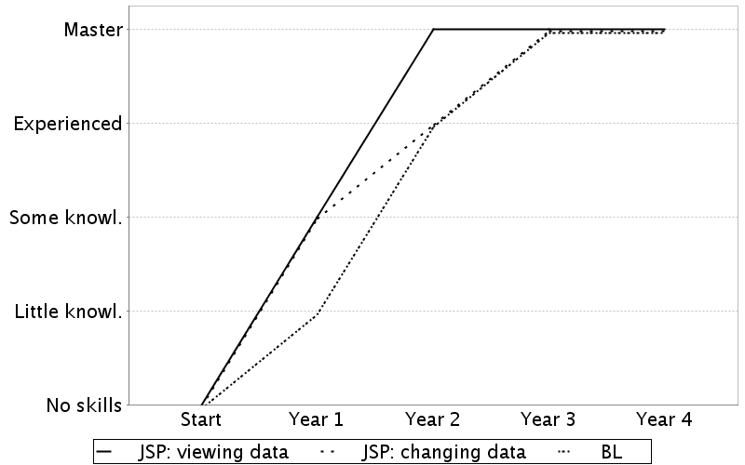
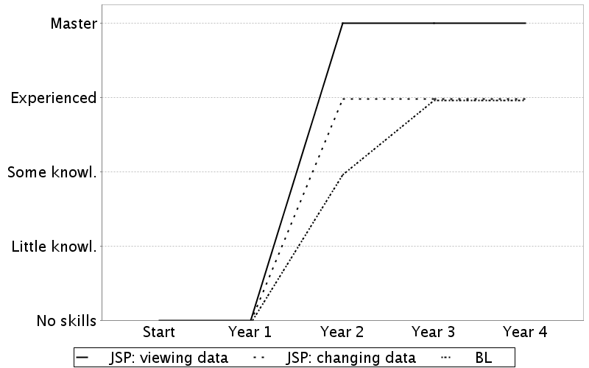
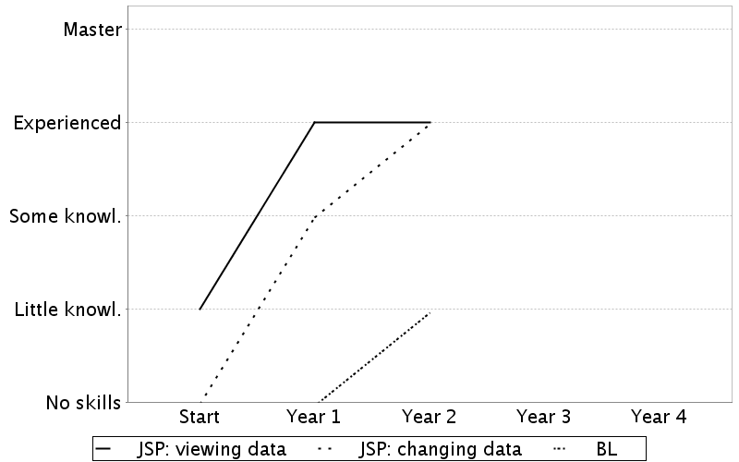
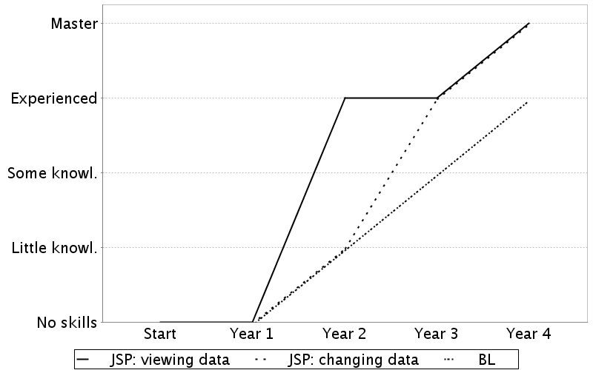
Individual learning curve examples

Slide 13
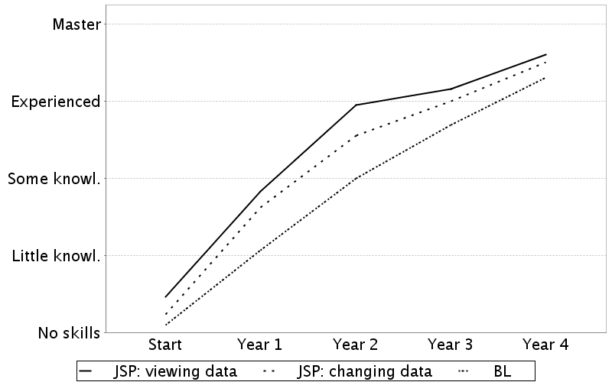
Combined learning curves

Slide 14
Discussion
The little theory appears to be confirmed
A graceful learning path (cf. amateur radio, Bogdan and Bowers 2007):
  Read MDDs and write JSP for viewing data
  JSP for changing data
  BL, change MDDs
Technology is part of the “configuration” process (Lave and Wenger)
Code navigation and legibility important for members’ peripheral learning
Support for peripheral participation by Amateur programming experimentation in sandboxes
  Each member has their own sandbox, with own copy of the Intranet

Slide 15
But…
Motivation to join the Tech Committee also originates from
Makumba belonging to the student organization
  It is something they give to the world (cf. amateurs’ Public)
Participating in a long tradition of using Web systems, even before companies did it (1995)
  (cf. Amateurs’ Pioneering)
Mysterious initiation rite: the Makumba party
So cultural meanings ascribed to the technology within the community complement the skill modularity
Traditions, war stories, rituals, world-unique specificities

Slide 16
Also…
Many former Tech Committee members (currently professionals) point out that Makumba design breaks some professional principles, while it enforces others
Breaking the principles helps initial learning, and is therefore appreciated
Design of such technologies for pre-professional amateurs may thus benefit from selecting relevant professional principles
Team-scalable code: members can often work on the intranet independently from each other
  Thus one’s mistakes do not affect the other
  Professional frameworks often lead to higher code interdependence

