Slide 1
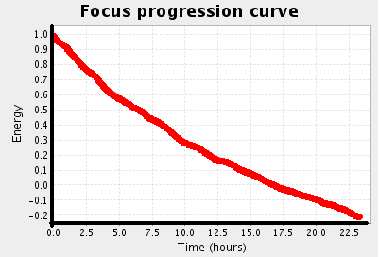
Design: Mechanism
1
2
Initial Energy
100
Event
Initial matching using
Initial Percolation Rules
Energy progression
with time
„Bob edits
personList.jsp“
„USER edits FILE“
query
Initial relations to
propagate through
„personNew.jsp dependsOn personList.jsp“
-20
Energy
Consumption
4
Relation matching using
Percolation Rules
Recording a
Percolation Step
(log entry)
3
„FILE dependsOn FILE“
query
Next relations
5
6
...

