Slide 1
Open Source Tools(cs-19)
Prepared By: Makwana Shailesh
KAMANI SCIENCE & PRATAPRAI ARTS COLLEGE, AMARELI (BCA DEPARTMENT

Slide 2
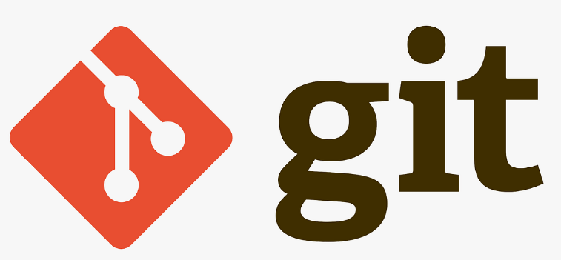
Git and Github
Version control with Git allows multiple people to collaborate on projects, track changes over time, and maintain a detailed history of the project. Here’s a basic overview of how to use Git for version control.
Git is a an Open Source distributed version control system that is available for free under the GNU General Public License

Slide 3

Git and Github
Git is open source software maintained by Linux, while Microsoft owns GitHub

Slide 4
Set Up Git
Install Git: You can download Git from git-scm.com
Configuration: Set up your username and email so Git can track who made changes.
git config --global user.name "Your Name" git config --global user.email your.email@example.com
Initialize a Git Repository:
To start tracking a project, initialize a Git repository in the project’s folder:
git init

Slide 5
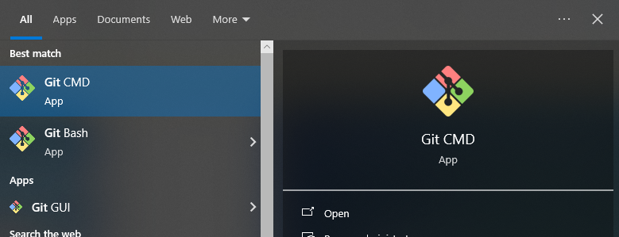
Git and Github

Slide 6
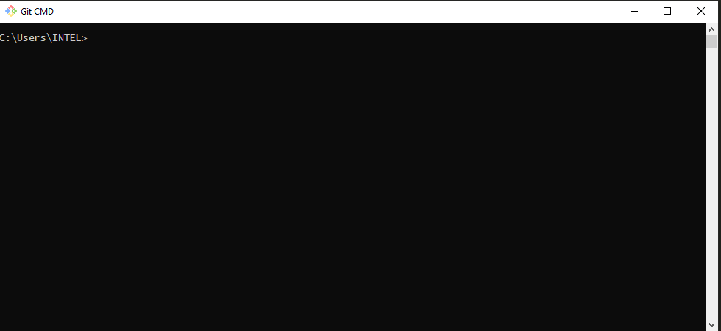
Git and Github

Slide 7
Set Up Git
Track Changes:
Check status: Use git status to see the current state of your working directory
git status

Slide 8
Set Up Git
Repository (Repo): A directory where Git tracks files and their history.
Commit: A snapshot of changes in the repository. Every commit has a unique ID.
Branch: A separate line of development. main (or master) is the default branch.
Merge: Combining changes from one branch into another.

Slide 9
Set Up Git
Clone: A copy of a Git repository that you can work on locally.
Push: Sending your local commits to a remote repository.
Pull: Fetching changes from a remote repository and merging them into your local branch.

Slide 10
Common Git Commands
Initialize a Repository:
git init
Clone a Repository:
git clone https://github.com/makwanashailesh6024/mywordpress
Check the Status:
git status

Slide 11
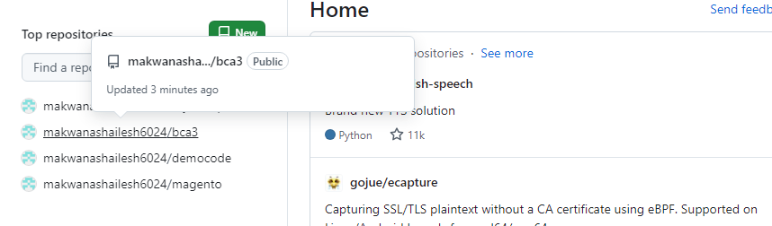
Create Repo and Clon video
https://www.loom.com/share/01082ce30cd043b8adfa7512aaa852f9

Slide 12
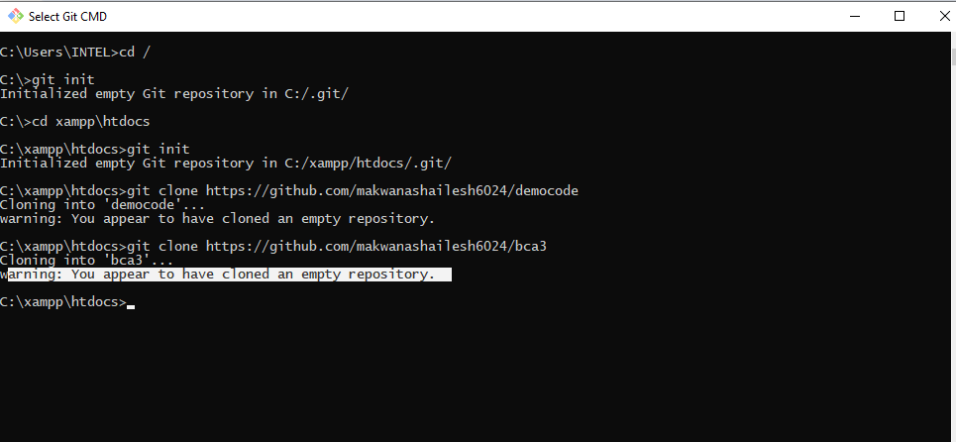
Create Repo and Clon video

Slide 13
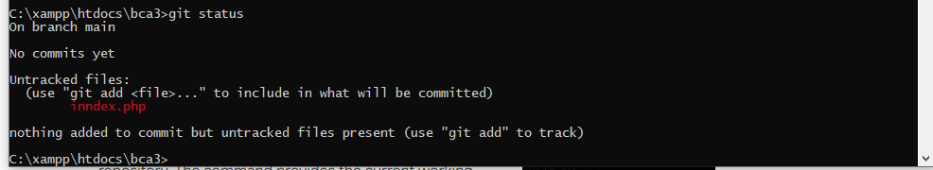
git info

Slide 14
git add && git commit
https://www.loom.com/share/cabd6516f7e442d6b37cecefd2f14f67?focus_title=1&muted=1&from_recorder=1

Slide 15
Common Git Commands
git add <file_name>
Commit Changes:
git commit -m "Commit message“
Create a New Branch:
git branch <branch_name>
Merge a Branch:
git merge <branch_name>
Push Changes to Remote Repository:
git push origin <branch_name>

Slide 16
Advantages
Local Repository: Every user has a full copy of the repository, including its entire history. This allows for offline work and reduces the risk of data loss.
Collaboration: Multiple users can work on different parts of the project simultaneously without interfering with each other’s work. Changes can be shared and merged as needed.

Slide 17
Advantages
Easy Branching: Git makes it simple to create, switch between, and delete branches. This is useful for developing features, testing, or fixing bugs in isolation without affecting the main codebase.

Slide 18
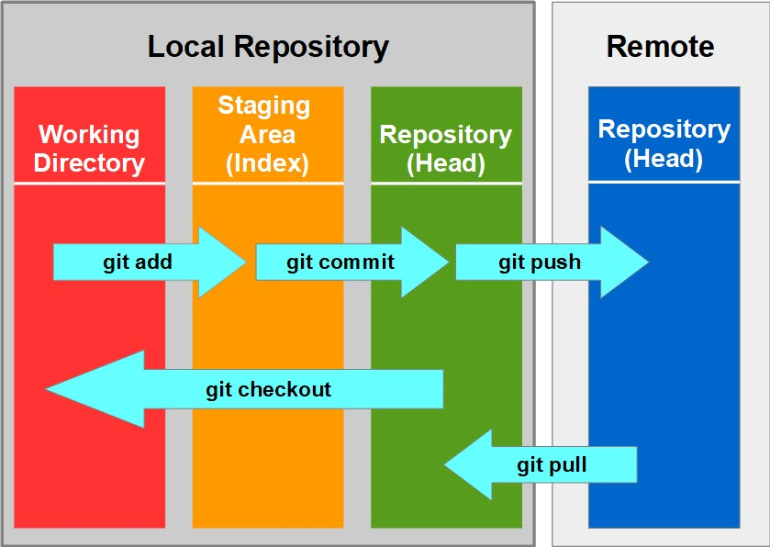
Git Fundamentals

Slide 19
Open source project management
Project management is the process of using skills, tools, and techniques to plan, organize, and execute a project to meet its objectives
A project management methodology is a set of principles and practices that guide you in organizing your projects to ensure their optimum performance.

Slide 20
Open source project management
Project management is the application of processes, methods, skills, knowledge and experience to achieve specific project objectives according to the project acceptance criteria within agreed parameters. Project management has final deliverables that are constrained to a finite timescale and budget.

Slide 21
How to choose the right project management methodology
There are lots of factors that will impact which project management methodology is right for your project, team, and organization. Here’s a quick breakdown of some of the key considerations that can help you decide
Cost and budget: On a scale of $ to $$$, what sort of budget are you working with? Is there room for that to change if necessary, or is it essential that it stays within these predetermined limits?

Slide 22
How to choose the right project management methodology
Team size: How many people are involved? How many stakeholders? Is your team relatively compact and self-organizing, or more sprawling, with a need for more rigorous delegation?
Ability to take risks: Is this a huge project with a big impact that needs to be carefully managed in order to deliver Very Serious Results? Or is it a smaller-scale project with a bit more room to play around?

Slide 23
How to choose the right project management methodology
Flexibility: Is there room for the scope of the project to change during the process? What about the finished product?
Timeline: How much time is allotted to deliver on the brief? Do you need a quick turnaround, or is it more important that you have a beautifully finished result, no matter how long it takes?

Slide 24
project management methodology examples and frameworks
Waterfall methodology
Agile methodology
Scrum methodology
Kanban methodology
Scrumban methodology
eXtreme programming (XP) methodology
Adaptive project framework (APF) methodology
Lean methodology
Critical path method

Slide 25
project management methodology examples and frameworks
Critical chain project management
New product introduction (NPI)
Package enabled reengineering (PER)
Outcome mapping
Six Sigma
PMI’s PMBOK
PRINCE2 methodology
Rapid application development (RAD) methodology

Slide 26
What is the Agile methodology?
Agile methodology is a project management approach that emphasizes continuous improvement and collaboration, and involves breaking projects into phases
Some principles of Agile methodology include:
Satisfying customers through early, continuous improvement and delivery
Welcoming changing requirements, even late in the project
Delivering value frequently
Building projects around motivated individuals
The most effective way to communicate is face-to-face

Slide 27
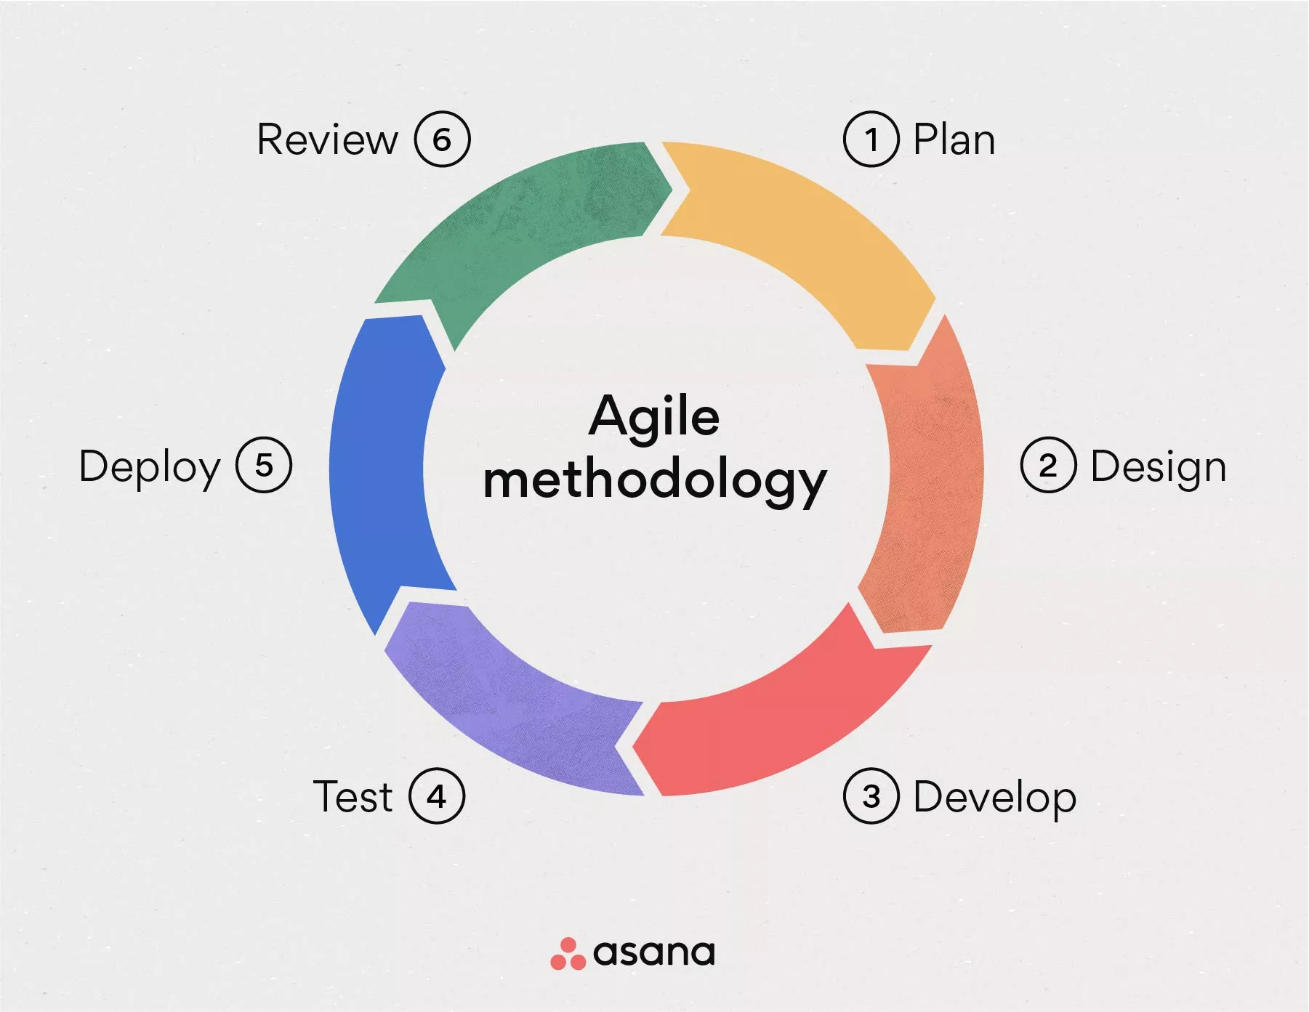
Agile methodology

Slide 28
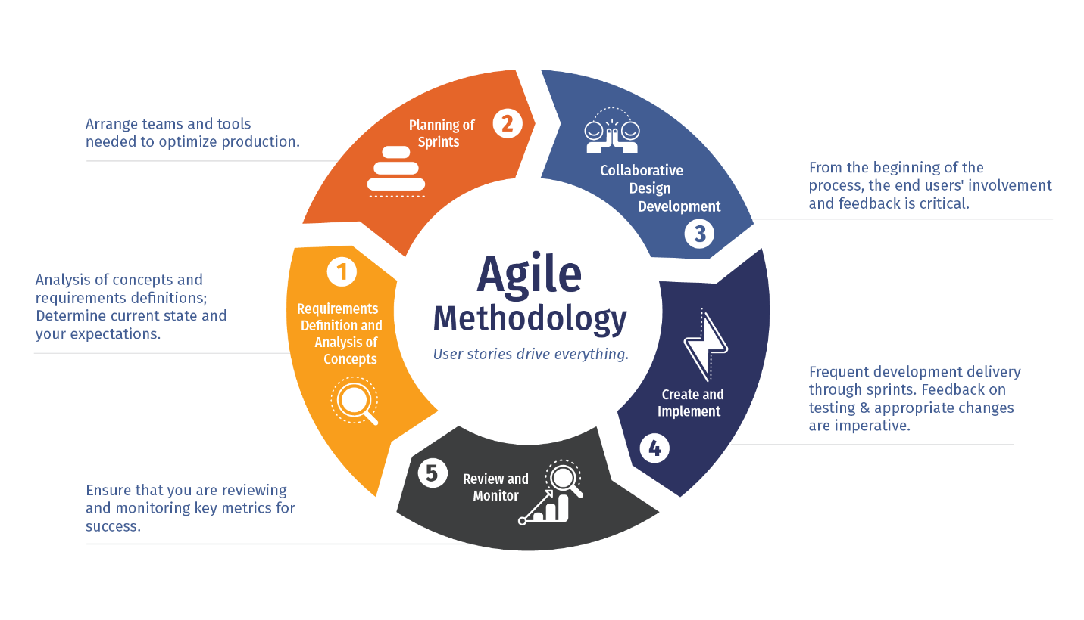
Agile methodology

Slide 29
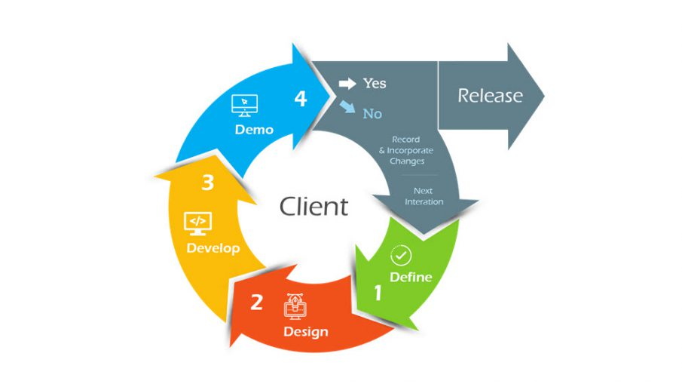
Agile methodology

Slide 30
Agile methodology
Agile methodology is a project management framework that breaks projects down into several dynamic phases, commonly known as sprints. In this article, get a high-level overview of Agile project management, plus a few common frameworks to choose the right one for your team.

