Slide 1
Chapter 4 – Requirements Engineering

Slide 2
Topics covered
Functional and non-functional requirements
Requirements engineering processes
Requirements elicitation
Requirements specification
Requirements validation
Requirements change

Slide 3
Requirements engineering
The process of establishing the services that a customer requires from a system and the constraints under which it operates and is developed.
The system requirements are the descriptions of the system services and constraints that are generated during the requirements engineering process.

Slide 4
What is a requirement?
It may range from a high-level abstract statement of a service or of a system constraint to a detailed mathematical functional specification.
This is inevitable as requirements may serve a dual function
May be the basis for a bid for a contract - therefore must be open to interpretation;
May be the basis for the contract itself - therefore must be defined in detail;
Both these statements may be called requirements.

Slide 5
Types of requirement
User requirements
Statements in natural language plus diagrams of the services the system provides and its operational constraints. Written for customers.
System requirements
A structured document setting out detailed descriptions of the system’s functions, services and operational constraints. Defines what should be implemented so may be part of a contract between client and contractor.

Slide 6
User and system requirements

Slide 7
Readers of different types of requirements specification

Slide 8
System stakeholders
A system stakeholder is anyone who should have some direct or indirect influence on the system requirements.
Stakeholders include end users who will interact with the system and anyone else in an organization who will be affected by it.

Slide 9
Stakeholders in the Mentcare system
Patients whose information is recorded in the system.
Doctors who are responsible for assessing and treating patients.
Nurses who coordinate the consultations with doctors and administer some treatments.
Medical receptionists who manage patients’ appointments.
IT staff who are responsible for installing and maintaining the system.

Slide 10
Stakeholders in the Mentcare system
A medical ethics manager who must ensure that the system meets current ethical guidelines for patient care.
Health care managers who obtain management information from the system.
Medical records staff who are responsible for ensuring that system information can be maintained and preserved, and that record keeping procedures have been properly implemented.

Slide 11
Agile methods and requirements
Many agile methods argue that producing detailed system requirements is a waste of time as requirements change so quickly.
The requirements document is therefore always out of date.
Agile methods usually use incremental requirements engineering and may express requirements as ‘user stories’ (discussed earlier).
This is practical for business systems but problematic for systems that require pre-delivery analysis (e.g. critical systems) or systems developed by several teams.

Slide 12
Functional and non-functional requirements

Slide 13
Functional and non-functional requirements
Functional requirements
Statements of services the system should provide, how the system should react to particular inputs and how the system should behave in particular situations.
May state what the system should not do.
Non-functional requirements
Constraints on the services or functions offered by the system such as timing constraints, constraints on the development process, standards, etc.
Often apply to the system as a whole rather than individual features or services.
Domain requirements
Constraints on the system from the domain of operation

Slide 14
Functional requirements
Describe functionality or system services.
Functional user requirements may be high-level statements of what the system should do.
Functional system requirements should describe the system services in detail.

Slide 15
Functional requirements examples
A user shall be able to search the appointments lists for all clinics.
The system shall generate each day, for each clinic, a list of patients who are expected to attend appointments that day.
Each staff member using the system shall be uniquely identified by his or her 8-digit employee number.

Slide 16
Requirements imprecision
Problems arise when functional requirements are not precisely stated.
Ambiguous requirements may be interpreted in different ways by developers and users.
Consider the term ‘search’ in requirement 1
User intention – search for a patient name across all appointments in all clinics;
Developer interpretation – search for a patient name in an individual clinic. User chooses clinic then search.

Slide 17
Requirements completeness and consistency
In principle, requirements should be both complete and consistent.
Complete
They should include descriptions of all facilities required.
Consistent
There should be no conflicts or contradictions in the descriptions of the system facilities.

Slide 18
Non-functional requirements
These define system properties and constraints e.g. reliability, response time and storage requirements. Constraints are I/O device capability, system representations, etc.
Process requirements may also be specified mandating a particular IDE, programming language or development method.
Non-functional requirements may be more critical than functional requirements. If these are not met, the system may be useless.

Slide 19
Non-functional requirements implementation
Non-functional requirements may affect the overall architecture of a system rather than the individual components.
For example, to ensure that performance requirements are met, you may have to organize the system to minimize communications between components.
A single non-functional requirement, such as a security requirement, may generate a number of related functional requirements that define system services that are required.
It may also generate requirements that restrict existing requirements.

Slide 20
Nonfunctional requirements examples
Product requirement The Mentcare system shall be available to all clinics during normal working hours (Mon–Fri, 0830–17.30). Downtime within normal working hours shall not exceed five seconds in any one day. Organizational requirement Users of the Mentcare system shall authenticate themselves using their health authority identity card. External requirement The system shall implement patient privacy provisions as set out in HStan-03-2006-priv.
Notes:
The organizational requirement specifies how users authenticate themselves to the
system. The health authority that operates the system is moving to a standard authentication
procedure for all software where, instead of users having a login name, they
swipe their identity card through a reader to identify themselves. The external requirement
is derived from the need for the system to conform to privacy legislation. Privacy
is obviously a very important issue in healthcare systems and the requirement specifies
that the system should be developed in accordance with a national privacy standard.

Slide 21
Goals and requirements
Non-functional requirements may be very difficult to state precisely and imprecise requirements may be difficult to verify.
Goal
A general intention of the user such as ease of use.
Verifiable non-functional requirement
A statement using some measure that can be objectively tested.
Notes:
A common problem with non-functional requirements is that users or customers
often propose these requirements as general goals, such as ease of use, the ability of
the system to recover from failure, or rapid user response. Goals set out good intentions
but cause problems for system developers as they leave scope for interpretation
and subsequent dispute once the system is delivered. For example, the following system
goal is typical of how a manager might express usability requirements:

Slide 22
Goal vs. Testable non-functional requirement
The system should be easy to use by medical staff and should be organized in such a way that user errors are minimized.
Medical staff shall be able to use all the system functions after four hours of training. After this training, the average number of errors made by experienced users shall not exceed two per hour of system use.
Notes:
I have rewritten this to show how the goal could be expressed as a ‘testable’ nonfunctional
requirement.
It is impossible to objectively verify the system goal, but in the description below you can at least include software instrumentation to count the
errors made by users when they are testing the system.

Slide 23
Metrics for specifying nonfunctional requirements
Property | Measure
Speed | Processed transactions/second User/event response time Screen refresh time
Size | Mbytes Number of ROM chips
Ease of use | Training time Number of help frames
Reliability | Mean time to failure Probability of unavailability Rate of failure occurrence Availability
Robustness | Time to restart after failure Percentage of events causing failure Probability of data corruption on failure
Portability | Percentage of target dependent statements Number of target systems

Slide 24
Requirements engineering processes

Slide 25
Requirements engineering processes
The processes used for RE vary widely depending on the application domain, the people involved and the organisation developing the requirements.
However, there are a number of generic activities common to all processes
Requirements elicitation;
Requirements analysis;
Requirements validation;
Requirements management.
In practice, RE is an iterative activity in which these processes are interleaved.

Slide 26
A spiral view of the requirements engineering process
Notes:
requirements engineering processes may include four
high-level activities. These focus on assessing if the system is useful to the business
(feasibility study), discovering requirements (elicitation and analysis), converting
these requirements into some standard form (specification), and checking that the
requirements actually define the system that the customer wants (validation). I have
shown these as sequential processes in Figure 2.6. However, in practice, requirements
engineering is an iterative process in which the activities are interleaved.

Slide 27
Requirements elicitation

Slide 28
Requirements elicitation
Sometimes called requirements elicitation or requirements discovery.
Software engineers work with a range of system stakeholders to find out about the application domain, the services that the system should provide, the required system performance, hardware constraints, other systems, etc.
Stages include:
Requirements discovery,
Requirements classification and organization,
Requirements prioritization and negotiation,
Requirements specification.

Slide 29
The requirements elicitation and analysis process

Slide 30
Process activities
Requirements discovery
Interacting with stakeholders to discover their requirements. Domain requirements are also discovered at this stage.
Requirements classification and organisation
Groups related requirements and organises them into coherent clusters.
Prioritisation and negotiation
Prioritising requirements and resolving requirements conflicts.
Requirements specification
Requirements are documented and input into the next round.
Notes:
Organisation: The most common way of grouping requirements is
to use a model of the system architecture to identify sub-systems and to associate
requirements with each sub-system. In practice, requirements engineering
and architectural design cannot be completely separate activities.

Slide 31
Problems of requirements elicitation
Stakeholders don’t know what they really want.
Stakeholders express requirements in their own terms.
Different stakeholders may have conflicting requirements.
Organisational and political factors may influence the system requirements.
The requirements change during the analysis process. New stakeholders may emerge and the business environment may change.

Slide 32
Interviewing
Formal or informal interviews with stakeholders are part of most RE processes.
Types of interview
Closed interviews based on pre-determined list of questions
Open interviews where various issues are explored with stakeholders.
Effective interviewing
Be open-minded, avoid pre-conceived ideas about the requirements and are willing to listen to stakeholders.
Prompt the interviewee: springboard question, a requirements proposal, or by working together on a prototype system.

Slide 33
Problems with interviews
Application specialists may use language to describe their work that isn’t easy for the requirements engineer to understand.
Interviews are not good for understanding domain requirements
Requirements engineers cannot understand specific domain terminology;
Some domain knowledge is so familiar that people find it hard to articulate or think that it isn’t worth articulating.

Slide 34
Stories and scenarios
People usually find it easier to relate to real-life examples rather than abstract descriptions. They can understand and criticize a scenario of how they might interact with a software system.
Requirements engineers can use the information gained from this discussion to formulate the actual system requirements.
Scenarios and user stories are real-life examples of how a system can be used.

Slide 35
Stories and scenarios
Stories and scenarios are a description of how a system may be used for a particular task.
Because they are based on a practical situation, stakeholders can relate to them and can comment on their situation with respect to the story.

Slide 36
Scenarios
A structured form of user story should include
A description of the starting situation;
A description of the normal flow of events;
A description of what can go wrong;
Information about other concurrent activities;
A description of the state when the scenario finishes.

Slide 37
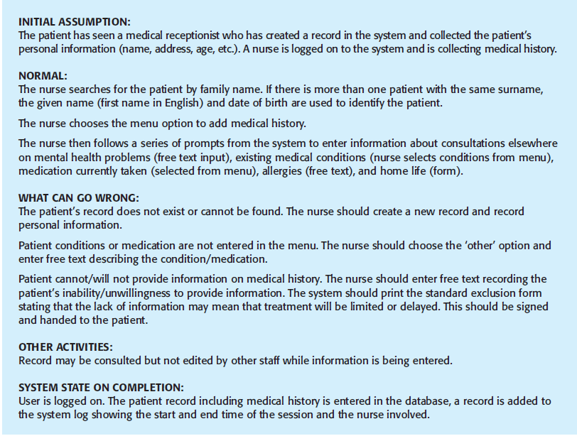

Slide 38
Requirements specification

Slide 39
Requirements specification
The process of writing down the user and system requirements in a requirements document.
User requirements have to be understandable by end-users and customers who do not have a technical background.
System requirements are more detailed requirements and may include more technical information.
The requirements may be part of a contract for the system development
It is therefore important that these are as complete as possible.

Slide 40
Ways of writing a system requirements specification
Notation | Description
Natural language | The requirements are written using numbered sentences in natural language. Each sentence should express one requirement.
Structured natural language | The requirements are written in natural language on a standard form or template. Each field provides information about an aspect of the requirement.
Design description languages | This approach uses a language like a programming language, but with more abstract features to specify the requirements by defining an operational model of the system. This approach is now rarely used although it can be useful for interface specifications.
Graphical notations | Graphical models, supplemented by text annotations, are used to define the functional requirements for the system; UML use case and sequence diagrams are commonly used.
Mathematical specifications – e.g. Z-Notation | These notations are based on mathematical concepts such as finite-state machines or sets. Although these unambiguous specifications can reduce the ambiguity in a requirements document, most customers don’t understand a formal specification. They cannot check that it represents what they want and are reluctant to accept it as a system contract

Slide 41
Natural language specification
Requirements are written as natural language sentences supplemented by diagrams and tables.
Used for writing requirements because it is expressive, intuitive and universal. This means that the requirements can be understood by users and customers.

Slide 42
Guidelines for writing requirements
Invent a standard format and use it for all requirements.
Use language in a consistent way. Use shall for mandatory requirements, should for desirable requirements.
Use text highlighting to identify key parts of the requirement.
Avoid the use of computer jargon; ‘architecture, module’
Include an explanation (rationale) of why a requirement is necessary.

Slide 43
Problems with natural language
Lack of clarity
Precision is difficult without making the document difficult to read.
Requirements confusion
Functional and non-functional requirements tend to be mixed-up.
Requirements amalgamation
Several different requirements may be expressed together.

Slide 44
Example requirements for the insulin pump software system
3.2 The system shall measure the blood sugar and deliver insulin, if required, every 10 minutes. (Changes in blood sugar are relatively slow so more frequent measurement is unnecessary; less frequent measurement could lead to unnecessarily high sugar levels.) 3.6 The system shall run a self-test routine every minute with the conditions to be tested and the associated actions defined in Table 1. (A self-test routine can discover hardware and software problems and alert the user to the fact the normal operation may be impossible.)

Slide 45
Structured specifications
An approach to writing requirements where the freedom of the requirements writer is limited and requirements are written in a standard way.
This works well for some types of requirements e.g. requirements for embedded control system but is sometimes too rigid for writing business system requirements.

Slide 46
Structured specifications
Definition of the function or entity.
Description of inputs and where they come from.
Description of outputs and where they go to.
Information about the information needed for the computation and other entities used.
Description of the action to be taken.
Pre and post conditions (if appropriate).
The side effects (if any) of the function.

Slide 47
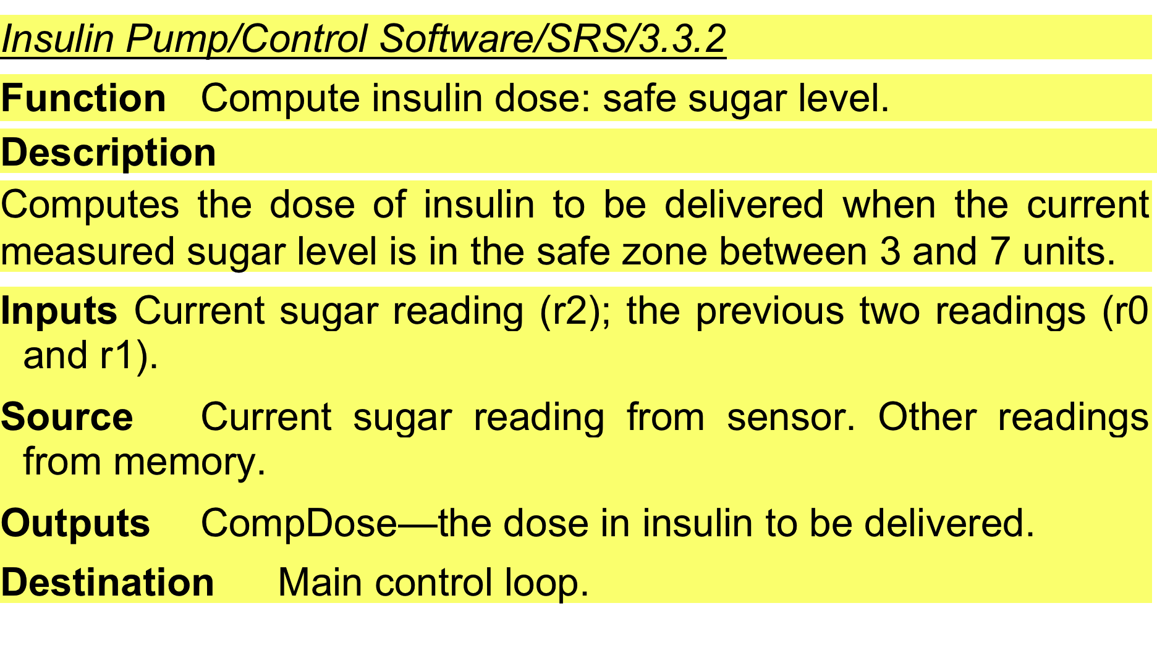
A structured specification of a requirement for an insulin pump

Slide 48
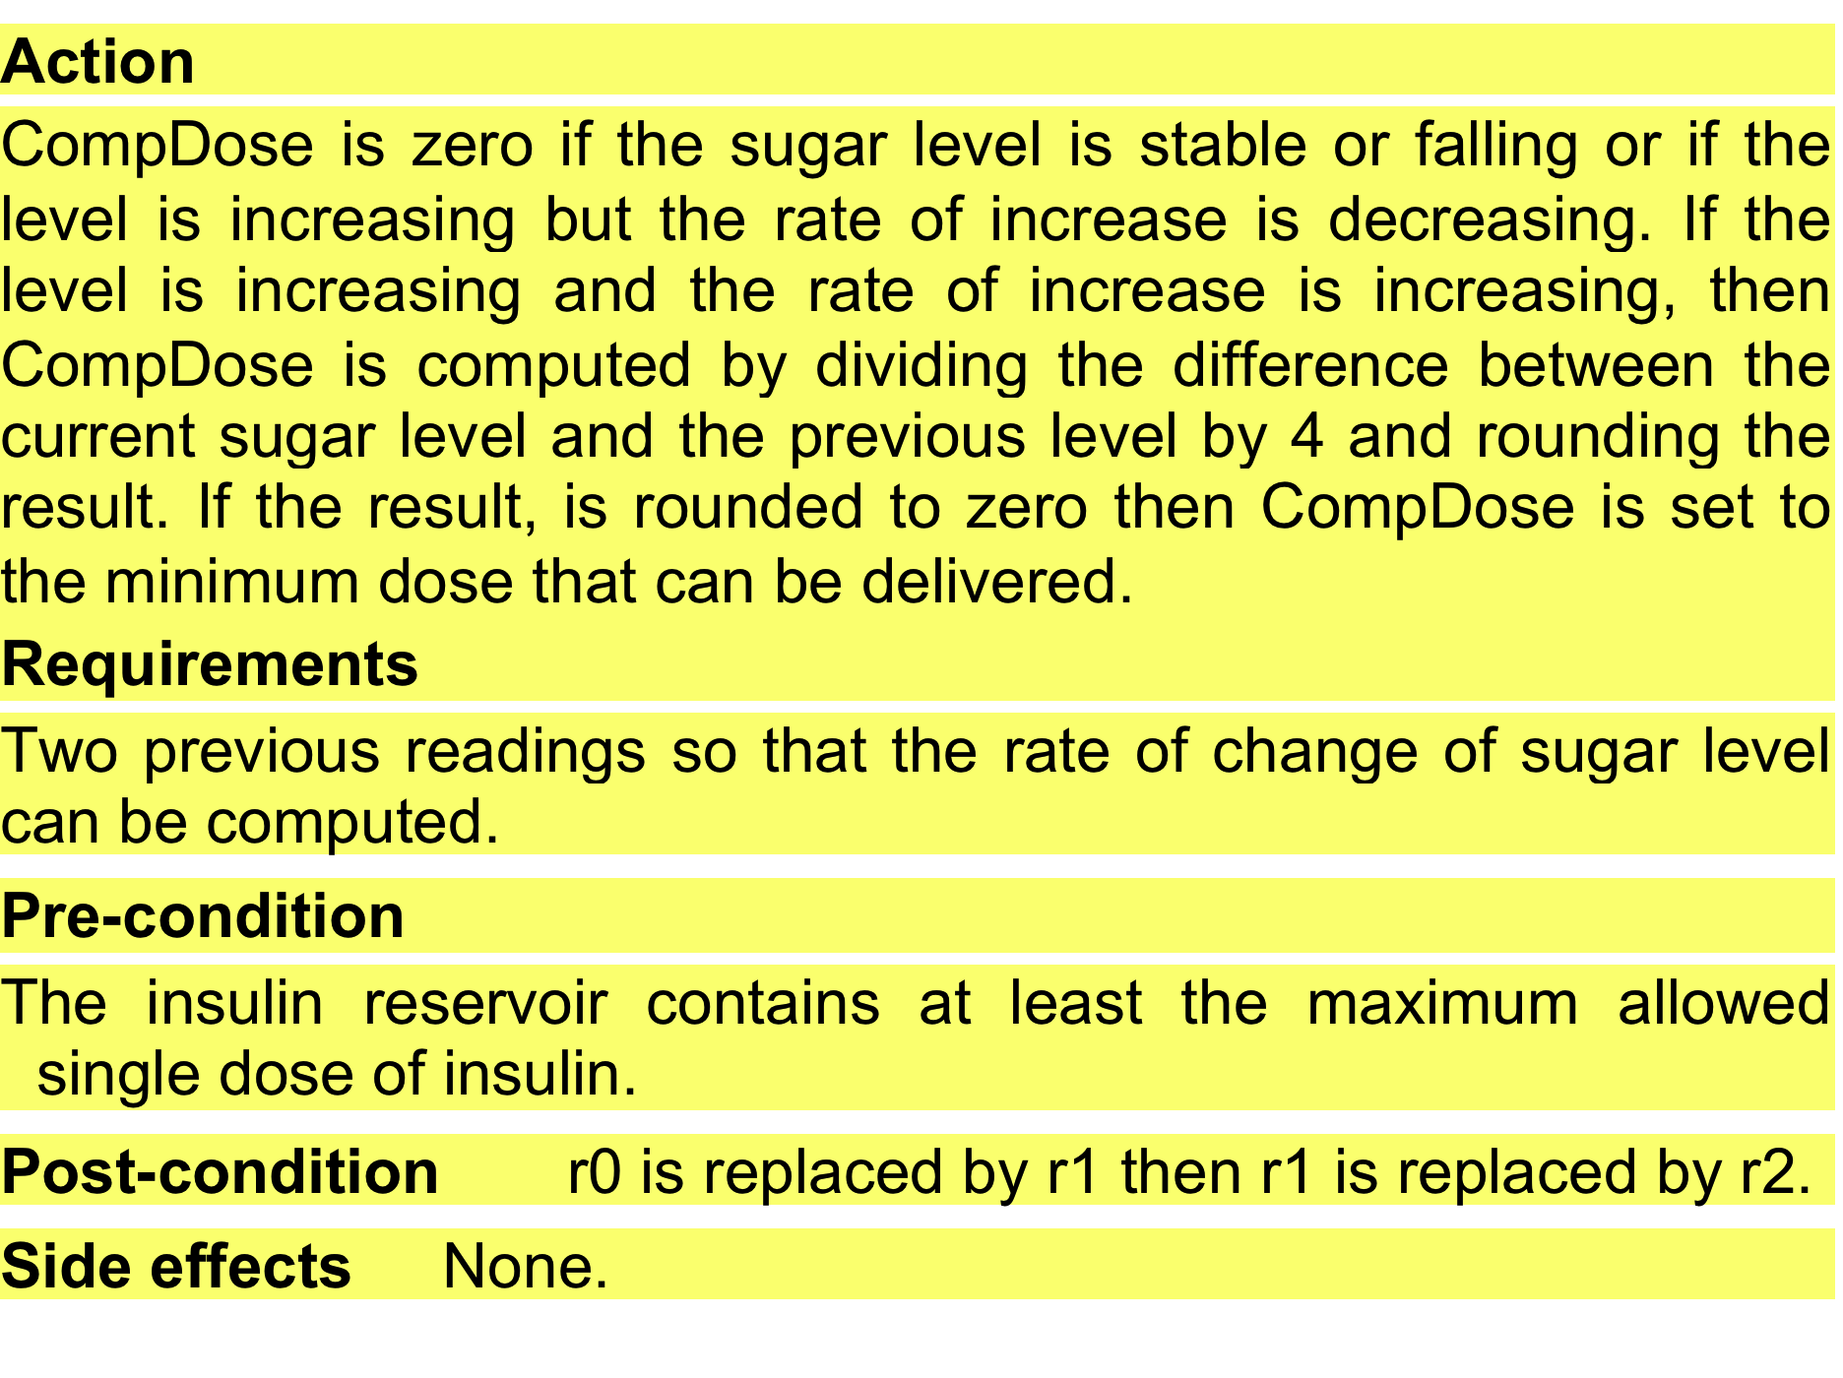
A structured specification of a requirement for an insulin pump

Slide 49
Use cases
Use-cases are a kind of scenario that are included in the UML (Unified Modelling Language).
«A session is started when a customer inserts an ATM card into the card reader slot of the machine. The ATM pulls the card into the machine and reads it. (If the reader cannot read the card due to improper insertion or a damaged stripe, the card is ejected, an error screen is displayed, and the session is aborted.) The customer is asked to enter his/her PIN, and is then allowed to perform one or more transactions, choosing from a menu of possible types of transaction in each case. After each transaction, the customer is asked whether he/she would like to perform another. ... »
De facto standard in object oriented analysis
Summarizes user and system interaction

Slide 50
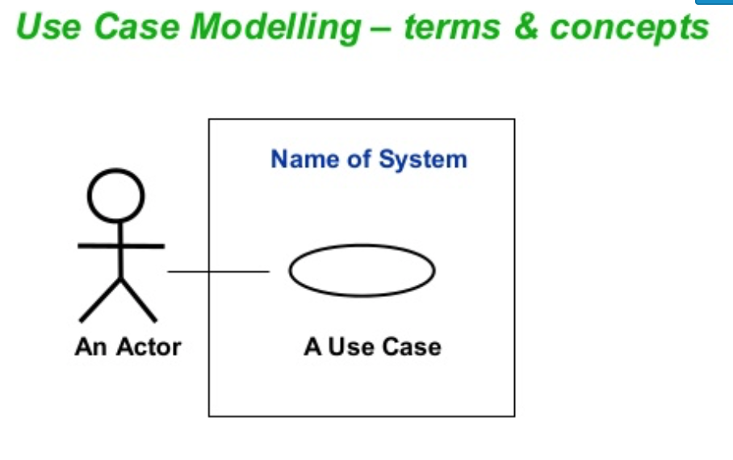

Slide 51
Use cases for the Mentcare system

Slide 52
Use cases
Use cases document the behavior of the system from the users’ point of view.
User: anything external to the system
A use case involves a sequence of interactions between the initiator and the system
In a use case, the system is considered as a black-box. We are only interested in externally visible behavior
“Getting started: Using use cases to capture requirements”, James Rumbaugh, 1994
“Using UML”, Perdita Stevens, Rob Pooley, 2000

Slide 53
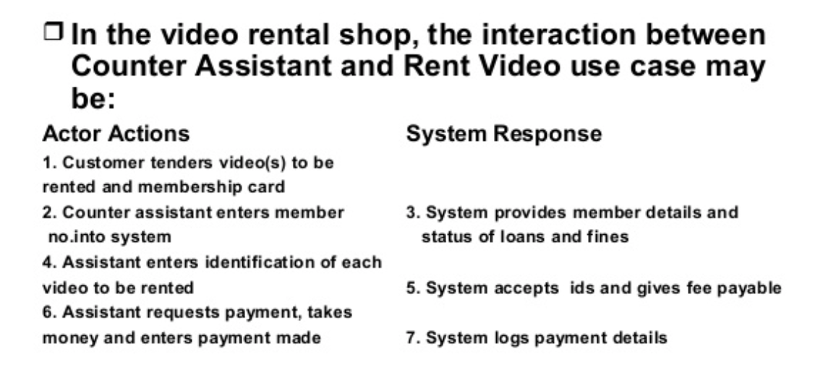

Slide 54
Use Case: Requirements in Context
Informally, a use case is a story of using a system to fulfill a goal.
Rent Videos
Used by primary actors
E.g., Clerk
External agents
something with behavior
Use supporting actors.
CreditAuthorizationSystem

Slide 55
Use cases diagrams: Actors
An actor is a role played by an outside entity that interacts directly with the system
An actor can be a human, or a machine or program
An actor is something with behavior
Çöp Adam

Slide 56
Guideline questions for identifying actors
Which user groups are supported by the system to perform their work?
Which user groups execute the system's main functions?
Which user groups perform secondary functions, such as maintenance and administration?
With what external hardware or software system will your system interact?

Slide 57
Scenarios and Use Cases
A scenario = A use case instance
One particular story of using a system
E.g., successfully purchasing items with cash.
Each way of using the system is called a use case
A use case is a collection of related success and failure scenarios describing an actor using a system to support a goal
So, a scenario is one path through the use case
Installing
a Database
Notes:
A scenario is a specific sequence of actions and interactions between actors and the system

Slide 58
Success and Failure Scenarios Example: Handle Returns
Handle Returns
Main Success Scenario: A customer arrives at a checkout with items to return. The cashier uses the POS system to record each returned item …
Alternative Scenarios
If the customer paid by credit, and the reimbursement transaction to his/her credit account is rejected, inform the customer and pay them with cash
If the item identifier is not found in the system, notify the Cashier and suggest manual entry of the identifier code
If the system detects failure to communicate with the external accounting system, …

Slide 59
Notation
Brief: one-paragraph summary
Written during early requirements analysis, to get a quick sense of subject and scope
May take only a few minutes to create
Casual: Informal paragraph format. Multiple paragraphs that cover various scenarios
Written during early requirements analysis, to get a quick sense of subject and scope
Fully Dressed: All steps and variations are written in detail, and there are supporting sections.
After many use cases have been identified in a brief format, a few of them are written in detail at each iteration

Slide 60
Fully Dressed Style: A Template
Use Case Section | Comment
Use Case Name | Should be the goal as a short active verb phrase
Scope | What system is being considered black-box
Level | Summary, User-goal, or Subfunction
Primary Actor | A role name for the primary actor
Stakeholders & Interests | List of stakeholders and key interests in the use case
Preconditions | What must be true on start
Success Guarantees | What must be true on successful completion
Main Success Scenario | A typical, unconditional happy path scenario of success
Extensions | Alternate scenarios of success or failure
Special Requirements | Related non-functional requirements
Technology and Data Var. List | Varying I/O methods and data formats
Frequency of occurrence | Influences investigation, testing, and timing of implementation
Miscellaneous | Open issues

Slide 61
Use Case and Test Cases
http://www.craiglarman.com/wiki/downloads/applying_uml/larman-ch6-applying-evolutionary-use-cases.pdf
http://www.math-cs.gordon.edu/courses/cs211/ATMExample/UseCases.html#Session

Slide 62
Requirement Validation: Characteristics of a Good SRS
Correct
Unambiguous
Complete
Consistent
Ranked for importance and/or stability
Verifiable
Modifiable
Traceable

Slide 63
Correct
Every requirement stated in SRS should be one that the software shall meet.
Should be compared with applicable superior (higher-level) specification.
The customer or user can determine if the SRS correctly reflects the actual needs.
Traceability makes this procedure easier.

Slide 64
Unambiguous
Every requirement stated in SRS should have only one interpretation.
Enablers
Each characteristic of the final product should be described using a unique term.
A natural language SRS should be reviewed by an independent party.
Natural languages are inherently ambiguous, they should be used carefully

Slide 65
Complete
SRS should include the following elements:
All significant requirements (functional and non-functional)
Definition of the responses of the software to all realizable classes of input data in all realizable classes of situations. (responses to both valid and invalid input)
Full labels and references to all figures, tables and diagrams in the SRS and definition of all terms and units of measure.
Notes:
All significant requirements, whether relating to functionality, performance, design constraints, attributes, or external interfaces
Responses to all realizable classes of input data and situations should be included (responses to both valid and invalid input) should be included

Slide 66
Consistent
No subset of individual requirements described should conflict. (Refers to internal consistency)
Possible conflicts:
Specified characteristics of real-world objects may conflict
The format of a report tabular ... textual
All lights shall be green ... all lights shall be blue
There may be logical or temporal conflicts between two specified actions
Will add two inputs ... will multiply two inputs
A must follow B … A and B occur simultaneously
Consistent terminology
Different part of SRS may use different terms to refer to the same object

Slide 67
Verifiable
A requirement is verifiable if and only if there exists some finite cost-effective process with which a person or machine can check that the software product meet the requirement.
Ambiguous requirements are not verifiable.
Non-verifiable statements
Works well … good human interface … usually happen
Avoid there phrases!!!
A verifiable statement
Output of the program shall be produced within 20 seconds of event x 60% of the time; and shall be produced within 30 seconds of event x 100% of the time.

Slide 68
Modifiable
The style and structure of SRS should make it possible to change it easily, completely and consistently
Coherent and easy-to-use organization with a table of contents, index, explicit cross-referencing
No redundancy
Express each requirement separately
Notes:
Its structure and style are such that any changes to the requirements can be made easily, completely, and consistently while retaining the structure and the style.

Slide 69
Traceable
The origin of each of requirements in SRS is clear. SRS should facilitate referencing of each requirement in the future development or enhancement documentation.
Backward traceability: each requirement explicitly referencing its source in earlier documents.
Forward traceability: each requirement in the SRS having unique name or reference number.
Very important during operation and maintenance.

Slide 70
Ranked for Importance / Stability
Each requirement should have an identifier to indicate either the importance or stability of that particular requirement.
All of the requirements are not equally important. Some may be essential while others may be desirable.
Dimension of stability
Can be expressed in terms of the number of expected changes
Degree of necessity
Essential … conditional … optional

Slide 71
Users of a requirements document

Slide 72
Requirements document variability
Information in requirements document depends on type of system and the approach to development used.
Systems developed incrementally will, typically, have less detail in the requirements document.
Requirements documents standards have been designed e.g. IEEE standard. These are mostly applicable to the requirements for large systems engineering projects.

Slide 73
The structure of a requirements document
Chapter | Description
Preface | This should define the expected readership of the document and describe its version history, including a rationale for the creation of a new version and a summary of the changes made in each version.
Introduction | This should describe the need for the system. It should briefly describe the system’s functions and explain how it will work with other systems. It should also describe how the system fits into the overall business or strategic objectives of the organization commissioning the software.
Glossary | This should define the technical terms used in the document. You should not make assumptions about the experience or expertise of the reader.
User requirements definition | Here, you describe the services provided for the user. The nonfunctional system requirements should also be described in this section. This description may use natural language, diagrams, or other notations that are understandable to customers. Product and process standards that must be followed should be specified.
System architecture | This chapter should present a high-level overview of the anticipated system architecture, showing the distribution of functions across system modules. Architectural components that are reused should be highlighted.

Slide 74
The structure of a requirements document
Chapter | Description
System requirements specification | This should describe the functional and nonfunctional requirements in more detail. If necessary, further detail may also be added to the nonfunctional requirements. Interfaces to other systems may be defined.
System models | This might include graphical system models showing the relationships between the system components and the system and its environment. Examples of possible models are object models, data-flow models, or semantic data models.
System evolution | This should describe the fundamental assumptions on which the system is based, and any anticipated changes due to hardware evolution, changing user needs, and so on. This section is useful for system designers as it may help them avoid design decisions that would constrain likely future changes to the system.
Appendices | These should provide detailed, specific information that is related to the application being developed; for example, hardware and database descriptions. Hardware requirements define the minimal and optimal configurations for the system. Database requirements define the logical organization of the data used by the system and the relationships between data.
Index | Several indexes to the document may be included. As well as a normal alphabetic index, there may be an index of diagrams, an index of functions, and so on.

