Slide 1
Chapter 7 – Design and Implementation

Slide 2
Topics covered
Object-oriented design using the UML
Design patterns
Implementation issues
Open source development

Slide 3
Design and implementation
Software design and implementation is the stage in the software engineering process at which an executable software system is developed.
Software design and implementation activities are invariably inter-leaved.
Software design is a creative activity in which you identify software components and their relationships, based on a customer’s requirements.
Implementation is the process of realizing the design as a program.

Slide 4
Object-oriented design using the UML

Slide 5
Process stages
There are a variety of different object-oriented design processes that depend on the organization using the process.
Common activities in these processes include:
Define the context and modes of use of the system;
Design the system architecture;
Identify the principal system objects;
Develop design models;
Specify object interfaces.
Process illustrated here using a design for a wilderness weather station.

Slide 6
System context and interactions
Understanding the relationships between the software that is being designed and its external environment is essential for deciding how to provide the required system functionality and how to structure the system to communicate with its environment.
Understanding of the context also lets you establish the boundaries of the system. Setting the system boundaries helps you decide what features are implemented in the system being designed and what features are in other associated systems.

Slide 7
Context and interaction models
A system context model is a structural model that demonstrates the other systems in the environment of the system being developed.
An interaction model is a dynamic model that shows how the system interacts with its environment as it is used.

Slide 8
System context for the weather station
Notes:
The cardinality information on the link shows that there is one control system but several weather stations, one satellite, and one general weather information system.

Slide 9
Weather station use cases
Notes:
When you model the interactions of a system with its environment you should use an abstract approach that does not include too much detail. One way to do this is to use a use case model. As we discussed earlier, each use case represents an interaction with the system. Each possible interaction is named in an ellipse and the external entity involved in the interaction is represented by a stick figure.

Slide 10
Architectural design
Once interactions between the system and its environment have been understood, you use this information for designing the system architecture.
You identify the major components that make up the system and their interactions, and then may organize the components using an architectural pattern such as a layered or client-server model.
The weather station is composed of independent subsystems that communicate by broadcasting messages on a common infrastructure.

Slide 11
High-level architecture of the weather station

Slide 12
Architecture of data collection system

Slide 13
Object class identification
Identifying object classes is often a difficult part of object oriented design.
There is no 'magic formula' for object identification. It relies on the skill, experience and domain knowledge of system designers.
Object identification is an iterative process. You are unlikely to get it right first time.

Slide 14
Approaches to identification
Use a grammatical approach based on a natural language description of the system.
Base the identification on tangible things in the application domain.
Use a behavioural approach and identify objects based on what participates in what behaviour.
Use a scenario-based analysis. The objects, attributes and methods in each scenario are identified.

Slide 15
Weather station object classes
Object class identification in the weather station system may be based on the tangible hardware and data in the system:
Ground thermometer, Anemometer, Barometer
Application domain objects that are ‘hardware’ objects related to the instruments in the system.
Weather station
The basic interface of the weather station to its environment. It therefore reflects the interactions identified in the use-case model.
Weather data
Encapsulates the summarized data from the instruments.

Slide 16
Weather station object classes

Slide 17
Design models
Design models show the objects and object classes and relationships between these entities.
There are two kinds of design model:
Structural models describe the static structure of the system in terms of object classes and relationships.
Dynamic models describe the dynamic interactions between objects.

Slide 18
Examples of design models
Subsystem models that show logical groupings of objects into coherent subsystems.
Sequence models that show the sequence of object interactions.
State machine models that show how individual objects change their state in response to events.
Other models include use-case models, aggregation models, generalisation models, etc.

Slide 19
Subsystem models
Shows how the design is organised into logically related groups of objects.
In the UML, these are shown using packages - an encapsulation construct. This is a logical model. The actual organisation of objects in the system may be different.

Slide 20
Sequence models
Sequence models show the sequence of object interactions that take place
Objects are arranged horizontally across the top;
Time is represented vertically so models are read top to bottom;
Interactions are represented by labelled arrows, Different styles of arrow represent different types of interaction;
A thin rectangle in an object lifeline represents the time when the object is the controlling object in the system.

Slide 21
Sequence diagram describing data collection

Slide 22
State diagrams
State diagrams are used to show how objects respond to different service requests and the state transitions triggered by these requests.
State diagrams are useful high-level models of a system or an object’s run-time behavior.
You don’t usually need a state diagram for all of the objects in the system. Many of the objects in a system are relatively simple and a state model adds unnecessary detail to the design.

Slide 23
Weather station state diagram

Slide 24
Interface specification
Object interfaces have to be specified so that the objects and other components can be designed in parallel.
Designers should avoid designing the interface representation but should hide this in the object itself.
Objects may have several interfaces which are viewpoints on the methods provided.

Slide 25
Weather station interfaces

Slide 26
Design patterns

Slide 27
Design patterns
A design pattern is a way of reusing abstract knowledge about a problem and its solution.
A pattern is a description of the problem and the essence of its solution.
It should be sufficiently abstract to be reused in different settings.
Pattern descriptions usually make use of object-oriented characteristics such as inheritance and polymorphism.

Slide 28
Pattern elements
Name
A meaningful pattern identifier.
Problem description.
Solution description.
Not a concrete design but a template for a design solution that can be instantiated in different ways.
Consequences
The results and trade-offs of applying the pattern.

Slide 29
Singleton Pattern
Objects for logging
Printer spooler
Timer, Counter
….
There are many objects we only need one of…..
Having multiples of them will cause chaos

Slide 30
Singleton
Intent: Ensure the class has only 1 instance and provide global visibility
Applicability:
The class should have exactly one instance which should be accessible from a method in the class.
The class can be subclassed, and clients can use the subclass as an instance of the superclass without having to change any code.
Static (global) variables are not elegant solution. That is why we have this pattern
Notes:
Singleton in math: a set with only one element
Singleton in se: a class with only one instance

Slide 31
example
We need to maintain an incremental counter,
the simple counter class needs to keep track of an integer value that is being used in multiple areas of an application.
The class needs to be able to increment this counter as well as return the current value.
the desired class behavior would be to have exactly one instance of a class that maintains the integer and nothing more.
Problem: Global visibility, enforce only 1 instance

Slide 32
Why not static?
Temptation: create an instance of a counter class as a static global variable.
Really solves only a part of the problem;
the problem of global accessibility,
but does nothing to ensure that there is only one instance of the class running at any given time.
The responsibility of having only one instance of the class should fall on the class itself and not on the user of the class.

Slide 33
Enforcing singularity
The users of the class should always be free from having to monitor and control the number of running instances of the class.
What is needed is a way to control how class instances are created and then ensure that only one gets created at any given time.

Slide 34
Singleton - Structure
Client
Singleton
-static instance:Singleton
#Singleton()
+static getInstance():Singleton
non-public constructor
Returns the instance.
Only way to get an
instance, hence class
controls instance count

Slide 35
Singleton -Implementation
Java implementation
class Singleton{
private static Singleton instance=null ;
privateSingleton(){…}
public static Singleton getInstance(){
if(instance==null) instance=new Singleton();
return instance;
}
C++ implementation
class Singleton{
private: static Singleton* instance=0;
protected: Singleton(){…}
public: static Singleton* getInstance();
};
Singleton* Singleton::getInstance(){
if (instance==0) instance=new Singleton; return instance;}

Slide 36
Example
1 Audio device
If there were two audio device objects, programmers could try to play multiple sounds simultaneously,
unpredictable and unwanted results.
We need only one audio device object
e.g. sun.audio.AudioDevice class
1 printer spooler, 1 window manager
Notes:
it can implement internal queuing as necessary to make sure that one sound file stops or finishes before it tries to play another.
A queue could be shared between different audio device objects, but the overhead for maintaining the queue and communicating between the different objects is prohibitive.

Slide 37
Singleton-Consequences
Controlled access to the sole instance
Permits subclassing
client applications can be configured at runtime by selecting a different subclass
Overwrite getInstance() method
getInstance() makes a look up

Slide 38
Real-world Example
A large application such as Tomcat needs to handle error messages carefully.
Tomcat uses ResourceBundles to support multilingual error messages and store those error messages in a properties file.
Tomcat allocates a properties file for each package.
Each properties file is handled by an instance of the org.apache.catalina.util.StringManager class.
When a class in a package needs to look up an error message in that package's properties file, it will first obtain an instance of StringManager.
However, many classes in the same package may need a StringManager, and it is a waste of resources to create a StringManager instance for every object that needs error messages.
Tomcat needs the StringManager class designed so that an instance is shared by all objects inside a package.
Notes:
It is a Singleton class with multiple instances (one for each package)

Slide 39
Notes:
It is a Singleton class with multiple instances (one for each package)

Slide 40
Adapter
Intent
Convert interface of one class to another, so that unrelated or incompatible classes can work together
Applicability
You want to use an existing class and its interface does not match the one you need
You want to create a reusable class that collaborates with unforeseen classes
Adapter lets classes work together that couldn’t otherwise because of incompatible interfaces.
In short: When you’ve got this, and you need that, Adapter solves the problem.
Notes:
Object Adapter and Class Adapter

Slide 41
Defining problem
class WhatIHave {
public void g() {}
public void h() {}
}
interface WhatIWant {
void f();
}
Convert interface of one class to another, so that unrelated or incompatible classes can work together

Slide 42
Adapter-Structure
Client
Target
Adaptee
+request()
+specificRequest()
Adapter
{return super.specificRequest();}
+request()
Class Adapter pattern
Notes:
Commited to 1 adaptee.
Huge + : don’t have to reimplement the entire adapteee. Can also override the behavior of the adaptee (because of subclassig) if it is needed
More efficient than object adapter, since there is 1 object only at runtime (otherwise you have adapter and adaptee objects)

Slide 43
Adapter-Structure
Client
Target
Adaptee
+request()
+specificRequest()
Adapter
{return super.specificRequest();}
+request()
class WhatIHave { //Adaptee
public void g() {}
public void h() {}
}
interface WhatIWant { //Target
void f();
}
class Adapter
extends WhatIHave
implements WhatIWant{
void f(){ super.g(); super.h();}
}

Slide 44
Adapter-Structure
Object Adapter pattern
Client
Target
Adaptee
+request()
+specificRequest()
Adapter
adaptee
{return adaptee.specificRequest();}
+request()
Notes:
Can adapt any subclass of adaptee
More flexible than class adaptee

Slide 45
Adapter-Structure
class WhatIHave { //Adaptee
public void g() {}
public void h() {}
}
interface WhatIWant { //Target
void f();
}
class Adapter
implements WhatIWant{
private WhatIHave adaptee;
void f(){ adaptee.g();
adaptee.h();}
}
Client
Target
Adaptee
+request()
+specificRequest()
Adapter
adaptee
{return adaptee.specificRequest();}
+request()

Slide 46
Adapter-Structure
Client
Target
Adaptee
+request()
+specificRequest()
Adapter
{return super.specificRequest();}
+request()
Client
Target
Adaptee
+request()
+specificRequest()
Adapter
adaptee
{return adaptee.specificRequest();}
+request()
Notes:
Sadece method delegation degil, bazen de voltaj degistiren adapter gibi calisiyor
i.e. request(){adaptee.req1(); adaptee.req2();} gibi olabilir.

Slide 47
Example
Stack
+push(Object)
+pop():Object
+top():Object
DLinkedList
+insert(Node,Object)
+insertTail(Object)
+remove(Node,Object)
+removeTai:Object
+getTail():Object
+………..
DListStack
Client program uses a Stack.
There is a double linked list implementation
Adapt the linked list to a Stack interface
class DListStack implements Stack {
private DLinkedList dlist;
public DListStack(){dlist = new DLinkedList(); }
public void push(Object o){dlist.insertTail (o);}
public Object pop(){return dlist.removeTail ();}
public Object top(){return dlist.getTail ();}}
Notes:
Client{ … Stack stack=new DListStack(); // or create a dlist and wrap it with the adapter

Slide 48
Implementation issues

Slide 49
Configuration management
Configuration management is the name given to the general process of managing a changing software system.
The aim of configuration management is to support the system integration process so that all developers can access the project code and documents in a controlled way, find out what changes have been made, and compile and link components to create a system.
See also Chapter 25.

Slide 50
Configuration management activities
Version management, where support is provided to keep track of the different versions of software components. Version management systems include facilities to coordinate development by several programmers.
System integration, where support is provided to help developers define what versions of components are used to create each version of a system. This description is then used to build a system automatically by compiling and linking the required components.
Problem tracking, where support is provided to allow users to report bugs and other problems, and to allow all developers to see who is working on these problems and when they are fixed.

Slide 51
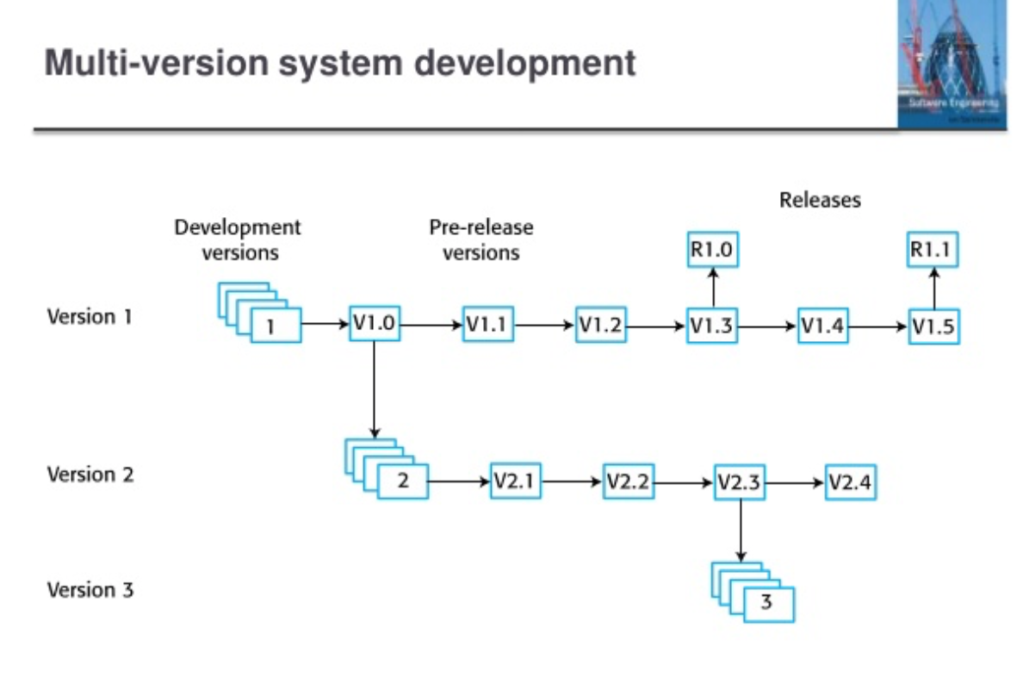

Slide 52
Integrated development environments (IDEs)
Software development tools are often grouped to create an integrated development environment (IDE).
An IDE is a set of software tools that supports different aspects of software development, within some common framework and user interface.
IDEs are created to support development in a specific programming language such as Java. The language IDE may be developed specially, or may be an instantiation of a general-purpose IDE, with specific language-support tools.

Slide 53
Open source development

Slide 54
Open source development
Open source development is an approach to software development in which the source code of a software system is published and volunteers are invited to participate in the development process
Its roots are in the Free Software Foundation (www.fsf.org), which advocates that source code should not be proprietary but rather should always be available for users to examine and modify as they wish.
Open source software extended this idea by using the Internet to recruit a much larger population of volunteer developers. Many of them are also users of the code.

Slide 55
Open source systems
The best-known open source product is, of course, the Linux operating system which is widely used as a server system and, increasingly, as a desktop environment.
Other important open source products are Java, the Apache web server and the mySQL database management system.

Slide 56
Open source issues
Should the product that is being developed make use of open source components?
Should an open source approach be used for the software’s development?

Slide 57
Open source business
More and more product companies are using an open source approach to development.
Their business model is not reliant on selling a software product but on selling support for that product.
They believe that involving the open source community will allow software to be developed more cheaply, more quickly and will create a community of users for the software.

Slide 58
Open source licensing
A fundamental principle of open-source development is that source code should be freely available, this does not mean that anyone can do as they wish with that code.
Legally, the developer of the code (either a company or an individual) still owns the code. They can place restrictions on how it is used by including legally binding conditions in an open source software license.
Some open source developers believe that if an open source component is used to develop a new system, then that system should also be open source.
Others are willing to allow their code to be used without this restriction. The developed systems may be proprietary and sold as closed source systems.

Slide 59
License models
The GNU General Public License (GPL). This is a so-called ‘reciprocal’ license that means that if you use open source software that is licensed under the GPL license, then you must make that software open source.
The GNU Lesser General Public License (LGPL) is a variant of the GPL license where you can write components that link to open source code without having to publish the source of these components.
The Berkley Standard Distribution (BSD) License. This is a non-reciprocal license, which means you are not obliged to re-publish any changes or modifications made to open source code. You can include the code in proprietary systems that are sold.

Slide 60
License management
Establish a system for maintaining information about open-source components that are downloaded and used.
Be aware of the different types of licenses and understand how a component is licensed before it is used.
Be aware of evolution pathways for components.
Educate people about open source.
Have auditing systems in place.
Participate in the open source community.

Slide 61
Key points
Software design and implementation are inter-leaved activities. The level of detail in the design depends on the type of system and whether you are using a plan-driven or agile approach.
The process of object-oriented design includes activities to design the system architecture, identify objects in the system, describe the design using different object models and document the component interfaces.
A range of different models may be produced during an object-oriented design process. These include static models (class models, generalization models, association models) and dynamic models (sequence models, state machine models).
Component interfaces must be defined precisely so that other objects can use them. A UML interface stereotype may be used to define interfaces.

Slide 62
Key points
When developing software, you should always consider the possibility of reusing existing software, either as components, services or complete systems.
Configuration management is the process of managing changes to an evolving software system. It is essential when a team of people are cooperating to develop software.
Most software development is host-target development. You use an IDE on a host machine to develop the software, which is transferred to a target machine for execution.
Open source development involves making the source code of a system publicly available. This means that many people can propose changes and improvements to the software.

