Slide 1
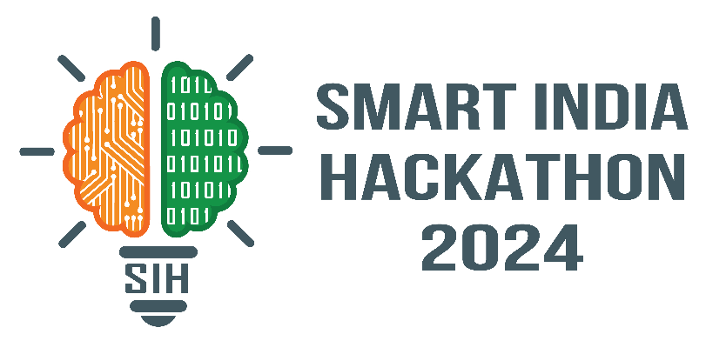
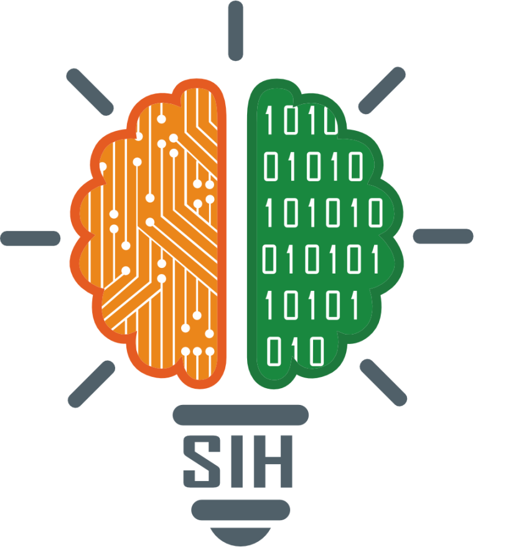
SMART INDIA HACKATHON 2024
Problem Statement ID – 1554
Problem Statement Title- Smart Irrigation System for Precision Farming
Theme- Agriculture, Food Tech & Rural Development
PS Category- Hardware
Team ID- 7195
Team Name (Registered on portal) – EEE08

Slide 2
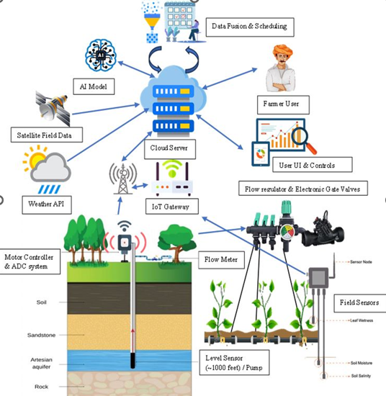

Proposed Solution
Block Diagram
Methodology
1) Direct field data processing- (N, P, K, PH) data from ground field data passed to IoT Gateway via wireless communication
2) Weather API & Satellite field Data - Open weather API & Satellite field Data from satellites (Tamilnadu Agricultural University-TNAU) are passed to cloud server
3) Cloud Server: Data from IoT gateway, satellite & weather data are processed with modeled AI algorithm. Servers run the AI and scheduling algorithm helps to manage irrigation more effectively
4) Monitor and control irrigation scheduling in real time via Mobile dashboard application interface
Innovation and uniqueness of the solution
Remote sensing technology & Direct field Sensor data- Combine satellite data with ground-based sensors for improved accuracy
Demo video & Resources here
Artificial Intelligence and Big Data analytics is employed to extract the information from the image
IOT is employed for data transmission from server node to control unit, motor ON/OFF can be controlled through Mobile App
Click here for Demo & Resources

Slide 3
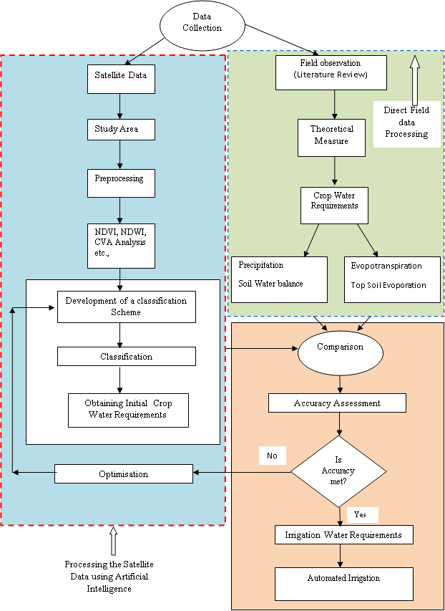
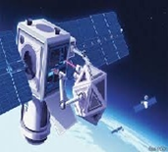
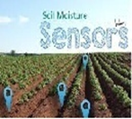

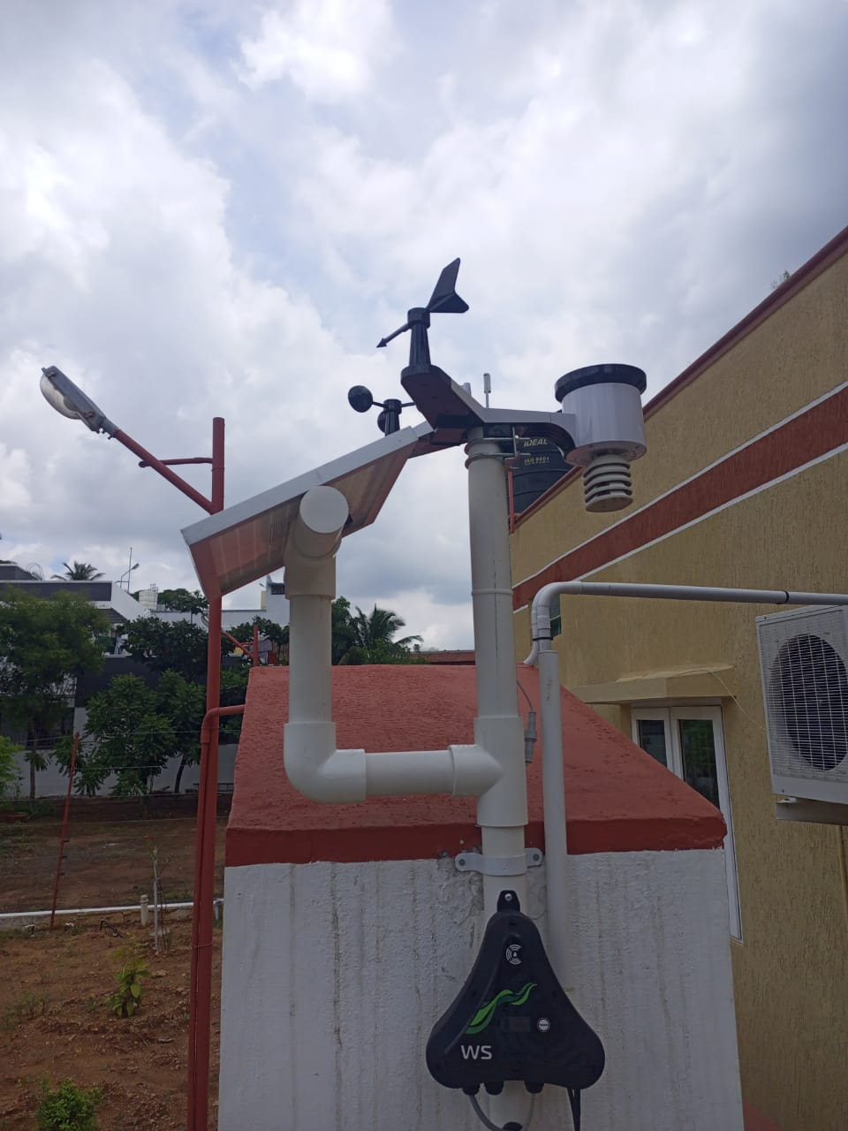
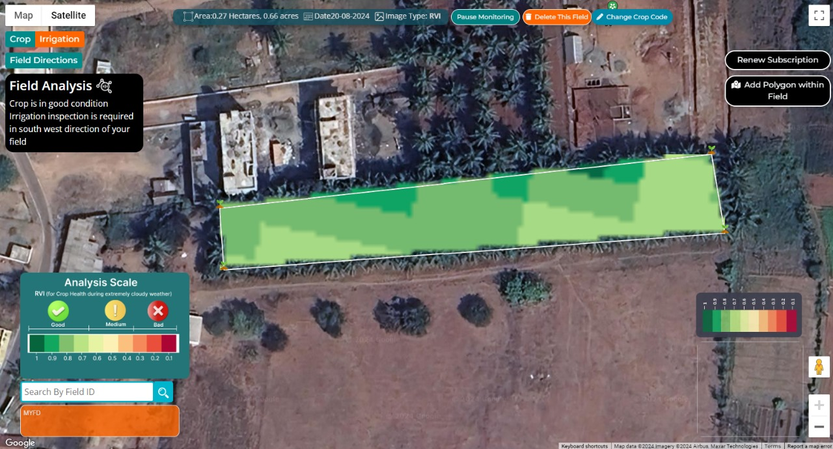
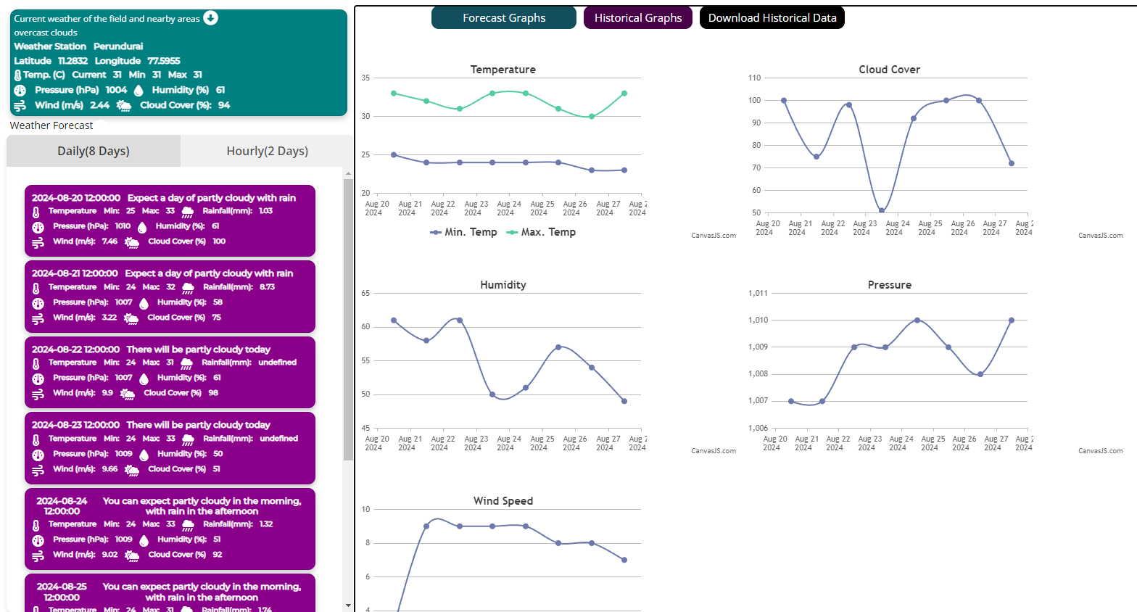
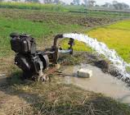
TECHNICAL APPROACH
FLOWCHART
EEE08
TECHNOLOGIES USED
C/C++: to code microcontroller Python: Back-end services, APIs & handling data JavaScript: Essential for front-end development
React Native: App development Framework: Tensor flow & Node Js
AI: ML-Random forest regressor Cloud storage & IOT gateway : Data transfer Electronic relays: Motor automation
Satellite image: By external vendors
Working prototype
Field data
Satellite image
Solar powered sensor module for detecting soil moisture level
Real Time data monitoring

Slide 4
IMPACT AND BENEFITS
EEE08
Potential impact on the target audience
Slogan: More crop and income per drop of water
Target audience : Farmers, Farmer Producer Organization (FPOs) &
Environmentalist
Farmers | Farmer Producer Organization (FPOs) | Environmentalist
Increase in family income | Increase in crop production/ land productivity | Increase availability of natural resources
Increase in irrigated area and coverage | Increase in the yield and a considerable saving in water | Change in land use pattern
Increase in livelihood/ employment opportunities | Promote economic development of village community | Control desertification
Develop an irrigation approach that fosters water conservation and better irrigation management | Mitigate the adverse effects of drought on crops and livestock | Encourage restoration of ecological balance
Benefits of the solution
Social Benefits:
Increase in crop production/ land productivity
Increase in livelihood/ employment opportunities
Economic Benefits:
Reduced Water Usage
Increased Agricultural Productivity
Environmental Benefits:
Water Conservation
Improved Soil Health
Control desertification

Slide 5
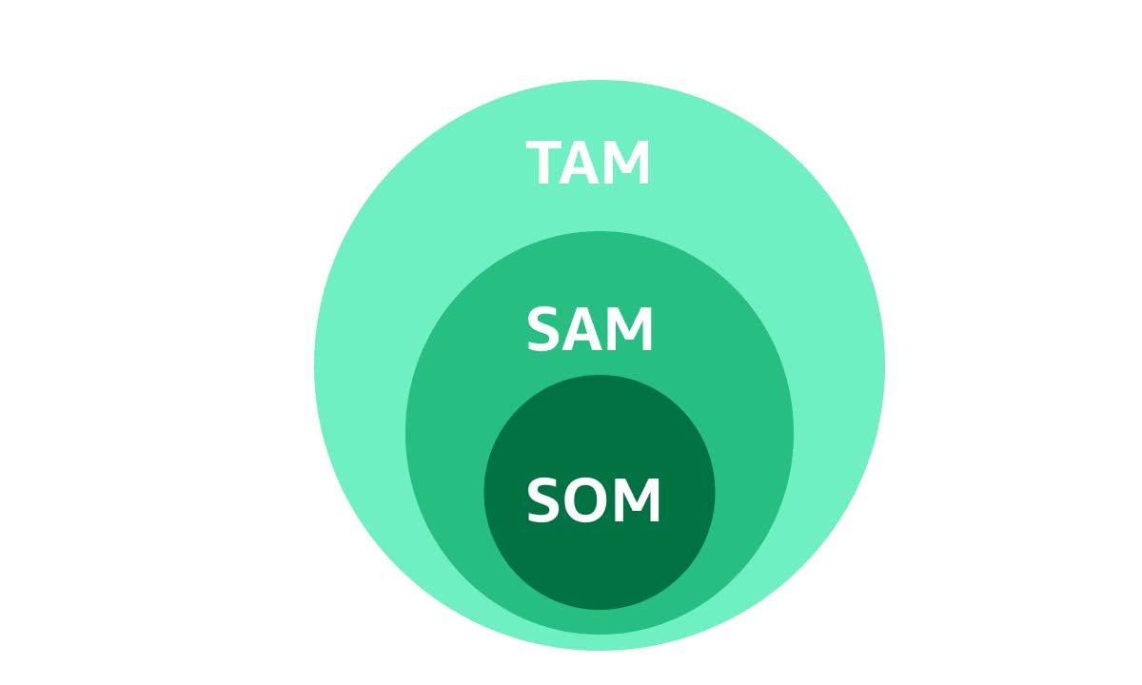
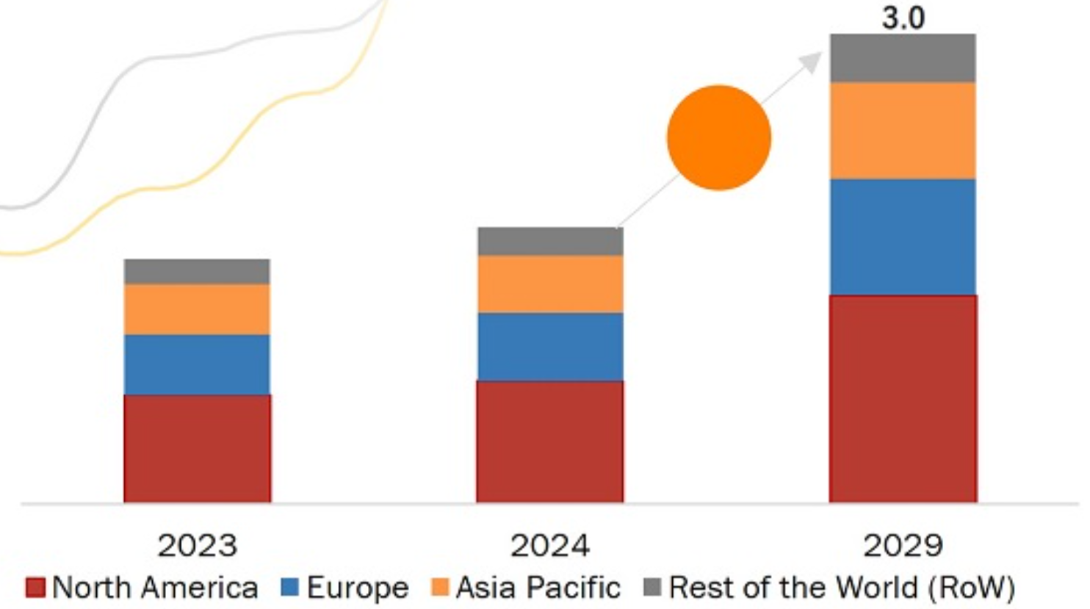
FEASIBILITY AND VIABILITY
EEE08
Feasibility Analysis
Satellite Imagery: High-resolution satellite
images assessing vegetation health, soil moisture
& weather conditions.
Data Integration: Integrating satellite imagery
with ground-based data can enhance accuracy
Cloud computing: Process and analyze large volumes of satellite data efficiently
Potential Challenges and Risks
20 BILLION
TOTAL ADRESSABLE MARKET
Compatibility with existing irrigation infrastructure and practices can be complex
Cloud cover and atmospheric conditions can affect the quality and frequency of satellite imagery
Handling and storing large volumes of data
Lack of Awareness among the farmers
5 BILLION
[SERVICE
ADRESSABLE
MARKET]
500 MILLION
[SERVICE
OBTAINABLE
MARKET]
Viability Analysis
Strategies for Overcoming Challenges
The Global Smart Irrigation Market is estimated to be worth USD 3 Billion by 2029 growing at a CAGR of 11.2% during the forecast period.
Approx cost estimation for our proposed system is 6800 INR.
Satellite remote sensing has been proposed as a low-cost solution to fill widespread gaps in monitoring of agricultural water use globally.
Our proposed work combine satellite data with ground-based sensors for improved accuracy
Data Security: Employ encryption methods for data transmission and storage
Dissemination of Knowledge, training on smart irrigation system for the farmers

Slide 6
RESEARCH AND REFERENCES
EEE08
Research papers | Web resources | Books
Omar H. Kombo, SanthiKumaran, and Alastair Bovim, (2021), “ Design and Application of a Low-Cost, LowPower, LoRa-GSM, IoT Enabled System for Monitoring of Groundwater Resources With Energy Harvesting Integration”, IEEE Access. | https://tnau.ac.in/site/nrm/remote-sensing-and-gis-about-department/ | "Introduction to Remote Sensing" by James B. Campbell and Randolph H. Wynne
YounessTace, Mohamed Tabaa, Sanaa Elfilali, CherkaouiLeghris, HassnaBensag, Eric Renault, “Smart irrigation system based on IoT and machine learning” Energy Reports, Volume 8, Supplement 9, 2022,Pages 1025-1036 | https://www.tomorrow.io/weather-api/ | "Fundamentals of Satellite Remote Sensing" by Emilio Chuvieco and Alfredo Huete
Khalifeh, A. Al-Qammaz, K. A. Darabkh, L. Abualigah, A. M. Khasawneh and Z. Zinonos, "An AI Based Irrigation and Weather Forecasting System utilizing LoRaWAN and Cloud Computing Technologies," 2021 IEEE Conference of Russian Young Researchers in Electrical and Electronic Engineering (ElConRus), St. Petersburg, Moscow, Russia, 2021, pp. 443-448, doi: 10.1109/ElConRus51938.2021.939643 | https://farmonaut.com/ https://fasal.co/ | "Precision Agriculture Technology for Crop Farming" Edited by Qin Zhang and Francis J. Pierce
M. SafdarMunir, Imran SarwarBajwa, Amna Ashraf, Waheed Anwar, Rubina Rashid, "Intelligent and Smart Irrigation System Using Edge Computing and IoT", Complexity, vol. 2021, Article ID 6691571, 16 pages, 2021. | https://agriwelfare.gov.in/en/Agricultural_Statistics_at_a_Glance | "The Robotics Revolution in Agriculture" Edited by Simon Blackmore

