Slide 1
Project Expo - Team S08

Slide 2
Deep Fake Detection
By,
Atul Shah
Shailesha Maganahalli
Shreyus Puthiyapurail
Srilalitha Veerubhotla
CMPE 295B Sec 48 – Masters Project

Slide 3
Significance of Deep Fake Detection
DeepFake – derived from the combination of words ‘Deep Learning’ and ‘Fake’ - is a process of synthesizing seemingly real but fake images or videos by face swapping and manipulation of original content using deep learning technology. Deep Fake’s Definity need a high attention in today’s world of searching truthiness. False information is highly spread day-to-day especially in social media. Applications like this will find out the original truth and let the user benefit with right information among the videos.

Slide 4
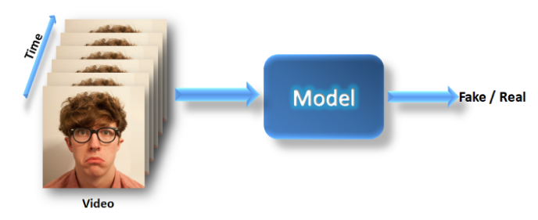
Objective of Deep Fake Detection
In our project, User can scan YouTube link, local pre-stored mp4 files or using chrome extension can scan browsing videos to identify if the video is fake or real and the percentage of fakeness in the video.

Slide 5
We used Face Forensics dataset Face Forensics++ is a forensics dataset which is benchmarked datasets in the deep fake’s it consists of 1000 originally collected videos and labelled using different manipulation methods like deep fakes, Face2Face, Face Swap and Neural Textures. There are 977 videos which are been collected from YouTube and contains clear face tracking without occlusions. This helps us to tap the methods used for video forgery generation. By ensuring the high-quality video selection collected videos have resolution greater than 480pixels.
Data Set

Slide 6
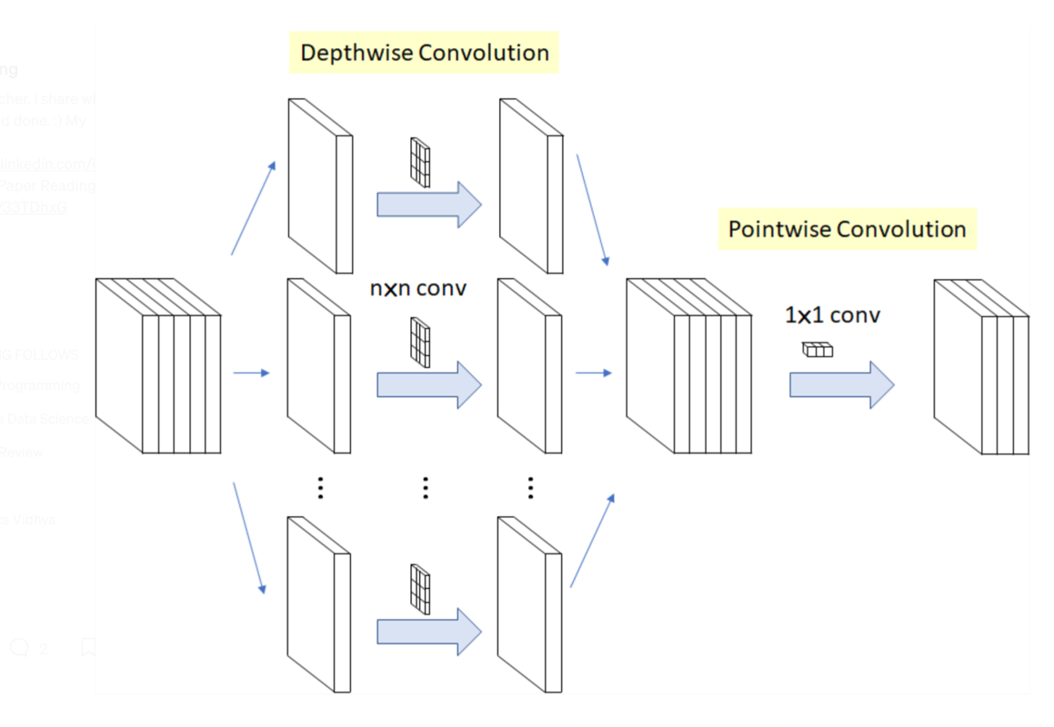
Model Architecture - Xception
Xception Model Architecture

Slide 7

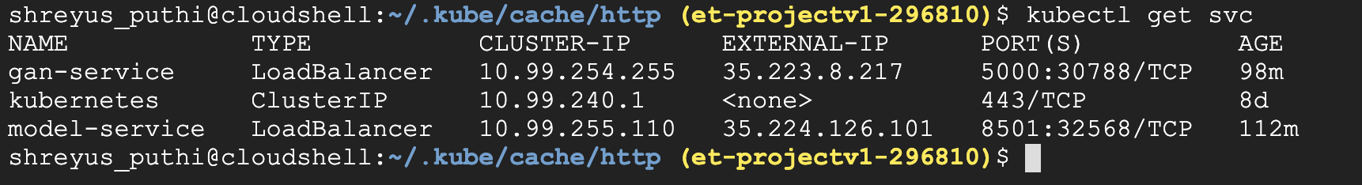
Kubernetes

Slide 8
Model Demo
Let’s View The Deep Fake Video Detection

Slide 9
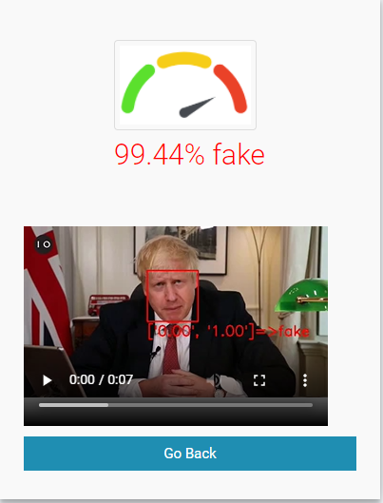
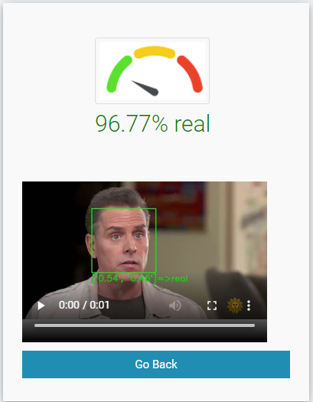
Deep Fake Detection
Application:
http://35.184.128.190:5008/

Slide 10
Thank You

