Slide 1
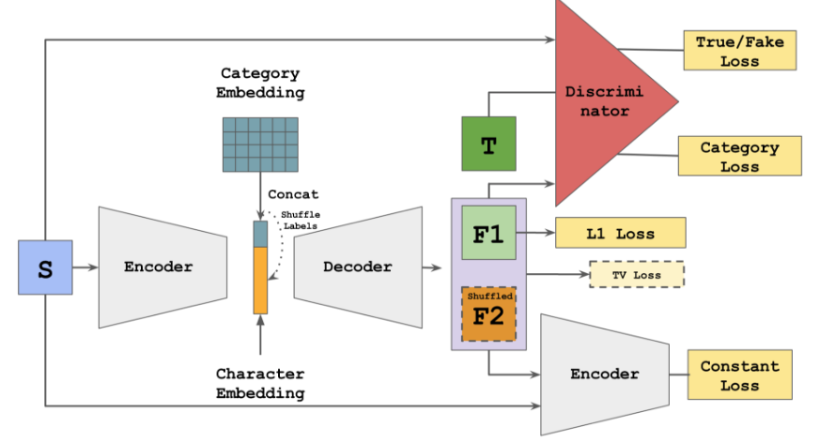
const_loss
const_loss :
source 에서 encoding한 결과 (encoded_real_A) 와
generator로 생성된 fake_B를 다시 encoding한 결과인 encoded_fake_B의 차이
DTN-Network에서 가져온 것
the source and generated character should resemble the same character, thus they must appear close to each other in the embedded space as well. The introduction of this loss GREATLY, GREATLY improves the convergence speed, by enforcing the encoder to preserve the identity of generated character, narrowing down the possible search space.

Slide 2
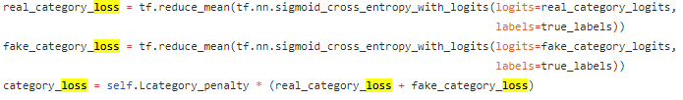
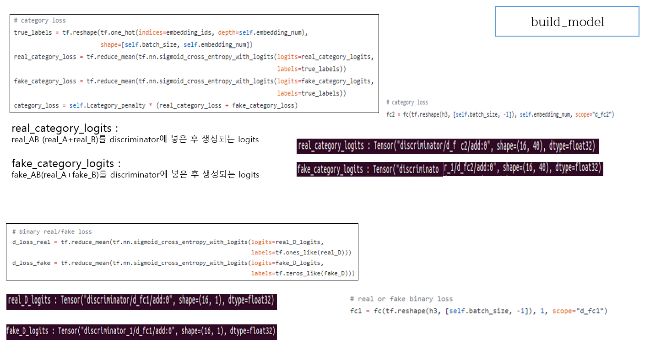
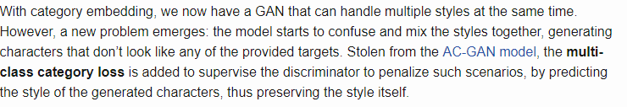
category_loss
Category Embedding for One-to-Many Modeling
1.0

Slide 3

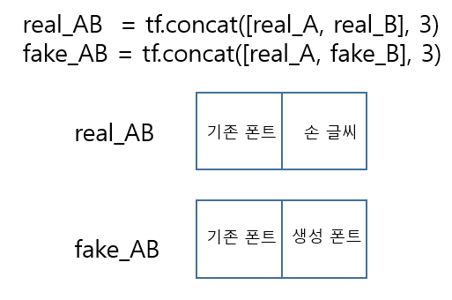
d_loss,
l1_loss

Slide 4
cheat_loss,
g_loss

