Slide 1
Computer Science Fundamentals
Seminar 1

Slide 2
NB
Q&A
https://intranet.wiut.uz/LearningMaterial/Discussion/Details/2843?moduleId=559
Telegram channel: https://t.me/CS_fun2023_2024
Contact details
Module leader: Olga Yugay, oyugay@wiut.uz
Tutor: Nargiza Akramova, n.akramova@wiut.uz
Assessment
40% CW 60% Exam
For CW up to 5 extra marks can be assigned in border-line cases (i.e. 29, 39, 69) if there is evidence of participation in-class activities (it will be evident from Github profile)
Please, join
Notes:
For the instructor: Other instructions are meant to be given with different tasks, and upcoming tutorials to motivate participation in in-class activities

Slide 3
Tutorial objectives
Part A
To explore collaboration tools
To explore Google docs from revision point of view
To gain basic understanding of version control
To explore how Google documents related to Git
Part B
To understand classification of programming languages
To get introduced to Python
Using the Python Interpreter Interactively
Running a Python Script from the Command Line
Online Python REPL Sites
IDE

Slide 4
Part A

Slide 5
Activity 1: Systems vs applications programmer
Refer to the diagram below and distinguish between a systems programmer and an applications programmer.
What was the rationale behind the development of operating systems?
User
Program A
Program B
Computer

Slide 6
Activity 2: My development team
Development process steps are listed below (not in order). Define and tell what happens at each step:
Arrange the steps above in chronological order
programming
documenting
designing
specifying
conceiving
testing
bug fixing
Notes:
For the instructor: Encourage students to participate by asking them if they see themselves working in a development team sometime soon or maybe even creating their own development team. So for that, they need to get an idea what is development process in the first place
Tutor may ask students to define and help them if they do not know before splitting them.
For arranging steps it is recommended to split students into groups of 2-4
Answer: conceiving, specifying, designing, programming, documenting, testing, and bug fixing (although the exact answer depends on development methodology, but we just look at it in general terms)

Slide 7
Activity 3: My development team (continued)
Now with steps more or less clear, what roles are associated with each step?
programming
documenting
designing
specifying
conceiving
testing
bug fixing
Notes:
For the instructor:
Encourage students to participate by asking them what role they find more suitable for themselves
Tutor may help them/hint them if they do not know
it is recommended keep students work in groups of 2-4 and make them discuss what roles they see
Answer: conceiving - account director (not strictly this title, but often used), specifying - system analyst, project manager, designing - designer/system analyst, programming-programmer, documenting-programmer, project manager, testing-programmer, tester, and bug fixing-programmer

Slide 8
Activity 4: Focus on collaboration
Now you got the development team
At which step do you think the team members need to collaborate together?
programming
programming
documenting
documenting
designing
designing
specifying
specifying
testing
conceiving
testing
conceiving
bug fixing
bug fixing
Notes:
For the instructor:
Answer: virtually at all steps, e.g. Account Director/Business analyst sets initial design and requirements with client, this has to be communicated to designer and programmers through Project Manager/Team lead and so on. And the whole process has to be documented. QA engineer participates in testing process.
Stress out the importance of ease of collaboration, documentation, revision control => software tools help with that

Slide 9
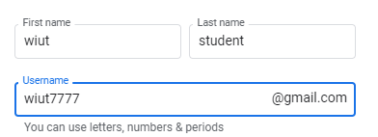
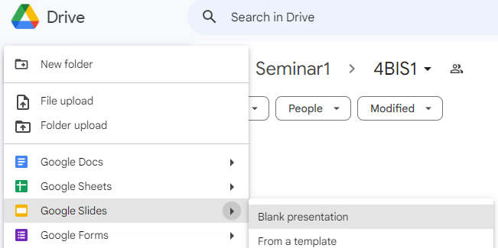
Activity 5: Let’s collaborate and get to know each other
Create a google account using your ID in the username
Open google drive https://www.google.com/intl/en/drive/
Let’s get into groups of 4-5 people. Each person should get registered on google.
Collaborate within your mini group on a following task:
One person in group, makes a folder, named with your IDs
and shares with the rest and wiut.tutor@gmail.com
Name and save a Google Slides presentation with your IDs
Each person should get write a small self introduction on a selected slide and share his/her strengths/interests in IT and which step of development they would be interested in.
Notes:
For instructor: 10 - 15 minutes
Attendance sheet can be used to group students

Slide 10
Activity 5: Demo
Review collaboration on Google doc, Figma
Naming significant revisions, experiment with rollback
Leaving comments, and discuss with team members
Chatting while working on Google Slides
Playing with sharing rights, explore difference between viewer, commenter and editor roles.
Viewer and commenter cannot see version history, note it for sharing coursework with wiut.tutor@gmail.com
Tag other users to get their attention using @nameoftheuser
Notes:
For instructor: Demonstrate how to rollback to particular version, how to name versions

Slide 11
Activity 6: Version control
How do you understand term version control?
Have you heard about Git?
Git is a powerful piece of version control software that helps you to keep track of different versions of your code, collaborate on your code with other people, and experiment with new changes to your code
Watch What is Git?
A quick introduction into Git
So how revisions you made in your Google presentation related to Git?
Read about Git https://git-scm.com/about for upcoming tutorials

Slide 12
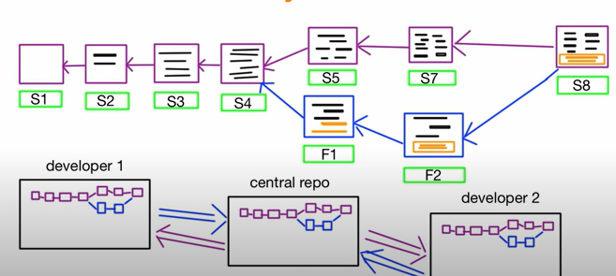
Activity 7: Review git
How do you understand the following terms, refer to the image on the right during explanation:
Commit
Branch
Merge
Central repository
Local copy of repository
Notes:
For the instructor: Ask students and highlight commits (s1, s2..) branches, merges, central repository, local copy repository, push changes to central repository

Slide 13
Part B
Notes:
For instructor: Students can be given 5-10 minute break, those who do not have google account may setup account during the break

Slide 14
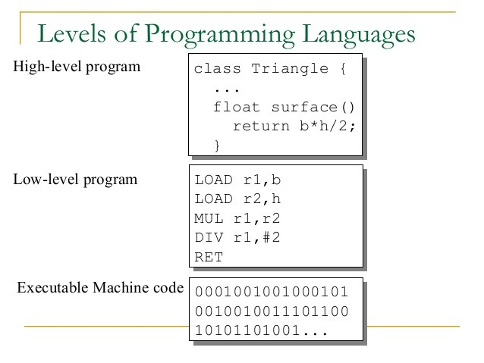
Task 1: Classification of programming languages
Given samples of code, which of them correspond to machine, assembly, high-level language?
Distinguish between machine language and assembly language.
Distinguish between assembly language and high-level languages.
Notes:
For instructor: on click correct answers will appear
Machine language is the language that is built into the electrical
circuitry of a computer.
Assembly language is a language made up of mnemonic codes that
represent machine-language instructions.
Programs written in assembly language are translated into machine
language programs by a computer program called an assembler.
Whereas assembly language is a language made up of mnemonic codes
that represent machine-language instructions, high-level languages use
English-like statements to represent a groups of assembly-language
statements or machine-language statements. There is a one-to-one
correspondence between statements in an assembly language and the
statements they represent in machine language. There is a one-to-many
correspondence between high-level statements and the corresponding
machine-language statements.

Slide 15
Python interpreter
https://www.youtube.com/watch?v=Korc0gwhUNE
code.py
______
______
______
______
Interpreter
Byte code
______
______
______
______

Slide 16
Python
Options to use Python
Using the Python Interpreter Interactively
Running a Python Script from the Command Line
Online Python REPL Sites
IDE

Slide 17
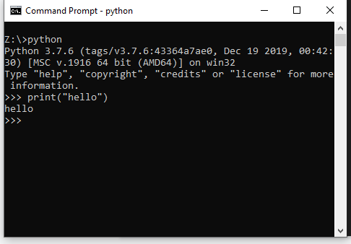
Using the Python Interpreter Interactively
Open command line
Type python to start interpreter
Type print(“hello”)
Type exit()

Slide 18
b. Running a Python Script from the Command Line
Open Sublime or Notepad
Type print(“hello”)
Save file as hello.py to Z:
Open command line, go to Z: by typing z:
Run the file by typing python hello.py

Slide 19
c. Online Python REPL Sites
Go to https://repl.it/languages/python3
Print the following:
======
WIUT
======
Notes:
Note that each line is executed with separate command

Slide 20

d. open PyCharm
Click on Start button
Search for PyCharm
Task 1
Try: print('='*10)
Recreate the logo using rule above
==========
WIUT BIS
==========

Slide 21
Important terms
Variables are simply places to store information and to give that information a name. As the term indicates the information stored is "variable", meaning that it can change
Expressions are combinations of values, variables, and operators that the Python interpreter evaluates to compute a resulting value.
2 + 2
1 + 2 + 3 * (8 ** 9) - sqrt(4.0)
max(3, 94)
round(81.5)
"hello"
"hello" + "world"
None
True
False

Slide 22
Data types
Variables can store data of different types, and different types do different things.
Python has the following data types built-in by default:
We will cover the data types in detail in upcoming weeks
Text Type: | str
Numeric Types: | int, float, complex
Sequence Types: | list, tuple, range
Mapping Type: | dict
Set Types: | set, frozenset
Boolean Type: | bool
Binary Types: | bytes, bytearray, memoryview

Slide 23
Data types
In Python, the data type is set when you assign a value to a variable:
Data type of any object can be identified by using the type() function:
year = 2023
module_name = “CSF”
print(type(year))
print(type(module_name))

Slide 24
Task 2:
Print this using variables for all possible components
***************
WIUT
***************
For more advanced feature, try input() function for getting input from user

Slide 25
Homework 0: Install git
https://git-scm.com/book/en/v2/Getting-Started-Installing-Git
https://youtu.be/8JJ101D3knE
Register on Github with your google account (containing ID, not your name)

Slide 26
Homework 1: Python operators
Review python operators
https://www.w3schools.com/python/python_operators.asp
Write a code for calculating total mark for the CSF module.
Assessment components: 40% CW 60% Exam
Notes:
Pause the video for needed time and write code for the following task

Slide 27
Homework 2: Generations of hardware
Fill out the table below.
 | Memory (primary and secondary) | Processing power | Purpose
First generation hardware
Second generation hardware
Third generation hardware

Slide 28
Homework 4: Review the collaboration tools
Explore some examples of collaboration tools (videos) are available on internet:
Google docs
InVision Studio
Trello
Guess what development steps they are for? What other tools you may need in different steps of the development? Your coursework is closely related to given topic
Notes:
For the instructor: The videos will be downloaded and made available either through intranet or james

Slide 29
Homework 5: Comparing Python to other languages
Collaborate in previous group, create a google Document/Spreadsheet and compare Python to other languages.
Put references
Explore Publish to web feature

Slide 30

Recommended actions
!
Join telegram channel: https://t.me/CS_fun2023_2024
Intranet: e-version of Dale, Computer Science Illuminated, Ch 1
Or library: get and read Dale, Computer Science Illuminated, Ch 1
Do homework on slides
Watch how to organize Google Drive online
Read https://www.python.org/about/gettingstarted/
Explore additional sources:
https://realpython.com/installing-python/
https://realpython.com/interacting-with-python/
https://realpython.com/run-python-scripts

Slide 31
Thank you and good bye!

