Slide 1
ER diagram of the database of the project's application
Made by: Malak NHAMI – Marwa MAZOUZ – Sara LAMNAIY – Mohamed MOUSSAID

Slide 2
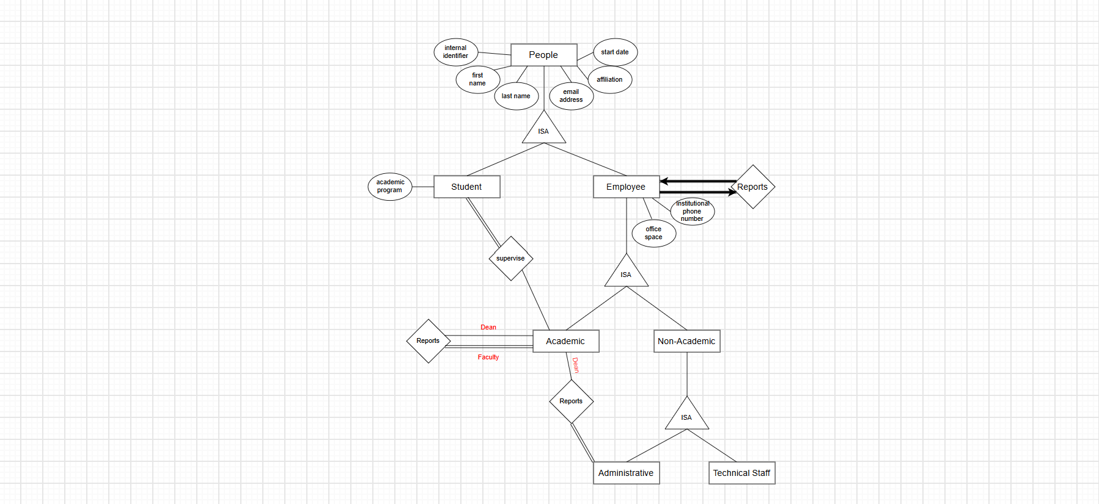

Slide 3
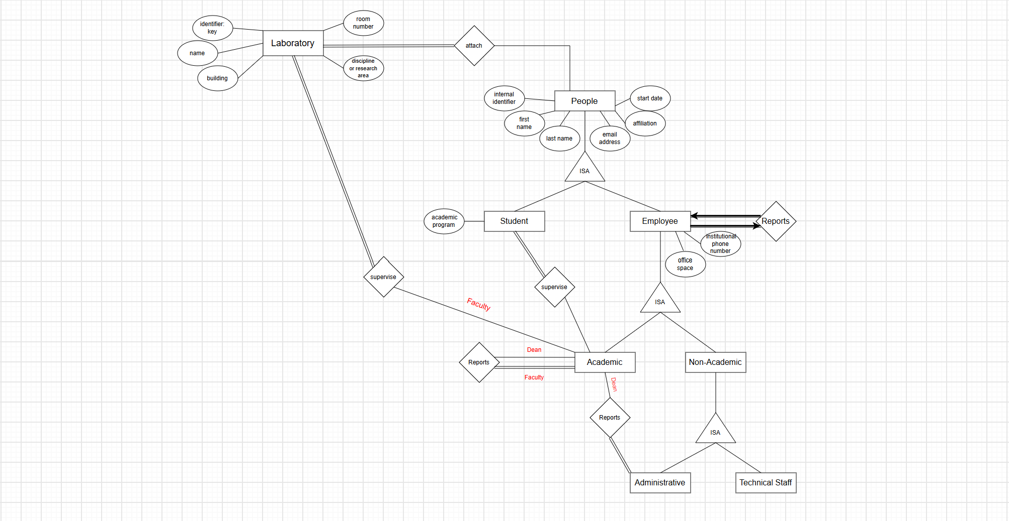

Slide 4
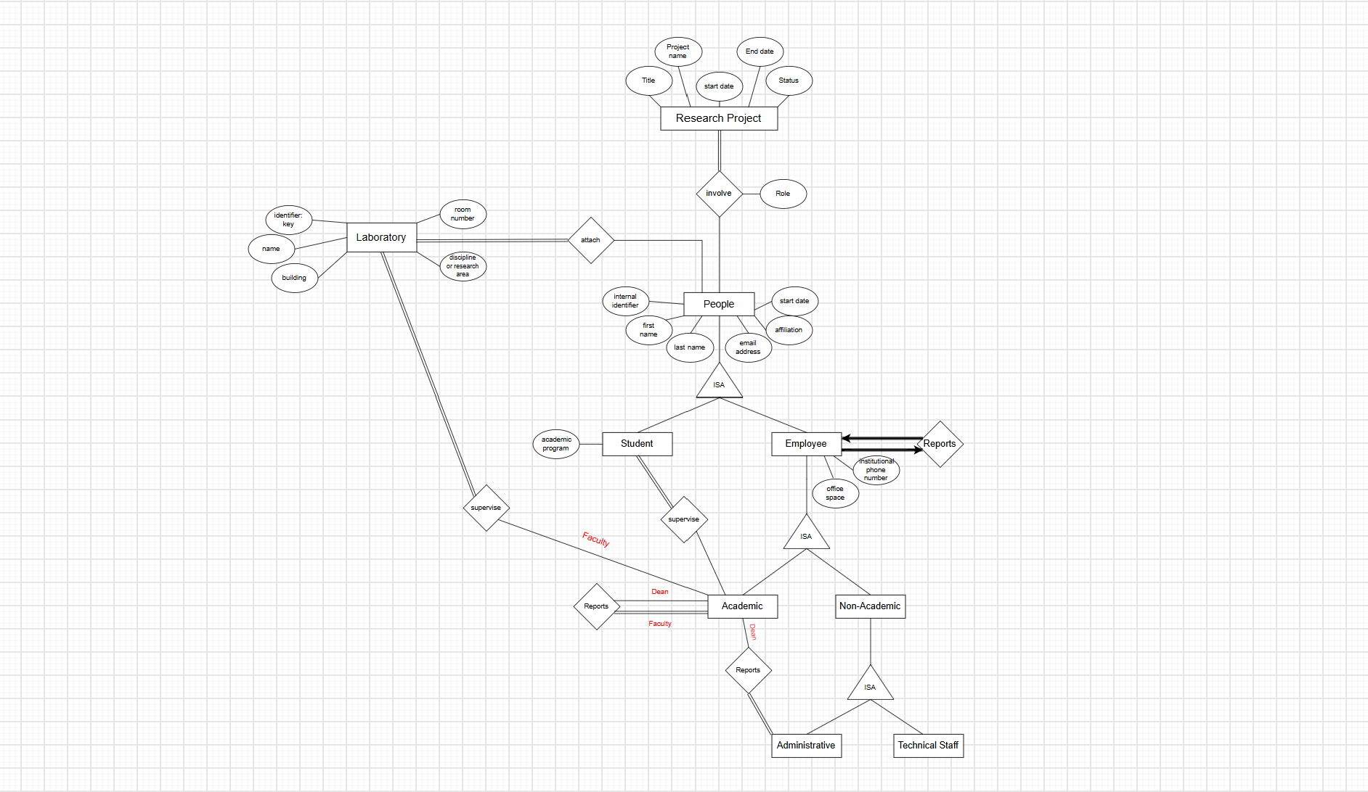

Slide 5
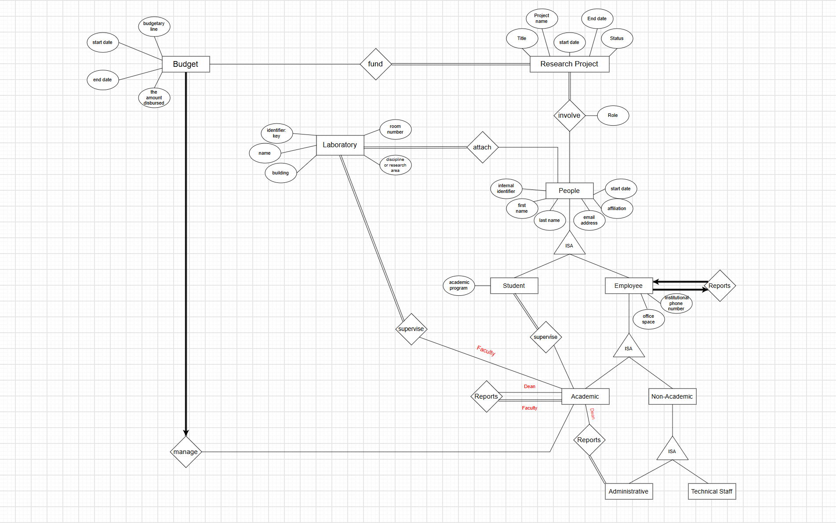

Slide 6
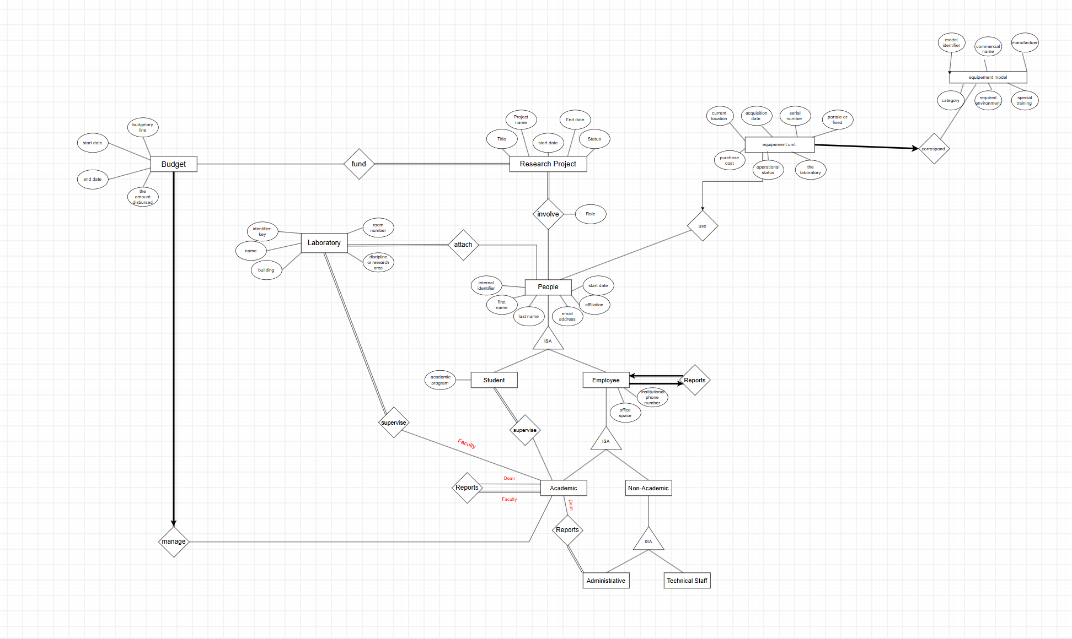

Slide 7
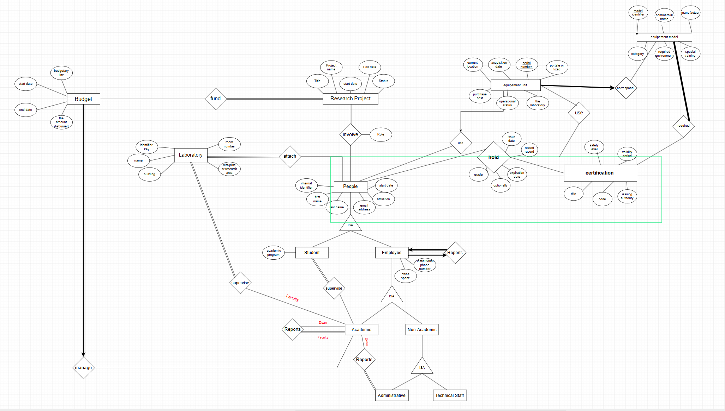

Slide 8
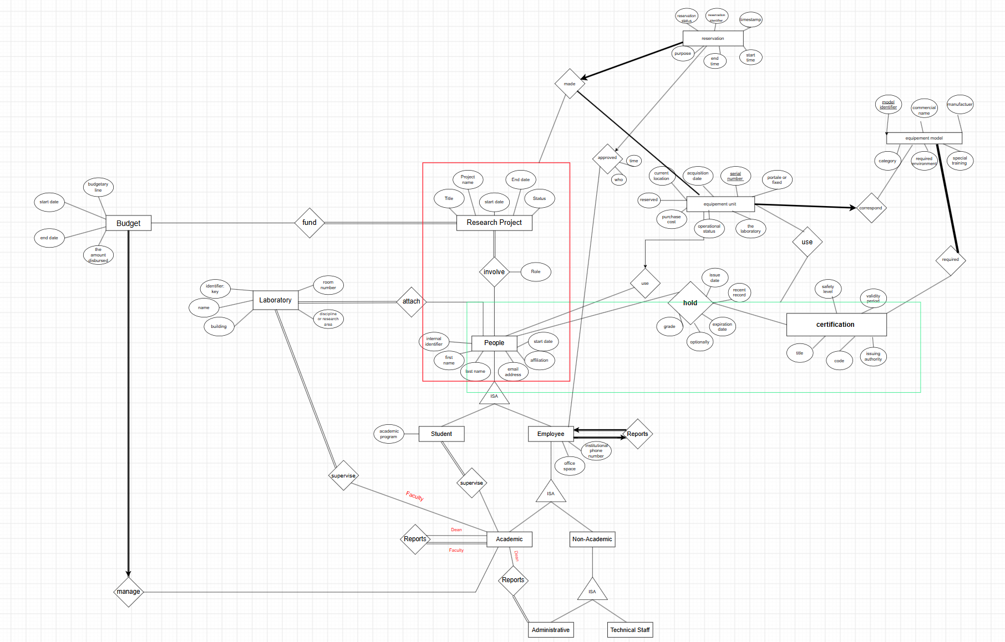

Slide 9
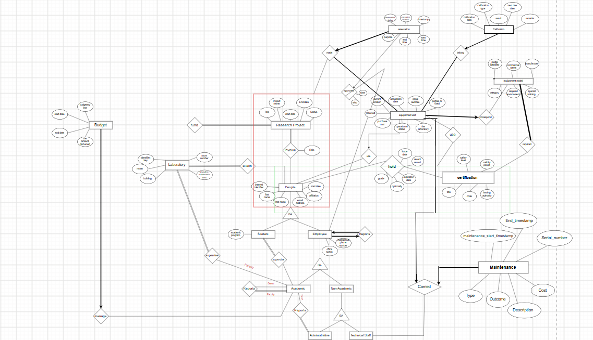

Slide 10
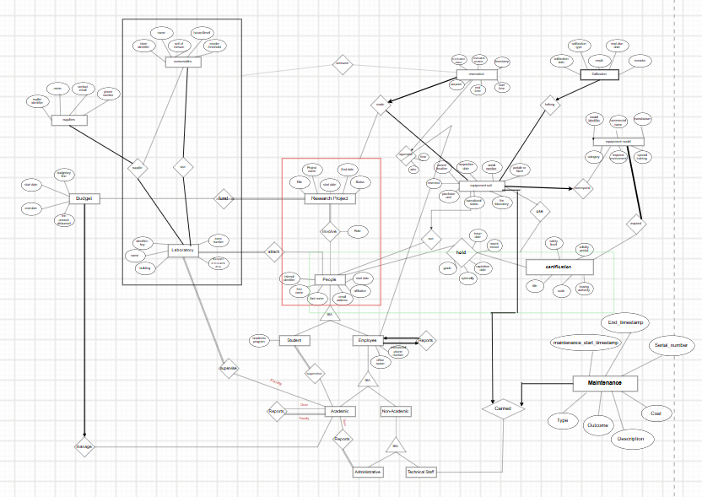

Slide 11
Note:
Unfortunately given that the size of the page we were working on is too big to the point that the screenshot looks blurry, we ask you kindly to go and check our work in details in the attached file with the extension ".drawio" for better readability.
The interface is easily accessed using the file below:
https://app.diagrams.net/
No need to sign up -
Make sure to download the attached file and access it through clicking on File -> Open from... -> Device to open it.

