Slide 1
Academic English
Meeting One
Lecturer: Islam Mohiadeen

Slide 2
Today Agendas
• Introduction about the course
• Listening Activity
• Giving your Opinion

Slide 3
• Introduction about the course

Slide 4
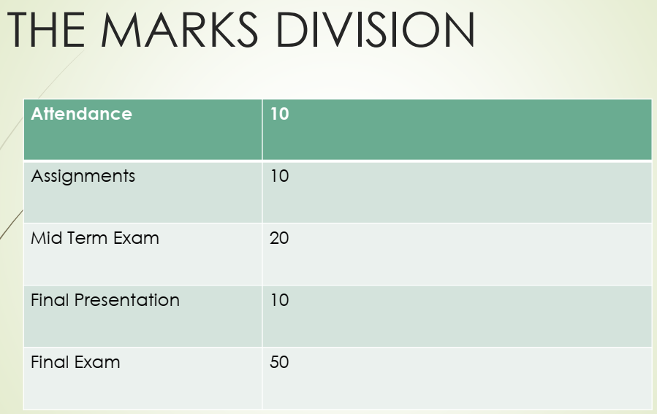

Slide 5
Why Academic English ?

Slide 6
Your questions and expectations

Slide 7


Slide 8
Active Listening
It is a communicative way of listening and responding to others.
It focuses attention on the speaker and what he means

Slide 9
Work sheet one

Slide 10
Work sheet two

Slide 11


