Slide 1

Meet Ahmed

Slide 2

Ahmed studied abroad for years. When he came back to Bahrain to start his business, he had a problem: he struggled to write catchy social media captions in our local dialect
عربي

Slide 3
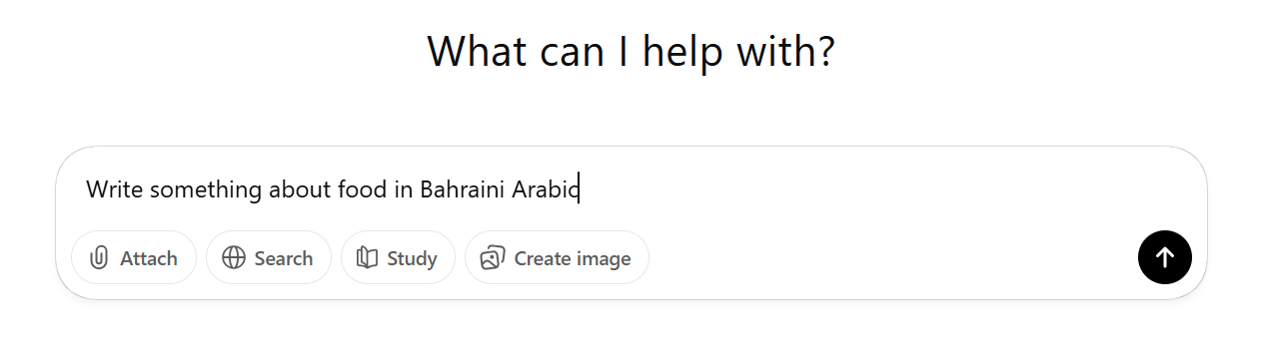
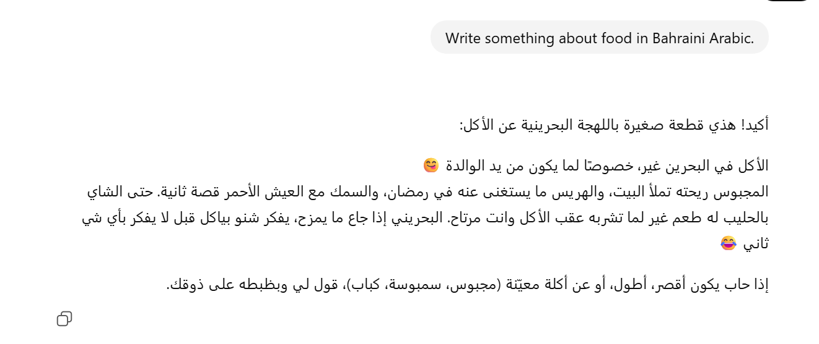
He tried to use standard AI tools like ChatGPT, but the results were very boring and too formal. It sounded like a school textbook, not like a local brand. Ahmed needed something that speaks 'Bahraini' to win the hearts of his customers.

Slide 4
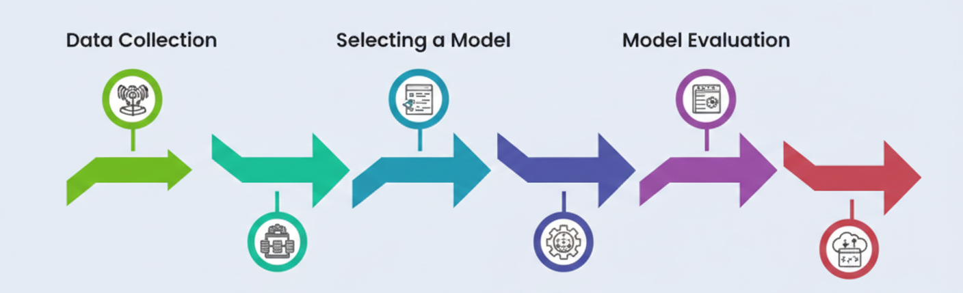
The Plan
I will take a smart pre-trained model and teach it how we talk in Bahrain. I will use Python to create this 'brain' so it understands.

Slide 5
Data Collection
I will start by collecting real data from where Bahrainis hang out: Instagram , X , (Tafash Comedy Series)
How I will store the data?!!
I will save all the text I find into an Excel file (CSV). This will make it easy for me to organize the data

Slide 6
Prototype Goal
I will build a simple website using Streamlit to show the prototype. The goal is that when Ahmed types a simple idea, the AI gives him a perfect Bahraini caption. This will make the brand feel like a local friend

Slide 7


Slide 8
Challenges
Data Scarcity: Finding a large dataset of authentic Bahraini slangis difficult. We plan to address this by scraping local social media.
Model Tone: Standard AI often sounds too formal.

Slide 9

User Experience: Making the AI sound like a real Bahraini to satisfy local business owners

Slide 10
Next Steps
Data Phase: Collect and clean Bahraini text from various local sources.
Training the AI

