Slide 1



Dooit Project
Ted x Presentation
Analyze Gender Disparity in Medical Device Payments
Presented by: Husky Trailblazers (Team 1)
INT 6940: Experiential Network Projects
Professor: Yin Jiang
Date: December 5, 2024

Slide 2
AGENDA
Overview
Scope & Deliverables
Key Findings
Actionable Recommendations
Appendix

Slide 3
OVERVIEW OF THE PROJECT
Aiming to promote leadership development in women.
Goal:
Focused on analyzing gender-based payment disparities in the medical devices sector of the healthcare industry over 3 years (2021-2023).
Scope:
Analyzed top-20 companies, and potential for expansion.
Limited to companies operating within the United States.
10

Slide 4
PROJECT ASSUMPTIONS & DELIVERABLES
Assumptions:
Single Data Source: Analysis based on OpenPaymentsData accuracy.
Findings rely on complete, accurate reporting.
Deliverables:
Gender Payment Gap Analysis Report.
Visual Representation of Data and Emerging Patterns.
Strategic Insights and Actionable Recommendations.
10

Slide 5
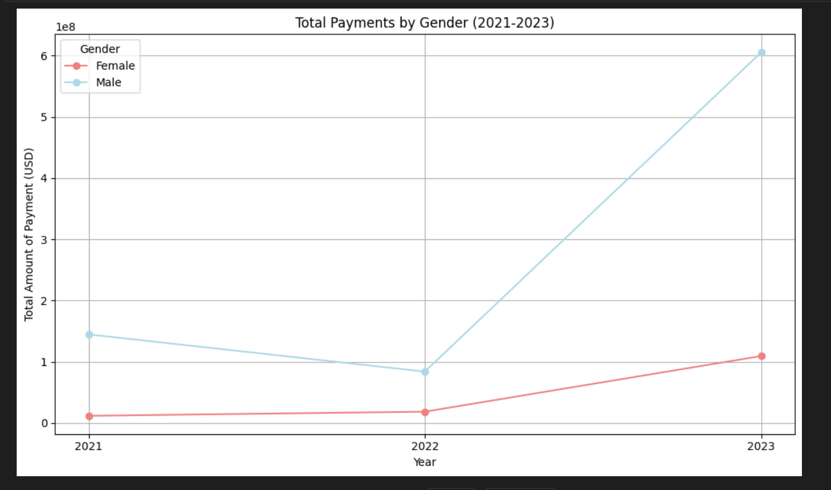
KEY FINDINGS: GENERAL TRENDS
60% more was spent on male promotions than on females. [Fig. 1]
Consistent male dominance in Top-20 companies. [ Fig. 2]
Gender disparity is evident in services and compensations.
Education spending gaps improving slowly: a modest 9.6% improvement over 3 years.
Speaker payments see faster progress: a significant 20% improvement.
Other categories show better balance: more consistent gender equity.
Fig 1: Total amount spent on male vs. female ( 3 yr trend)
10

Slide 6
KEY FINDINGS: SPECIALTY BASED
Medical Doctors dominate payments significantly:
In 2023, $670M in total payments.
80.6% for male & 13.2% for female practitioners. [Fig 3]
Nurse practitioners lead among females:
Female payments in Nurse Practitioners grow (33% in 2023).
Female payments have risen 2x since 2021.[Fig 4]
Certified Nurse-Midwives:
Female payments dropped 13% from 2021-2023. [Fig 5]
10

Slide 7
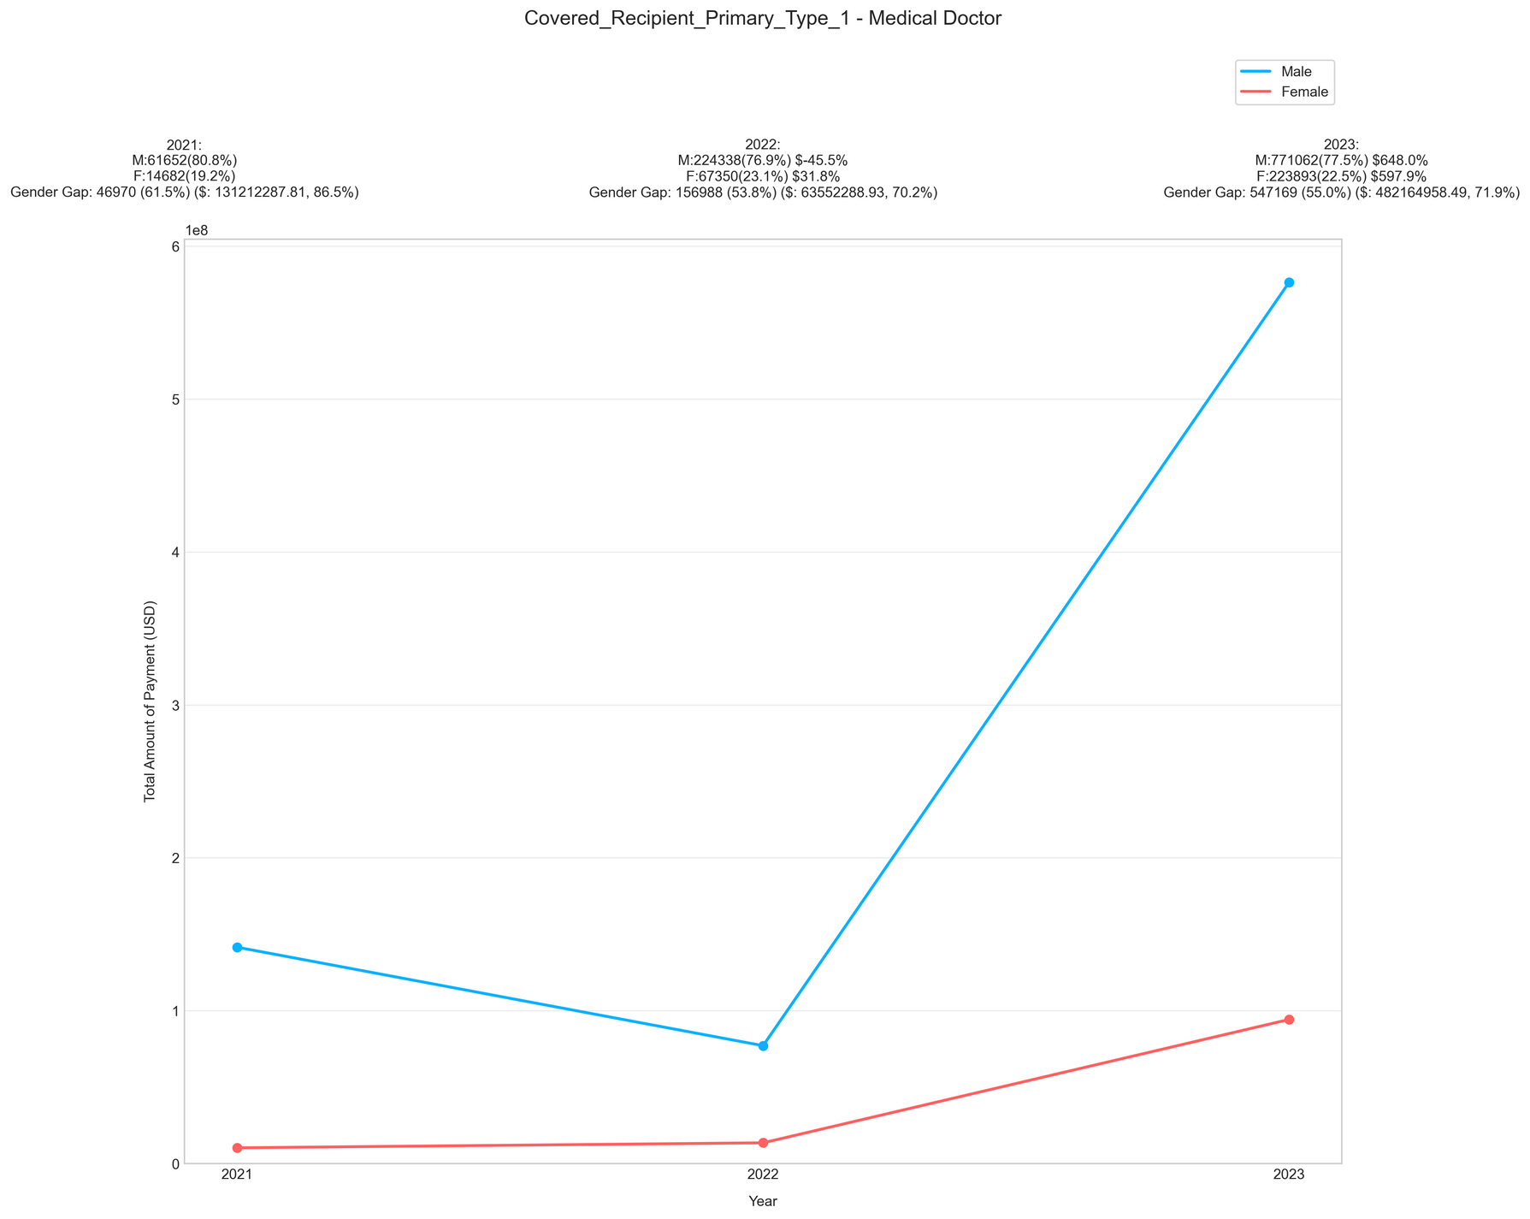
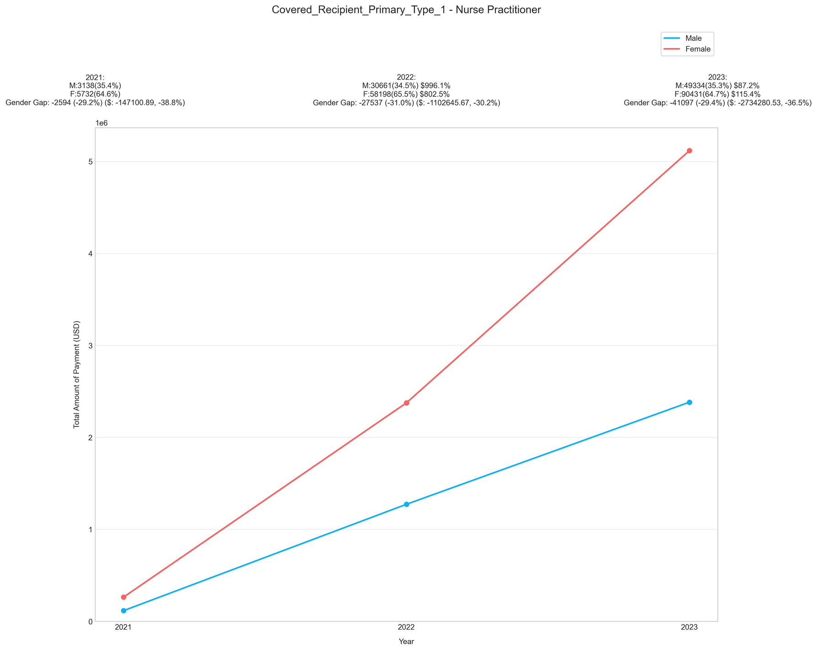
KEY FINDINGS: SPECIALTY BASED
Fig 3: F to M ratio - Medical Doctors
Fig 4: F to M ratio - Nurse Practioners
10

Slide 8
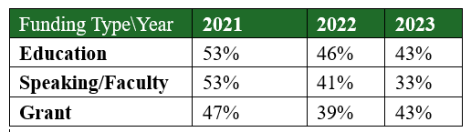
KEY FINDINGS: NATURE OF PAYMENTS
Males receive higher payments in royalties, licenses, and research grants. [Fig 7][Fig 8]
Pay gap narrowing in education, speaker/faculty, and grants. [Table 1]
Pay gap widening in debt forgiveness, acquisitions, and consulting fees. [Table 2]
Table1: Categories Showing Payment Gaps Narrowing Down
10

Slide 9
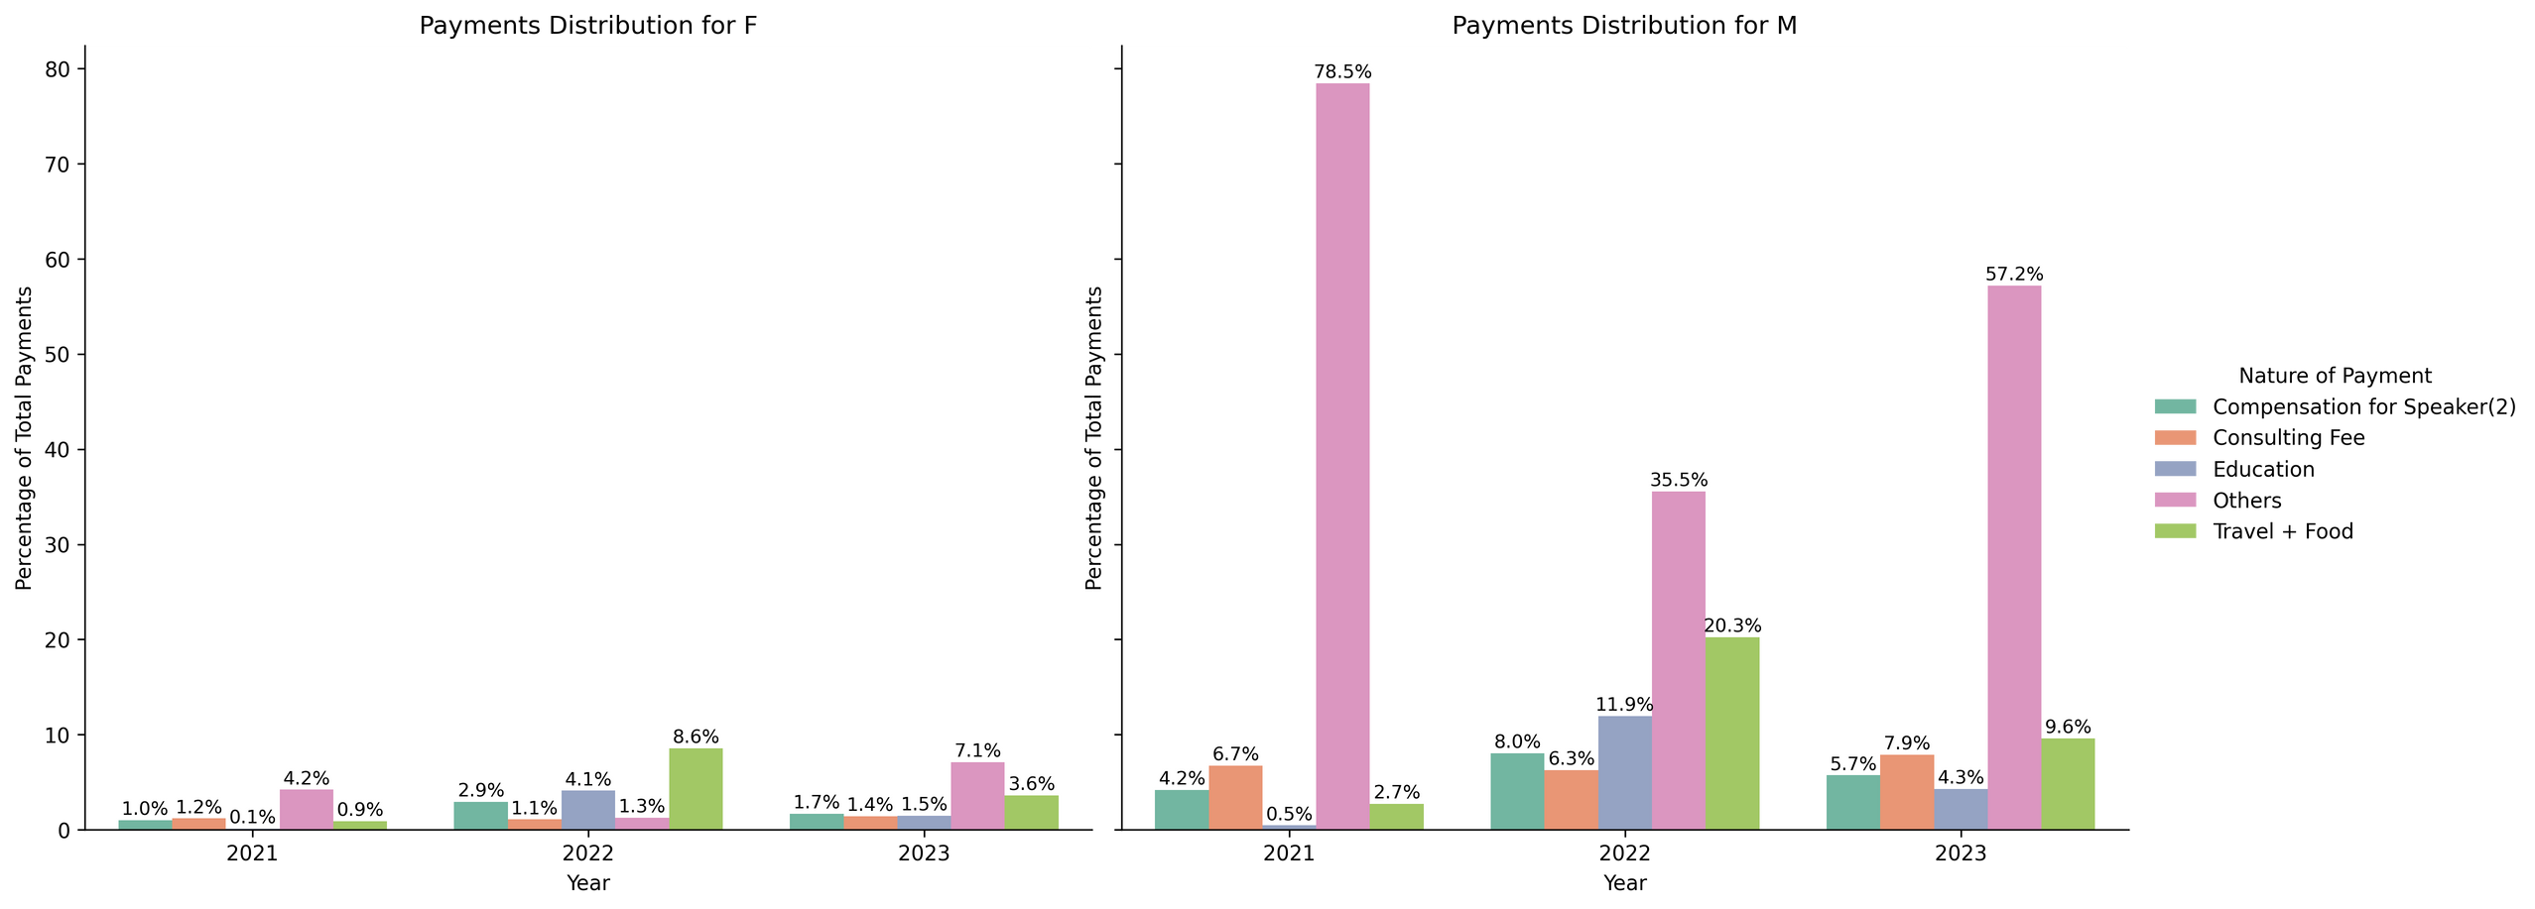
KEY FINDINGS: NATURE OF PAYMENTS
Fig 9: Nature of Payment Distribution- 3 yrs overview
10

Slide 10
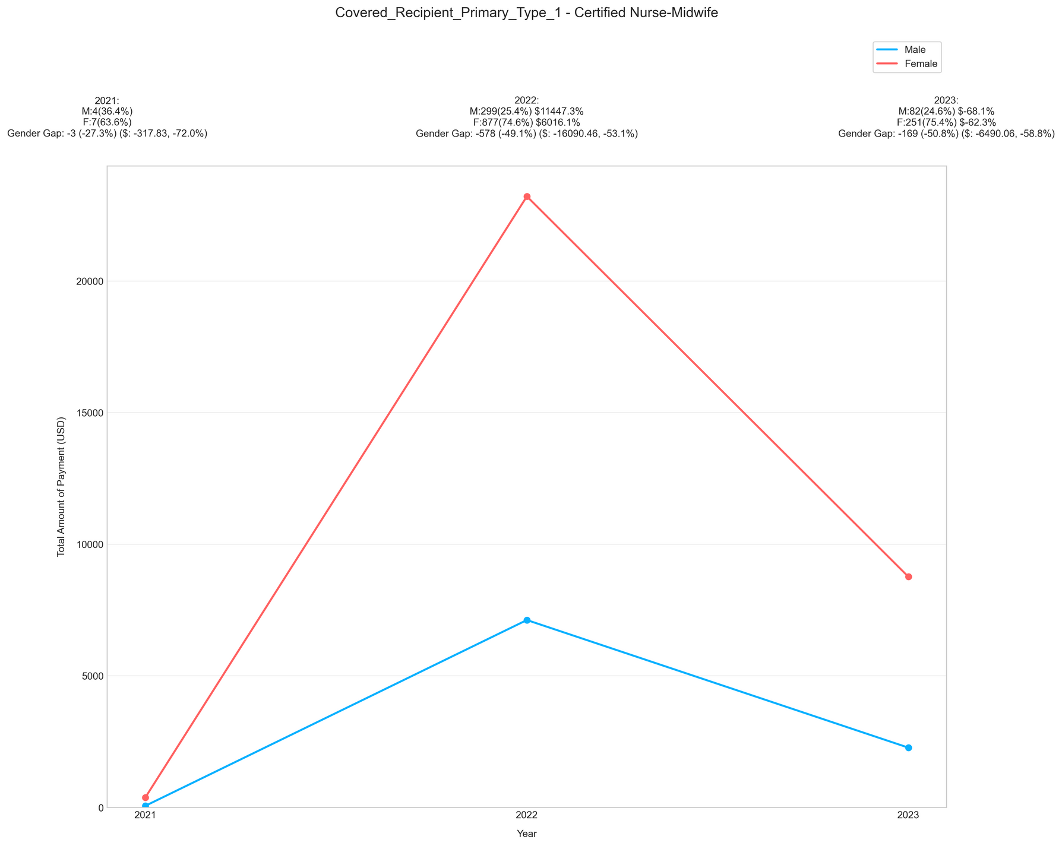
KEY FINDINGS: RESEARCH TRENDS
Overall gender gap decreased by 51%
$5.5M (2021) to $2.7M (2023).
Female non-physician practitioners saw a 300% rise, surpassing males (52% decline) in 2023.
10

Slide 11
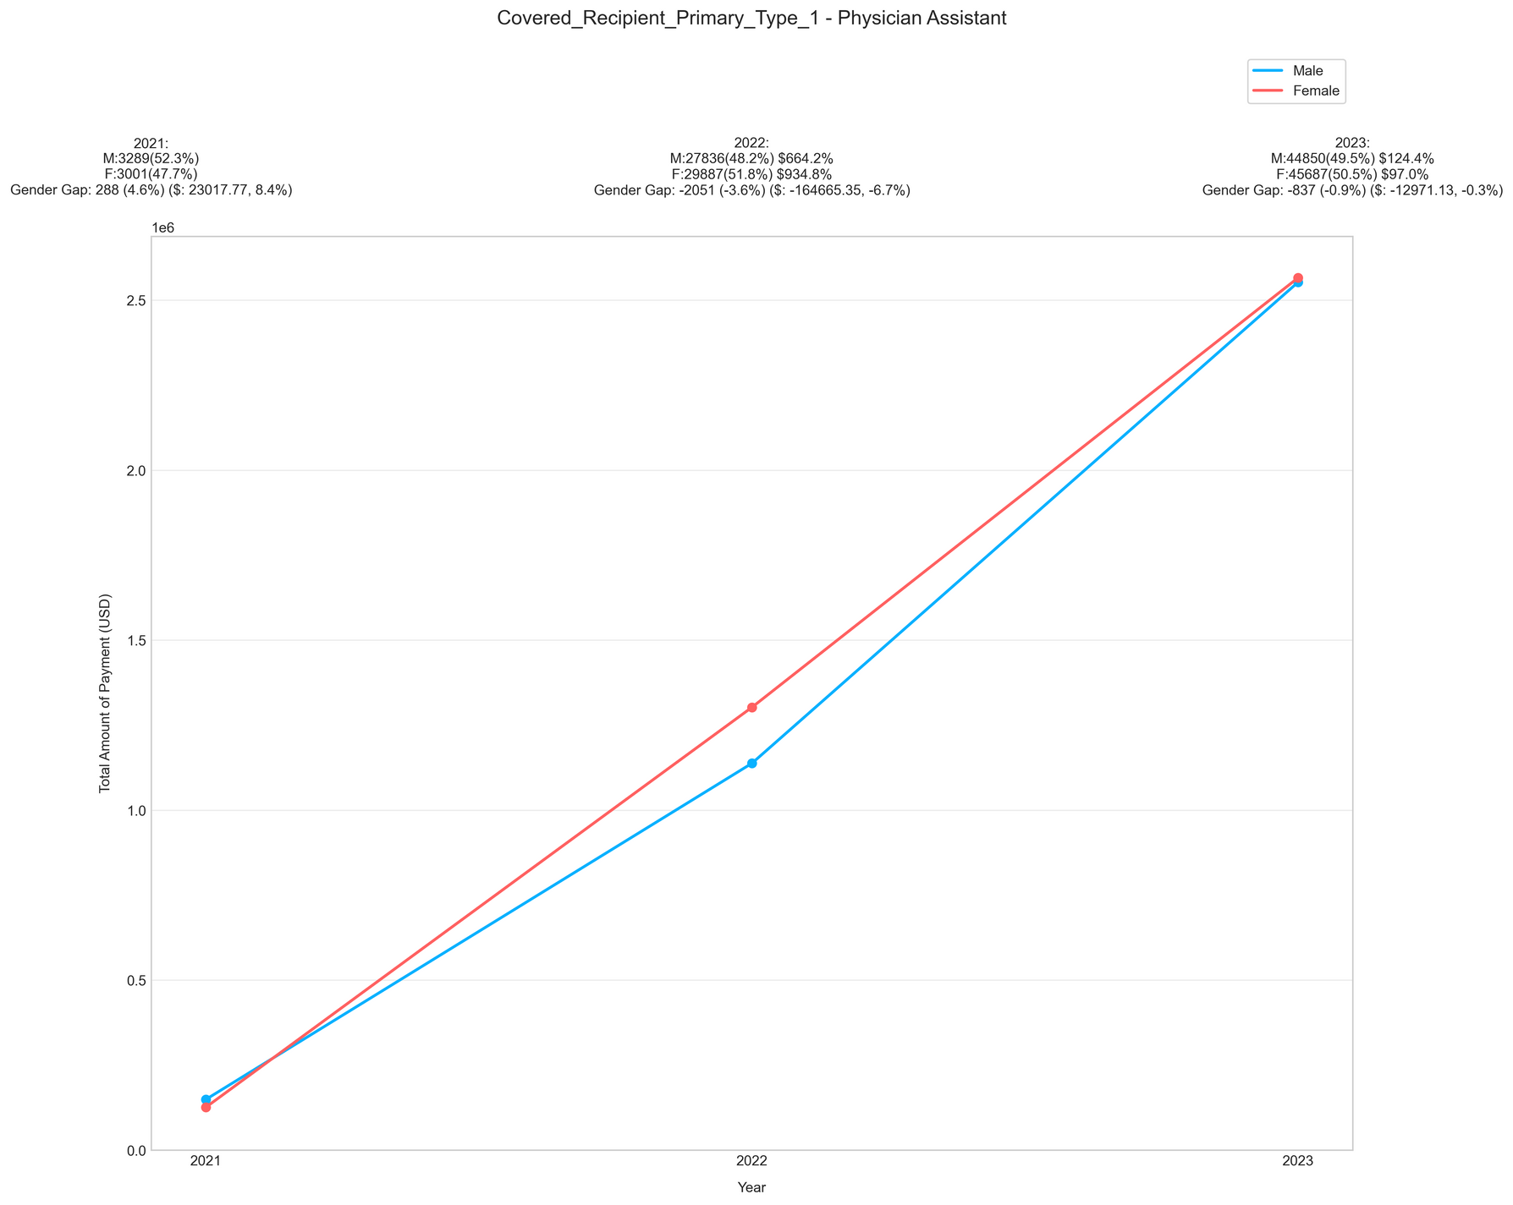
KEY FINDINGS: RESEARCH TRENDS
Physician gender gap narrowed by 43%, but males still receive higher payments.
Male payments declined, while female payments steadily increased from 12.9% (2021) to 28.9% (2023).
10

Slide 12
ACTIONABLE RECOMMENDATIONS
Targeted Leadership Workshops
Focus on specialties with 52% male dominance.
Increase Research and Consulting Opportunities for Women
Address 43% research gap for female physicians.
Establish Structured Mentorship Programs
Pair female professionals with leaders in their fields.
Partner with leading companies
Learn best practices and promote equitable policies.
10

Slide 13
MEET THE TEAM
Chaitrali Patne
Yash Sodvadiya
Yixuan Liu
Malak Parmar
Shreyansh Agarwal
Yunjie Xiong

Slide 14

Thank You!!!
10

Slide 15
APPENDIX: DATASET HIGHLIGHTS
2M+ records; General & Research Payments
Gender Split (General): 69% Male, 31% Female
Gender Split (Research): 82% Male, 18% Female
Less data for female practitioners, especially physicians.
Predominantly male-dominated dataset.
Data Coverage: Primarily U.S.-based healthcare companies with professionals all around the world.
10

Slide 16
APPENDIX: GENERAL DATA INSIGHT
Fig 1: Total amount spent on male vs. female ( 3 yr trend)
10

Slide 17
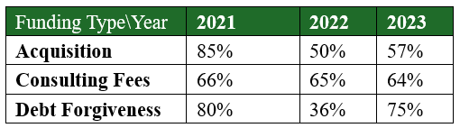
APPENDIX: TRENDS IN NATURE OF PAYMENTS
Table1: Categories Showing Payment Gaps Narrowing Down
Table2: Categories Showing Payment Gaps Widening
10

Slide 18
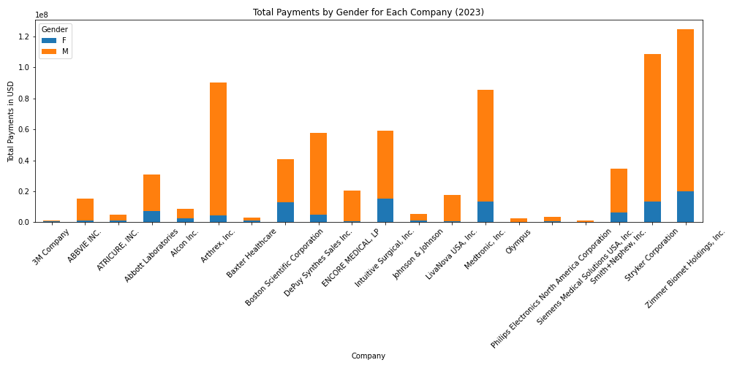
APPENDIX: TRENDS IN 2023
Fig 2: Total amount spent on male vs. female by top-20 companies (year - 2023 data)
10

Slide 19
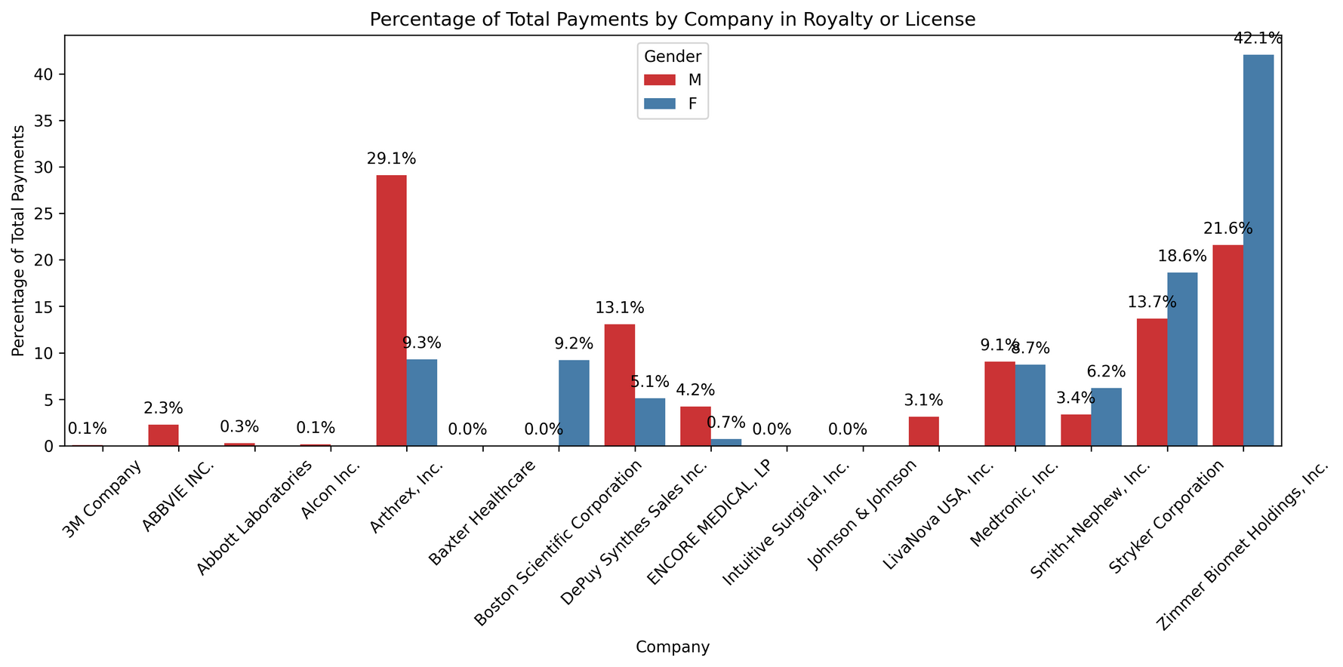
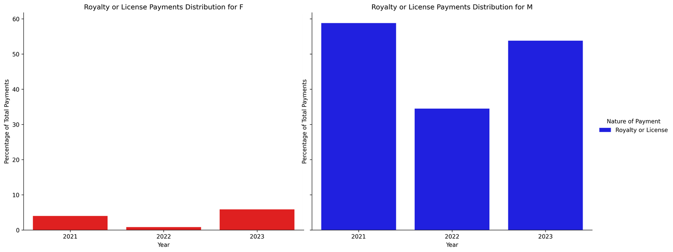
APPENDIX: TRENDS IN NATURE OF PAYMENTS
Fig 8: Royalty or License Payments Company-wise
Fig 7: Royalty or License Payments
10

Slide 20
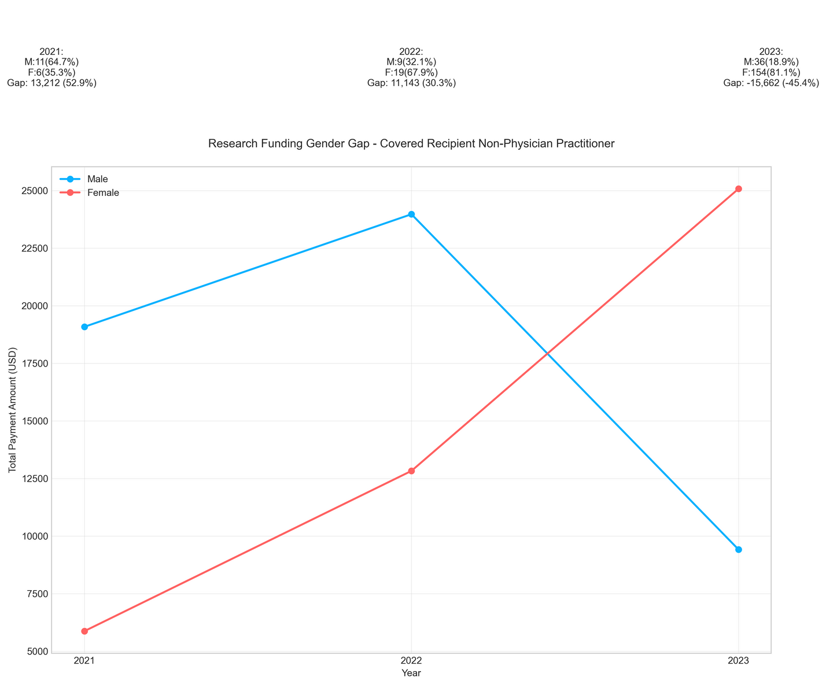
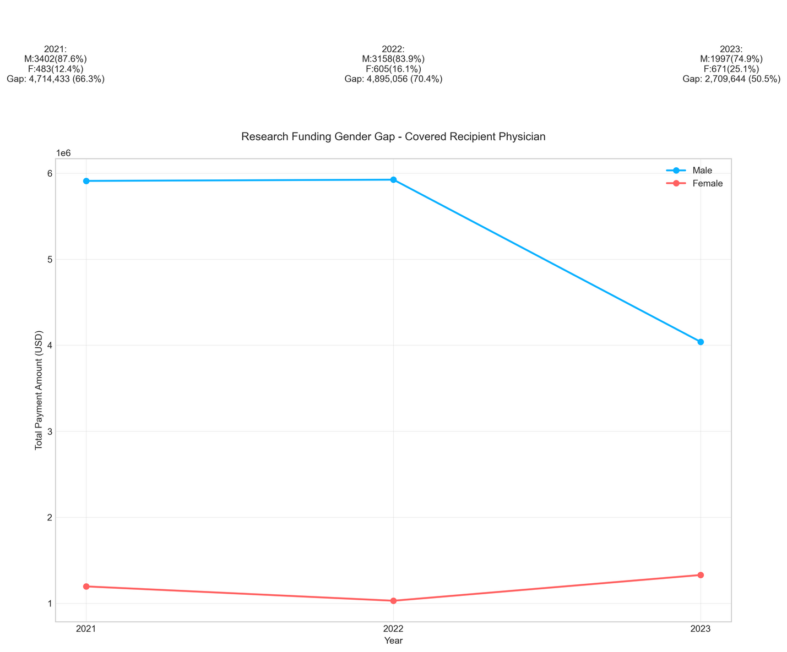
APPENDIX: RESEARCH TRENDS
Fig 10: Gender gap for Non-Physician Practioner
Fig 11: Gender gap for Physician Practioner
10

