Slide 1

Supply Chain Optimization Analysis
Presented by : AWS Trible M
Date : 9/5/2025

Slide 2
🔍 Problem Statement :
supply chain operations often suffer from inefficiencies, delivery delays, and lack of visibility into top-performing products and customer behavior.
🛠 Proposed Solution :
A data-driven dashboard built with Power BI and Python that analyzes sales, orders, shipping, and customer data to provide actionable insights and optimize supply chain operations.
💡 Unique Value :
Combines interactive visualizations, deep performance analytics, and real-time filtering to support smarter, faster decision-making across regions and customer segments.

Slide 3
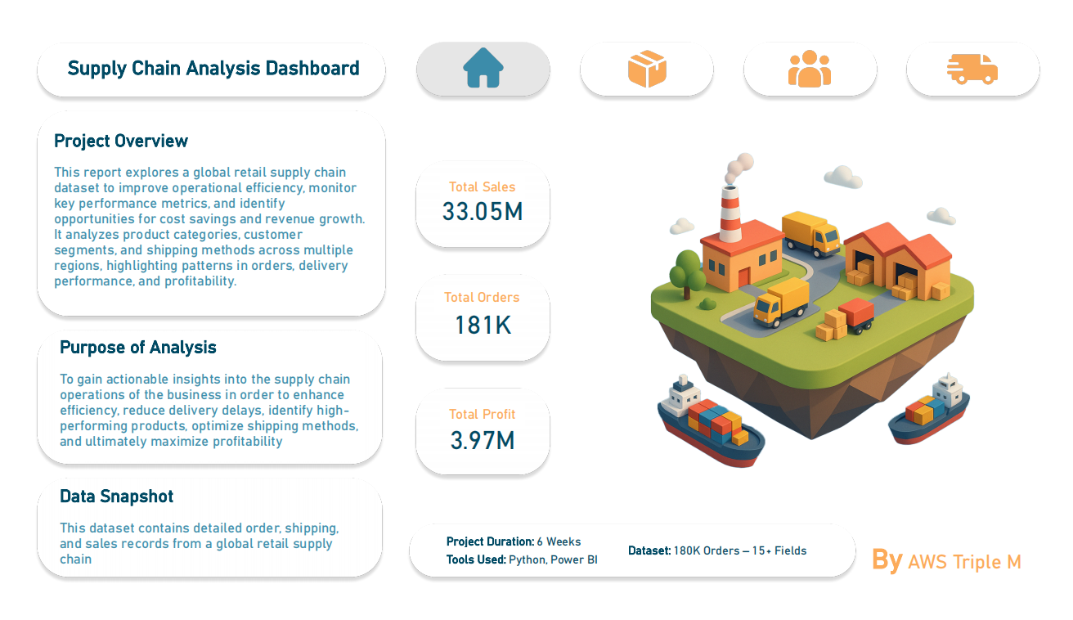
Supply Chain Analysis Dashboard:
This dashboard analyzes a global retail supply chain dataset to enhance operational efficiency, reduce delivery delays, and boost profitability.
It covers product categories, customer segments, and shipping methods across different regions.
Key Highlights:
- 1Total Sales: 33.05M
-2Total Orders: 181K
-4Total Profit: 3.97M
-5Dataset includes 180K+ orders with 15+ fields.
-6Tools used: Python & Power BI

Slide 4
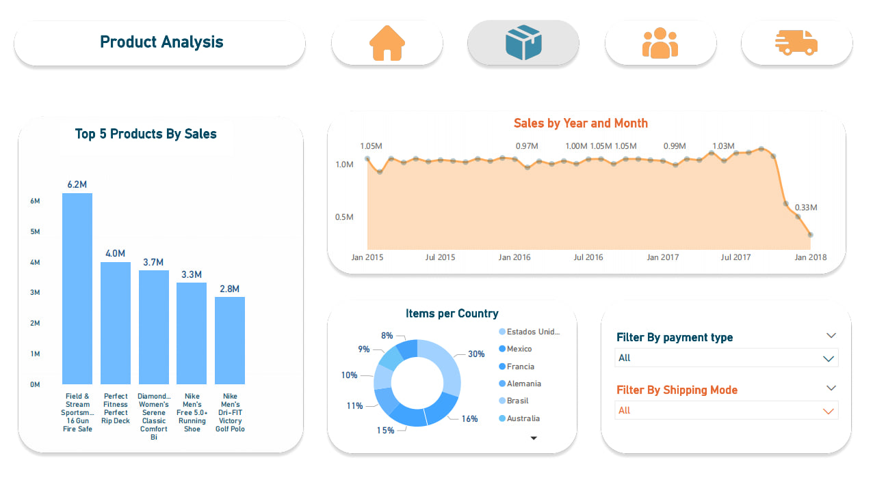
Product Analysis
Overview:
Analysis of top products, sales trends, and country distribution.
Highlights:
-1Top 5 Products: Field & Stream leads with $6.2M, Perfect Fitness at $4.0M.
-2Sales Trend: Peaked at $1.05M in 2015, dropped to $0.33M by 2018.
-3By Country: Mexico 30%, France & Germany under 15%.
Filters:
Filter by payment type or shipping mode.
Icons:
Home, product, people, delivery in blue/orange tones.

Slide 5
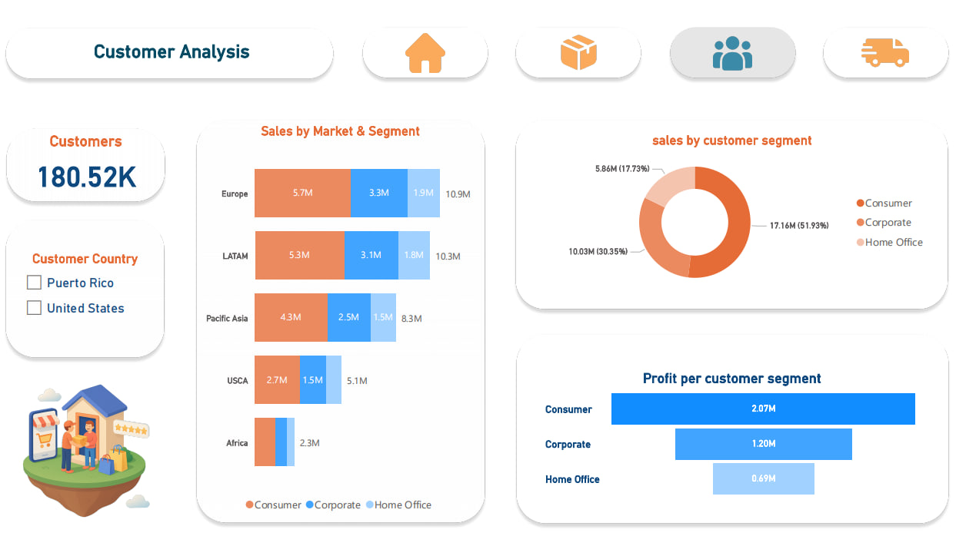
Customer Analysis
Overview:
Insights into customer base, sales, and profitability by segment and region.
Highlights:
-1Total Customers: 180.52K, with filters for Puerto Rico and the United States.
-2Sales by Market & Segment: Europe leads with $10.9M (Consumer: $5.7M, Corporate: $3.3M).
-3Sales by Segment: Consumer at 47.79% ($53.6M), Corporate at 29.38% ($12.1M).
Profit by Segment: Consumer leads with $2.07M, followed by Corporate at $1.20M.
Visuals:
Icons: (home, product, people, delivery) and a shopping illustration in blue/orange tones.

Slide 6
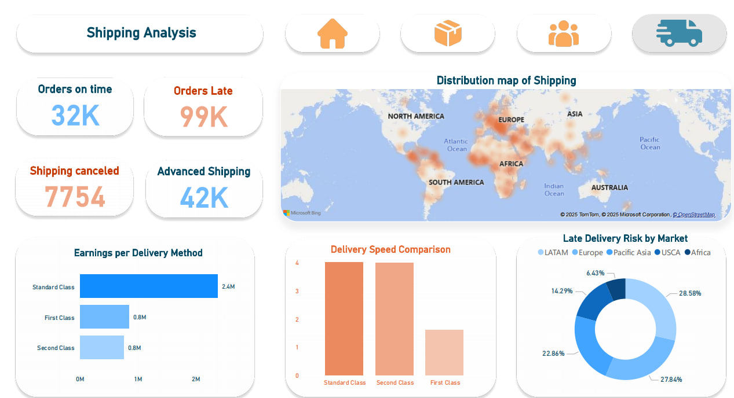
Shipping Analysis
Overview:
Key metrics on shipping performance and distribution.
Highlights:
-1Orders: 32K on time, 99K late, 775 canceled, 42K advanced.
-2Earnings by Method: Standard Class at $2.4M, First Class at $0.8M.
-3Delivery Speed: Standard Class leads, followed by Second and First Class.
-4Late Delivery Risk: USCA at 27.84%, Europe at 22.86%.
Visuals:
World map for shipping distribution, icons (home, product, people, delivery) in blue/orange tones.

Slide 7
How These Features Help:
📊 Analysts identify trends & bottlenecks easily.
🚚 Supply Managers track delays and optimize shipping.
🧠 Executives get instant insight into high/low performing areas.
📈 Sales Teams spot winning products and customer segments.
Primary End Users:
-1Business Analysts.
-2Supply Chain Managers.
-3Executives / Decision Makers.
-4Marketing & Sales Teams.
Key Features:
-1Interactive dashboards.
-2Real-time filtering (by region, segment, time).
-3Shipping delay risk indicators.
-4Sales/profit visualizations.
-5Market performance comparison.

Slide 8
Data Description :
1- Simulated retail supply chain data
2- Includes orders, customers, products, shipping, suppliers
3- CSV format – ready for analysis
4- Supports forecasting, shipping, inventory, supplier analysis
5- 180K+ records, 15+ fields

Slide 9



Tools Used :
1- Python (Pandas, Matplotlib, Seaborn)
2- Classification Model
3- Power BI
4- Excel

Slide 10
Report Final Project:
A detailed documentation of the data wrangling process, explaining how the dataset was cleaned and prepared for analysis.
Supply_Chain_QA:
A summary of the dataset's purpose, key questions, and business use cases related to supply chain optimization.
Final Power BI:
A visual dashboard presenting insights from the supply chain data using interactive charts and KPIs in Power BI.
ML Model “Classification”:
We used XGboost algorithm to classify sales operations into 4 categories -- (Accuracy : 98%) .

Slide 11
Team :
Ahmed Mabrouk - Team Leader
1-Data Analyst
Mahmoud & Shahd
4- Documentation Specialist
Manar
2- Machine Learning
Mahmoud
5- Presentation
Wessam
3- Power BI Developer
Ahmed & Malak

Slide 12
Any questions?
We’re happy to walk you through any part of the project or provide further insights.

