Slide 1

Global Education Insights
Understanding global education trends through data-driven insights
Presented by: Malak Sayed Ahmed & Faris Alaaeldin
ESLSCA 2025

Slide 2

Dataset
1. Economic Indicators
GDP per Capita
Unemployment Rate
2. Education Metrics
Primary Enrollment Rate
Secondary Enrollment Rate
Tertiary Enrollment Rate
Literacy Rate
Average Years of Schooling
Gender Parity Index (GPI)
3. Technology & Infrastructure
Internet Access
4. Policy & Governance
Government Policy Score

Slide 3

Data Cleaning
🛠 Tools Used:
Python libraries: pandas, numpy, scikit-learn
📉 Missing Values Handling:
Imputed using SimpleImputer (mean strategy)
🚨 Outlier Treatment:
Detection: Z-score method
Treatment: Winsorization to cap extreme values
🆕 Feature Engineering:
Created new variable: GDP_per_capita_log (log-transformed)

Slide 4

Data Transformations
Created Tables:
region_avg → Calculated average metrics (e.g., literacy, GDP) by region
enrollment_melted → Reshaped enrollment data for better comparison across education levels
gdp_combined → Merged GDP data with other indicators for analysis
Key Operations:
Joins — Combined datasets on country and year
Groupings — Summarized by region, country, and year
Aggregations — Computed averages, sums, and trends

Slide 5

Exploratory Data Analysis (EDA): Key Insights
📈 Strong GDP–Education Link:
Countries with higher GDP tend to show better education outcomes.
🌍 Regional Disparities:
Sub-Saharan Africa consistently lags behind in both GDP per capita and literacy rates.
📊 Global Improvement:
Overall, education levels have been rising globally over the years.

Slide 6

Tableau Visuals

Slide 7
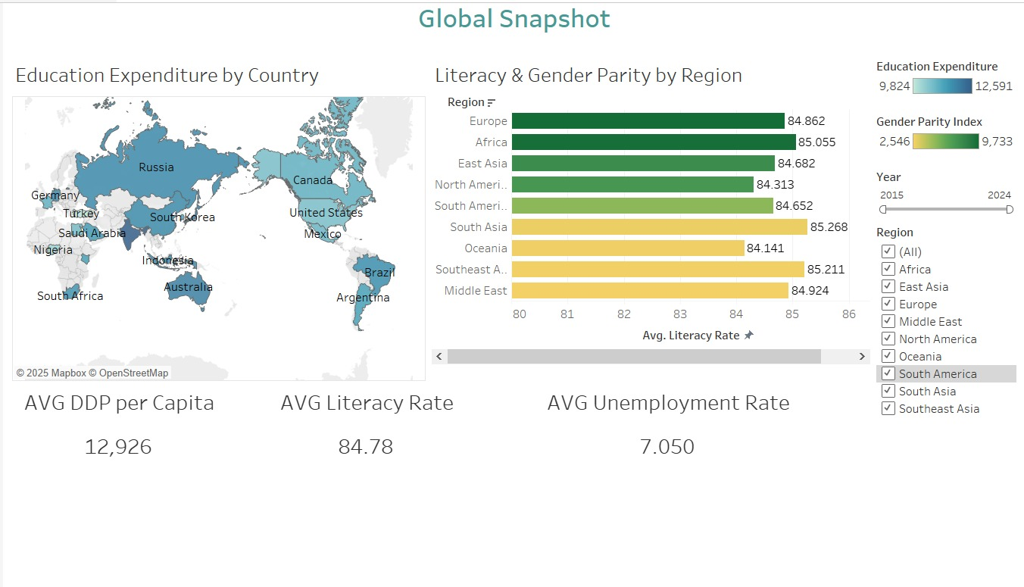
Dashboard 1

Slide 8
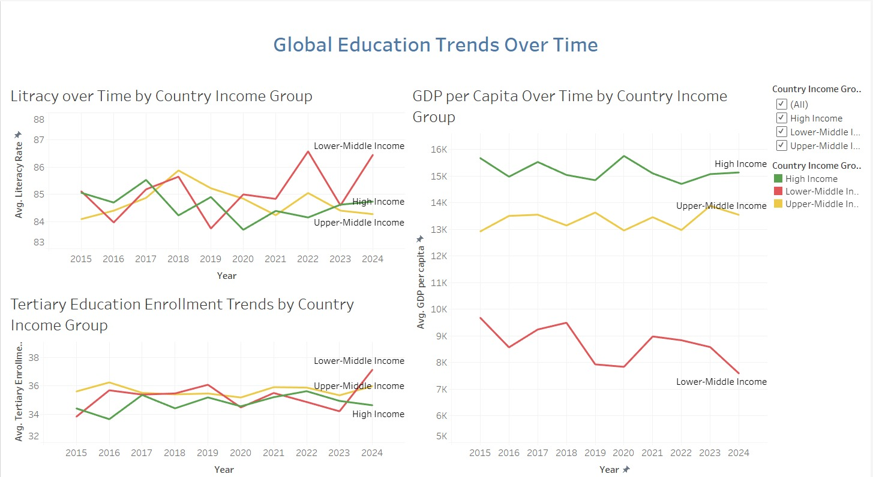
Dashboard 2

Slide 9
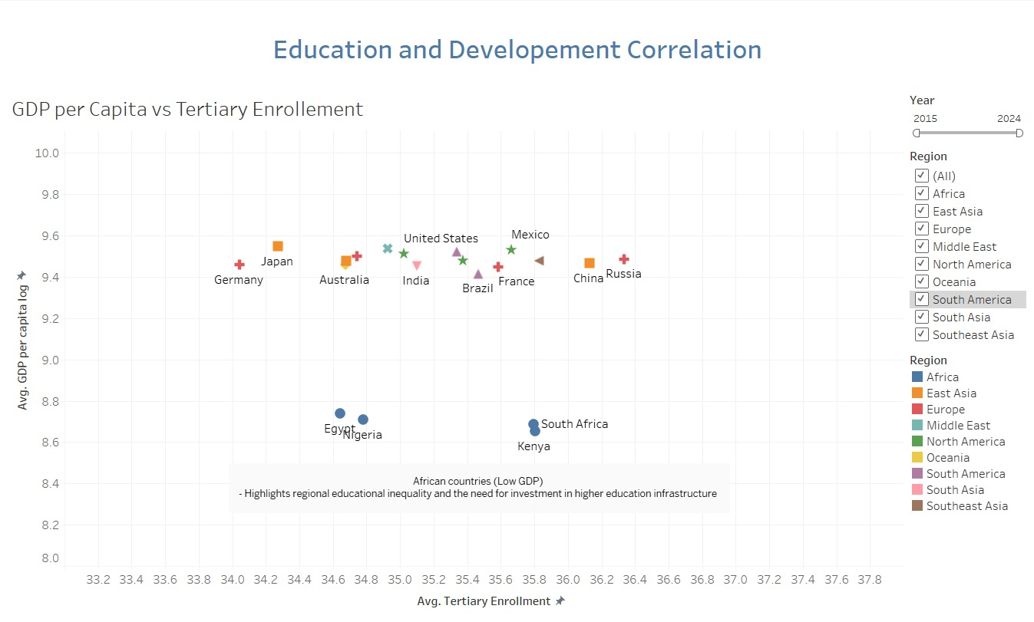
Dashboard 3

Slide 10
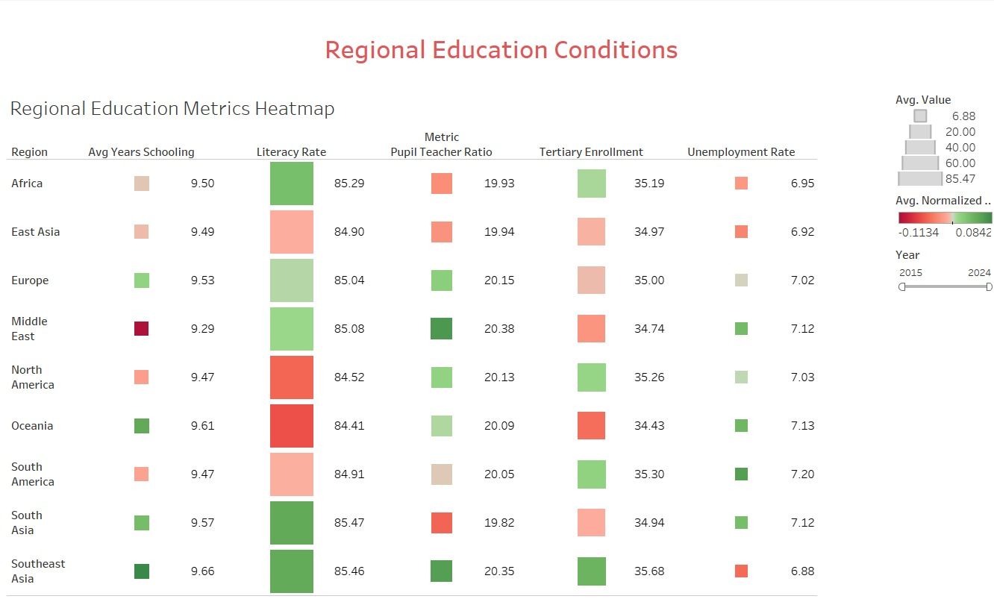
Dashboard 4

Slide 11

Findings
GDP and Education Are Interlinked:
Higher tertiary enrollment tends to align with higher GDP per capita.
Regional Disparities Noted:
Some low-GDP regions (e.g., Southeast & South Asia) show high literacy, indicating untapped potential.
Outlier Countries Identified:
Egypt, Nigeria, South Africa, and Kenya show strong literacy but low GDP and tertiary education rates.
Three Global Clusters Emerged:
1. High GDP & education (e.g., US, Germany)
2. Moderate metrics (e.g., Brazil, China)
3. Low GDP but rising literacy (e.g., African nations)
Policy Recommendations:
Boost tertiary education funding, expand digital learning, and address mismatches in education vs. economic outcomes.

Slide 12

Conclusion
Data insights reveal clear links between education and economic growth. To bridge global disparities, targeted investment in tertiary education and digital access is essential for unlocking long-term development potential.

