Slide 1

Airline Flight Performance Analysis
Exploring Delays, Cancellations & Operational Patterns
Presented by: Malak Sayed Ahmed & Faris Alaaeldin
ESLSCA 2025

Slide 2
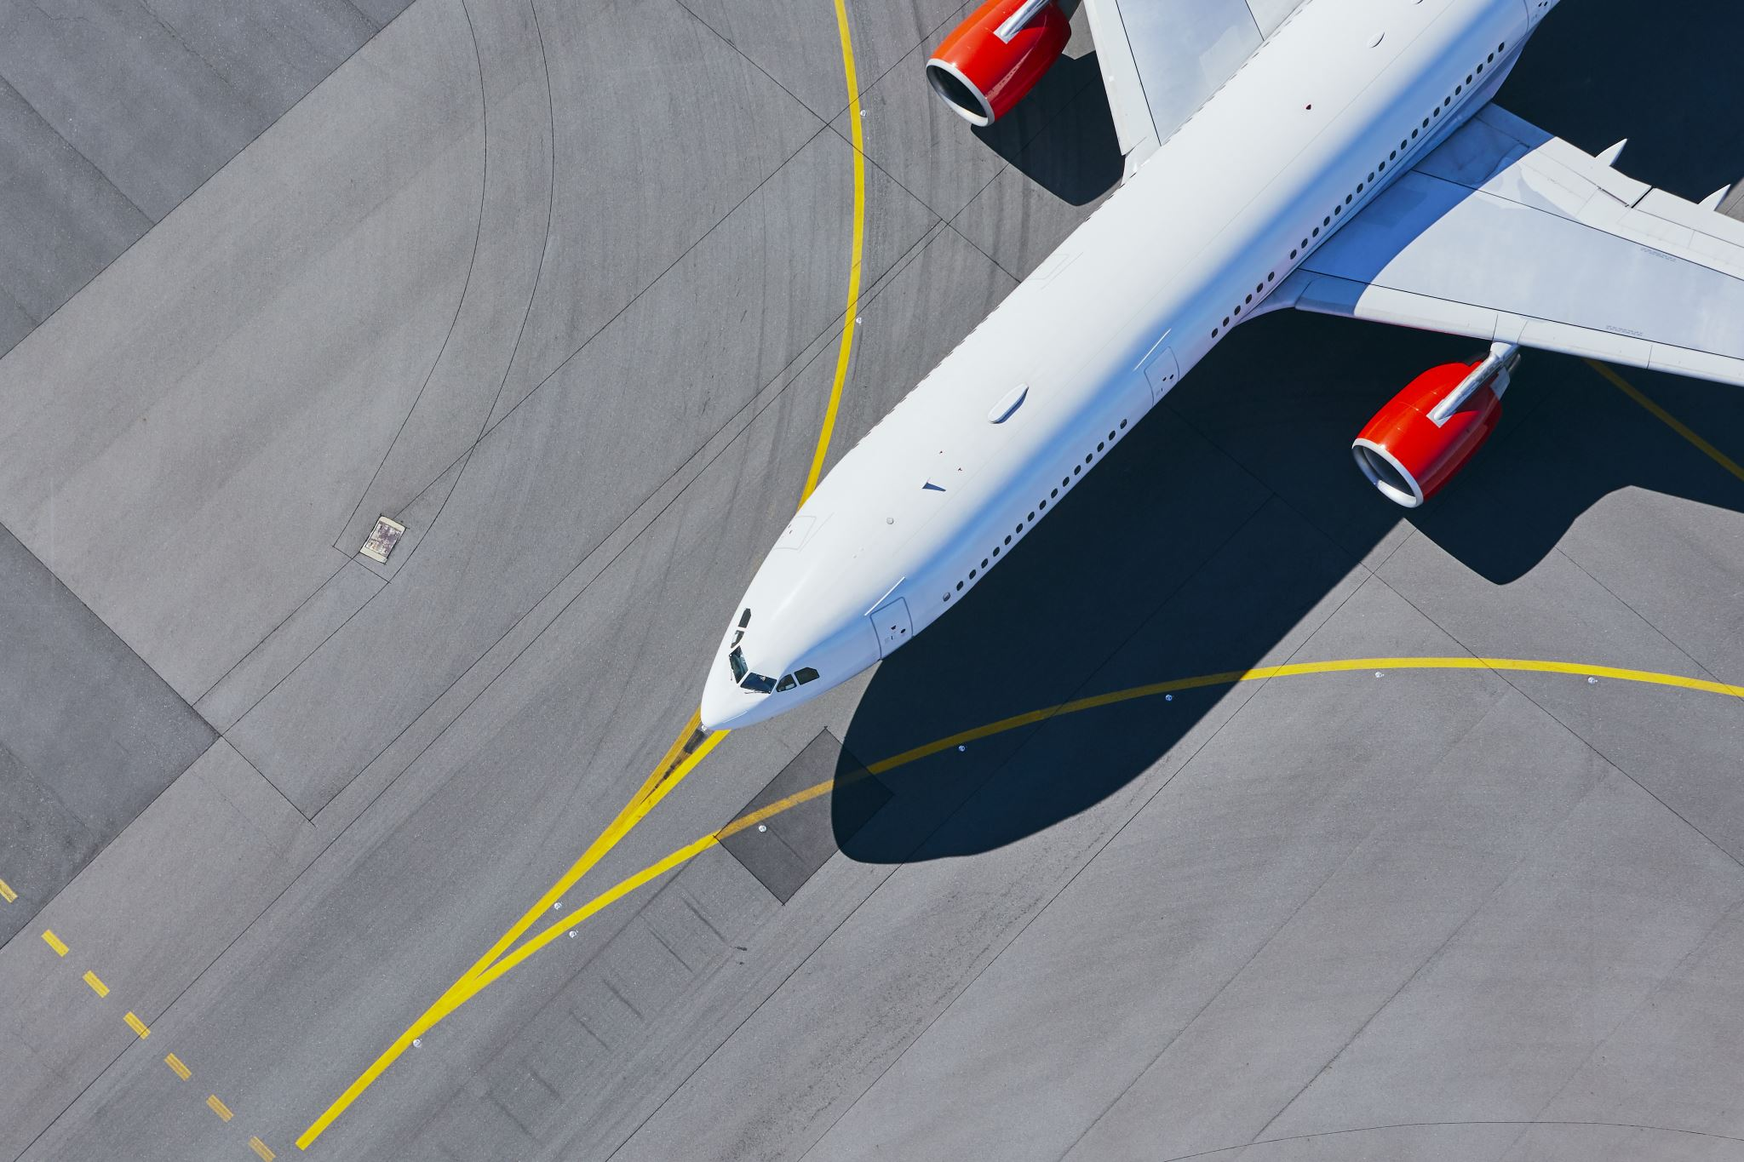
Introduction
Explore and visualize airline performance patterns
Focus: Arrival delays, cancellations, operational metrics
Analyze U.S. domestic flights using structured data pipeline

Slide 3
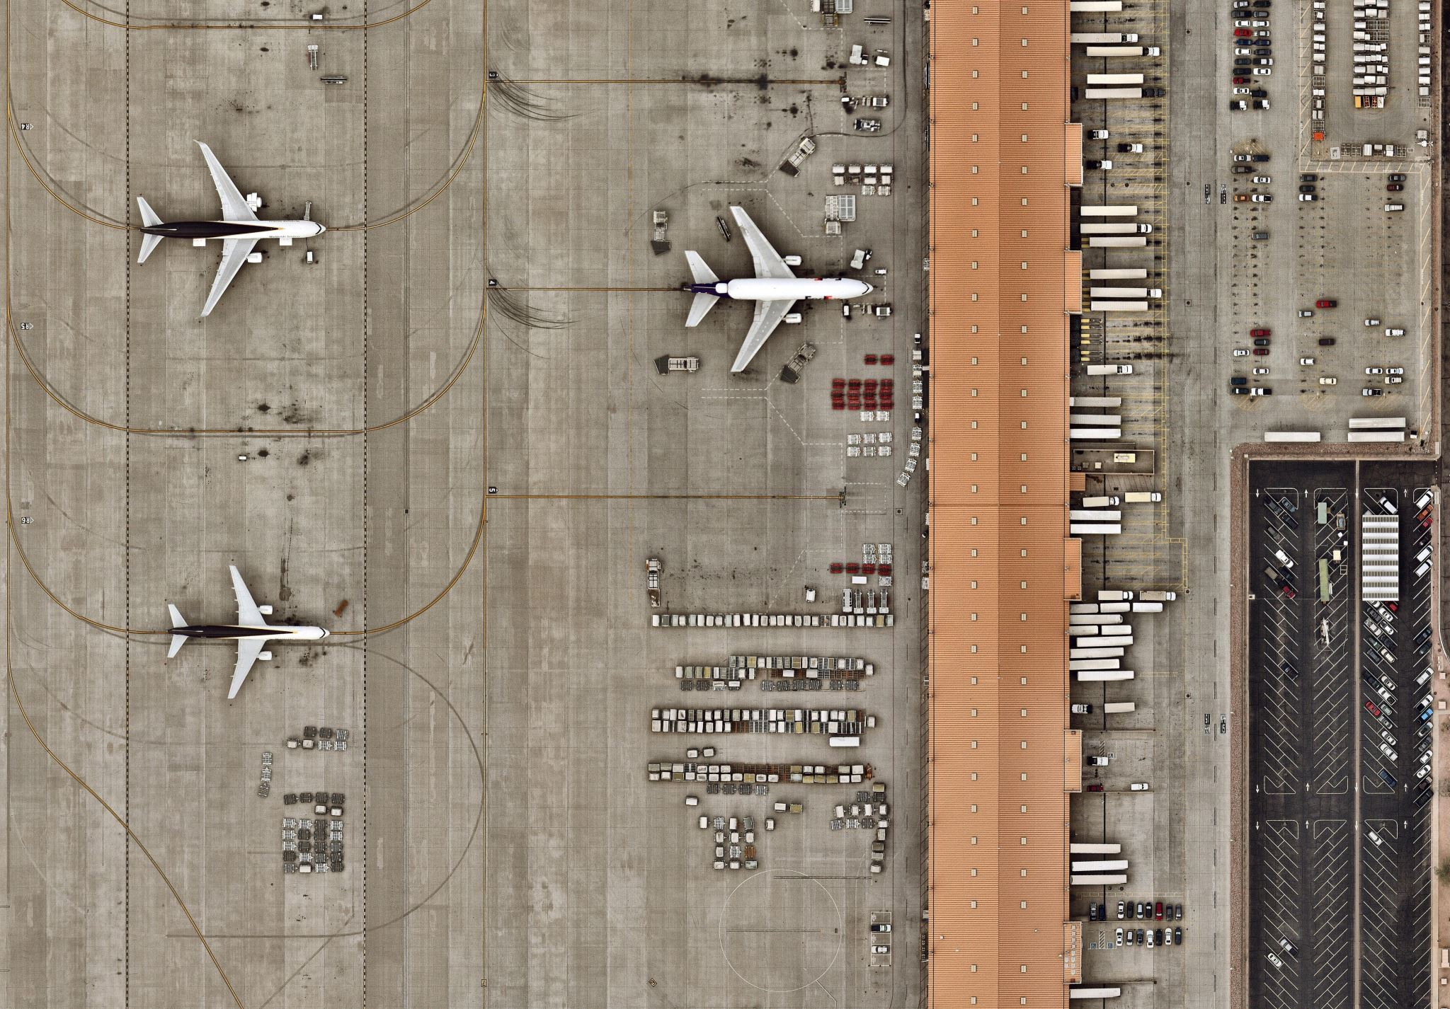
Dataset Overview
Source: flights_sample_10k.csv
10,000 rows, 32 columns
DEP_DELAY, ARR_DELAY, CANCELLED, CANCELLATION_CODE, DIVERTED, DISTANCE
-Key Columns: FL_DATE, AIRLINE, ORIGIN, DEST
Performance columns:

Slide 4

Data Preparation Tools: Python, SQLite, Tableau
Cleaning Steps:
Convert FL_DATE to datetime
Remove null DEP_DELAY / ARR_DELAY
Fill missing CANCELLATION_CODE with 'None'
Create DAY_OF_WEEK
Join airline names via SQLite
Export to Tableau-ready CSV

Slide 5
Data Transformation
Bin ARR_DELAY into categories
Create:
- DAY_OF_WEEK from FL_DATE
- DELAYED flag (ARR_DELAY > 15)
Normalize delay metrics
Load into SQLite for querying

Slide 6
Analysis Process
SQL:
- Avg delay per airline
- Top 10 delayed routes
- Cancellations by reason
- Delays by weekday
- Diverted stats
Python EDA:
- Delay histograms & boxplots
- Bar charts by day
- ML classifier: 95% accuracy

Slide 7
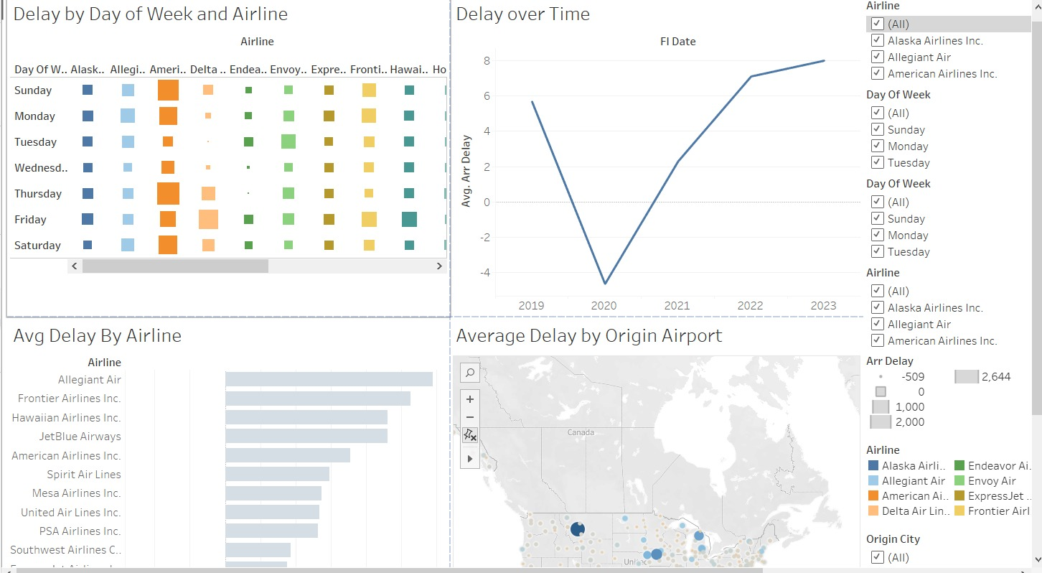
Tableau Visualizations

Slide 8
Insights & Findings
- Worst delays: Airline ATL
- Most punctual: Horizon Air
- Highest delays: Thurs & Sun
- Common cancel reason: 'A' (Carrier)
- Problem airports: ORD, ATL
- ML Classifier: 95% accurate with DEP_DELAY & DISTANCE

Slide 9
Deliverables Summary
File Name | Description
CLEANED_FLIGHTS.CSV | Cleaned dataset used for analysis
FLIGHTS.DB | SQLite database containing flight and airline tables
ANALYSIS_QUERIES.SQL | Documented SQL queries used during data analysis
FLIGHTS_FOR_TABLEAU.CSV | Cleaned and enriched dataset for Tableau visualizations
FLIGHTS_ANALYSIS.PY | Python script for cleaning, EDA, and machine learning
DASHBOARD.TWBX | Tableau workbook with interactive dashboards
SCREENSHOTS | Visuals of key charts for presentation and reporting

Slide 10
Conclusion
Complete lifecycle: Clean → Transform → Analyze → Visualize
Tools: Python, SQL, Tableau
Identified delay/cancellation patterns
- Supports data-driven airline operations

