Slide 1

AutoPicker
Our Recommendations
Elijah Cook
Malak Al-Hanafi

Slide 2
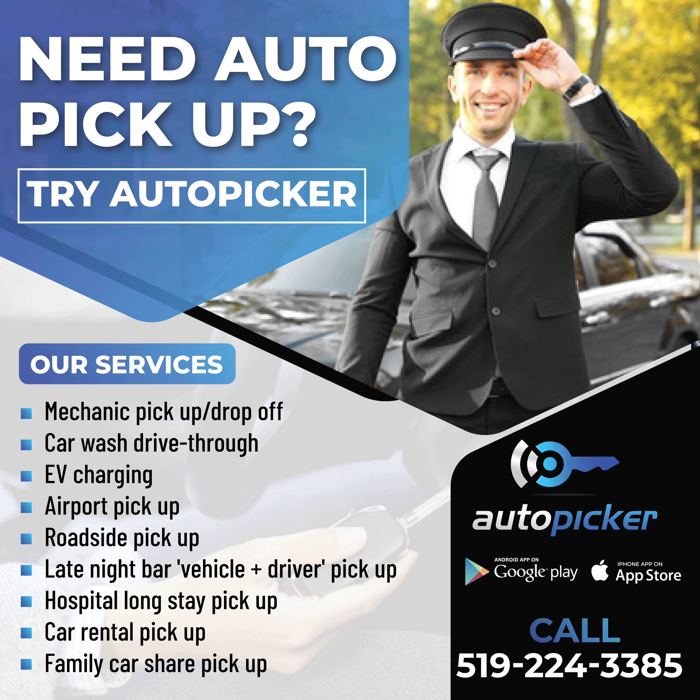
What is AutoPicker?
Incepted in 2020
Identified Gap in Canadian Auto Service Market
Delivering Your Vehicle to the Garage
Mobile App and Website
Currently Pre-Revenue

Slide 3



The Team
Dr. Akbar Saeed
Bashir Adeyemo
Olukayode Adeuja
Serial Entrepreneur
Business Professor at WLU and UWO
PhD in Management Information Systems
Car Fanatix
Identified the Problem
Market Analyst
Strong Communication Background
Previous HR Director at a Large Food Production Company
Runs Own Practice

Slide 4
Internal Analysis
Company’s Strategic Approach for Competitive Advantage
Focus on creating value through differentiation from competitors
Exploration of innovative ideas and approaches
Leveraging Resources for Industry Strength
Early-stage focus on building a strong brand and reputation
Their commitment to customer service (feedback & building trust)
Introduction of subscription-based services and integration of AI technology
HR is a core asset; they are a team with diverse skills and backgrounds
Understanding the auto service market
Notes:
Through our internal analysis we determined the company’s …. Through these two ideas 1, 2
These strategies tie the company’s profitability to pricing strategies, and the efficiency of its operations
Akbar has a personal interest in cars and runs a successful auto service garage so they understand the auto service market
bashir is a marketing analyst, and Kay in HR management
This shows that the team has a strong human resource asset

Slide 5
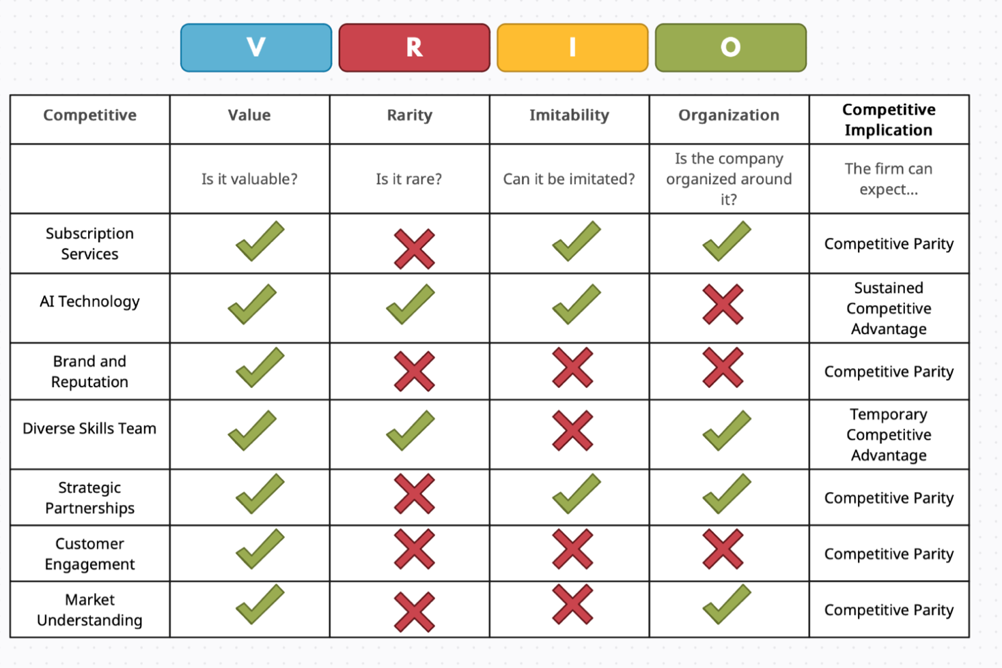
VRIO Assessment
Core Competencies Evaluated
Competitive Parity
High value, not rare, Risk of imitation
Sustained Competitive Advantage
Valuable, rare, costly/complex to imitate
Competitive Disadvantage
Not valuable
  No Strong Tech Background
Temporary Competitive Advantage
Valuable and rare, but not costly to imitate
Notes:
We also did a VRIO assessment which are Value, Rarity, Imitability, organization to evaluate the core competencies
Subscription Services:
High value due to convenience for customers and potential for consistent revenue
Not rare- any one has and can replicate this service
AI Technology
add value to the consumer as they provide a more personalized and insightful experience than traditional chat bots and decision algorithms
one aspect stands out that poses a competitive disadvantage
the lack of a strong tech background within the team
but AutoPicker must view this not as a permanent setback because there is room for improvement
We will talk more about it when we address the issues
Diverse Skills Team:
Unique expertise within the team is valuable and rare
Difficult for competitors to replicate, indicating a strong internal organization.

Slide 6
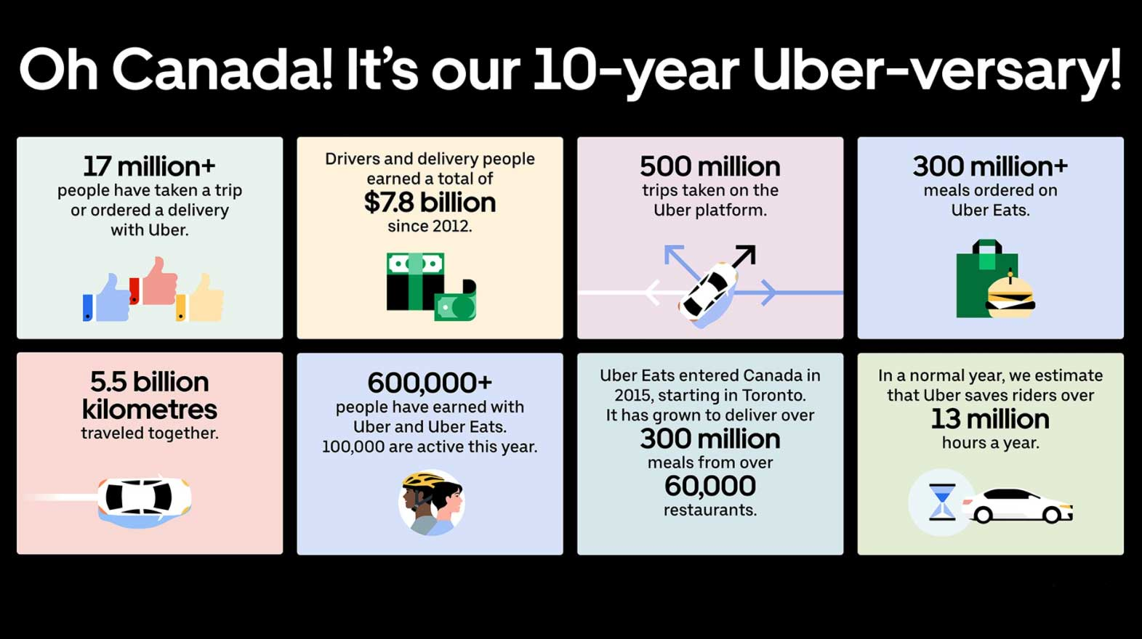
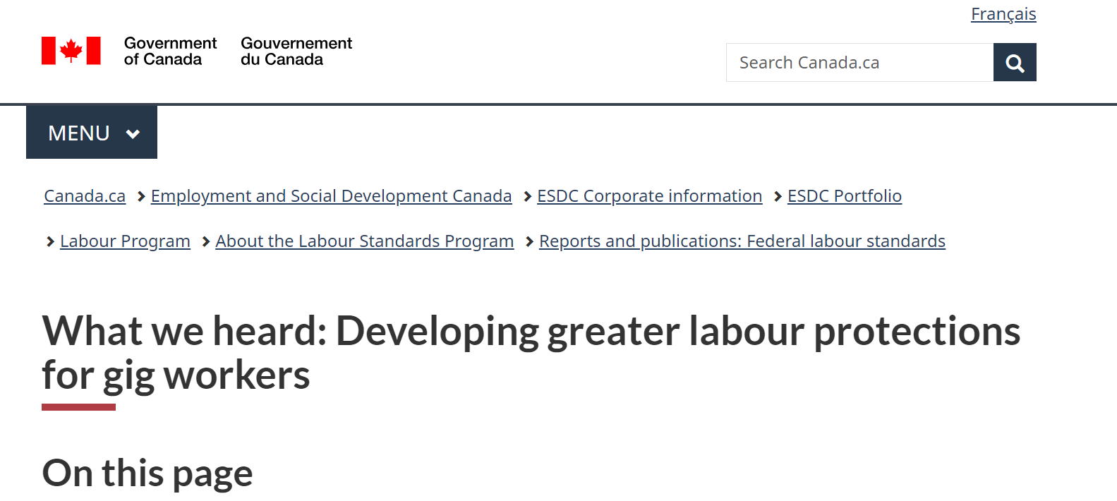
External Analysis
AutoPicker is in the “gig economy”
44% of all Canadians in 2022 struggled to meet day-to-day expenses
25% of Canadians will be over 65 by 2043
AI expected to grow to a $1.3 Trillion USD industry in 8 years
Canadians are shifting to EVs
Relatively Uncompetitive Market

Slide 7
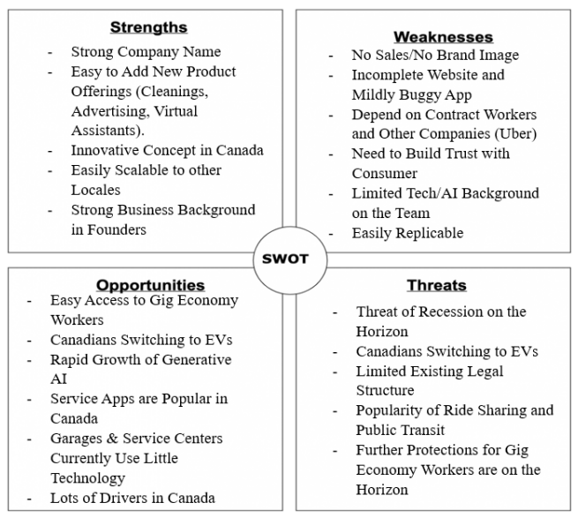
External Analysis
SWOT

Slide 8


Key Strategic Issues
Lack of Clear Direction
Over Dependence on Uber
Lack of Partnership and Advertising
Notes:
Strategic issues affect the long-term direction and overall fate of the company and are best resolved as soon as possible.
The first issue identified are differences in opinion by founders on the best business model to use.
While the app and website have been built and are “ready to take an order” the founders weren’t completely sure that this was the direction they wanted to take
pickup/drop-off services,
AI assistant for vehicles,
‘Skip-the-Dishes like’ app for various garages and services.
This can be quite dangerous for the future of the company and needs to be resolved
The second issue identified was an over dependence on Uber to fulfill company tasks unofficially.
Pilot is the person who takes the customer’s car to the garage
AutoPicker plans on using Uber in two main ways: providing drivers for their ‘pilots’ and providing ‘pilot’ background checks.
Without an official partnership agreement AutoPicker will save on costs
If Uber were to significantly increase the price of their rides, then providing the service could stop being profitable.
If Uber were to leave Canada or change the way drivers are verified , verifying wont work for AutoPicker
Reducing the reliance on Uber would make AutoPicker more robust against external changes.
The final issue is a lack of an advertising or partnership plan
Reaching out to garages/dealerships and building relationships with both them and their customers will be essential to AutoPicker’s success.
Addressing these issues is necessary step for AutoPicker to succeed

Slide 9

Recommendations
Finalize the Business Model
Necessary for the future growth of the company
Clear Operational Plan
Pickup and Drop-Off?
AI Integration?

Slide 10

Recommendations
Develop Internal Independent Systems
Reduce Dependence on Uber
Reduce Liability Risk
Reduce Cost to Provide Service

Slide 11

Recommendations
Partner With Garages and Consider Product Shift
Garages have Trust, AutoPicker has Tech
DoorDash of Auto Service

Slide 12
Thank you
Questions?

