Slide 1



Creating My Own Portfolio
Welcome to my portfolio! A visual showcase of my skills, achievements, and experience. Together, let's explore my journey towards success.
sm
by saugata malakar

Slide 2

Introduction
Hello there! I'm delighted to introduce myself to you. With my passion for web design and dedication to creating stunning digital experiences, I strive to make a lasting impact in the industry.

Slide 4

About Me
1
Passion-driven
Web designer with a love for creativity and innovation.
2
Experienced
Combined years of experience in front-end development and UI/UX design.
3
Adaptable
Capable of working in diverse teams and adapting to dynamic projects.

Slide 5
Skills and Achievements
UI/UX Design
Front-end Development
Project Management
Creating intuitive user experiences through stunning visual designs.
Building responsive websites with HTML, CSS, and JavaScript.
Leading teams to successful project completion and exceeding client expectations.

Slide 6
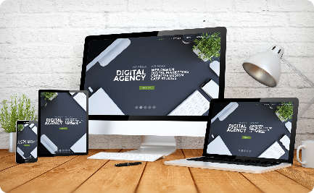
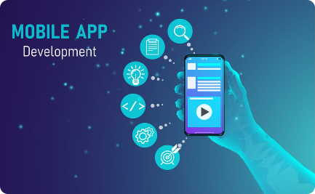

Portfolio
Website Design
Mobile App Development
Branding
Showcasing my expertise in crafting visually appealing and user-friendly websites.
Highlighting my skills in creating seamless mobile experiences across platforms.
Exploring my ability to create memorable and impactful brand identities for businesses.

Slide 7

Contact Me
Email
Send me an email at malakarg95@gmail.com
Phone
Reach out to me at +918240541867 for a chat about exciting opportunities.
Social Media
Connect with me on LinkedIn and Twitter for updates and collaboration.

