Slide 1
Delivery Companies Data Analysis with Power BI
Tech Mind x Data Solutions Internship – Session Task (2)

Slide 2
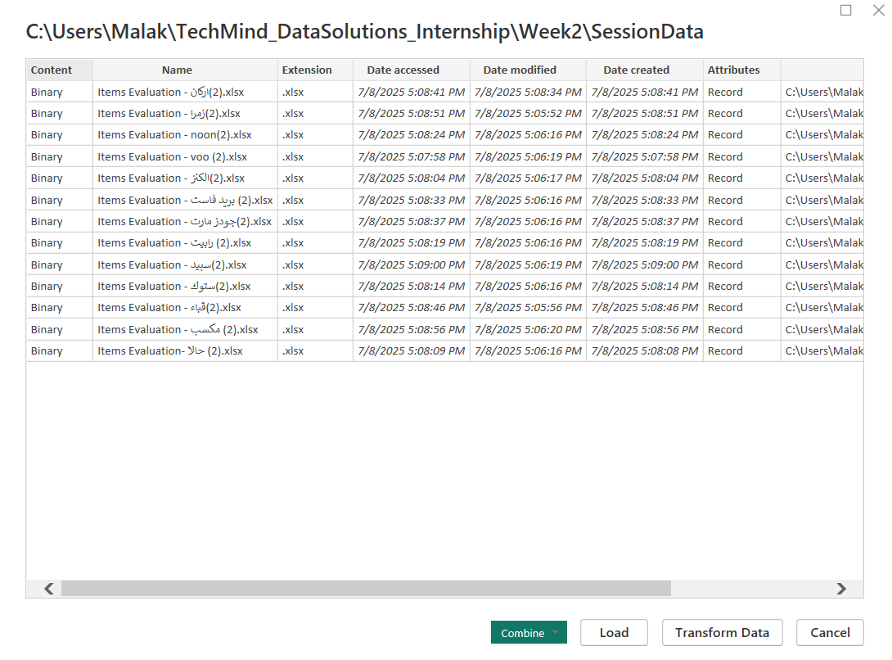
Loaded Data Folder to Power BI

Slide 3
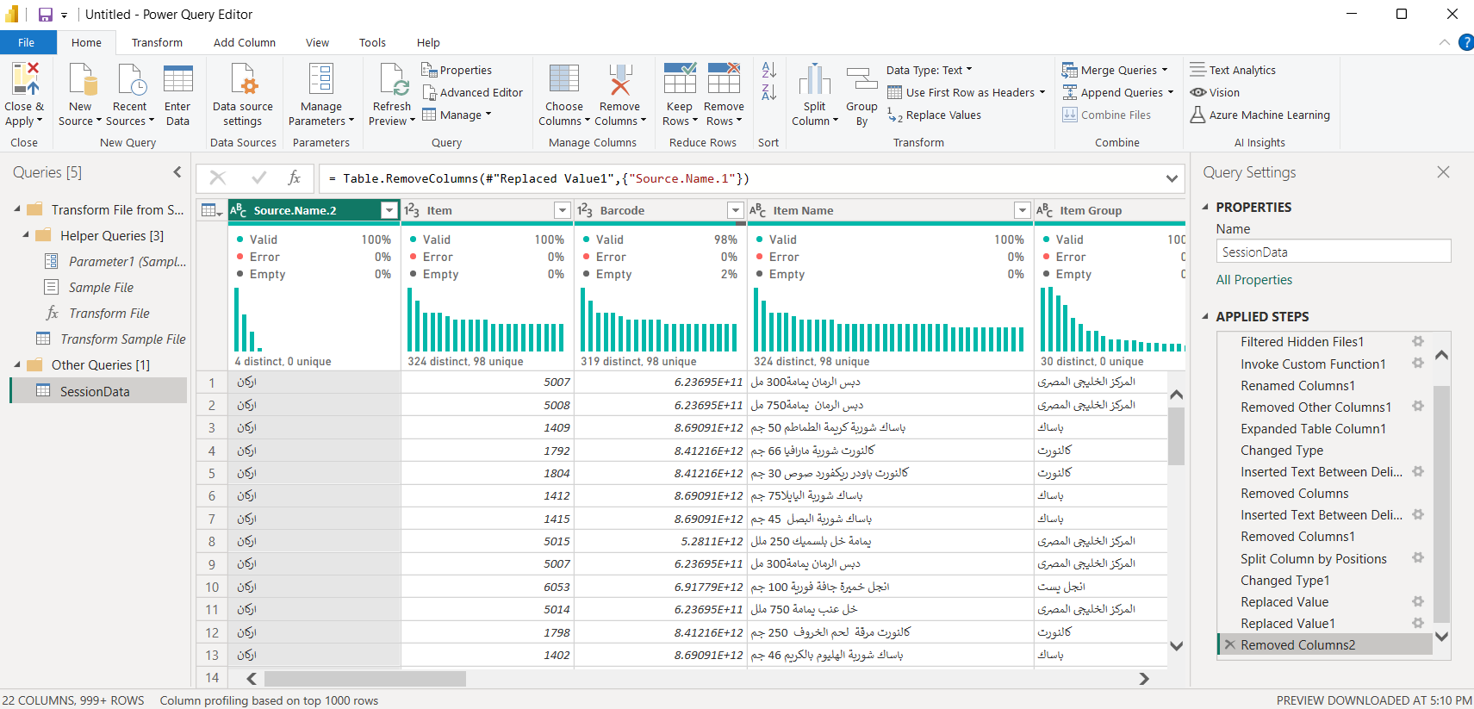
Applied Combine & Transform
Changed Source Name with split and replace

Slide 4
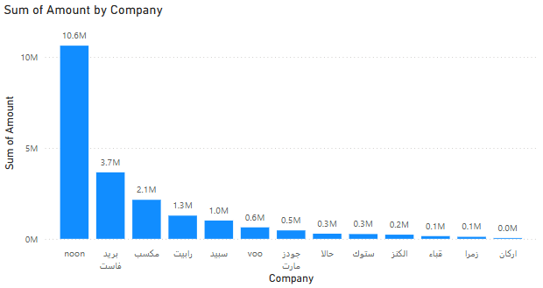
After Loading found through this chart that Noon is very high so decided to check on outliers

Slide 5
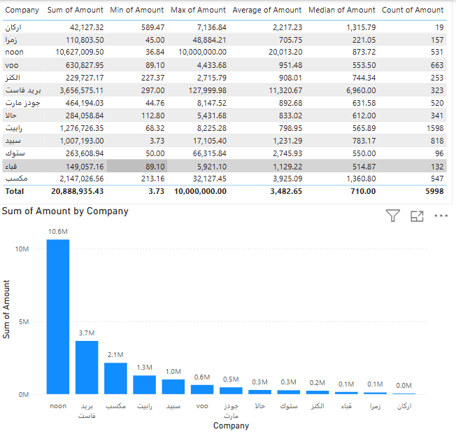
Found through statistics there must be outlier in noon

Slide 6
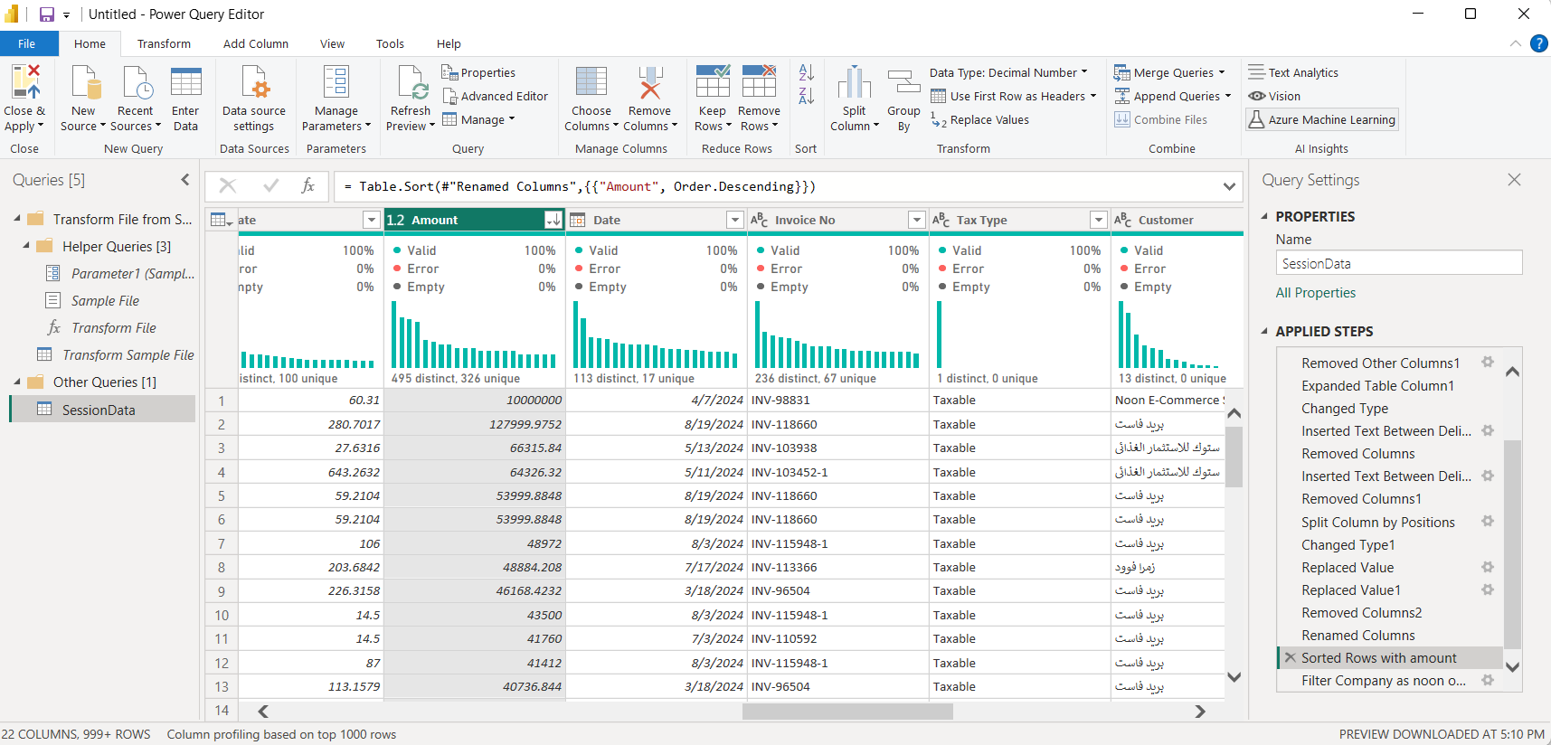
Through power query, filtered noon data and sorted them to see that there is one row that is an outlier

Slide 7
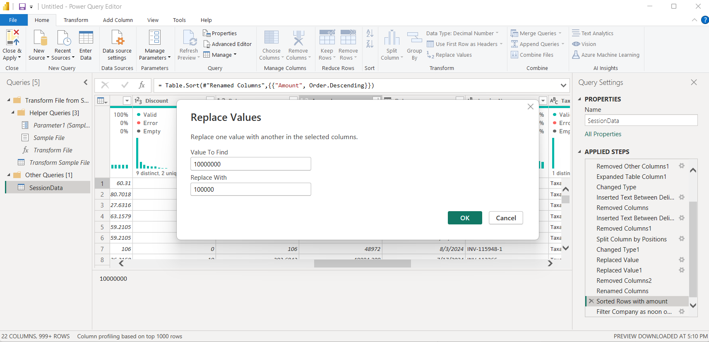
Decided to replace the outlier with a more logical value

Slide 8
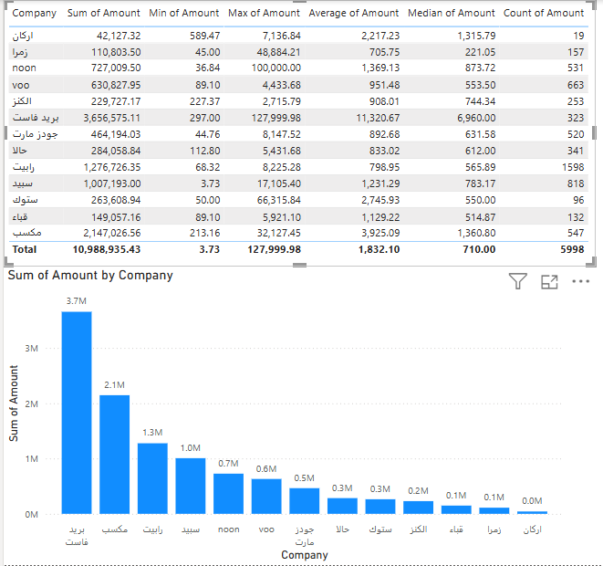
Then statistics became more logical

Slide 9
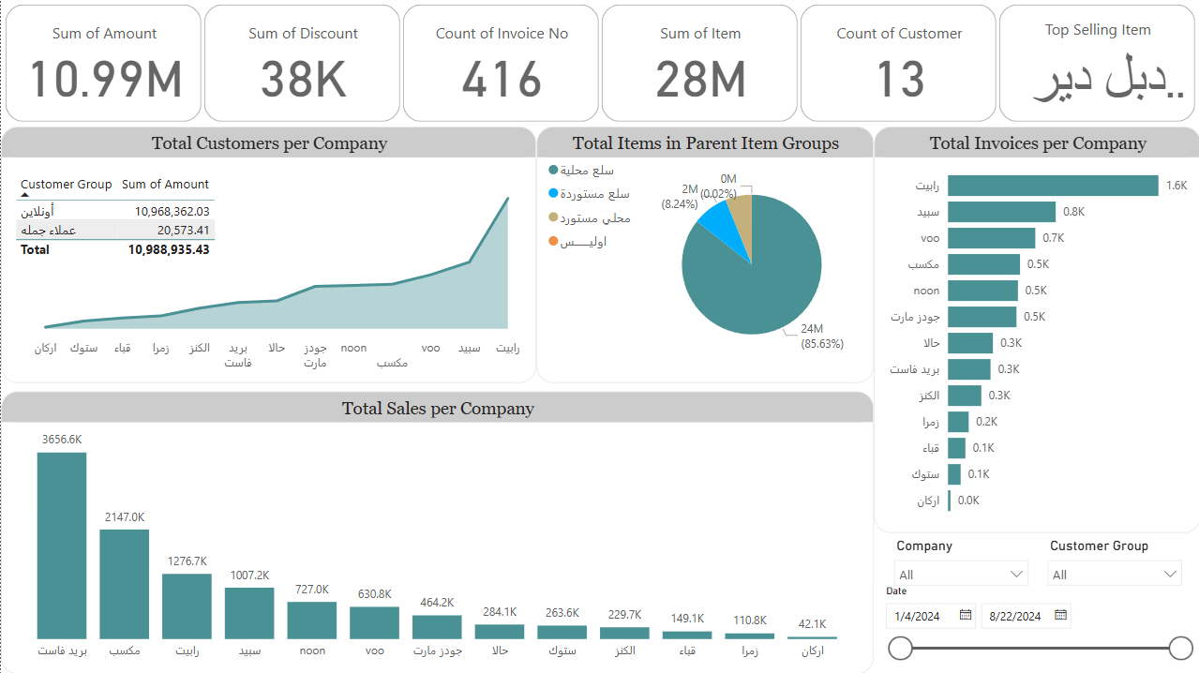
Developed the dashboard
Session2TechMindTaskFinalDashboard.pbix

