Slide 1
Multi-Threaded File-Server
CSCI315 Operating System
Dr. Ahmed El Nokrashy
Lecture - 03
Salma Hesham Salem 211000069
Omar El Sayed 211000093
Ziad Maher 211001772
Khadija Nasser El Tarabeshy 211000738
Malak Mohamed El Samman 211001045

Slide 2
CONTENTS
Introduction
Program Features
Flowchart
Code
Output

Slide 3
INTRODUCTION
Efficient file management is essential in the digital world. File servers allow network users to access, share, and manage files. Traditional servers struggle with high demand, but multi-threaded servers handle concurrent access better. This project aims to develop a Java-based multi-threaded file server to manage simultaneous read and write operations while ensuring data integrity.

Slide 4
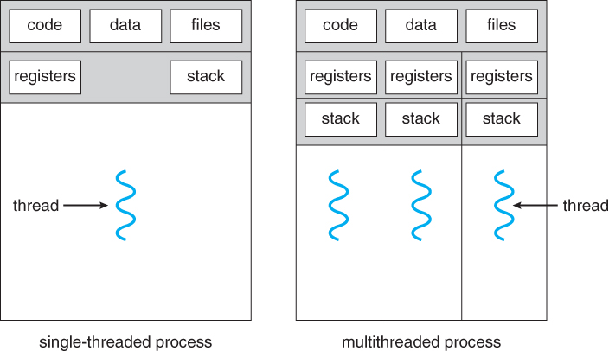

Slide 5
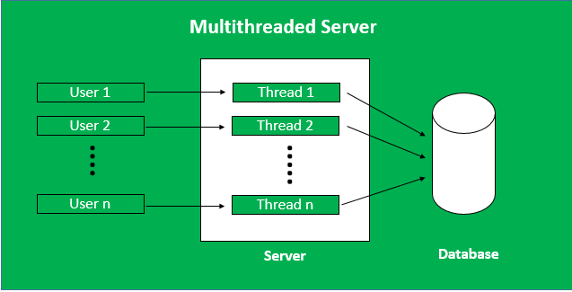

Slide 6





Program FEATURES
Read
Write
Access
Sync
GUI

Slide 7
FLowCHARt

Slide 8
CODE

Slide 9
Life is really simple, but we insist on making it complicated.

Slide 10
THANK YOU ☺

