Slide 1
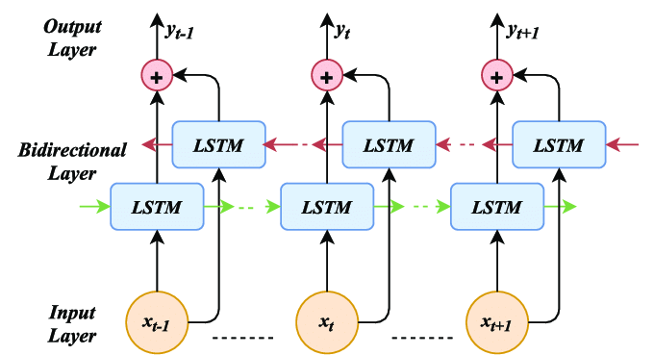
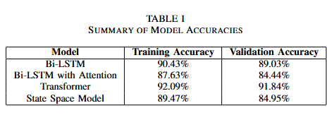
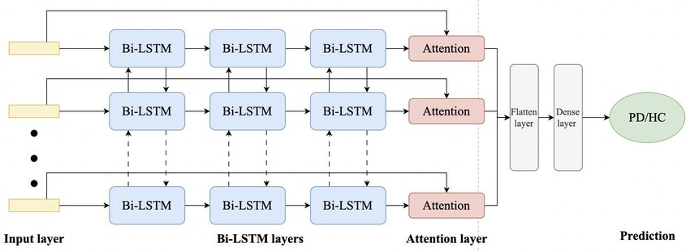
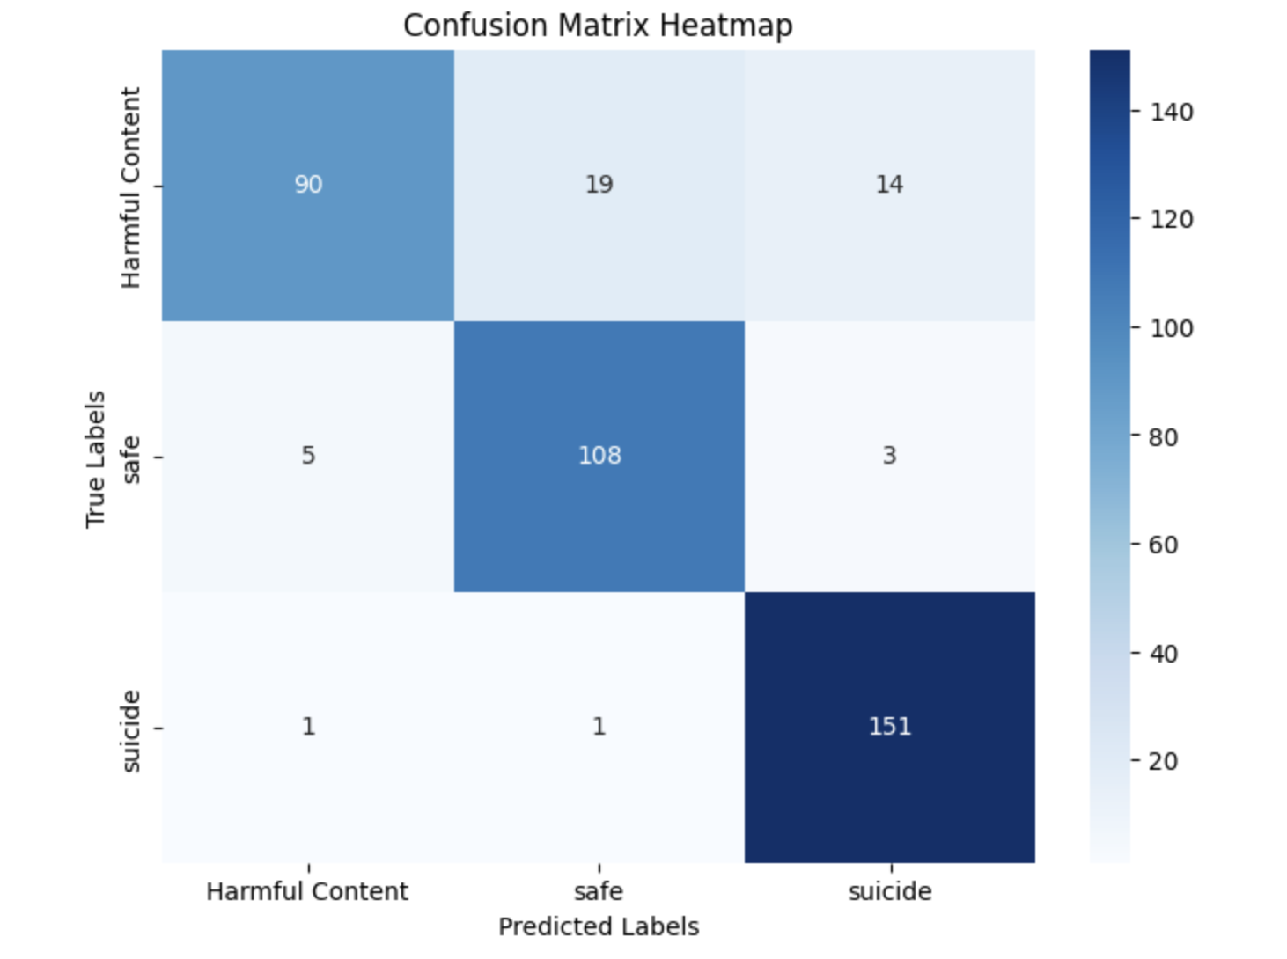
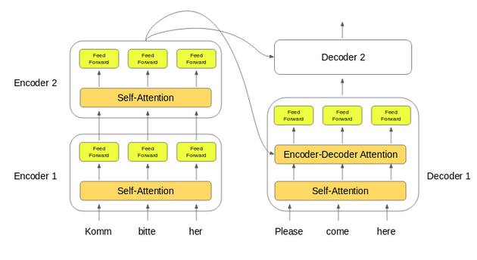
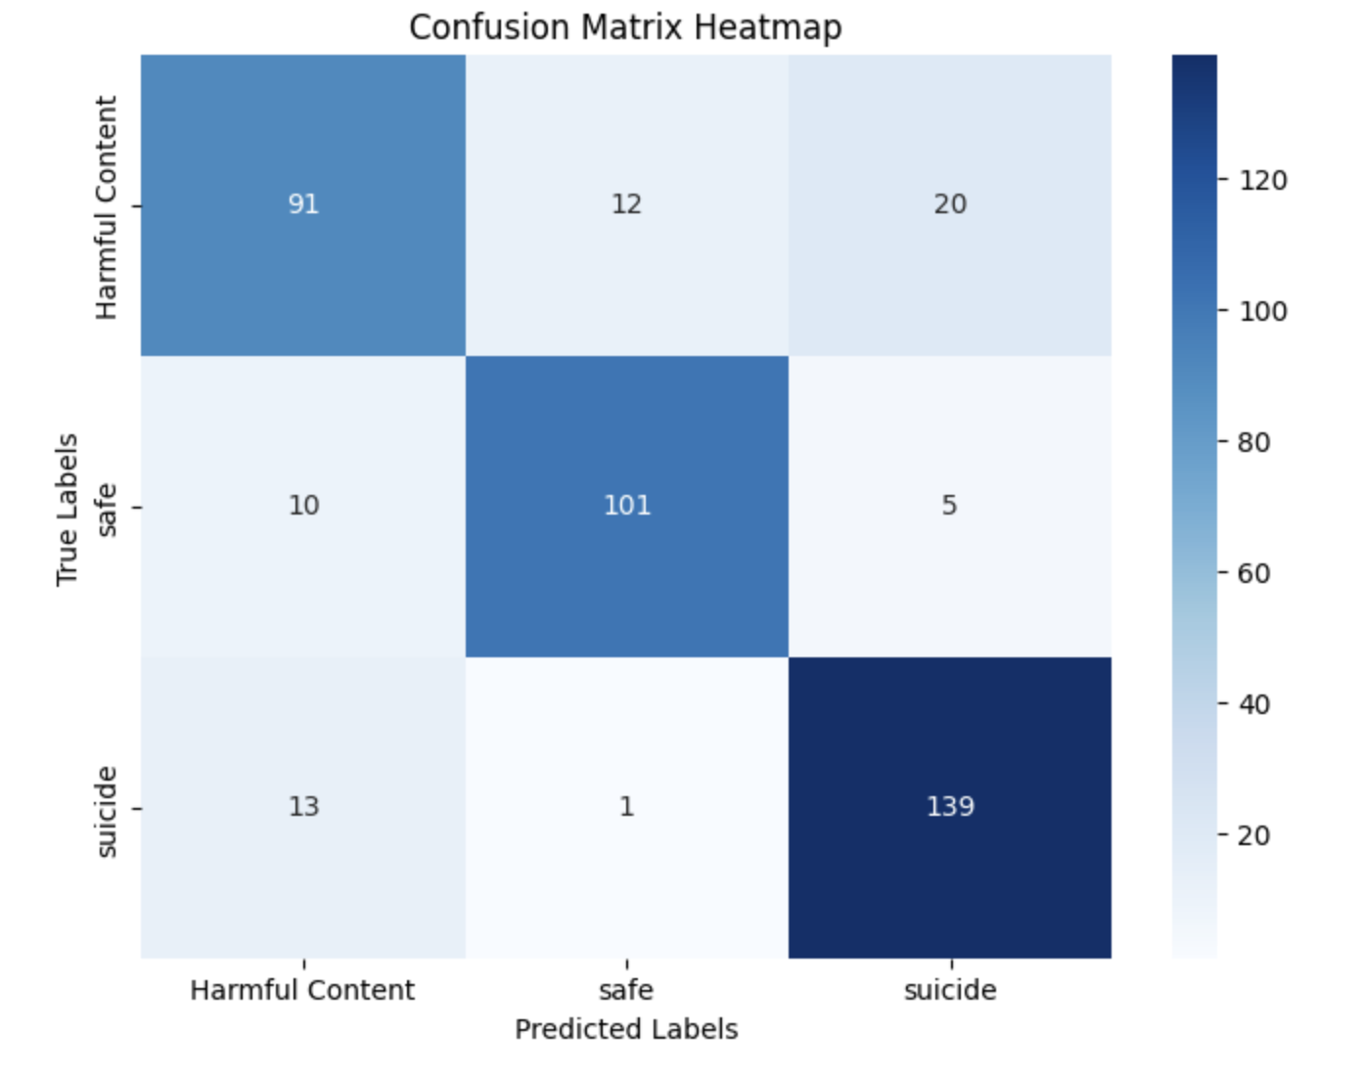
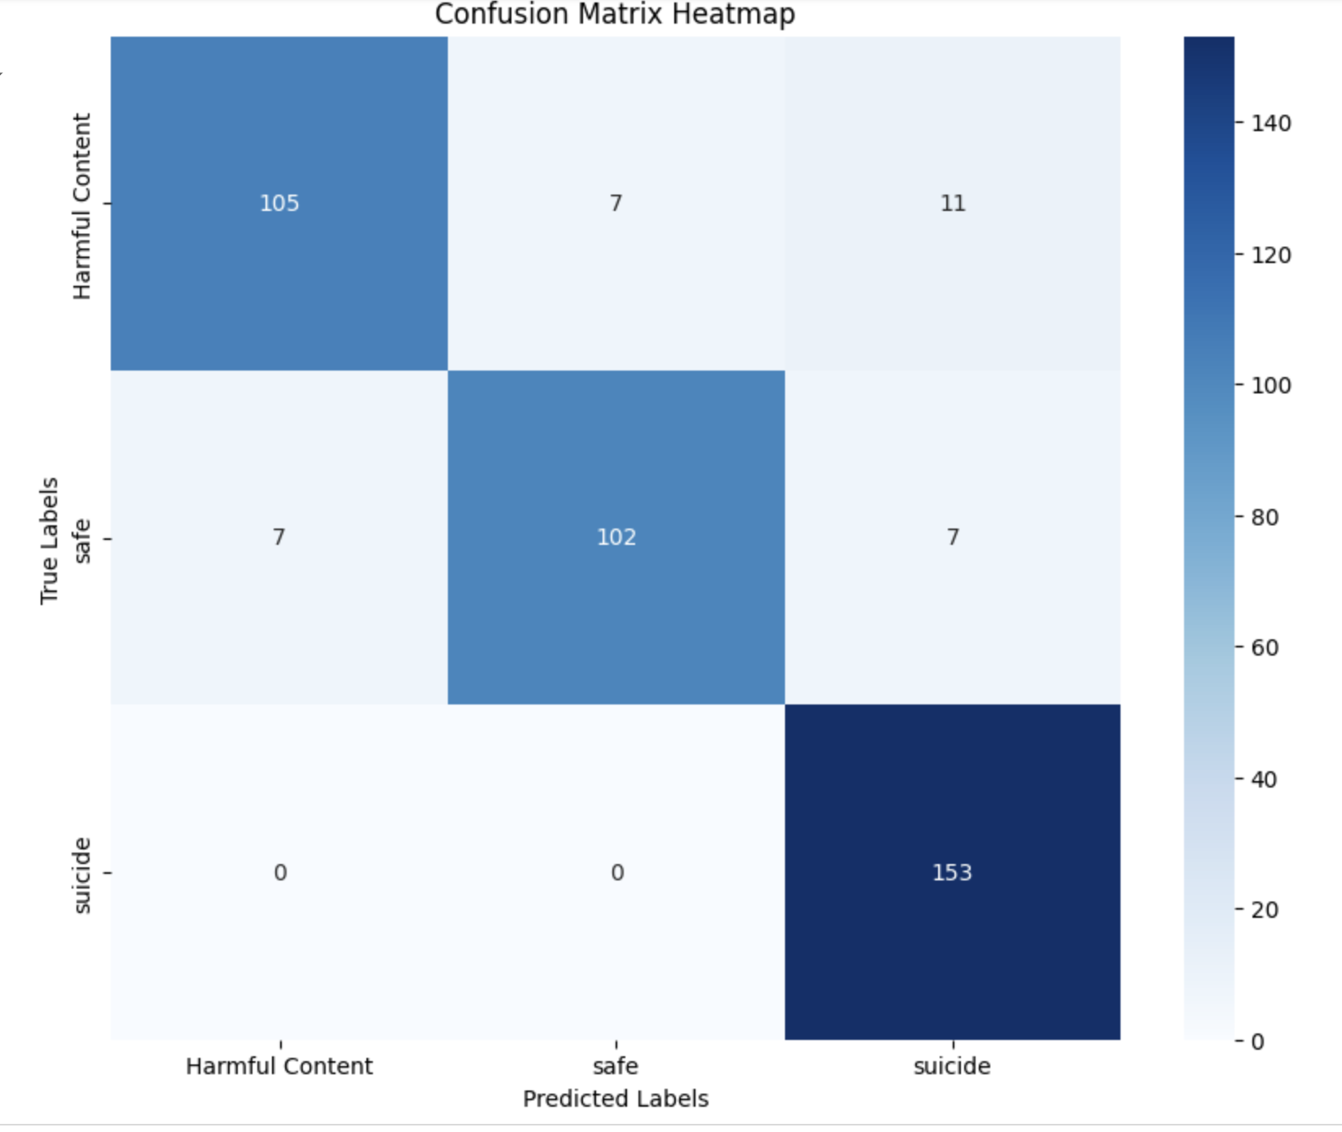
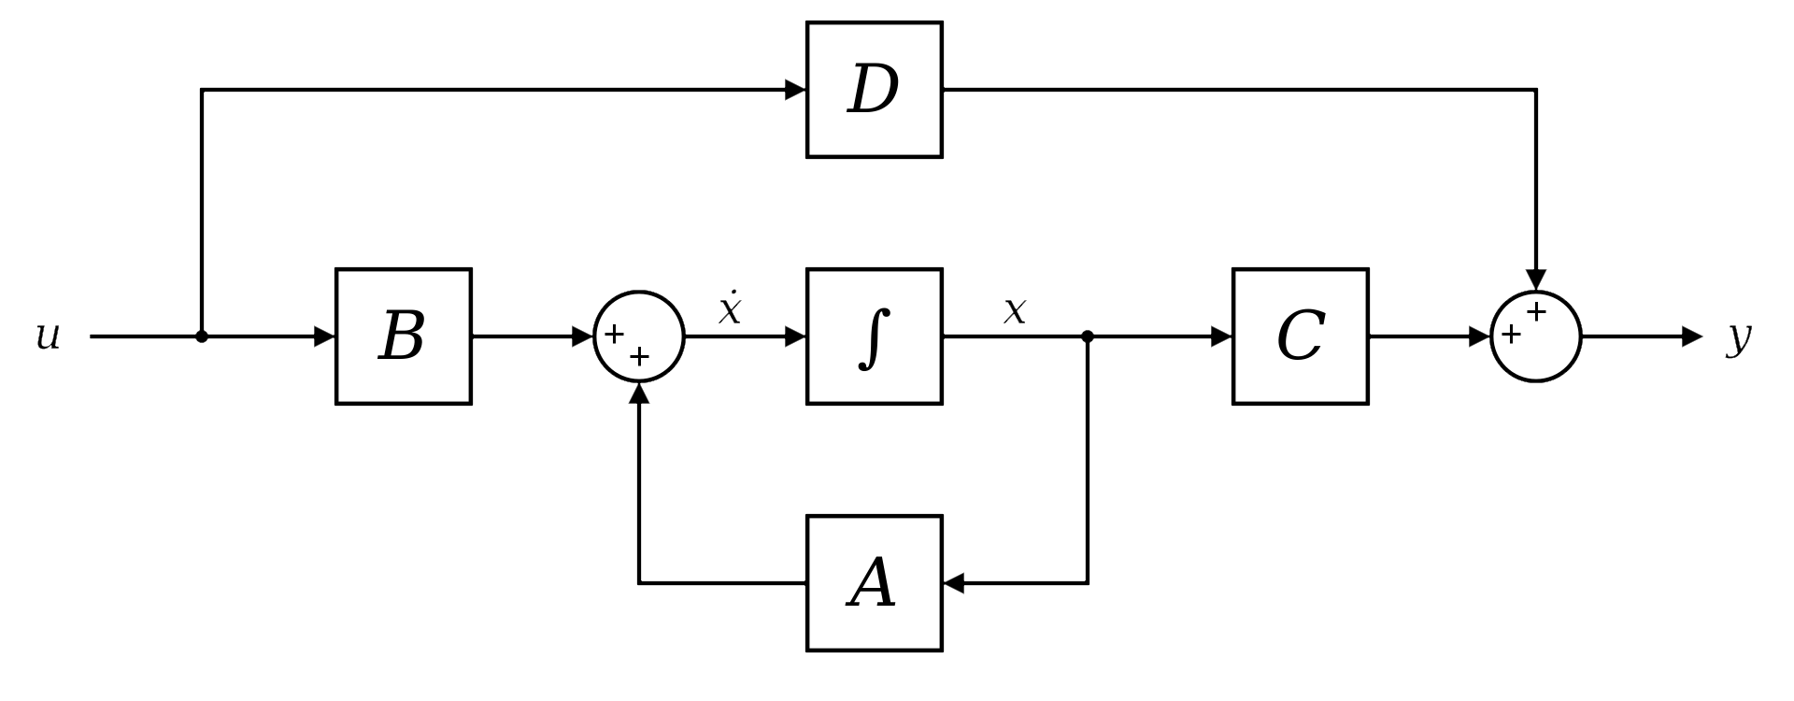
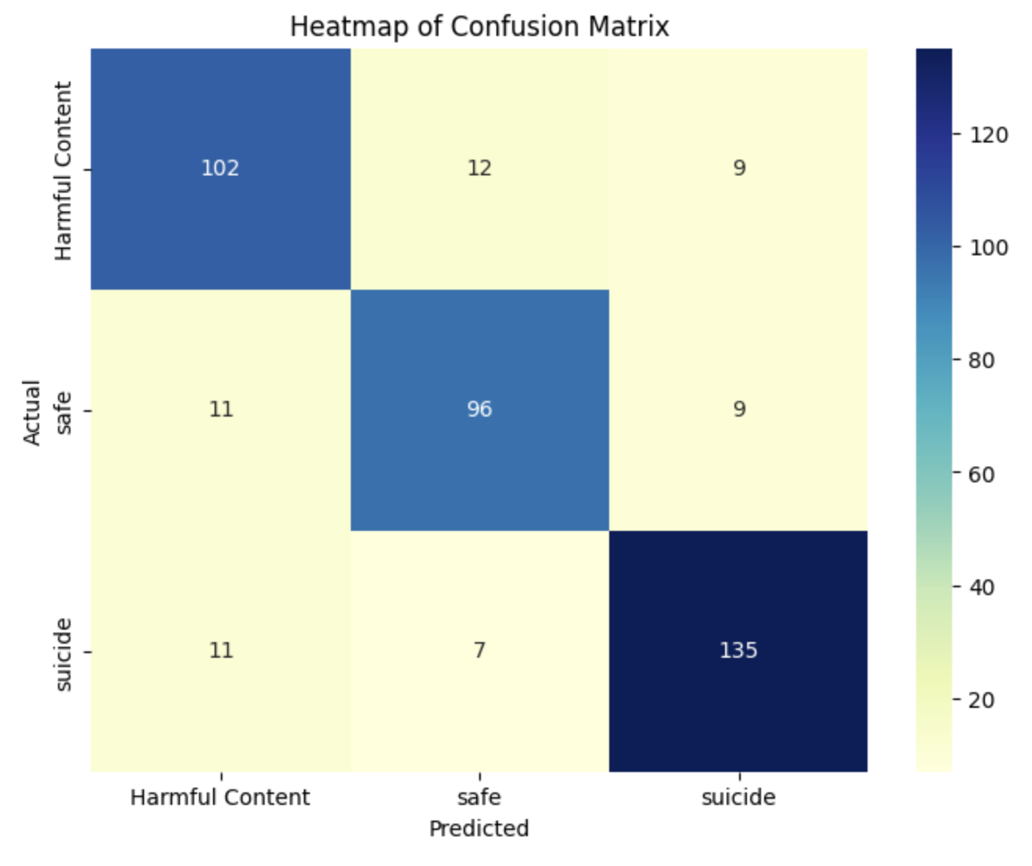
AIS411-5
Comparative Analysis of Video Classification Models Using the TikHarm Dataset
Abstract
Model Implementation:
Bi-LSTM and Bi-LSTM with Attention: These models process sequences of text extracted from video frames, capturing temporal dependencies. The attention mechanism in the latter model focuses on significant parts of the text to enhance classification accuracy.
Transformer: This model utilizes self-attention mechanisms to process all words (or frame captions) simultaneously, providing a global understanding of the context, which is crucial for accurately categorizing complex video content.
State Space Model (SSM): SSMs handle video data by modeling the sequence of frames as a dynamic system, which helps in understanding the temporal evolution of video content.
Training Procedure:
Hyperparameters: We employ an Adam optimizer with a learning rate of 0.001, adjusting parameters such as batch size and number of epochs based on preliminary runs to optimize performance.
Validation Strategy: The dataset is split into training (70%), validation (20%), and test (10%) sets. Models are evaluated during training using the validation set to monitor overfitting and underfitting.
Evaluation Metrics:
Accuracy and Loss: Training and validation accuracy and loss metrics are recorded to assess model performance over epochs.
Confusion Matrix: We generate confusion matrices for each model to visualize the classification performance across categories, helping identify models that are particularly prone to misclassifying specific types of content.
F1 Score, Precision, and Recall: These metrics are calculated to evaluate the models’ ability to balance the detection of harmful content without misclassifying safe content as harmful, which is critical for practical applications.
Attention Mechanism Impact: The Bi-LSTM with Attention highlighted its utility in focusing on temporally significant features, which, however, led to a higher rate of misclassifications in overlapping categories. This suggests that while attention mechanisms enhance model sensitivity, they require careful tuning to balance complexity and performance.
Practical Implications and Recommendations:
The robustness of the Transformer and the specialized effectiveness of the SSM in certain contexts suggest their potential integration into hybrid systems for improved content moderation.
The need for refined feature extraction and the incorporation of multimodal data (audio and visual cues) are recommended to enhance classification accuracy and reduce misclassifications
This research investigates the performance of deep learning models for video classification tasks using the TikHarm dataset, aiming to enhance automated content moderation systems and ensure safer online environments.
Context and Purpose: The study focuses on evaluating state-of-the-art models, including Bi-LSTM, Bi-LSTM with Attention, Transformer, and State Space Models, to address the increasing need for robust systems capable of handling sensitive video content categorization.
Multimodal Preprocessing Pipeline: The research employs an advanced preprocessing framework, using the BLIP model to extract key video frames and generate text captions. This ensures accurate and context-rich inputs for classification tasks.
Model Comparative Analysis: The study conducts a comprehensive evaluation of four machine learning architectures, emphasizing their ability to classify video content into three distinct categories: Harmful, Safe, and Suicidal. The Transformer model achieved the highest accuracy, while the State Space Model excelled in identifying high-risk content.
Temporal and Feature Overlap Challenges: Temporal misclassifications and overlapping features between "Harmful" and "Safe" categories were identified as key challenges. This analysis highlights the need for refined feature extraction techniques to improve model precision.
Practical Applications: The findings support the development of real-time content moderation tools, offering practical solutions for platforms to balance user safety with freedom of expression.
Future Directions: Incorporating multimodal data, such as audio and visual cues, along with enhanced attention mechanisms, is proposed to further improve model performance and address classification ambiguities.
Bi-LSTM
Introduction
In an era of digital ubiquity, accurately categorizing video content is essential for maintaining safe and appropriate online environments. This research investigates various deep learning models using the TikHarm dataset, focusing on the classification of videos into categories such as Harmful, Safe, and Suicidal. Through this study, conducted within the context of video content on social platforms, we utilize advanced modeling techniques to enhance content moderation tools, contributing to digital safety and compliance.
Objectives:
Model Evaluation and Comparison: The primary objective is to assess the performance of different deep learning architectures—Bi-LSTM, Bi-LSTM with Attention, Transformer, and State Space Model—in accurately classifying video content. This analysis will help determine which model provides the most reliable and efficient results for real-time content moderation.
Enhancement of Content Moderation: By identifying the strengths and weaknesses of each model, this research aims to refine video classification techniques, thus improving the accuracy and responsiveness of content moderation systems.
Reduction of Misclassification: A key objective is to minimize the occurrence of misclassifications, particularly between overlapping categories such as "Harmful" and "Safe," enhancing the precision of automated moderation tools.
Contributions:
Advancing Content Moderation Technologies: This study contributes to the field of digital media management by providing a comparative analysis of cutting-edge machine learning techniques for video classification, offering valuable insights into their practical applications and limitations.
Interdisciplinary Approach: By integrating insights from artificial intelligence, media studies, and psychology, this research enhances the understanding of how different models perform under varying conditions and their implications for user safety and platform integrity.
Framework for Future Research: The findings from this study will serve as a benchmark for future investigations, promoting advancements in machine learning applications for content moderation and establishing a foundation for the development of more sophisticated and effective moderation technologies.
Bi-LSTM with Attention
Transformer
State Space Model (SSM)
Conclusion
Significance of Video Classification in Content Moderation: The rapid proliferation of online video content necessitates advanced systems for identifying harmful and sensitive material. This study explores the comparative performance of four deep learning models, providing critical insights for developing safer digital platforms.
Bi-LSTM Model Insights: The Bi-LSTM model demonstrated robust sequential learning capabilities, achieving competitive accuracy levels. However, it faced challenges in distinguishing overlapping categories like "Harmful Content" and "Safe," highlighting the need for additional contextual enhancements.
Bi-LSTM with Attention: Incorporating attention mechanisms improved the model’s ability to focus on relevant sequences, particularly in capturing nuanced cues. Despite this, increased misclassifications in certain categories suggest that fine-tuning attention weights is essential for optimal performance.
Transformer Model Superiority: The Transformer model emerged as the best-performing architecture, achieving the highest training and validation accuracies. Its self-attention mechanism enabled superior handling of complex patterns, making it the most reliable model for general video classification tasks.
State Space Model (SSM): While the SSM exhibited lower overall accuracy compared to the Transformer, it excelled in detecting suicidal content with high recall. This highlights its potential for specialized applications in safety-critical scenarios.
Classification Challenges: Misclassifications primarily occurred between "Harmful Content" and "Safe" categories, reflecting feature overlap and subjectivity in labeling. Future studies could incorporate multimodal approaches, integrating audio and visual cues for improved precision.
Practical Implications for Content Moderation: The findings underscore the importance of selecting models based on specific application requirements. The Transformer is ideal for general-purpose tasks, while the SSM provides reliability in sensitive use cases, such as detecting suicidal content.
Future Directions: Further research should focus on multimodal data integration and advanced preprocessing pipelines to address overlapping categories. Enhanced attention mechanisms and real-time adaptability could also improve model performance in dynamic online environments.
Methodology
Results
This section outlines the systematic approach used to evaluate the performance of various deep learning models on the TikHarm dataset, aimed at classifying video content as Harmful, Safe, or Suicidal. Our methodology encompasses data preprocessing, model implementation, training procedures, and evaluation metrics.
Data Collection and Preprocessing:
Dataset Overview: The TikHarm dataset comprises a curated collection of video clips labeled across three categories: Harmful, Safe, and Suicidal. Each video is annotated with tags derived from a comprehensive review process involving multiple experts.
Preprocessing Steps: Videos are first segmented into frames. Key frames are then extracted based on movement and content significance using the BLIP model for further analysis. Each frame is converted into a caption using advanced natural language processing techniques to facilitate text-based classification.
This study examined the efficacy of four deep learning architectures—Bi-LSTM, Bi-LSTM with Attention, Transformer, and State Space Model (SSM)—in classifying video content using the TikHarm dataset. The evaluation focused on their performance in distinguishing between harmful, safe, and suicidal content.
Model Performance Overview:
Accuracy and Loss Trends: The Transformer model demonstrated superior performance with a high training accuracy of 92.09%. Visualizations of training and validation accuracy over epochs (please describe or confirm the visuals) highlight the learning efficiency and stability of the Transformer compared to other models.
Confusion Matrix Analysis: Each model's ability to classify content correctly was assessed using confusion matrices. These visualizations (please confirm or describe) show how the models differentiate between the categories, with particular attention to the misclassifications between "Harmful Content" and "Safe."
Comparative Analysis:
Precision and Recall: The State Space Model showed exceptional capabilities in detecting "Suicidal" content with a very high recall rate, emphasizing its suitability for sensitive content detection. Comparative charts (please describe or confirm the visuals) illustrate the precision and recall rates across all models, underscoring the specific strengths and weaknesses of each.
Malak Elsamman
Salma hesham
Khadiga Nasser
Rovan ehab
Mohamed hafez

