Slide 1
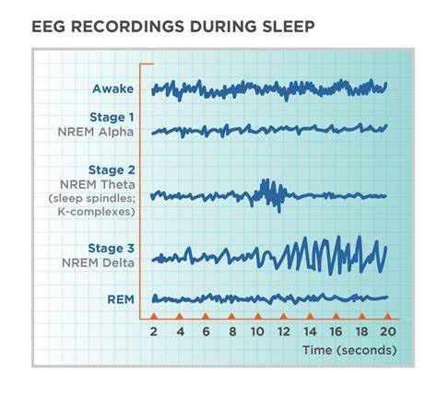
Sleep Stages Classification
Course: Biomedical Signal Processing
Under the supervision of: Dr. Ibrahim Sadek
By: Malak Mohammed Farag

Slide 2
Dataset
The Multi-Ethnic Study of Atherosclerosis (MESA) is a study that investigates the development of cardiovascular disease before symptoms appears
Includes 6,814 participants aged 45–84 from diverse ethnic groups
The MESA Sleep study (2010–2012) included 2,237 participants
Multi-Ethnic Study of Atherosclerosis - Sleep Data - National Sleep Research Resource - NSRR

Slide 3
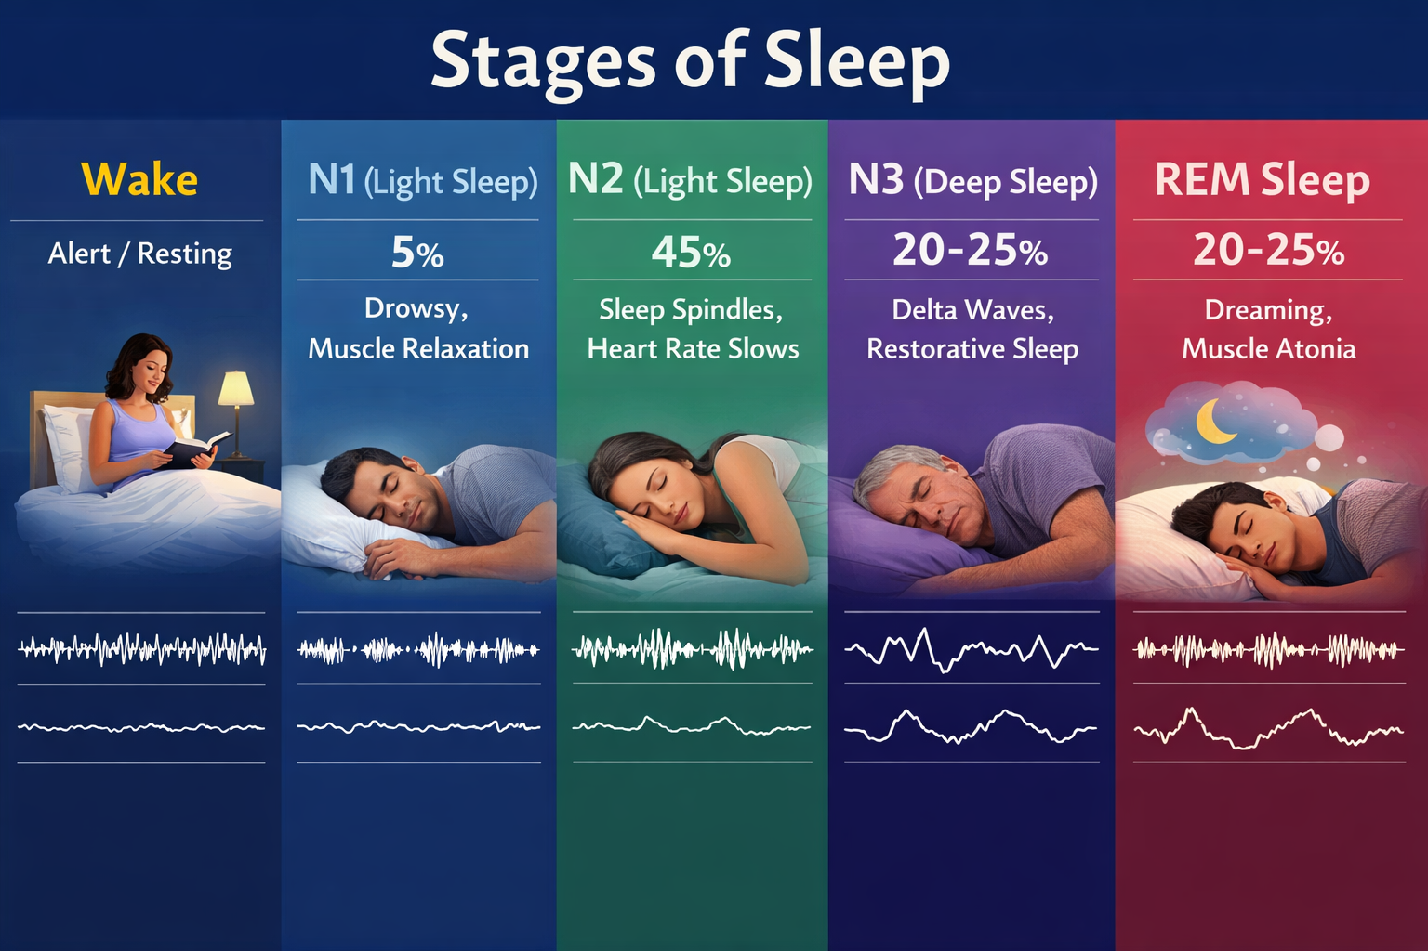
Dataset
Polysomnography: Contains EDF and XML files
EDF file: Storse different vital signs at the same time
XML file: Contains all events analyzed by the doctors
Other files
The Multi-Ethnic Study of Atherosclerosis (MESA) is a study that investigates the development of cardiovascular disease before symptoms appears
Includes 6,814 participants aged 45–84 from diverse ethnic groups
The MESA Sleep study (2010–2012) included 2,237 participants
Multi-Ethnic Study of Atherosclerosis - Sleep Data - National Sleep Research Resource - NSRR

Slide 4
Workflow
Previously Done:
Reading Data
Segmentation
Selecting Channel
Normalization
Splitting the data
Recent:
Building the Model
Training
Evaluation

Slide 5
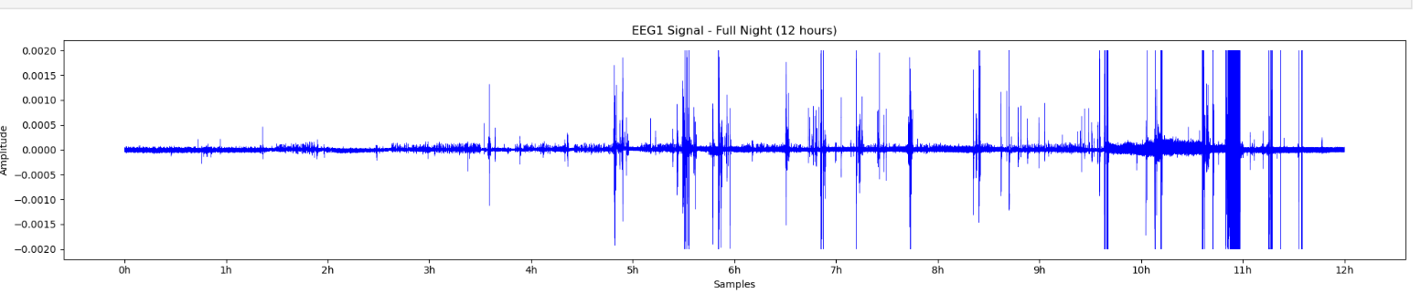
Reading Data
EDF files:
Channels: 27
“Just one channel will be used not all of them”
Duration: 12Hrs
Sampling rate: 256 Hz “Points in each second”
XML files:
Events
Filtering
“Sleep stages only”
All similar events are in one epoch

Slide 6
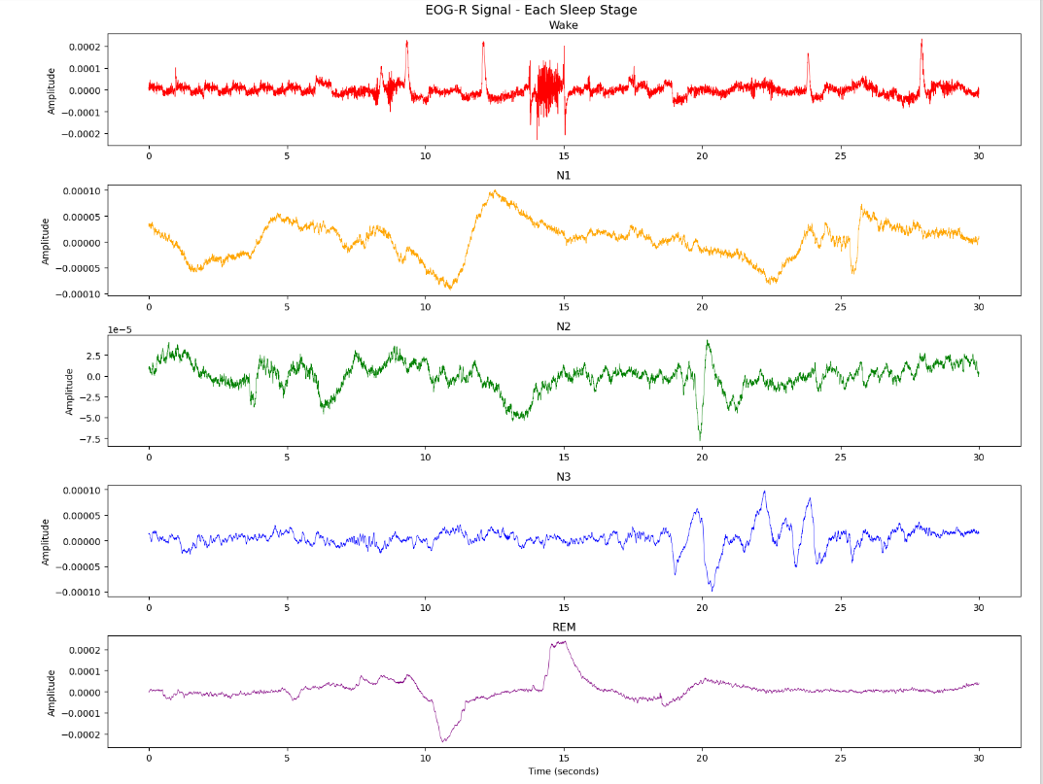
Segmentation & Channels Selection
Each epoch is segmented into smaller ones ranging about 30 seconds
The EOG-R channel is selected

Slide 7
Why EOG
EOG shows significant physiological changes across all sleep stages: during wakefulness, eye movements are frequent and erratic; during N1, slow rolling eye movements occur and during N2 and N3, movements are minimal or absent
Electrodes are easier to place and less affected by scalp impedance issues compared to EEG electrodes, which makes EOG more practical for both clinical and home monitoring.

Slide 8
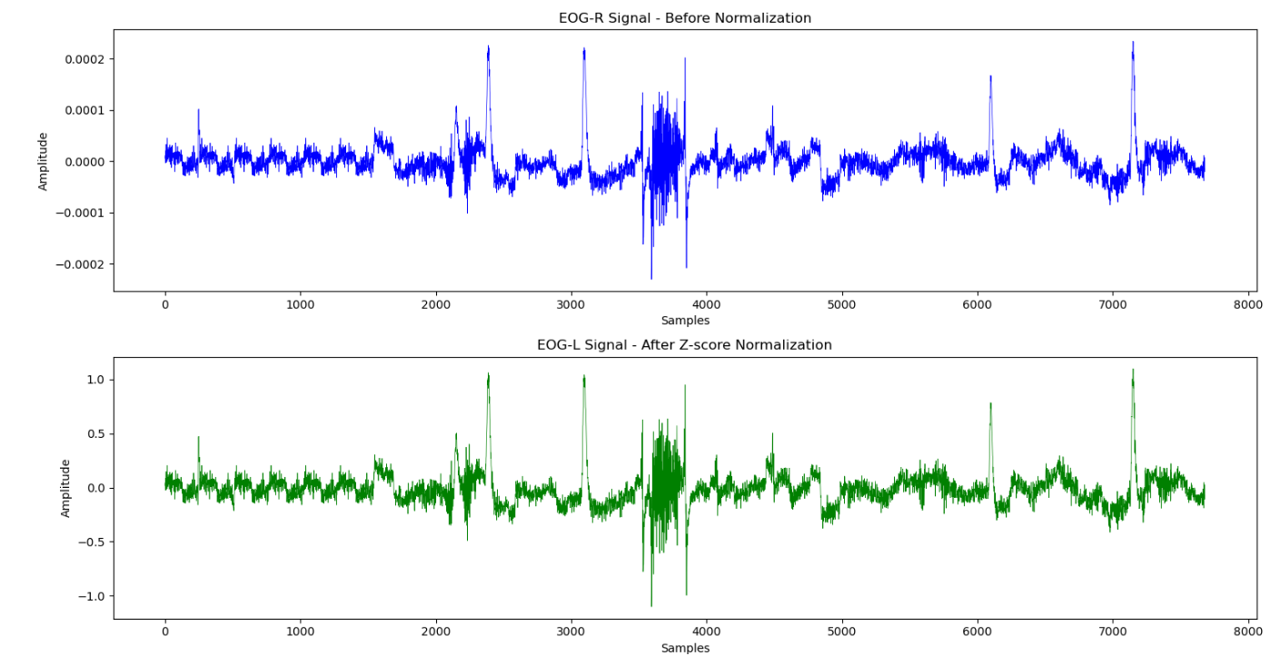
Normalization
Z-score normalization was applied to make the model training more stable and to reduce the effect of amplitude differences between channels.

Slide 9
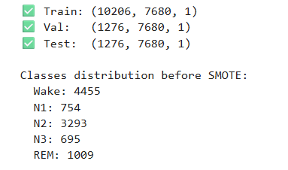
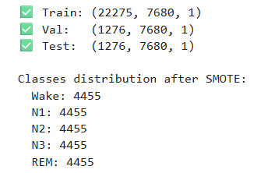
Handling Class Imbalance
SMOTE: Generates Samples for minority classes
Class Weighs: Modify the loss function

Slide 10
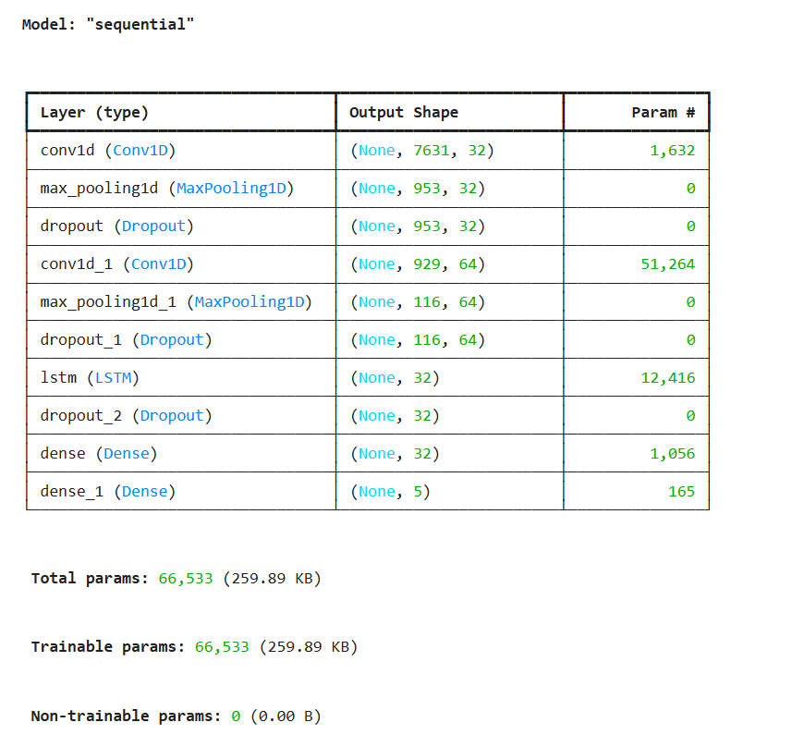
Building The Model
Sequential Model
Hybrid CNN-LSTM
The CNN layers extract local spatial features from the signal, and the LSTM layer captures long-term temporal dependencies to improve sleep stage recognition performance.

Slide 11
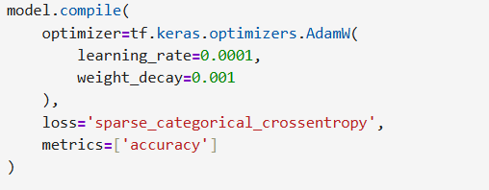
Building The Model
Optimizer: The model was compiled using the AdamW optimizer, an extension of the Adam optimizer that incorporates decoupled weight decay regularization.

Slide 12
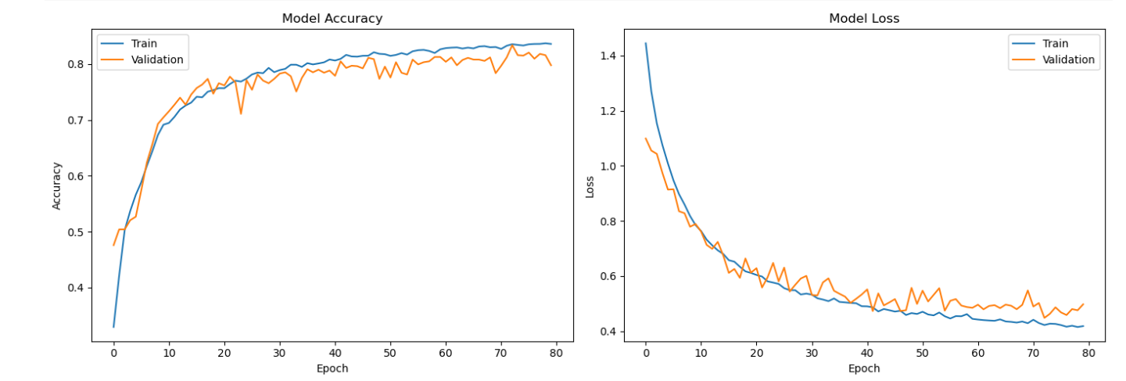
Training
Training the and saving the best model
Epochs: 80
Batch size:64

Slide 13
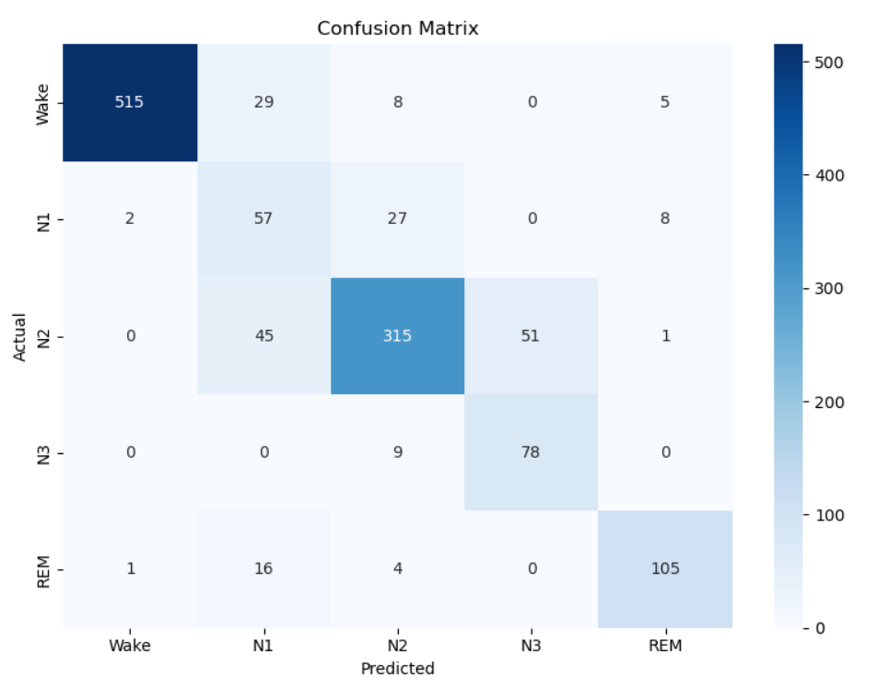
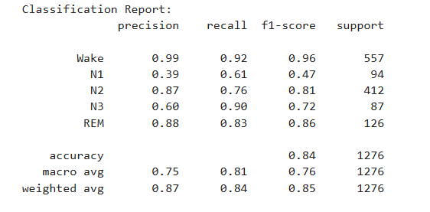
Results
The overall test accuracy achieved was 84%
The model showed strong performance in detecting: Wake stage & REM stage
N2 & N3 sleep stages achieved good classification performance
The N1 stage achieved the lowest performance due to its transitional characteristics

Slide 14
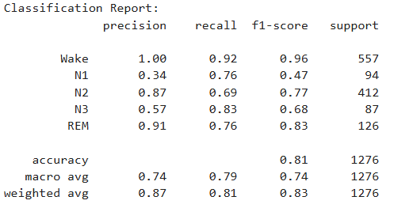
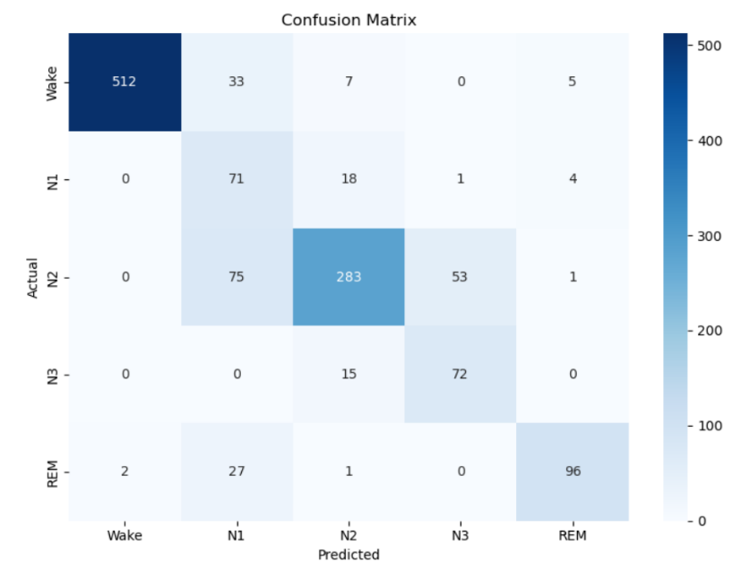
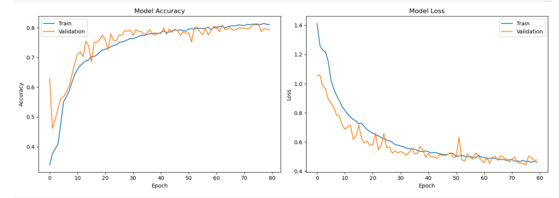
Results for EOG-L

Slide 15
THANK YOU!

