Slide 1
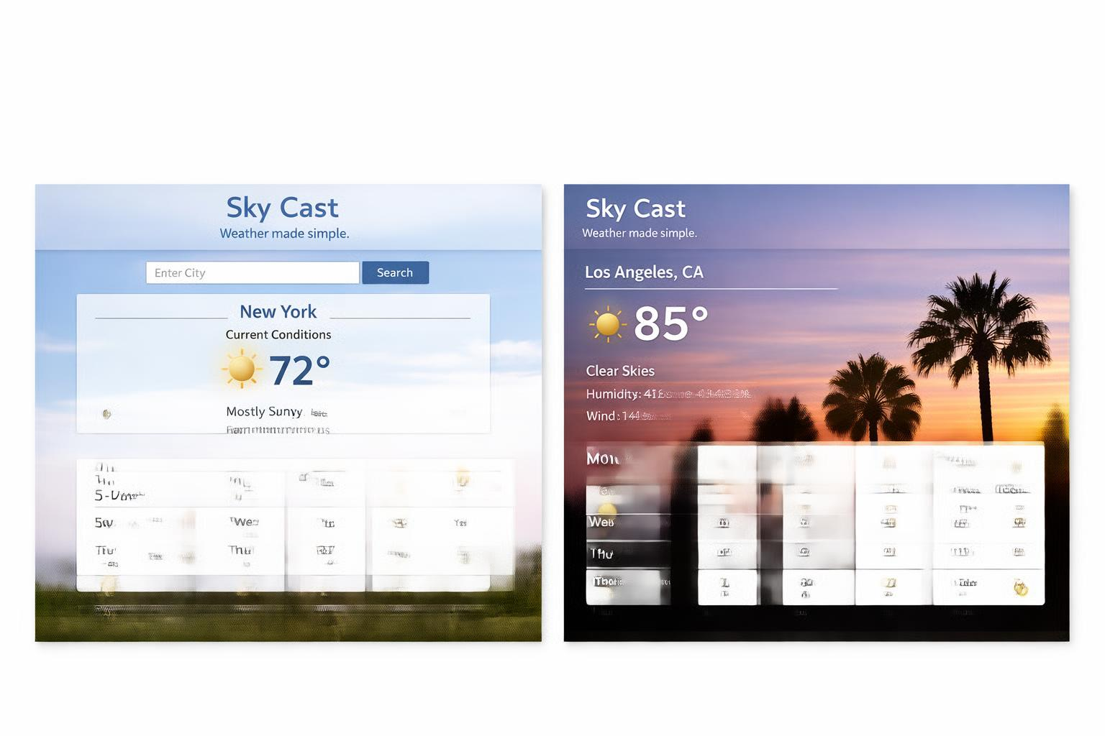
Sky Cast- A simple Weather Dashboard
Want the Weather made simple for you?
Sky Cast is a lightweight, ad‑free weather dashboard built using Python, Flask, and the OpenWeather API. Designed for everyday users who want fast, clear, real‑time weather updates without clutter or distractions. Provides current conditions (temperature, humidity, wind speed, general weather) and a five‑day forecast in a clean, minimal interface.
Who will use this/What will this do?
Allow users to type in a city and instantly view Temperature, Humidity, Wind speed, Conditions (Clear, Cloudy, Rain, etc.) Display a five‑day forecast with intuitive weather icons' Run locally in a browser using Flask. This can be used by anyone including :students, parents, or anyone needing a quick, reliable snapshot of the day’s weather.
Why does this project matter? Most weather apps are cluttered with ads and unnecessary features. Sky Cast focuses on clarity, speed, and simplicity. Demonstrates real development skills: API integration,JSON parsing, Flask routing, and Front‑end templating
Team Members: 1

