Slide 1
Employee Attrition Case Study
By Malak Mosly

Slide 2
Predicting attrition…
Important for Workforce Planning
More efficient budgeting
Improving productivity
Enriching employee’s lives

Slide 3
Employee data
Obtained from Kaggle
29 factors accounted for

Slide 4
PRIMARY GOALS
Predict attrition accurately
Highlight critical factors

Slide 5
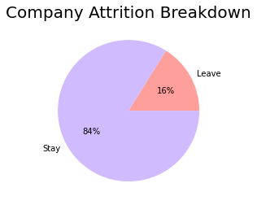
First look

Slide 6
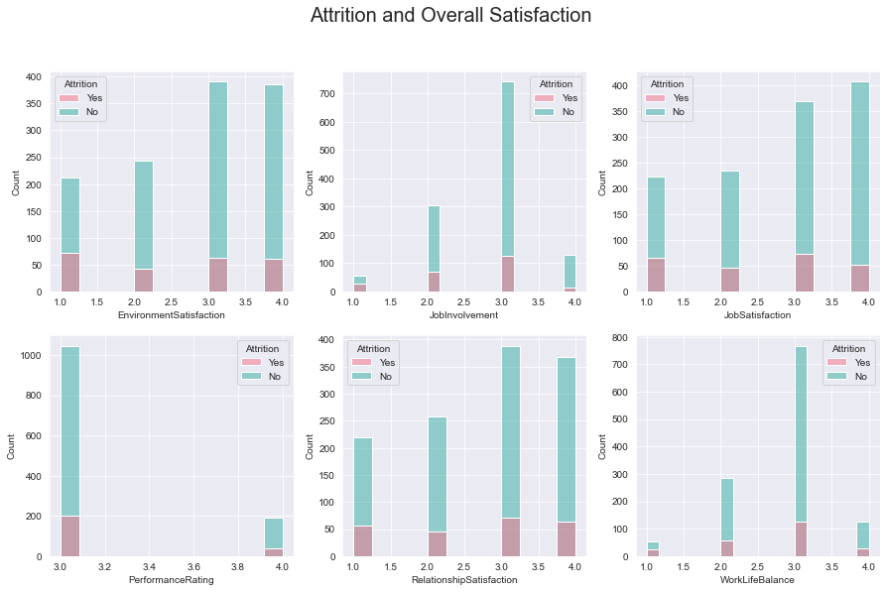
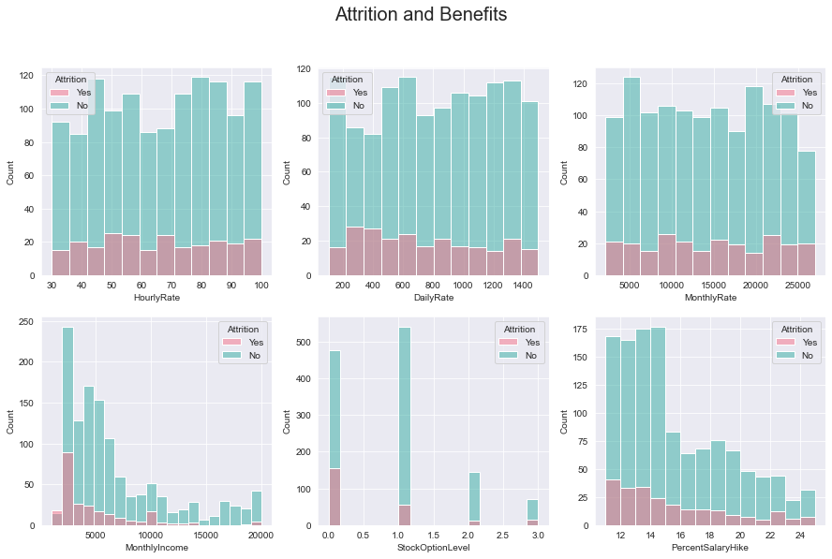
First look (cont.)

Slide 7
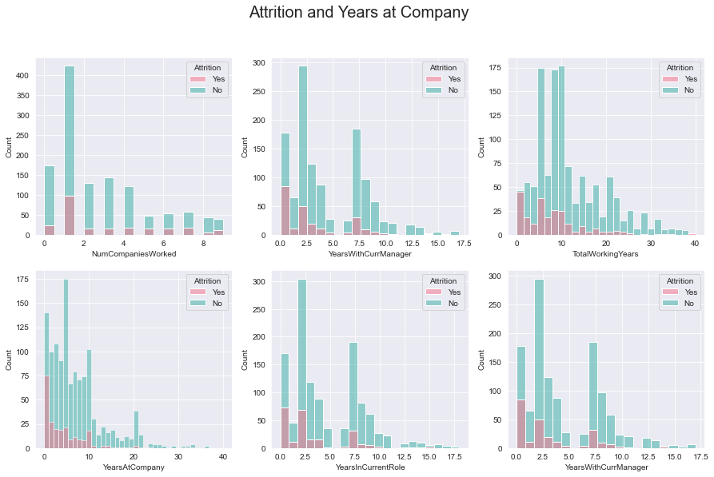
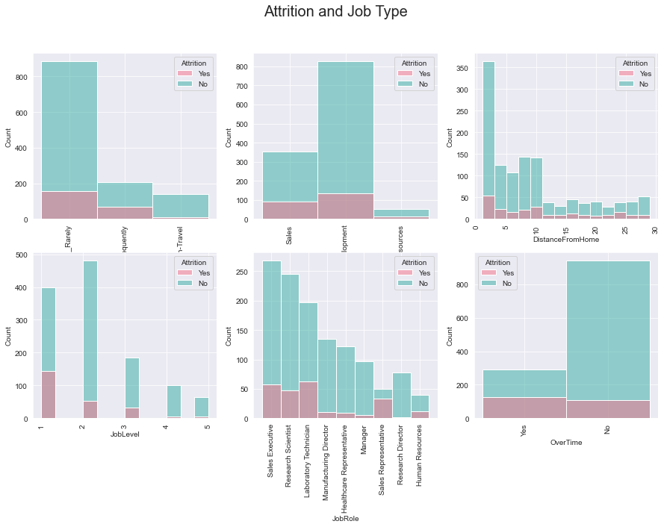
First Look (cont.)

Slide 8
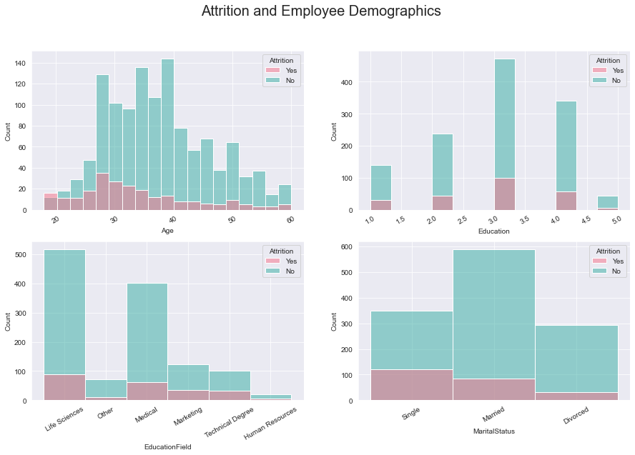
First Look (cont.)

Slide 9
Modeling
Four ML models chosen
One basic regression model
Three classification models
Model performance tested and compared

Slide 10
Model performances
​ | Logistic Regression | Gradient Boosting | Random Forest ​ | XGB
Accuracy | 85.71% | 86.39% | 86.39% | 84.81%
Avg. CV score | 85.22% | 86.6% | 85.5%​ | 85.7%
Avg. f1 score | 84%​ | 84% | 84% | 82%

Slide 11
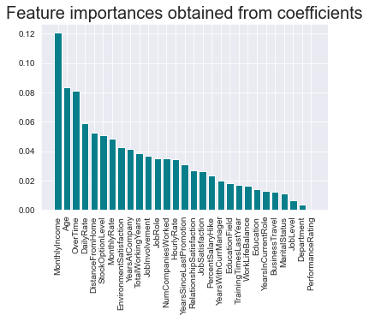
Most important factors
Most critical features:
Monthly Income
Age
Overtime
Distance from home
Stock option level
Most relevant satisfaction metric was environment satisfaction

Slide 12
Interpretations
A
Monthly income critical incentive for retention
B
Mid-Senior level employees most likely to stay
C
Time and resources for commute important factor
D
Additional benefits (e.g., stock options) can increase retention

Slide 13
KEY Recommendations
COMPETITIVE MONETARY INCENTIVES
FLEXIBILITY IN THE WORKPLACE
Prioritize up-to-date salaries
​Drive compensation satisfaction via benefits
​
Offer more hybrid/remote opportunities
Focus on employee recognition ​

Slide 14
SUMMARY
Being able to accurately predict attrition brings a variety of benefits. It allows the company to confidently carry out Workforce Planning, which leads to more effective budgeting, and drives employee morale and productivity. This will drive long-term profitability and innovation and will simultaneously increase employee’s quality of life. ​

Slide 15
THANK YOU
Malak Mosly
malakmosly@hotmail.com
Code

