Slide 1
DISEASE OUTBREAK SIMULATION
(MONTE CARLO SIMULATION)
Presented by: Malak Srour (6142)
Presented for : Dr. Mohammad Aoude

Slide 2
INTRODUCTION:
Monte Carlo simulation is a computational technique that uses random sampling to model the probability of different outcomes in a process that cannot easily be predicted due to the presence of random variables.
Epidemiological modeling plays a crucial role in understanding how infectious diseases spread within populations. Simulating these outbreaks using Monte Carlo methods allows researchers to explore different scenarios and prepare public health responses.
PROBLEM STATEMENT:
While simulating, Sequential bottleneck occurs, simulating 10M outbreaks takes a big time, so the objective to develop the sequential simulator and to Implement a concurrent version that exploits the independence between simulation runs, and achieves a meaningful speed-up while maintaining correctness and statistical consistency.

Slide 3
Taking some parameters as inputs: population Size, initial Infected, hospitalization Rate, recovery Rate, fatality Rate, total Beds As outputs: Average Deceased Average PeakBeds

Slide 4
DESIGN :
for Sequential:
The core algorithm is implemented in SequentialSimulator class and runs as follows:
- Starts with a fixed number of infected individuals.
- Simulates day-by-day progression of the outbreak.
- Updates susceptible, infected, recovered, and deceased populations based on probabilities.
- Tracks hospital bed usage and whether capacity was exceeded.
This design allows for perfectly parallelizable execution since each simulation is independent of others

Slide 5
for parallel strategy:
simulation is independent and stateless , they can be safely executed in parallel. The steps are:
-Partition Work : Divide the total number of simulations evenly among threads.
-Each thread gets its own random number generator with a unique seed to avoid correlation.
run Simulations : Each thread runs its assigned chunk using a local SequentialSimulator.
- Aggregate Results : Use LongAdder counters to accumulate key statistics (e.g., total deceased, peak beds, capacity exceeded).
- Use ExecutorService to manage threads and ensure all finish before final results are reported.

Slide 6
Synchronization Strategy
Because each simulation is independent , we minimized shared state and synchronization overhead:
A- Avoiding Shared State
Each thread gets:
- Its own instance of Random, seeded uniquely via baseSeed + threadIndex
- Its own instance of SequentialSimulator
This ensures that no two threads share mutable state during simulation.
B- Safe Aggregation Using LongAdder
We use LongAdder to safely accumulate statistics across threads:
- totalDeceased.add(result.totalDeceased())
- peakBeds.add(result.peakHospitalBedUsage())

Slide 7
Libraries used:
java.util.Random: Used to generate pseudo-random numbers for simulating stochastic behavior (e.g., infection spread, recovery, death).
java.util.concurrent.ExecutorService + Executors: Manages a pool of threads to run simulations concurrently. In ParallelSimulator, it runs chunks of simulations across multiple threads. it simplifies thread management compared to raw threads and efficient and scalable way to distribute work across threads.
java.util.concurrent.atomic.LongAdder: Collects aggregated statistics (e.g., total deceased, peak beds) across threads safely and efficiently.it is more efficient than AtomicLong or synchronized counters under high contention, scales well with large numbers of threads, and thread-safe when collecting simulation results.
java.nio.file.* (Files, Paths): to writes simulation results to a CSV file using Files.write(...). It is the standard Java library for file I/O operations.
java.util.concurrent.TimeUnit: makes awaitTermination(...) on ExecutorService more readable by using time units like TimeUnit.HOURS.
- java.util.record: it defined immutable data classes:
* SimulationParams: Holds configuration values
* OutbreakResult: Stores output of each simulation

Slide 8
Testing Methodology
1- correctness: ensured that the parallel version produces statistically equivalent results to the sequential version by:
- Comparing average deceased count and peak hospital beds between both versions.
- Logging all outputs to CSV
2- performance: measured :
- execution time for varying numbers of threads (1, 2, 4, 8, 16)
Speed-up relative to the sequential baseline
Average deceased count , peak hospital beds , and capacity exceeded count
CPU ultilization and memory usage.
All tests were run on the same machine to eliminate environmental noise.

Slide 9
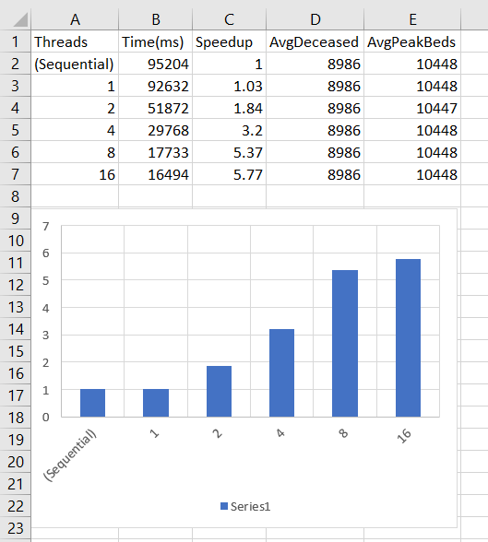
RESULTS
Csv file: speed up vs threads

Slide 10
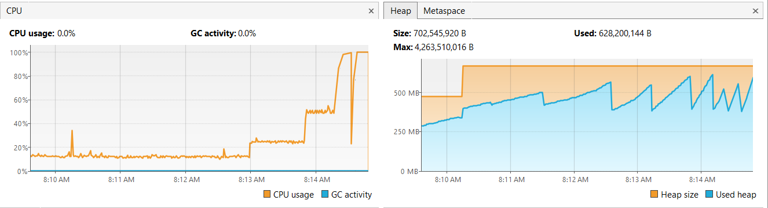
RESULTS
Visual VM: CPU and MEMORY usages

Slide 11
Comparison with Sequential (Wins & Trade-offs)
ASPECT | SEQUENTIAL | PARALLEL
TIME | ~100 s | Decreased by more than 3x
CPU Utilization | ~1 core | >85% for 8 core
Memory Usage | Low | Moderate increase due to thread stack
Correctness | Guaranteed | Maintained via thread-local RNG
Complexity | Simple | Increased coordination and tuning needed

