Slide 1

REQ2UI
B.SC. SOFTWARE ENGINEERING — GRADUATION PROJECT DEFENSE
Req2UI
From Natural Language to Secure Software Artifacts Using AI
Arab Academy for Science, Technology & Maritime Transport (AASTMT) — College of Computing and Information Technology, Smart Village — 2025/2026
TEAMMennatallah Hany · Mayar Hany · Yasmin Haitham · Malak Tarek · Mohamed Bassem
SUPERVISORDr. Salma Radwan Abdel-Hamid
REQ2UI · AASTMT 2025/2026
01 / 21
Notes:
- Open by introducing the team and the project name "Req2UI" — a graduation project from the Software Engineering track at AASTMT, supervised by Dr. Salma Radwan Abdel-Hamid. - State the one-line pitch: turn a natural-language description of a software system into a complete, security-aware artifact bundle using AI. - Note the academic context — B.Sc. defense, College of Computing and Information Technology, Smart Village, 2025/2026. - Promise the committee a roughly 20-minute walkthrough covering motivation, architecture, demo, and validation. - Invite questions at the end; mention the live demo can be opened on request.

Slide 2
REQ2UI
Agenda
What we’ll cover
Eight sections, ~20 minutes.
01
02
03
04
Motivation & Problem
Objectives & Related Work
Proposed Solution & Architecture
The 10-Stage Pipeline
Why manual SRS fails.
What we set out to do.
The big idea.
Centerpiece.
05
06
07
08
Concurrency, Resumability & Security
UML, UI Code & Traceability
Tech Stack & Live Demo
Testing, Results & Future Work
Outputs.
What’s running.
Validation + roadmap.
How it stays fast & safe.
REQ2UI
02 / 21
Notes:
- Walk the committee through the structure: 8 sections, roughly 20 minutes total. - Sections 1–3 set up the motivation, objectives, and the proposed solution at a high level. - Sections 4–6 dive into the 10-stage pipeline, concurrency, security, and the generated UML/UI/traceability outputs. - Sections 7–8 cover the live demo, validation results, and where the work goes next. - Flag that detailed Q&A is at the end, but short clarifications between sections are welcome.

Slide 3
REQ2UI
Motivation
Why Req2UI?
Manual SRS authoring fails the modern team.
01
02
03
◔
⚙
⛨
SLOW
INCONSISTENT
INSECURE
Requirements authored by hand take days to weeks per project. Iteration is painful and feedback loops are long, especially when stakeholders change their minds mid-cycle.
Style, depth, and terminology vary across teams and across projects. Two engineers reading the same input will produce two very different SRS documents.
Security requirements are routinely missing or tacked on late. Teams treat them as an afterthought rather than a first-class deliverable of the spec phase.
REQ2UI
03 / 21
Notes:
- Open by stating that manual SRS authoring fails the modern team in three concrete ways. - Slow: requirements take days to weeks per project and iteration loops are long, especially when stakeholders pivot mid-cycle. - Inconsistent: two engineers reading the same input produce two very different SRS documents — style, depth, and terminology drift. - Insecure: security requirements are routinely missing or bolted on late, rather than treated as a first-class spec deliverable. - Land the message: these three pains are exactly what Req2UI was built to remove.

Slide 4
REQ2UI
Problem
The tooling gap
Today’s tools each cover only one slice — none span the whole flow.
▤
A
▦
B
✦
C
Requirements tools
UI prototyping tools
Test automation tools
Generate an SRS document and stop there. No downstream artifacts, no security generation, no traceability to tests or UI.
Produce screens and components, but assume requirements are already settled upstream. No link back to a spec.
Assume requirements exist. They generate tests from an external spec or from existing code — not from natural language.
!
No tool auto-generates security requirements. No tool keeps end-to-end traceability across artifacts.
REQ2UI
04 / 21
Notes:
- Open by stating that today's tools each cover only one slice of the spec phase — none spans the whole flow. - Requirements tools stop at the SRS; UI prototypers assume requirements already exist upstream; test automators read from an external spec or from code, not from natural language. - Land the two specific gaps the callout highlights: no tool auto-generates security requirements, and no tool keeps end-to-end traceability across artifacts. - This fragmentation is precisely the gap Req2UI was built to close — set up the proposed solution on the next slides.

Slide 5
REQ2UI
Objectives
Five objectives
What Req2UI set out to deliver.
◌
▤
✦
✦
✦
01
02
03
04
05
Single input
Full SRS
Test cases
UML + UI
Traceability + export
Accept a plain-language description of a software system as the only input. No structured forms, no DSL.
Auto-generate a complete IEEE-830 SRS with functional, non-functional, and security requirements.
Generate functional test cases aligned to IEEE 829 and security test cases driven by OWASP Top 10 (2021).
Produce UML diagrams (use-case, class, sequence) and runnable UI code (HTML + Tailwind) per screen.
Maintain end-to-end traceability across artifacts and export the bundle as PDF, DOCX, LaTeX, and CSV.
REQ2UI
05 / 21
Notes:
- Walk the committee through the five objectives in order — they map directly to the deliverables validated later. - Objective 1: a single natural-language input — no structured forms, no DSL — sets the usability bar. - Objective 2: a full IEEE-830 SRS, including functional, non-functional, and security requirements. - Objective 3: tests — functional aligned to IEEE 829, security driven by OWASP Top 10 (2021). - Objectives 4 and 5: UML diagrams plus runnable UI code per screen, with end-to-end traceability and four export targets (PDF, DOCX, LaTeX, CSV).

Slide 6






REQ2UI
Related Work
What exists, what’s missing
Today’s categories each cover one slice. Req2UI spans all five.
CATEGORY
REQUIREMENTS
UI PROTOTYPE
TESTS
SECURITY
TRACEABILITY
Requirements generators
✓
✕
✕
✕
✕
UI prototypers
✕
✓
✕
✕
✕
Test automators
✕
✕
✓
✕
✕
Security scanners
✕
✕
PARTIAL
✓
✕
Req2UI OURS
✓
✓
✓
✓
✓
First integrated NL → SRS → UI → functional + security tests pipeline with auto security generation and full traceability.
REQ2UI
06 / 21
Notes:
- Walk the table left to right: today's categories each cover only one slice — requirements, UI, tests, or security. - Note that security scanners only do "partial" tests because they don't generate security requirements or run from natural language. - Highlight the bottom row: Req2UI is the only entry with all five columns checked. - Land the message: the gap is integration, not any single capability — Req2UI spans the whole flow. - Tee up the next slide: this is why "one input, full suite" is the proposed solution.

Slide 7
REQ2UI
Solution
One input. A complete, security-aware artifact suite.
A single natural-language description drives a 10-stage AI pipeline that emits every artifact a spec phase needs.
STEP 01
STEP 02
STEP 03
◌
✿
▣
›
›
Natural Language Input
10-Stage AI Pipeline
Artifact Suite
User describes the system in plain English.
Groq + Gemini generate artifacts concurrently.
SRS · Tests · UML · UI code · Traceability · Exports
EXPORT AS
PDF
·
DOCX
·
LaTeX
·
CSV
REQ2UI
07 / 21
Notes:
- Pitch the one-line story: one input, full suite — the user describes a system in plain English and gets a complete, security-aware artifact bundle. - Walk the three stages left to right: NL input, the 10-stage AI pipeline (Groq + Gemini running concurrently), and the artifact suite. - Emphasize that security is generated, not bolted on — it is a first-class stage of the pipeline. - Note the export targets (PDF, DOCX, LaTeX, CSV) so the artifacts land in whatever format the audience needs. - Tee up the next slide: the layered system architecture that makes this possible.

Slide 8
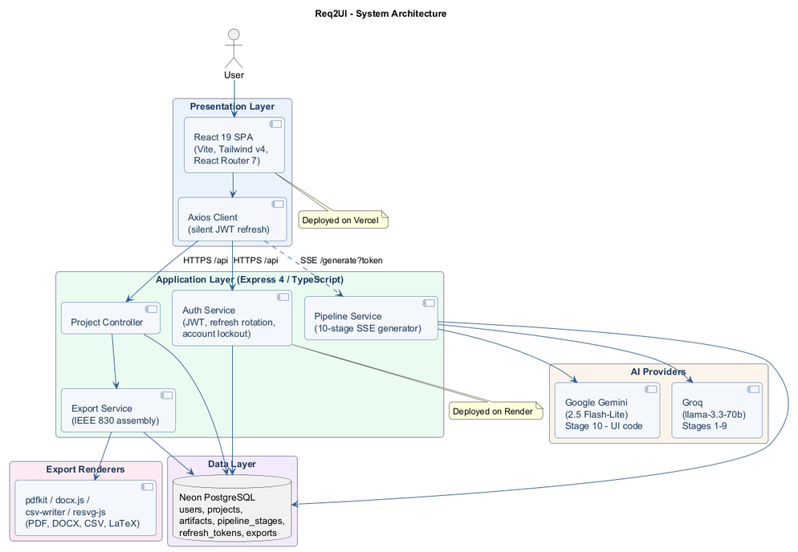
REQ2UI
Architecture
Layered architecture
React SPA → Express API → Groq / Gemini → Neon Postgres.
❄
PRESENTATION
React 19 SPA
TypeScript app with Tailwind v4, Vite, React Router 7. SSE listener streams live pipeline progress.
▦
APPLICATION
Express 4 API
TypeScript service orchestrating the 10-stage pipeline. JWT auth, Zod validation, Helmet, rate limiting.
▦
DATA
PostgreSQL on Neon
Serverless Postgres. Every artifact persisted keyed by (project, type) for resumability.
REQ2UI
08 / 21
Figure 5.1 — Architecture diagram (from thesis).
Notes:
Speaker notes: - Three clean layers: a React SPA on the front, an Express API in the middle, Postgres on Neon at the back. - The front end is just a TypeScript SPA with Tailwind and an SSE listener so the user sees the pipeline run live. - The Express API is the brain — it orchestrates the 10-stage pipeline and hardens every request with JWT, Zod, Helmet and rate limits. - Postgres on Neon is serverless; we key every artifact by (project, type), which is what makes resume-on-failure possible. - This layered split is exactly what enables both concurrency and resumability on the next slides.

Slide 9
REQ2UI
Pipeline
The 10-stage pipeline
From natural language to runnable artifacts.
01
02
03
04
05
Requirement Extraction
Functional Requirements
Non-Functional Requirements
Security Requirements
Functional Test Cases
Parse NL input; emit IEEE-830 narrative (abstract, scope, objectives).
IEEE-830 “The system shall…” statements.
Performance, usability, reliability — with measurable metrics.
Mapped to OWASP Top 10 (2021).
IEEE-829 structured test cases.
06
07
08
09
10
Security Test Cases
UI Wireframe Descriptions
Traceability Matrix
UML Diagrams
Runnable UI Code
Attack-vector driven, OWASP-aligned.
Per-screen layout & component description.
Requirement ↔ test ↔ security, with coverage %.
Use-case, class, sequence — emitted as Mermaid.
HTML + Tailwind per screen, two-pass generation.
☎
Stages 3–5 parallel · 6–7 parallel · 8–10 parallel
▦
Stages 1–9 · Groq llama-3.3-70b
✦
Stage 10 · Google Gemini 2.5-flash-lite
REQ2UI
09 / 21
Notes:
Speaker notes: - The pipeline is the centerpiece of the project — ten stages that turn one paragraph of natural language into a full artifact suite. - Stages 1 and 2 are sequential; from there, parallelism layers in: 3–5 together, then 6–7, then 8–10. - Stages 1 through 9 are all driven by Groq's llama-3.3-70b — text artifacts, JSON-structured. - Stage 10, the runnable UI code, is delegated to Google Gemini 2.5-flash-lite because code is its specialty. - The 10-stage split is also what makes resume-on-failure cheap: each stage is independently persistable.

Slide 10
REQ2UI
Two-LLM Strategy
Two LLMs, one pipeline
Each model owns what it's best at.
Groq
Google Gemini
llama-3.3-70b-versatile
2.5-flash-lite
Drives stages 1–9 — narrative, requirements, tests, traceability, UML as Mermaid.
Drives stage 10 — runnable UI code generation.
Two-pass strategy: shared design system first, then one HTML page per distinct screen.
Fast inference on Groq's LPU tier keeps the pipeline responsive.
Structured JSON output for downstream parsing & validation.
Strong code-generation quality at a fraction of the cost of larger models.
Cost-efficient for high-volume text generation.
Produces Tailwind-styled, runnable HTML out of the box.
Pipeline router dispatches each stage to its assigned model — no manual handoff.
REQ2UI
10 / 21
Notes:
Speaker notes: - Two LLMs, not one — each is chosen for what it's actually best at. - Groq llama-3.3-70b handles stages 1–9: it's fast on Groq's LPU, cheap, and emits clean structured JSON. - Google Gemini 2.5-flash-lite owns stage 10 — the runnable UI code — because code is its specialty. - The split also means cost stays low: we don't pay premium-model prices for text we can generate cheaper. - A pipeline router dispatches each stage to its model automatically — there's no manual handoff anywhere.

Slide 11
REQ2UI
Concurrency
Parallel stages, resumable runs
Independent stages run concurrently; failures pick up where they stopped.
Stage 01
02
LANE A
→
Sequential
↓
03
04
05
LANE B
·
·
Parallel after 02
↓
06
07
LANE C
·
Parallel after 05
↓
08
09
10
LANE D
·
·
Parallel after 07
⤓
Persisted artifacts
▶
Resume on failure
✦
Live progress
Every artifact saved keyed by (project, type).
Interrupted runs pick up from the last saved stage — no re-do.
Status pushed to the browser in real time via SSE.
REQ2UI
11 / 21
Notes:
Speaker notes: - Concurrency is layered, not flat — Lane A runs stage 01 alone, then Lane B fans out 02 through 05 in parallel. - Lane C runs 06 and 07 together; Lane D finishes with 08, 09, and 10 in parallel. - Layered parallelism is what cuts wall-clock time without making the dependency graph chaotic. - Every artifact is persisted keyed by (project, type) — that's the trick that lets a failed run resume from the last saved stage instead of restarting. - Live progress is streamed to the browser via Server-Sent Events, so the user watches each stage flip from queued to done in real time.

Slide 12

REQ2UI
Security
Security, not bolted on
OWASP Top 10 (2021) requirements auto-generated in stage 4; auth stack hardened end-to-end.
▤
⚿
↻
STAGE 4
OWASP-mapped requirements
JWT access tokens
Rotating refresh tokens
15-minute TTL; signed and verified on every request.
7-day TTL, SHA-256 hashed, with token-family theft detection.
Stage 4 auto-generates security requirements aligned to OWASP Top 10 (2021).
⚿
⊘
⛨
✓
bcrypt password hashing
Account lockout
Helmet + CORS
Zod input validation
Cost factor 12; salts managed by bcrypt.
5 failed logins → temporary lockout + audit entry.
Security headers + strict CORS allow-list.
Every API route validates its payload with Zod schemas.
✦
Rate limiting
Auth + generation endpoints throttled to prevent abuse.
REQ2UI
12 / 21
Notes:
Speaker notes: - Security is generated, not bolted on — stage 4 of the pipeline auto-emits OWASP Top 10 (2021) requirements as part of the spec. - The auth stack is hardened end-to-end: JWT access tokens with 15-minute TTL, rotating refresh tokens hashed with SHA-256 and family-theft detection. - Passwords use bcrypt at cost factor 12; accounts lock after five failed logins with an audit entry. - Every API route validates payloads with Zod, Helmet sets security headers, CORS is locked to an allow-list, and rate-limits guard the auth + generation endpoints. - Two layers of defense: requirements generated in the spec, controls enforced in the app.

Slide 13
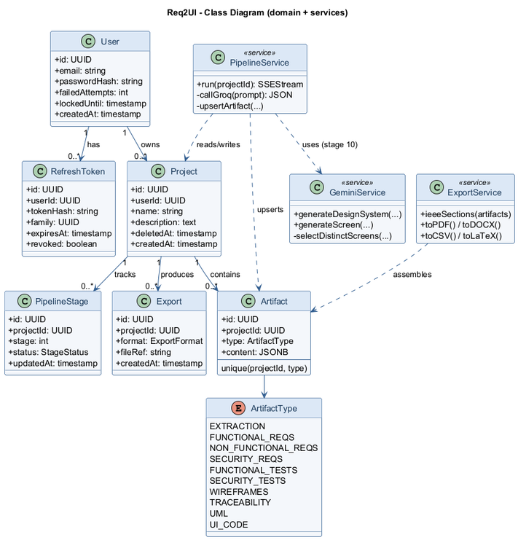
REQ2UI
UML + UI Code
Diagrams and runnable UI
Mermaid → PNG for UML; HTML + Tailwind per screen for UI.
UML
Use-case · class · sequence
Use-case, class, and sequence diagrams emitted as Mermaid.
Rasterized to PNG via resvg-js for embedding in PDF exports.
UI CODE (STAGE 10)
Two-pass strategy
Pass 1 — generate a shared design system: colors, typography, spacing, components.
Pass 2 — emit one HTML + Tailwind page per distinct screen, all consuming the design system.
Result — a low-fidelity but consistent and runnable UI prototype.
REQ2UI
13 / 21
Figure 5.3 — Class diagram (from thesis).
Notes:
Speaker notes: - UML diagrams — use-case, class, sequence — are emitted as Mermaid, so they're editable text and trivially version-controllable. - We rasterize Mermaid to PNG via resvg-js so the same diagrams can be embedded cleanly into the PDF and DOCX exports. - UI code is stage 10, run by Gemini, and uses a deliberate two-pass strategy. - Pass 1 generates a shared design system — colors, typography, spacing, components — so every screen speaks the same visual language. - Pass 2 emits one HTML + Tailwind page per distinct screen, all consuming that design system — the result is low-fidelity but consistent and runnable.

Slide 14
REQ2UI
Traceability
Every artifact links to every other
Illustrative matrix with coverage %, plus four export targets.
REQUIREMENT
TEST CASE
SECURITY
STATUS
▣
▤
FR-01
TC-001
—
✓
PDF
DOCX
User login
—
STC-005
Stakeholder-ready, paginated artifact bundle.
Editable Word doc for downstream revision.
SR-01
✓
OWASP A07
FR-04
TC-018
—
✓
Export PDF
NFR-02
TC-022
—
✓
Response < 500ms
SR-03
—
STC-009
✓
OWASP A03
✦
▦
LaTeX
CSV
Academic / publication-ready source.
Machine-readable matrix for tooling.
✓
Example coverage: 100% of FRs mapped to a test case; 100% of SRs mapped to a security test.
REQ2UI
14 / 21
Notes:
Speaker notes: - The traceability matrix is generated, not maintained by hand — every requirement links to its test case and (where applicable) its security control. - Coverage is 100% by construction: every functional requirement has a test, every security requirement has a security test. - The same matrix drives exports, so a stakeholder opening the PDF sees exactly what the engineer sees in-app. - Four export formats cover every audience: PDF for stakeholders, DOCX for downstream editing, LaTeX for academic use, CSV for tooling. - That closes the traceability gap called out in the problem statement — no artifact is an island.

Slide 15
REQ2UI
Tech Stack
Built on a modern TypeScript stack
One language end-to-end — frontend, backend, and tooling.
✦
FRONTEND
▦
BACKEND
React 19
TypeScript
Tailwind CSS v4
Vite
React Router 7
Node.js
Express 4
TypeScript
JWT
Zod
Helmet
bcrypt
◯
DATA & AI
↑
EXPORT & DEPLOY
PostgreSQL (Neon serverless)
Groq llama-3.3-70b
pdfkit
docx.js
csv-writer
resvg-js
Vercel (FE)
Google Gemini 2.5-flash-lite
Render (BE)
REQ2UI
15 / 21
Notes:
Tech stack overview — keep it crisp. - One language end-to-end: TypeScript across the React SPA, the Express API, and shared types — the team never context-switches. - Frontend is React 19 on Vite with Tailwind v4 and React Router 7; React 19's concurrent features power the live SSE progress UI. - Backend is Express 4 with JWT auth, Zod validation, Helmet headers, and bcrypt password hashing. - Data layer is serverless Postgres on Neon — pay-per-use, branchable, scales to zero between bursts. - AI is consumed as managed APIs: Groq llama-3.3-70b for text stages, Google Gemini 2.5-flash-lite for code generation. - Export toolchain (pdfkit, docx.js, csv-writer, resvg-js) runs server-side; deploy is split Vercel (FE) + Render (BE).

Slide 16
REQ2UI
Live Demo
Inside the app
Four screens the committee can ask to see live.
▦
SCREEN 01
✦
SCREEN 02
Dashboard
Project Detail
●
SSE
●
●
●
●
List of projects, status badges, last-run timestamp.
The 10 pipeline stages with live SSE progress.
Quick actions: New project, Open, Delete.
Re-run or resume from any saved stage.
✦
SCREEN 03
✦
SCREEN 04
Artifacts Viewer
UI Preview
PDF
HTML
●
●
CSV
●
Every generated artifact — SRS, tests, UML, UI code — listed.
Rendered HTML+Tailwind output per screen.
Each artifact individually downloadable.
Opened in a sandboxed iframe for live preview.
REQ2UI
16 / 21
Live walkthrough available on request.
Notes:
Live demo — invite the committee in. - These four tiles preview the screens we can walk through live; each is a styled mock, not the real screenshot. - Dashboard is the entry point: project list, status badges, last-run timestamp, and quick actions. - Project Detail is the centerpiece — the 10-stage pipeline rendered with live SSE progress; we can re-run, pause, or resume from any saved stage. - Artifacts Viewer lists every generated artifact (SRS, tests, UML, UI code) and lets you download each individually. - UI Preview opens the generated HTML + Tailwind per screen in a sandboxed iframe for live preview. - Offer a live walkthrough on request — keep this slide to ~30 seconds.

Slide 17
REQ2UI
Testing
Validated, not just demoed
Automated tests + standards conformance across every artifact type.
✓
▤
✓
24
IEEE 830
IEEE 829
SRS CONFORMANCE
TEST-DOC CONFORMANCE
AUTOMATED TESTS PASSING
Generated SRS follows IEEE-830 structure.
Test cases use IEEE-829 fields.
Across 2 suites: auth routes + export service.
⛨
⌇
✦
OWASP Top 10 (2021)
IEEE 12207
UML
SECURITY MAPPING
LIFECYCLE ALIGNMENT
Every SR linked to a Top-10 category.
Process standard followed end-to-end.
DIAGRAM STANDARD
Use-case, class, sequence per UML spec.
REQ2UI
17 / 21
Notes:
Testing & validation — make the conformance case. - Validation is two-pronged: automated tests for code paths, and standards-based conformance for artifacts. - 24 automated tests pass across 2 suites — auth routes (JWT issuance, refresh, lockout) and export service (PDF/DOCX/CSV/LaTeX generation). - Every artifact type maps to a recognized standard — this is not ad-hoc. - SRS follows IEEE 830 structure; test cases follow IEEE 829 fields. - Security requirements are mapped to OWASP Top 10 (2021); process alignment follows IEEE 12207. - UML diagrams follow the standard — use-case, class, and sequence per the UML specification.

Slide 18
REQ2UI
Results
What we delivered
Five objectives, five outcomes — all met.
01
Single input — Accepts free-form plain-language project descriptions.
✓
Met
02
Full SRS — IEEE-830 SRS with functional, non-functional, and security requirements.
✓
Met
03
Test cases — Functional tests (IEEE 829) + security tests (OWASP-driven).
✓
Met
04
UML + UI — Mermaid UML diagrams + HTML/Tailwind per screen.
✓
Met
05
Traceability + exports — Matrix with coverage % + PDF/DOCX/LaTeX/CSV.
✓
Met
Research gap closed: first integrated NL → SRS → UI → functional + security tests pipeline with auto security & full traceability.
REQ2UI
18 / 21
Notes:
Results — one objective, one outcome, all green. - Each of the five objectives set on slide 5 maps to a concrete, demonstrable deliverable. - Single input — the system accepts a free-form plain-language description with no structured forms or DSL. - Full SRS — IEEE-830 structure with functional, non-functional, and security requirements all generated. - Test cases — IEEE 829 functional tests plus OWASP-driven security tests. - UML + UI — Mermaid UML diagrams plus HTML + Tailwind per screen. - Traceability + exports — a coverage matrix plus PDF/DOCX/LaTeX/CSV bundles. - The gap stated in the problem statement is closed: first integrated pipeline of its kind.

Slide 19
REQ2UI
Limits & Future
Honest limits, clear roadmap
What we know is bounded — and where we're going next.
⚠
LIMITATIONS
➤
FUTURE WORK
Output quality depends on the LLM and on the detail of the user's input.
Throughput is bounded by API rate limits (free tiers on Groq & Gemini).
Generated UI is a low-fidelity prototype — not production-ready.
Some non-functional targets (load testing, full WCAG) still need dedicated test runs.
Coverage of OWASP is Top-10-only; ASVS-level depth is future work.
Admin dashboard for project + user management.
In-app artifact editing and refinement.
Self-critique refinement loops (LLM reviews its own output).
More export targets (e.g. Markdown, OpenAPI).
Domain fine-tuning / retrieval augmentation.
ASVS-level security requirements.
Auto-run generated tests against generated UI.
REQ2UI
19 / 21
Notes:
Limitations & future work — be candid, then point forward. - Output quality tracks both the LLM and the user's input detail — vague prompts yield vague specs. - Throughput is gated by free-tier rate limits on Groq and Gemini — a budget unlock, not an architectural one. - Generated UI is intentionally low-fidelity; it's a prototype scaffold, not production markup. - Some non-functional targets — full load testing and complete WCAG audits — still need dedicated test runs. - OWASP coverage is Top-10-only today; ASVS depth is on the roadmap. - Roadmap is concrete and incremental: admin tooling, in-app editing, self-critique loops, more export formats, fine-tuning, ASVS, and auto-running generated tests against generated UI.

Slide 20
REQ2UI
Conclusion
Req2UI closes the gap.
The first integrated pipeline covering natural language → SRS → UI prototype → functional + security test cases — with automatic security generation and full end-to-end traceability.
ONE INPUT. TEN STAGES. A COMPLETE, SECURITY-AWARE ARTIFACT SUITE.
IEEE 830
IEEE 829
OWASP Top 10 (2021)
REQ2UI
20 / 21
Notes:
Conclusion — land the contribution in one line, then pause. - One sentence: Req2UI closes the gap stated earlier in the deck. - The pipeline is the first integrated coverage from natural language to SRS, to UI prototype, to functional and security test cases. - Two differentiators we want the committee to remember: security is generated, not bolted on; and traceability is end-to-end across every artifact. - Tagline reinforces the mental model: one input, ten stages, a complete security-aware artifact suite. - Pause briefly here, then invite questions on the next slide.

Slide 21
REQ2UI
Thank You
Thank you.
Questions are welcome.
TEAM
Mennatallah Hany · Mayar Hany · Yasmin Haitham · Malak Tarek · Mohamed Bassem
SUPERVISOR
Dr. Salma Radwan Abdel-Hamid
Arab Academy for Science, Technology & Maritime Transport — 2025/2026
REQ2UI
21 / 21
Notes:
Closing — keep it warm and brief. - Thank the committee for their time and attention throughout the talk. - Thank our supervisor Dr. Salma Radwan Abdel-Hamid for her guidance, feedback, and patience across the project. - Thank the team — Mennatallah, Mayar, Yasmin, Malak, and Mohamed — every artifact in this deck was a shared effort. - Acknowledge the Arab Academy for Science, Technology & Maritime Transport and the College of Computing and Information Technology. - Open the floor: questions are welcome on any stage, decision, or trade-off — we're ready to go deep on architecture, security, or the pipeline.

