Slide 1
Clinic Management System Database
Enhancing Clinical Operations with a Relational SQL Database
Team:
Logain Yasser – 231001246
Malak Wagdy – 231001578
Youssef Hatem – 231001207

Slide 2
Introduction
Why this project?
Clinics require organized data systems.
Manual records → Inefficiency, errors.
Objective: Automate handling of appointments, diagnosis, and data tracking.

Slide 3
System Scope
What the system manages:
Departments & Clinics
Doctors
Patients
Appointments
Diagnoses & Payments

Slide 4
Entity-Relationship Design
Entities:
Department, Clinic, Doctor, Patient, Appointment
Relationships:
Department → Clinics & Doctors
Doctor → Appointments
Appointment → Patient

Slide 5
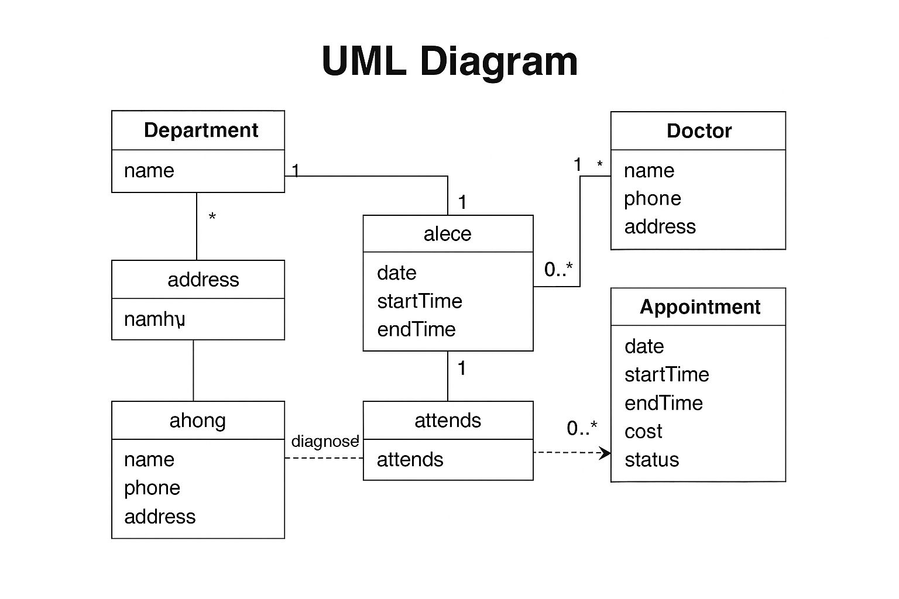
UML Diagram (Simplified)
Department → Clinic, Doctor
Doctor → Appointment
Appointment → Patient

Slide 6
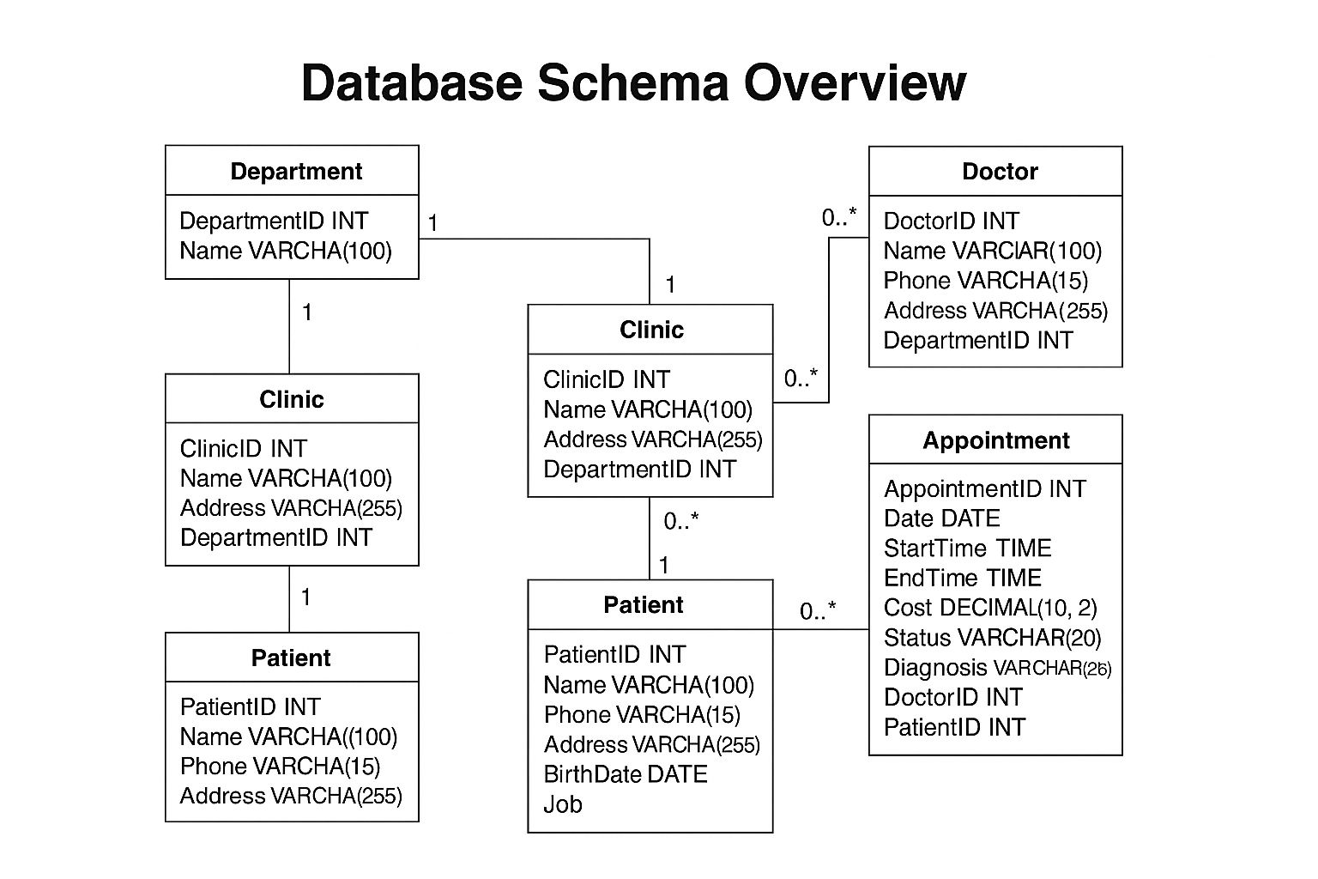
Database Schema Overview
Department: ID, Name
Clinic: ID, Name, Address, DepartmentID
Doctor: ID, Name, Phone, Address, DepartmentID
Patient: ID, Name, Phone, Address, DOB, Job
Appointment: Date, Time, Cost, Status, Diagnosis

Slide 7
Sample Data Snapshots
Doctor: Dr. Sarah Adams – Cardiology
Patient: Fatima Noor – Nurse
Clinic: Heart Health – Main Street
INSERT INTO Department VALUES (1, 'Cardiology');
INSERT INTO Doctor VALUES (1, 'Dr. Sarah Adams', ...);

Slide 8
Key SQL Query: Fatty Liver Diagnoses
SELECT DISTINCT p.Name
FROM Patient p JOIN Appointment a ON p.PatientID = a.PatientID
WHERE a.Diagnosis = 'Fatty liver'
AND a.Date >= CURDATE() - INTERVAL 1 YEAR;

Slide 9
Additional Key SQL Queries
Cardiology Clinic Addresses
Total Patient Payments (Last 3 Years)
SHOW TABLES – View All
DESCRIBE Appointment – Table Structure
SELECT * FROM Appointment

Slide 10
Key Features
Efficient appointment scheduling
Doctor-patient mapping
Centralized diagnosis records
Cost tracking and payment history
Clean SQL architecture

Slide 11
Future Improvements
Login system for admins/doctors
Billing & payment history tracking
Prescription and lab test integration
Export data to CSV
Add stored procedures and views

Slide 12
Conclusion
Reliable database for clinic needs
Improves accuracy, speed, traceability
Built using SQL scripts

Slide 13
Thank You

