Slide 1

ETL Project for Sales Data Analysis

Slide 2

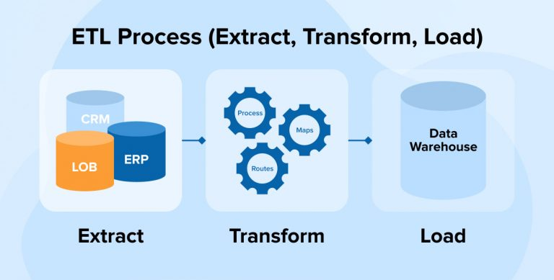
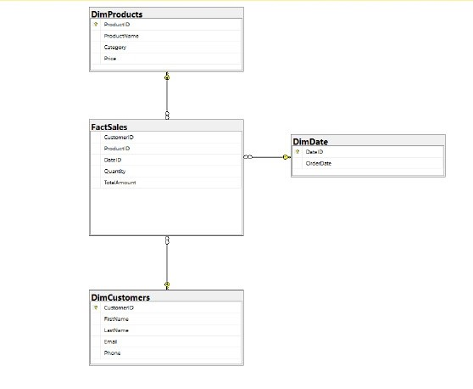
Project Overview
Objective:
To create a centralized system for sales data analysis.
Why ETL?
Multiple data sources need to be unified.
Improve data quality for effective reporting.
Tools Used:
Microsoft SQL Server
SSIS (SQL Server Integration Services)
Visual Studio

Slide 3
1-Dimensional Model Explanation:
Key Tables:
DimProducts: Contains product details (e.g., name, price, category).
DimCustomers: Contains customer details (e.g., name, email, phone).
DimDate: Stores order dates.
FactSales: Central table containing sales transactions (e.g., product, quantity, amount).

Slide 4
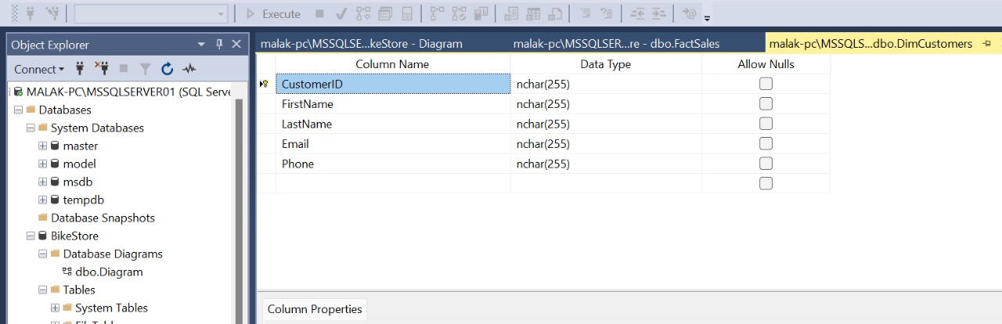
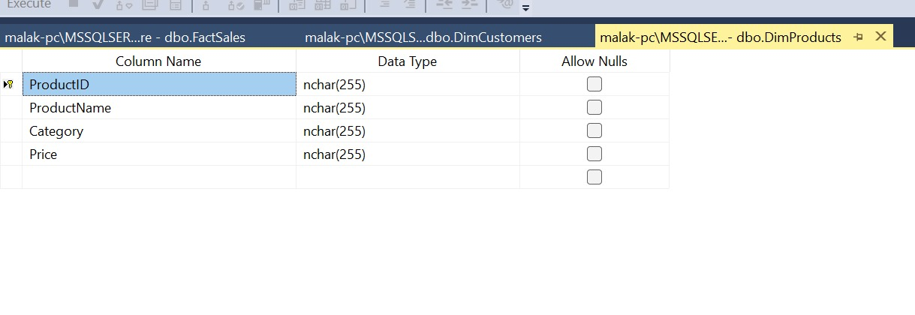
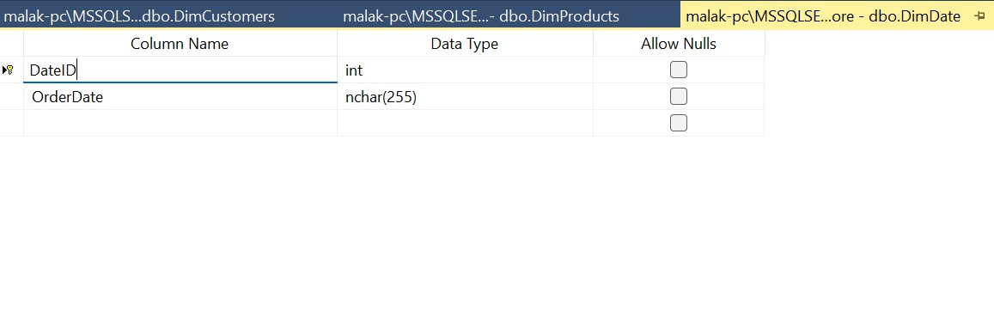
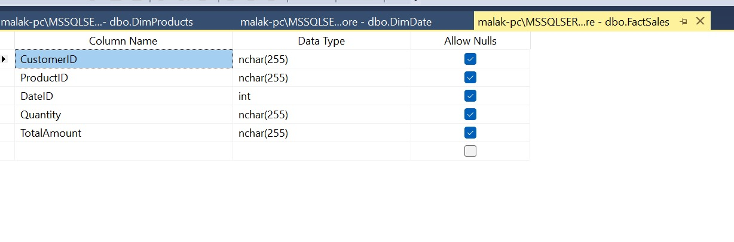
We designed a database named BikeStore and created the following tables to organize the data:
DimCustomer: Contains customer details.
DimProduct: Stores product-related information
DimDate: contains order date
FactSales: include foreign keys referencing the primary keys of the dimension tables

Slide 5
ETL Process in Detail

Slide 6
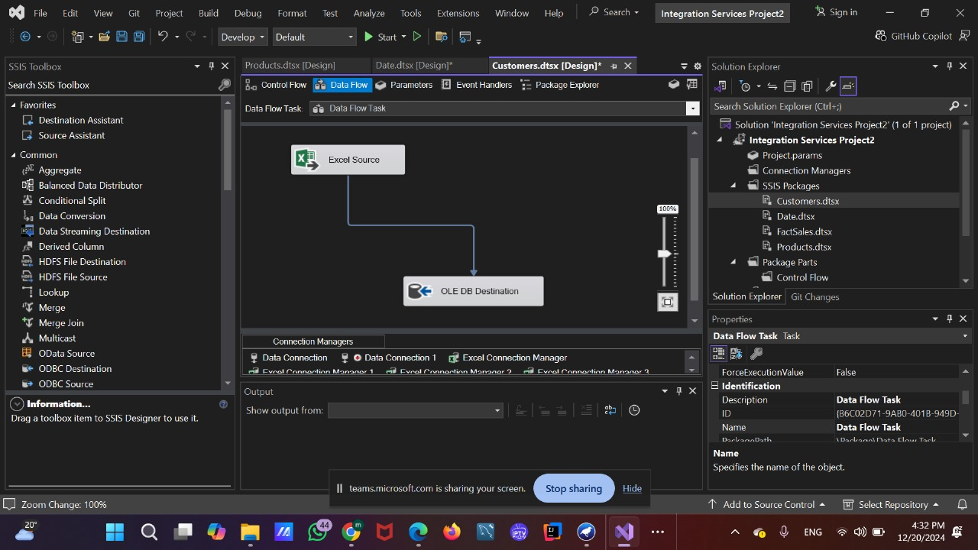
ETL Process in Detail
Step 1: Extract
Data is pulled from sources like Excel sheets or other databases.
Step 3: Load
Load the processed data into the Fact and Dimension tables in SQL Server.
Step 2: Transform
Cleaning: Remove nulls and duplicates.
Data Conversion: Convert data types (e.g., currency, dates).
Sorting and Merging: Organize and join data for meaningful analysis.

Slide 7
Extract
Customer Data: We used an Excel source and extracted data from the Customer table.
Product Data: Similarly, we used an Excel source to extract data from the Product table.
Date Data: The Order Date column was extracted from the Order table and mapped appropriately.
FactSales Data: We used an OLE DB source for the Date table and an Excel source for the Order and Order Details tables.

Slide 8
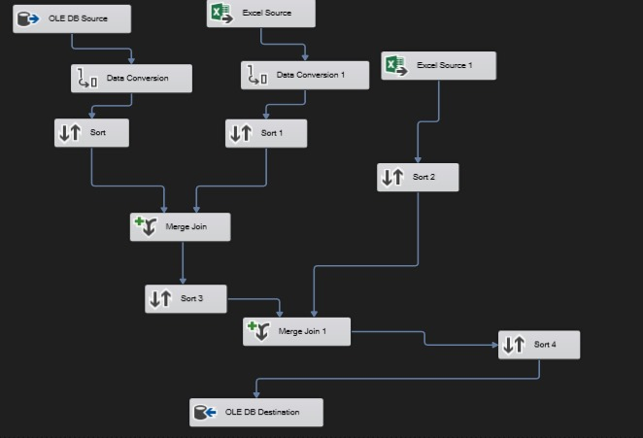
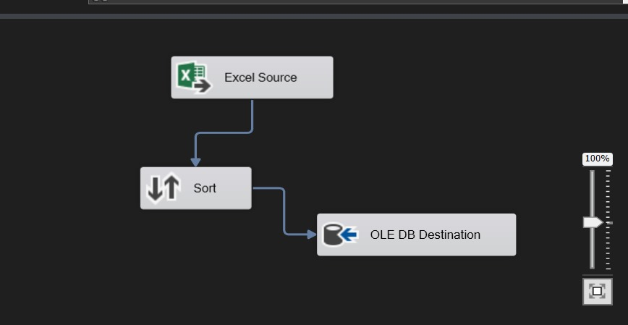
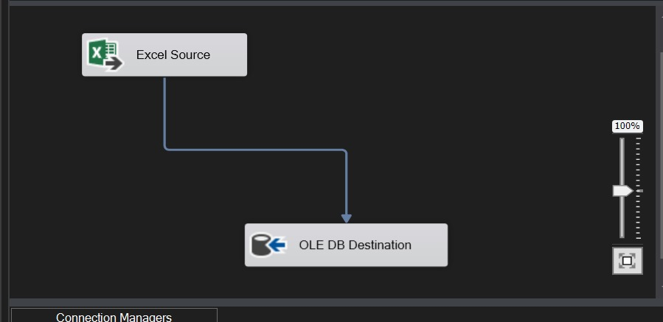
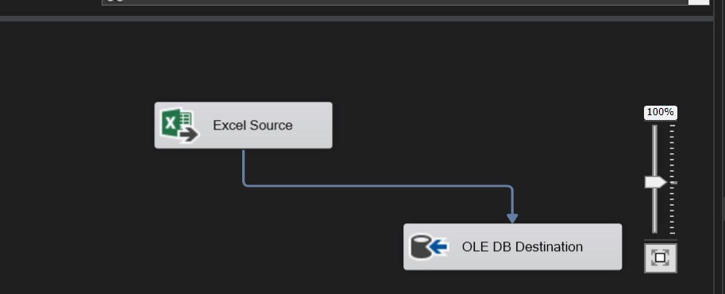
what we did in SSIS in using Visual Studio ?

Slide 9
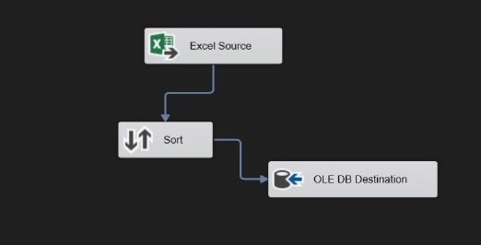
Transform Phase:
Sorting for better organization.
Merge Join to combine data streams.

Slide 10
Transform Phase:
Sorting for better organization.
We applied a sorting operation on the Order ID table using the Order Date column to eliminate any duplicate entries. Additionally, we ensured sorting was performed before merging any two tables to maintain data consistency and accuracy.
Merge Join to combine data streams.

Slide 11
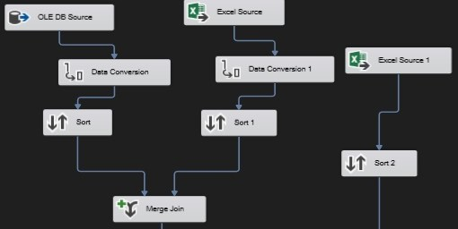
Transform Phase:
Sorting for better organization.
Merge Join to combine data streams.

Slide 12
Challenges and Difficulties in Science Team and Collaboration in Scientific Research
Merge Join to combine data streams.
We started by performing an inner join between the database table named Date and the Excel table Order, using the Order Date as the joining key. From this join, we selected the relevant columns: Customer ID, Total Amount, Date ID, and Order ID.Next, we took the output from this initial merge and performed another join inner with the Order Details table from the Excel file, using Order ID as the common key. From this second merge, we selected the necessary columns, including Customer ID, Product ID, Date ID, Quantity, and Total Amount.
Global Collaboration for Soil Conservation.

Slide 13
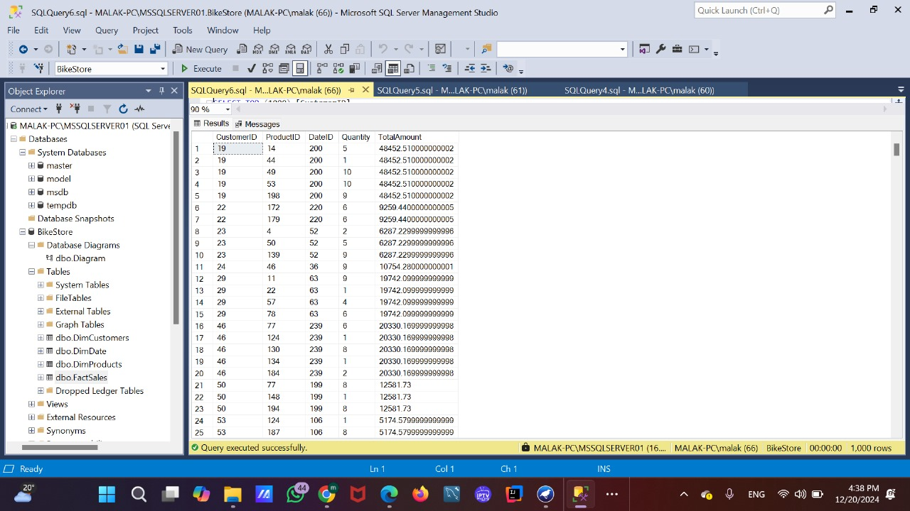
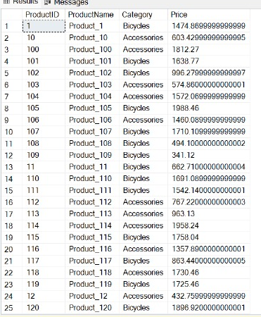
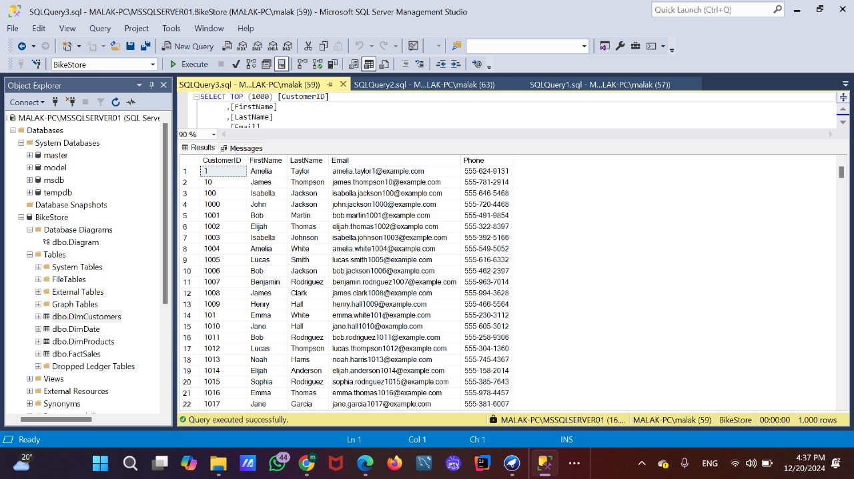
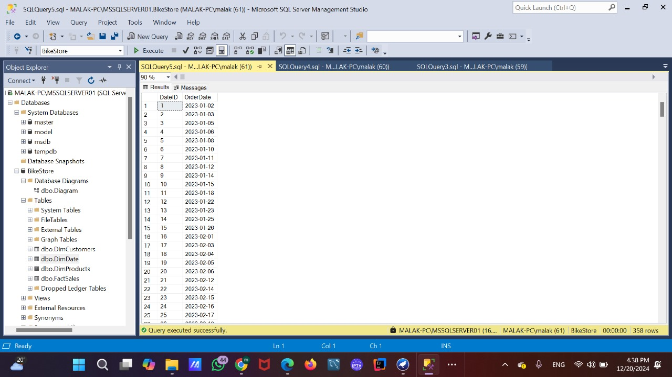
Challenges and Difficulties in Science Team and Collaboration in Scientific Research
Load
We loaded the extracted and transformed data into the database tables using an OLE DB destination
Output DimDate
Output DImCustomer
Output FactSales
Output DimProduct
Global Collaboration for Soil Conservation.

Slide 14

Advantages and Disadvantages of Team Science
Disadvantages
Thank You
Team member : 1- Ahmed Nada 22101167 2- Malak Yasser 22100400 3- shams abdelhalim 22101040 4- Maryam gomaa 22100578

