Slide 1

Coffee Shop System
Summer Training Project
Prepared by : Nour Mrad, Malak Yazbek
Presented to : Dr. Mohammad Choker, Samar Chamas

Slide 2

OBJECTIVE
This project aims to develop an efficient Coffee Shop Management System as a local desktop application, designed for coffee shop administrators. The goal is to streamline the management of daily operations, including orders, inventory, suppliers, and staff records, by replacing outdated manual methods and Excel sheets with a more efficient and user - friendly digital solution.

Slide 3

KEY FUNCTIONALITIES
Admin Functions :
User Management
Create, update, and delete user accounts.
Change user roles ( Admin / Staff ).
Menu & Book Management
Add, edit, and delete menu items and books.
Update stock levels, prices.
Supplier Management
Add suppliers and record supplied items.
Update supply prices and delivery history.
Analytics & Reports
Generate sales, inventory, and supplier reports.
Track most borrowed books and top menus.
Monitor daily operations.

Slide 4
KEY FUNCTIONALITIES
Staff (Cashier) Functions :
Order Processing
Create and manage customer orders.
Apply discounts and process payments.
Cancel orders when required.
Customer Service
Register new customers.
Manage billing and payments.
Update loyalty points with automatic tier upgrades.
Check customer tier status and benefits.
Book Borrowing
Record book borrowing and return transactions.
Collect and manage late fees.

Slide 5
TABLE OF CONTENTS
01
02
03
04
Literature Review
System Analysis
Requirements, Functionalities, Design.
Studying existing systems.
Database Implementation
Software Implementation
DBMS choice and MySQL tables.
Java, GUI, JDBC.

Slide 6
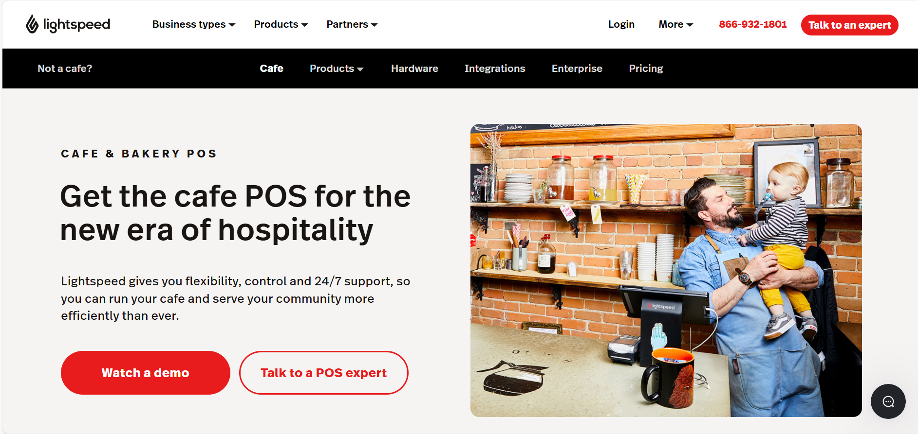
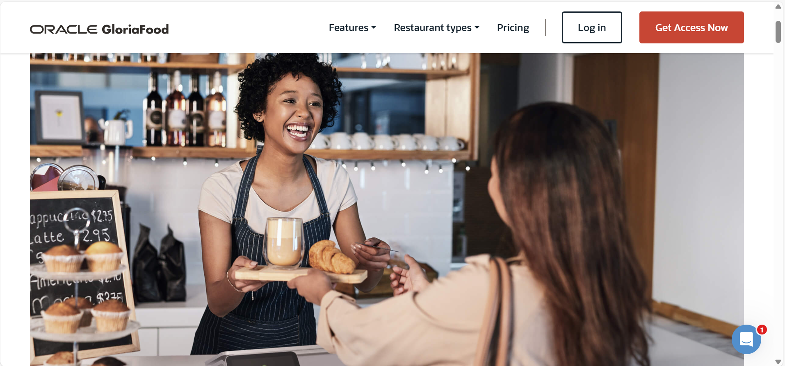
Literature Review
Lightspeed Café
GloriaFood Café

Slide 7
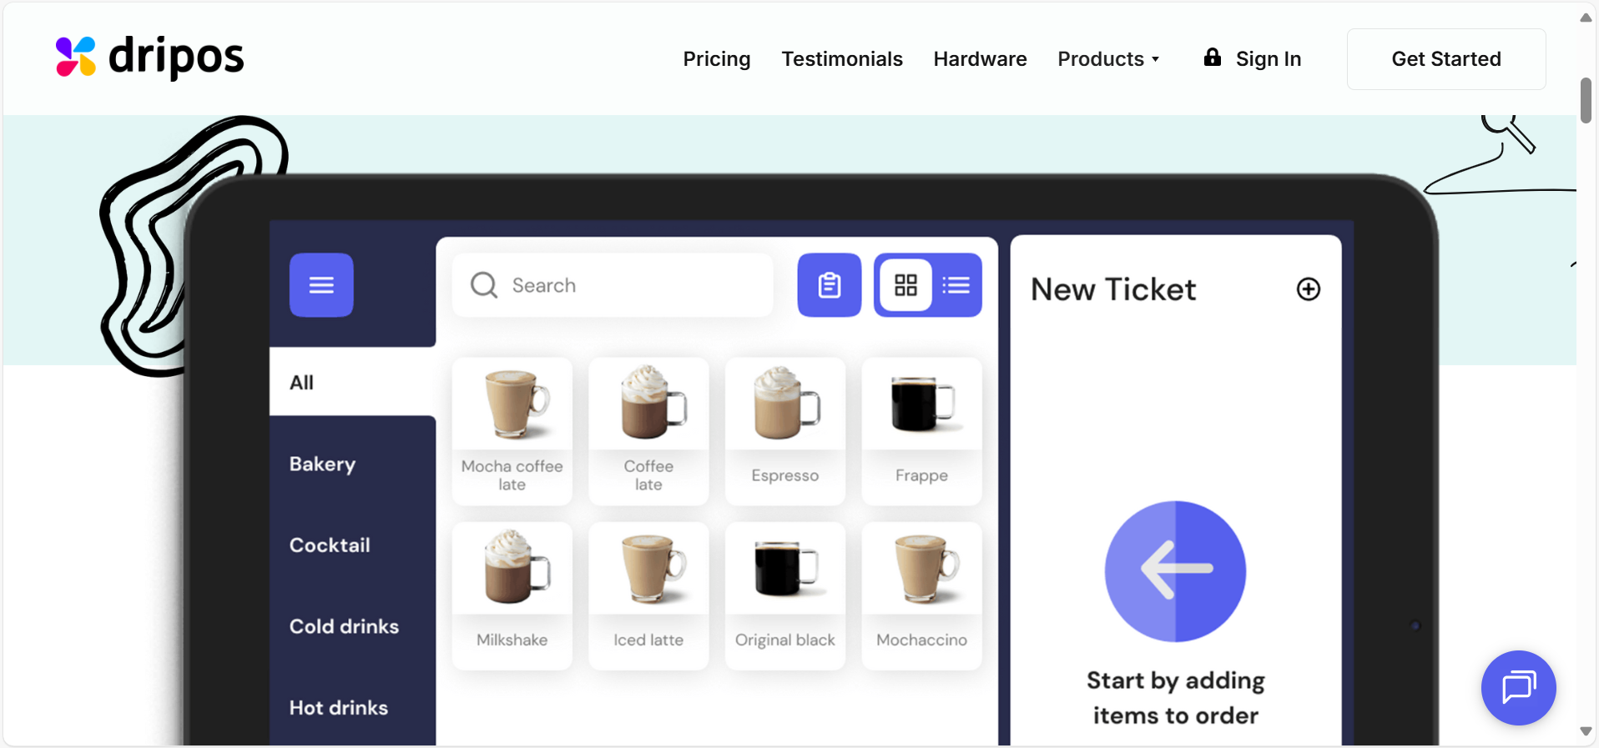
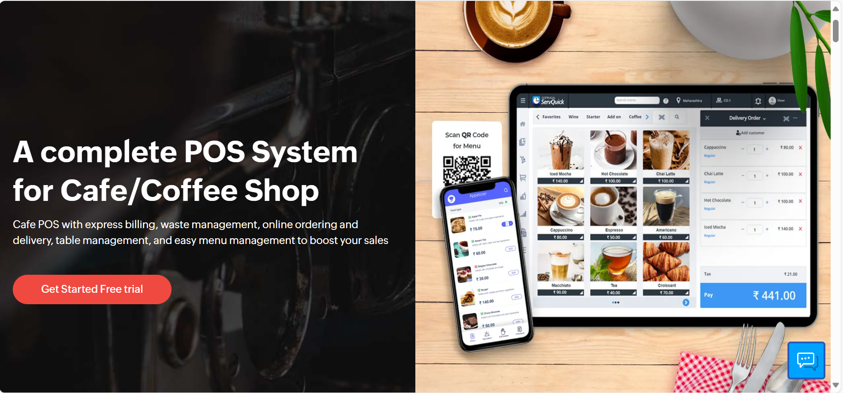
Literature Review
Dripos Café
GoFrugal Café

Slide 8
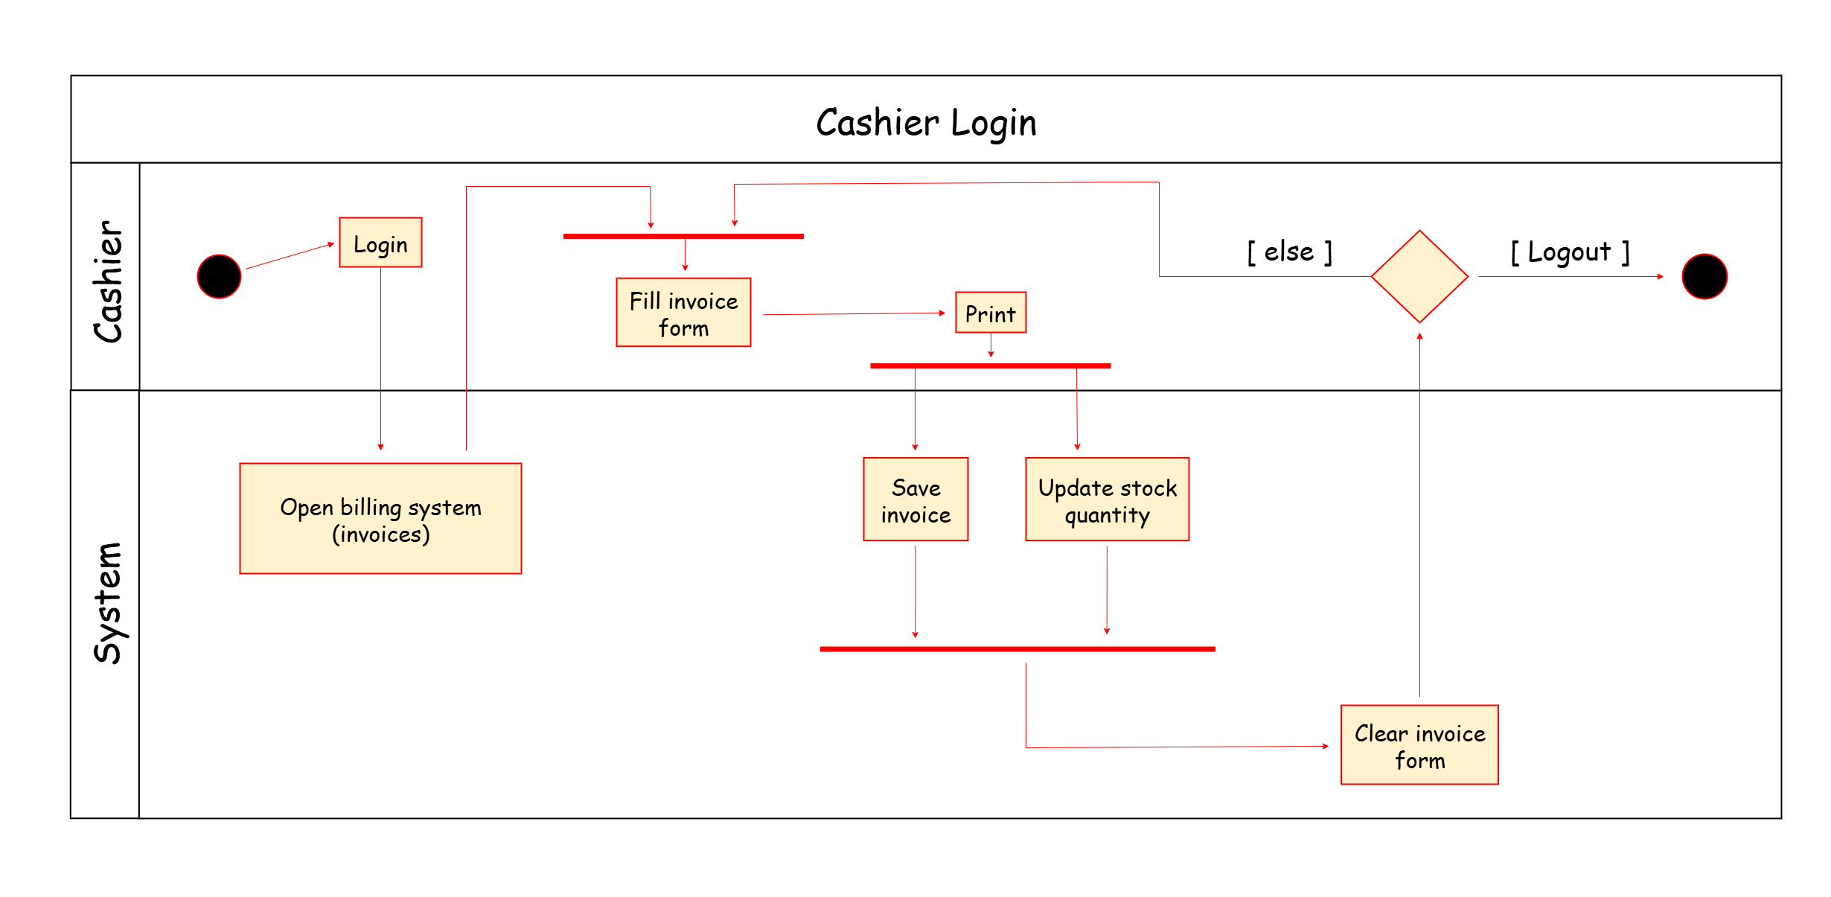
System Analysis
Activity Diagram
Use Case Diagram

Slide 9
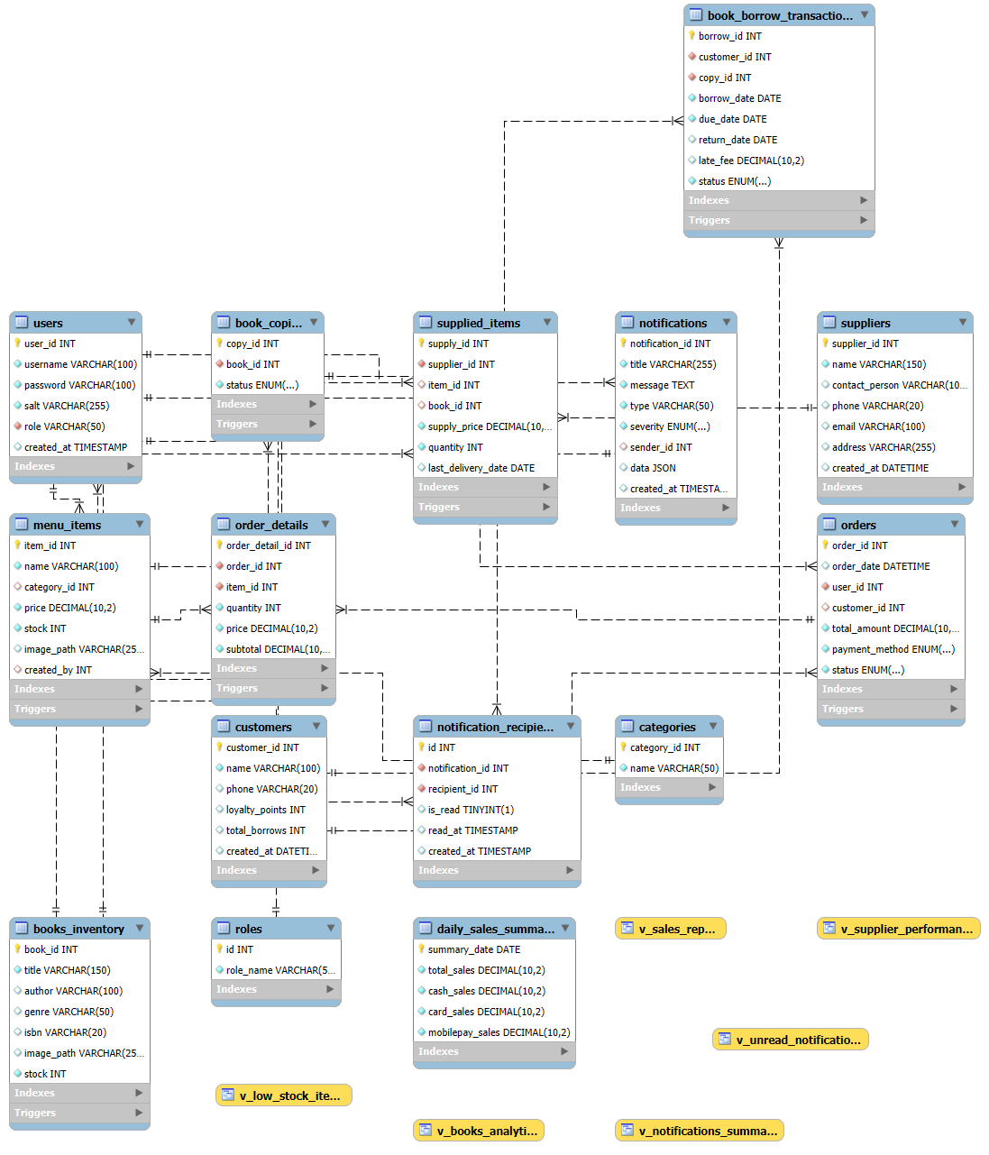
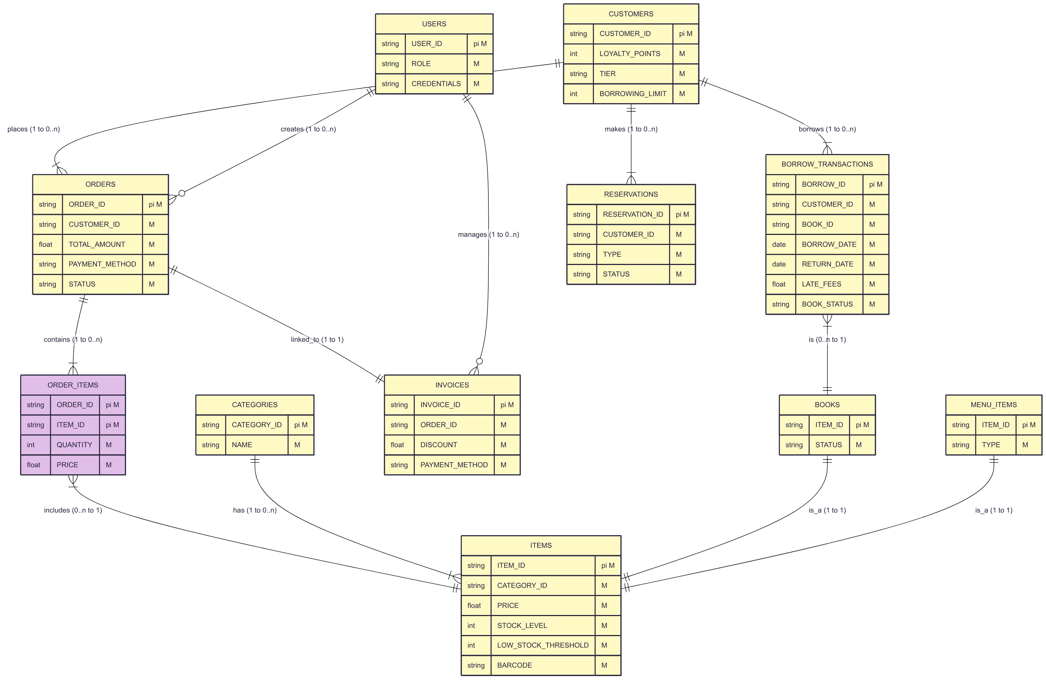
Model Diagram
Entity Relationship Diagram

Slide 10



DATABASE IMPLEMENTATION
Data Organization and Management
Data Integrity and Consistency
Scalability and Performance

Slide 11
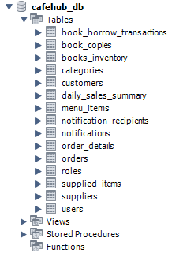


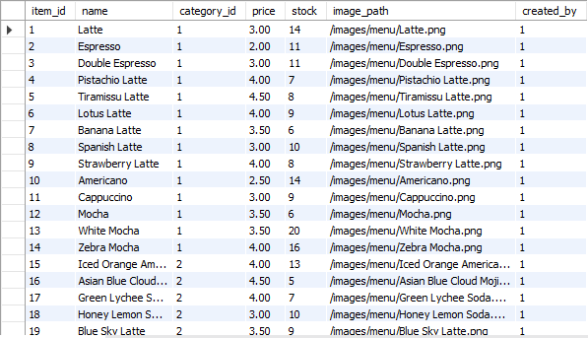
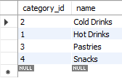
DATABASE IMPLEMENTATION
Schema
Users view
Roles view
Menu items view
Categories view

Slide 12
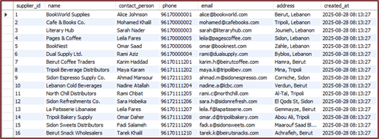
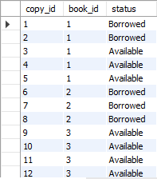
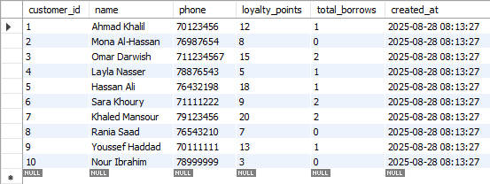
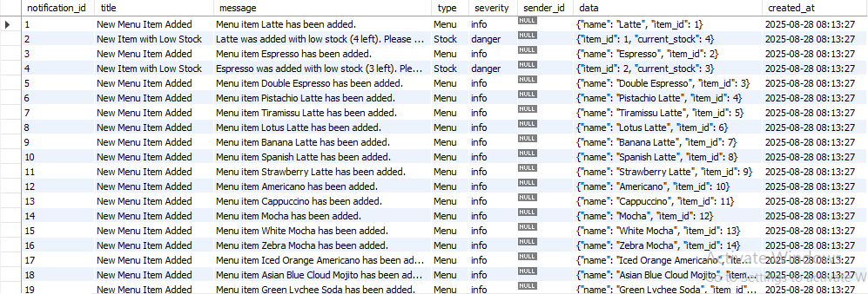
DATABASE IMPLEMENTATION
Suppliers view
Book copies view
Customers view
Notifications view

Slide 13
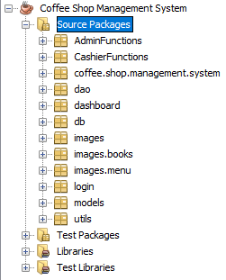
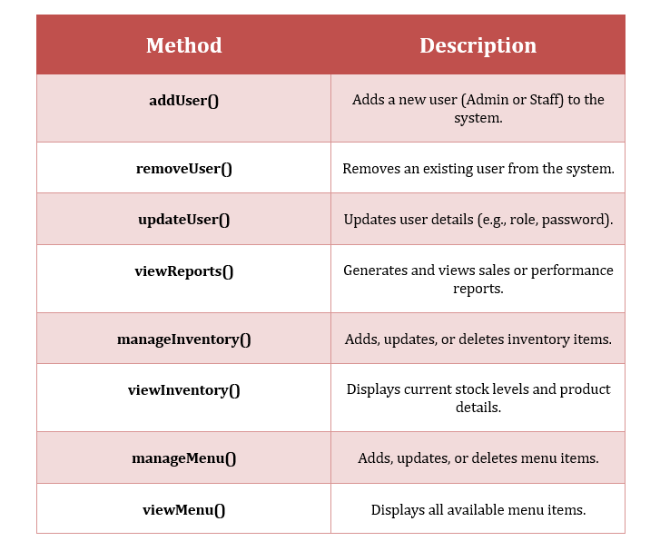
SYSTEM IMPLEMENTATION
Java Project
Admin Class Methods

Slide 14
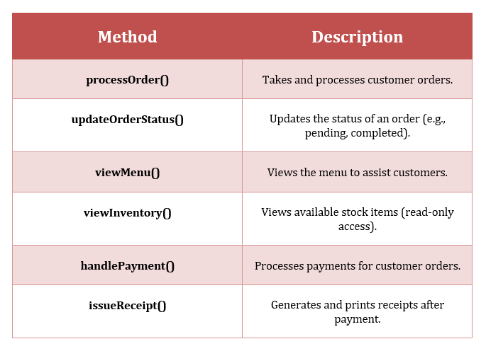
Staff Class Methods

Slide 15
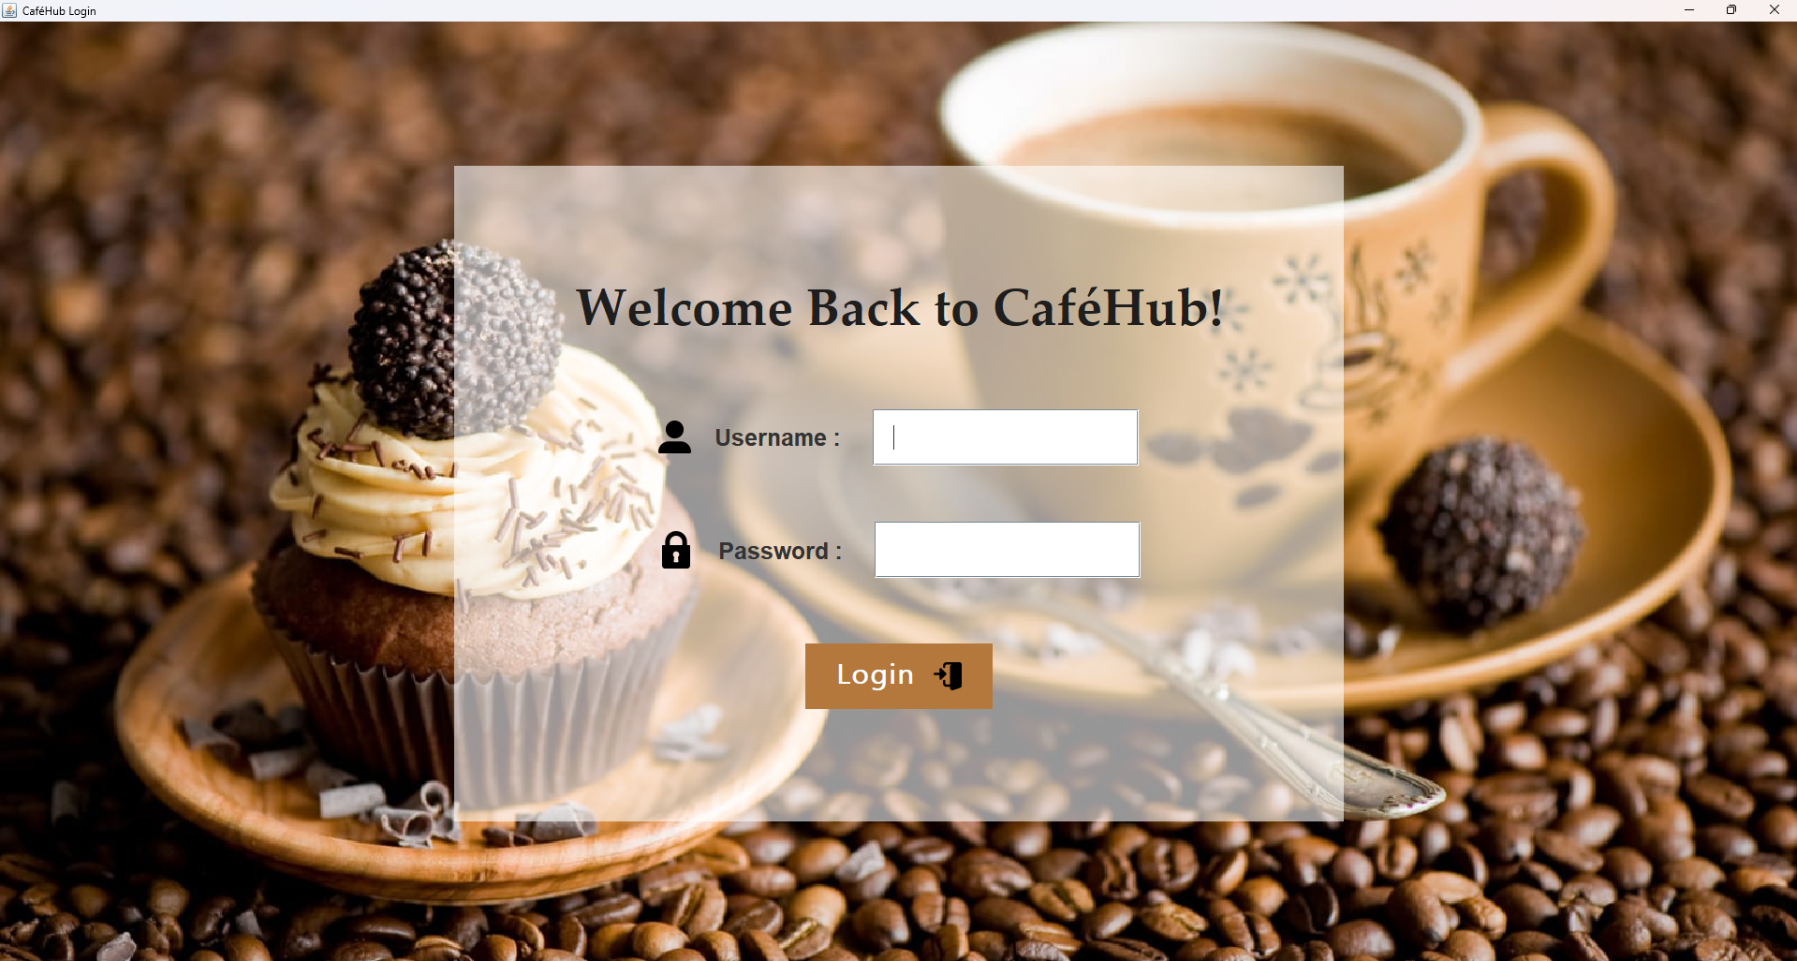
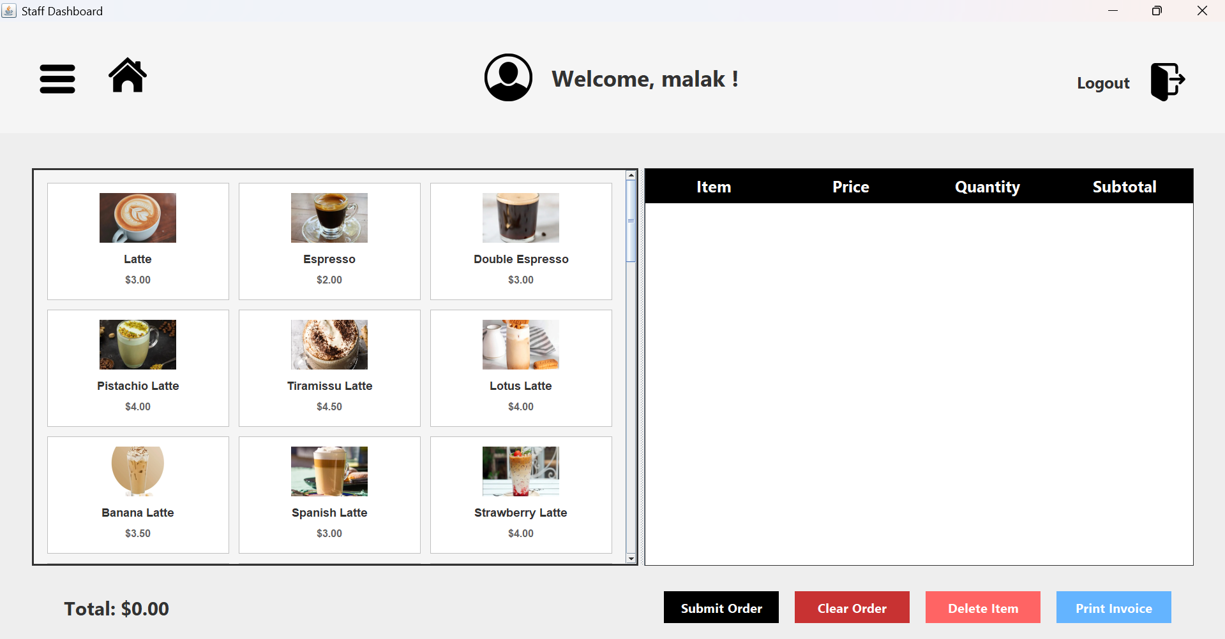
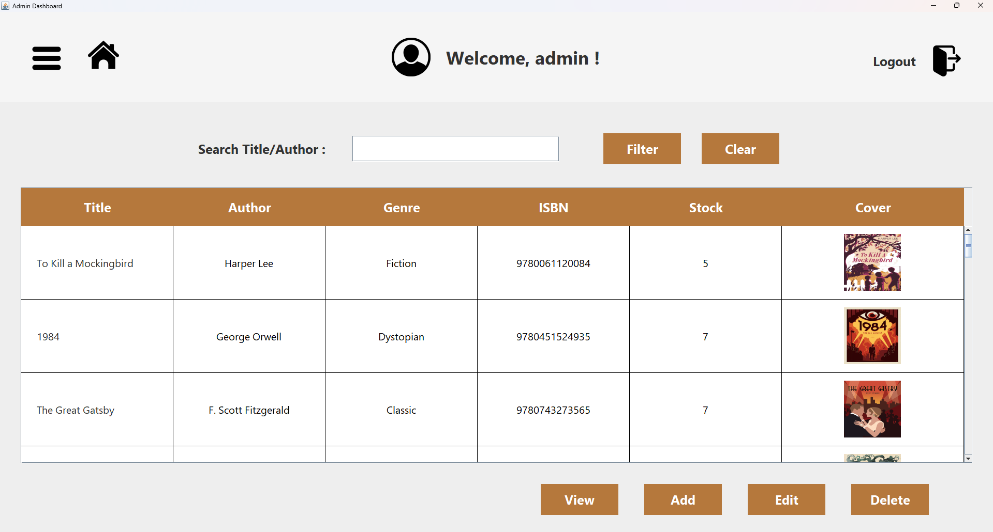
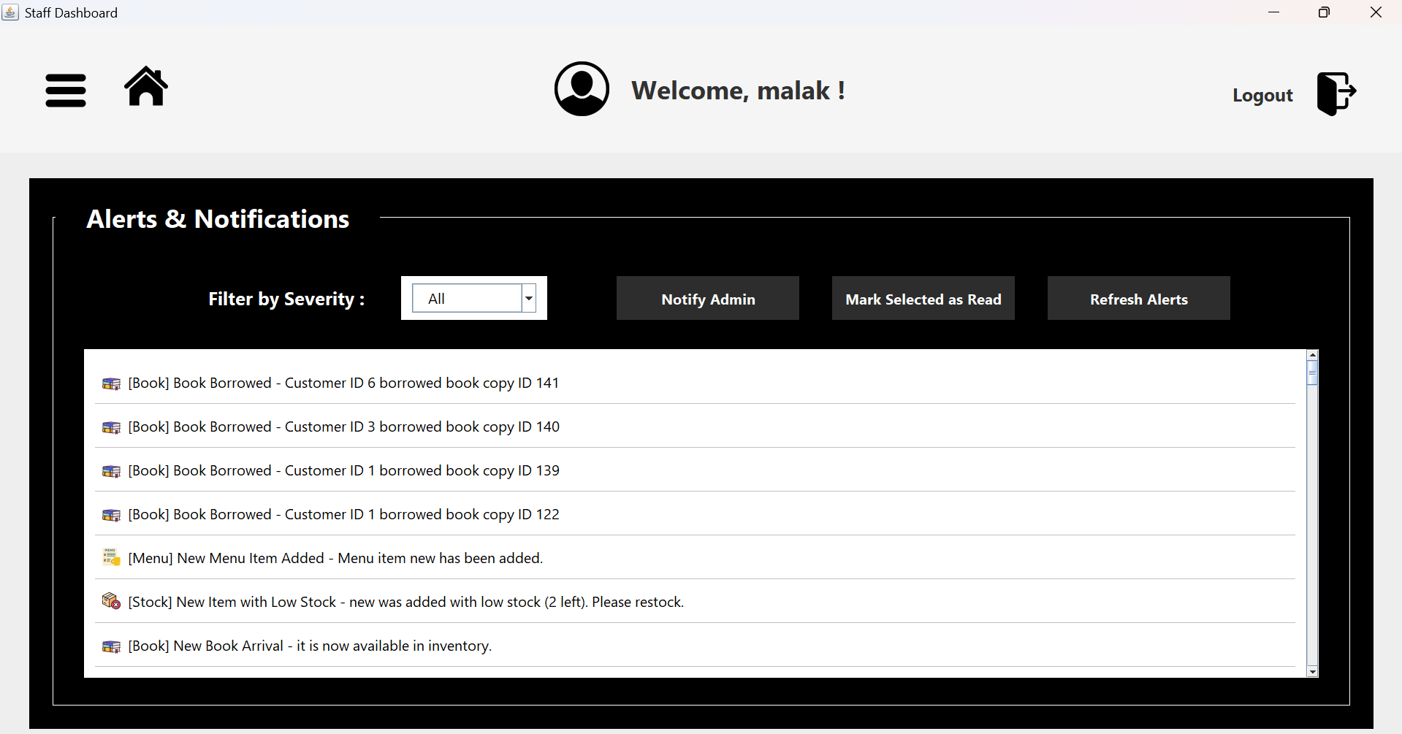
SYSTEM IMPLEMENTATION

Slide 16
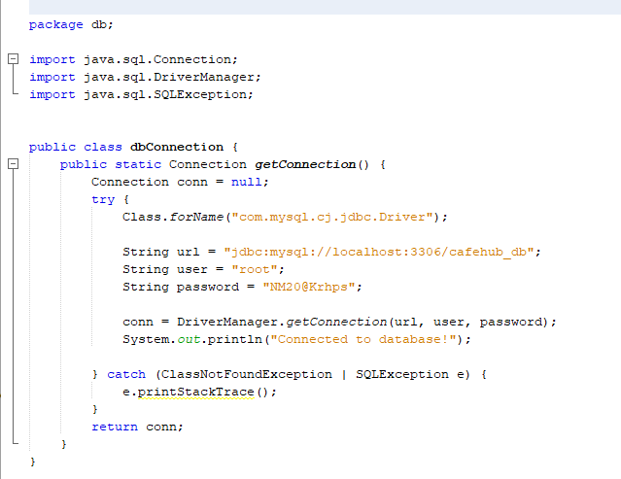
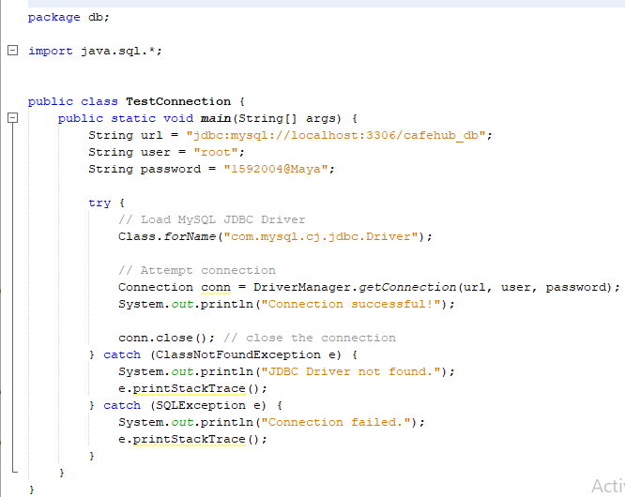

Slide 17






CONCLUSION
This Coffee Shop Management System is a user - friendly solution built with Java and MySQL, helping administrators efficiently manage orders, inventory, suppliers, and staff. With a simple interface, secure data handling, and streamlined operations, it enhances both management and customer experience.

Slide 18


THANKS
PO
PI
C ·
CA
FE
DO YOU HAVE ANY QUESTIONS?
HubCafé20@gmail.com
CaféHub.com

